Slide 1

Maslow’s hierarchy of network programming and the unmet needs
Ratul Mahajan
Microsoft Research

Slide 2
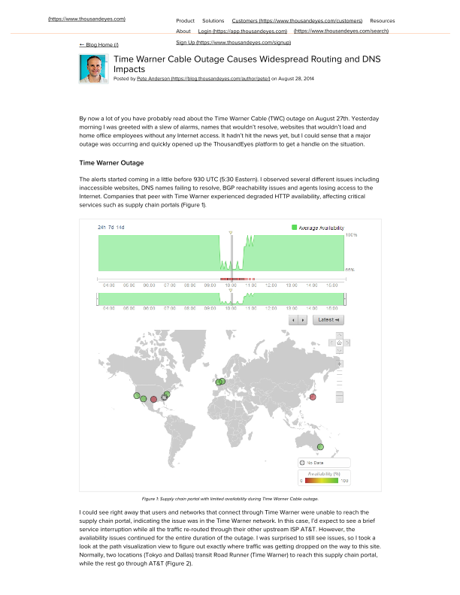
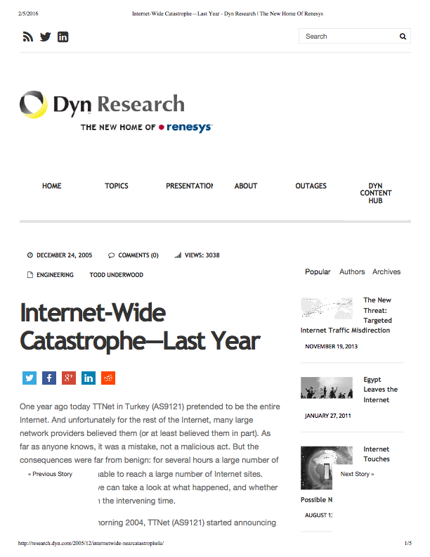
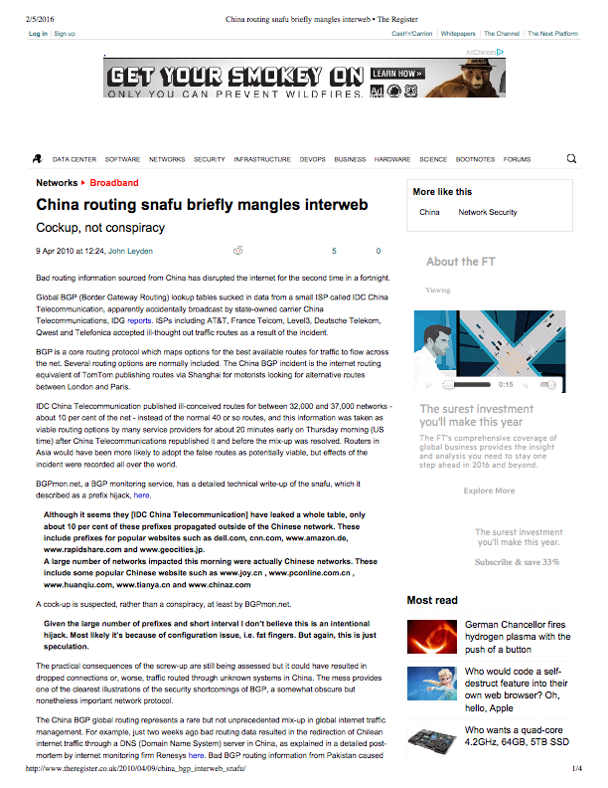
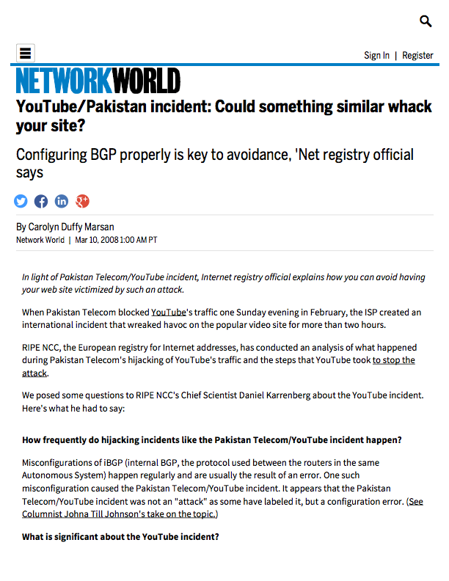
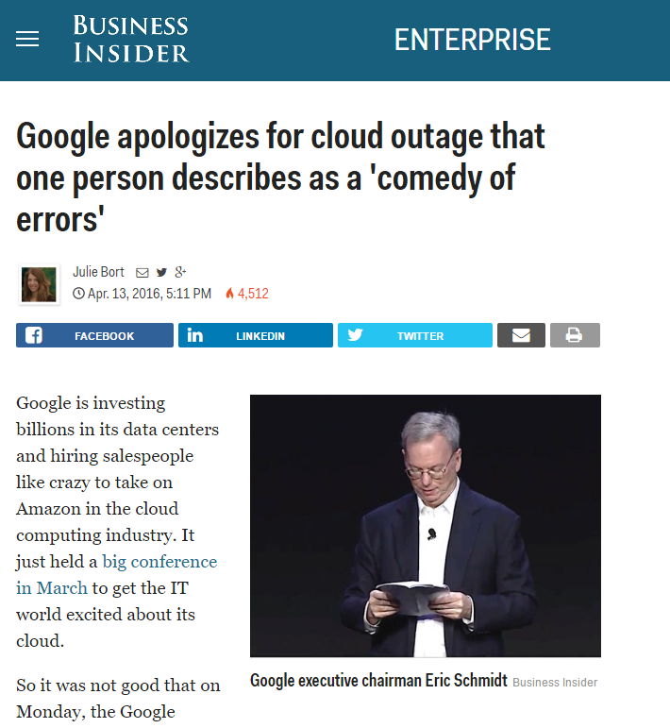

Slide 3



Slide 4
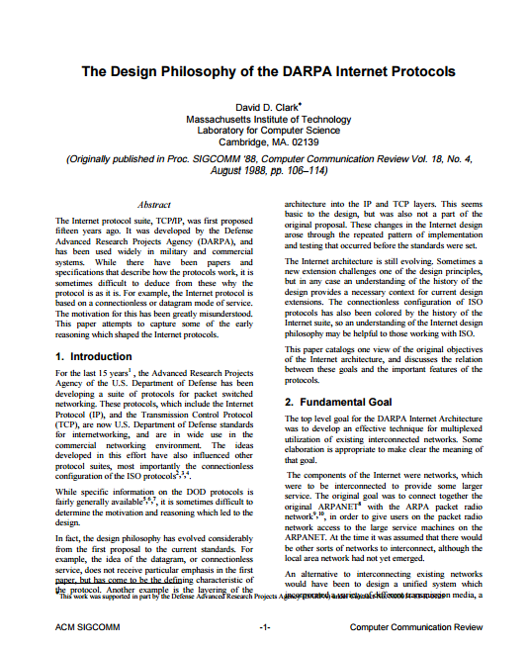
How we got here

Slide 5
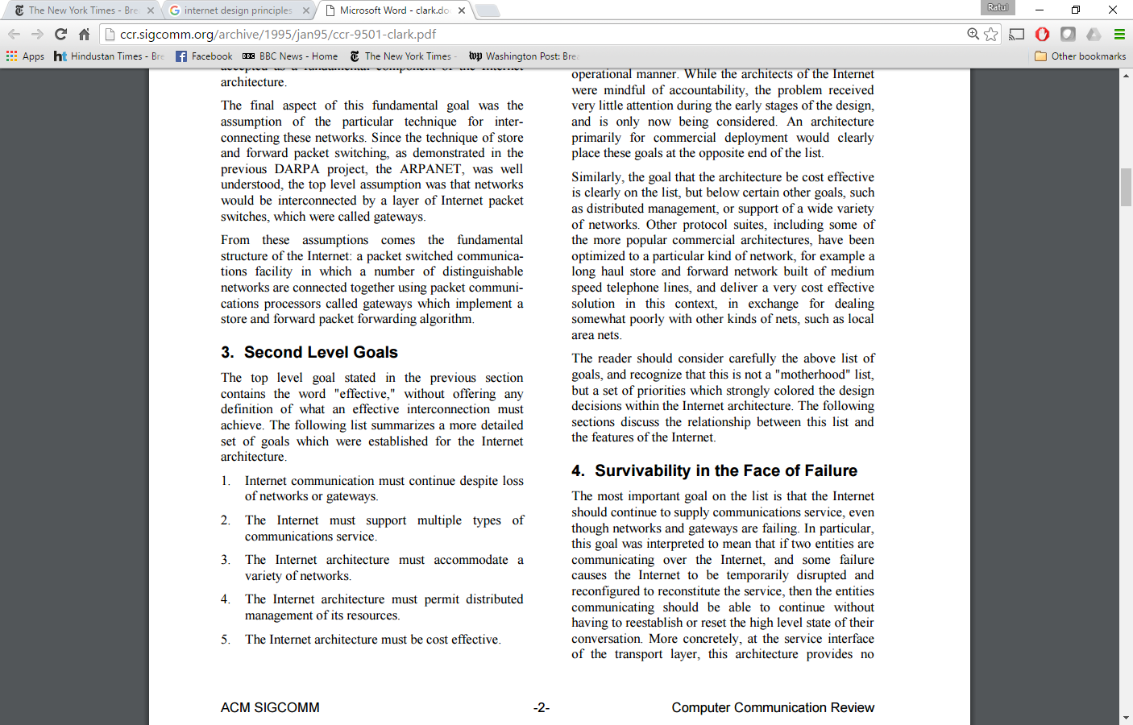
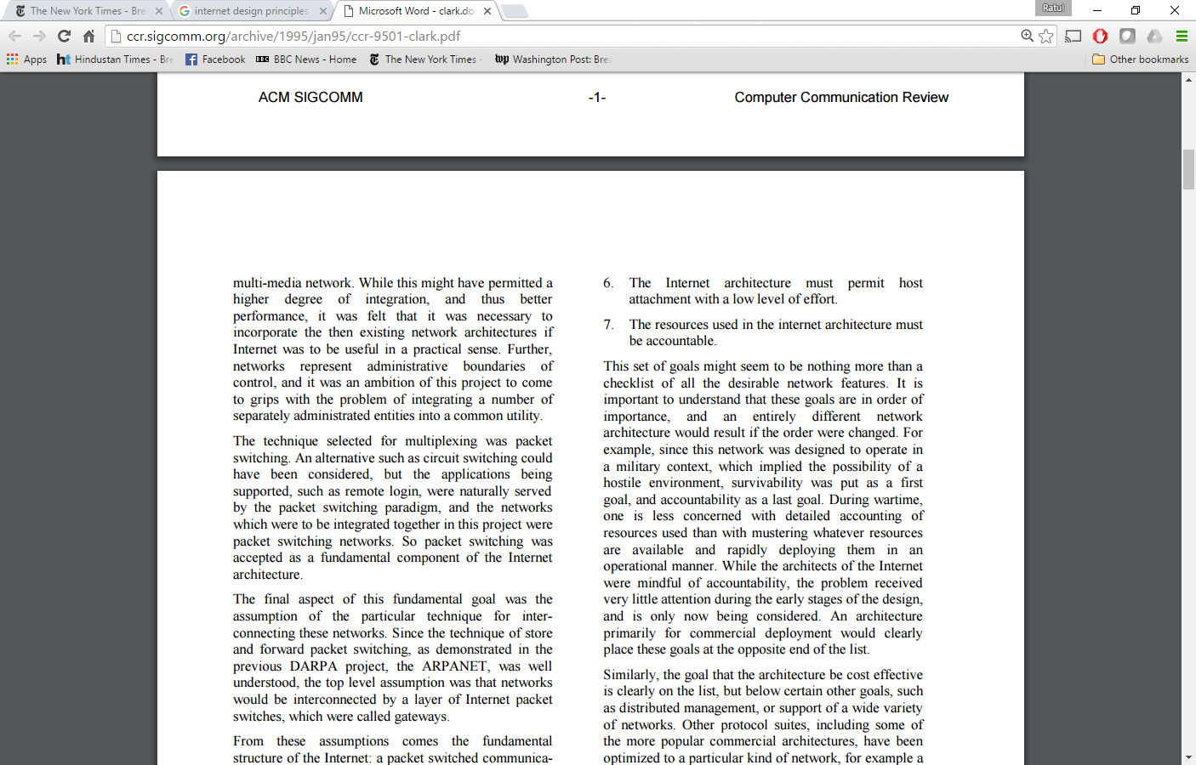
How we got here
Programmability was not a goal!

Slide 6
Why we can escape our fate now
Many new networks
Bigger networks
opportunity
pressing need

Slide 7
Microsoft Azure: Newer and bigger networks
 | 2010 | 2015
Data centers | A few | 100+
Network devices | 1000s | 100s of 1,000s
Network capacity | 10s of Tbps | Pbps

Slide 8
Hypothesis on complexity of network management
Complexity
Network size

Slide 9
Why we can escape our fate now
Many new networks
Bigger networks
Standardized abstractions
opportunity
pressing need
key enabler
Notes:
Opportunity
Pain
Possibility

Slide 10
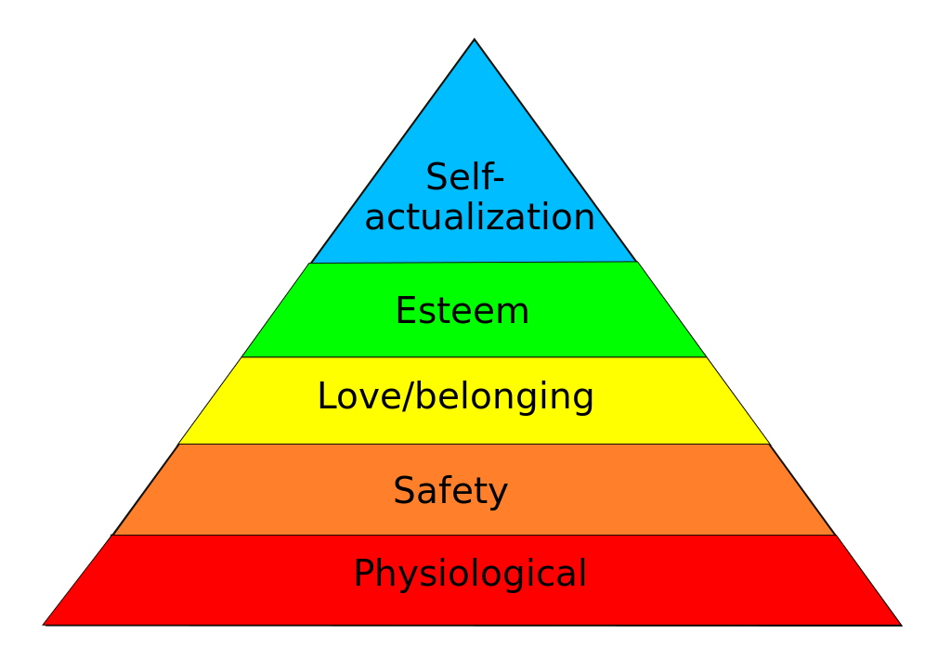
Maslow’s hierarchy for network programming
Efficiency
Policy-compliant forwarding
Bootstrapped, healthy devices
Human
Network

Slide 11
Maslow’s hierarchy for network programming
Unmet needs
Efficiency
Merlin, ??
{Fren,Pyr, Kin,..}etic, NetKAT, Propane
Policy-compliant forwarding
Bootstrapped, healthy devices
??
Network

Slide 12
Enabling abstractions for network programming
Unmet needs
Efficiency
??
OpenFlow, BGP
Policy-compliant forwarding
??
Bootstrapped, healthy devices
Network

Slide 13

Past: Management apps interacted with devices
Link corruption mitigation
Switch upgrade
Elastic scaling
Conflicts among apps
Hard to guarantee SLAs
Hard to develop applications

Slide 14
Anatomy of a management app
Link corruption mitigation
Switch upgrade
Elastic scaling
App logic
App logic
App logic
Monitor
Update
Monitor
Update
Monitor
Update

Slide 15
Statesman: Network state management service
App logic
App logic
App logic
Power on/off
Firmware version
Link state
Tunnels
…..
Network state database
Network state
Monitor
Update
[A network-state management service, SIGCOMM 2014]

Slide 16
Statesman: Network state management service
App logic
App logic
App logic
Proposed state
Observed state
Proposed state
Target state
Proposed state
Monitor
Update

Slide 17
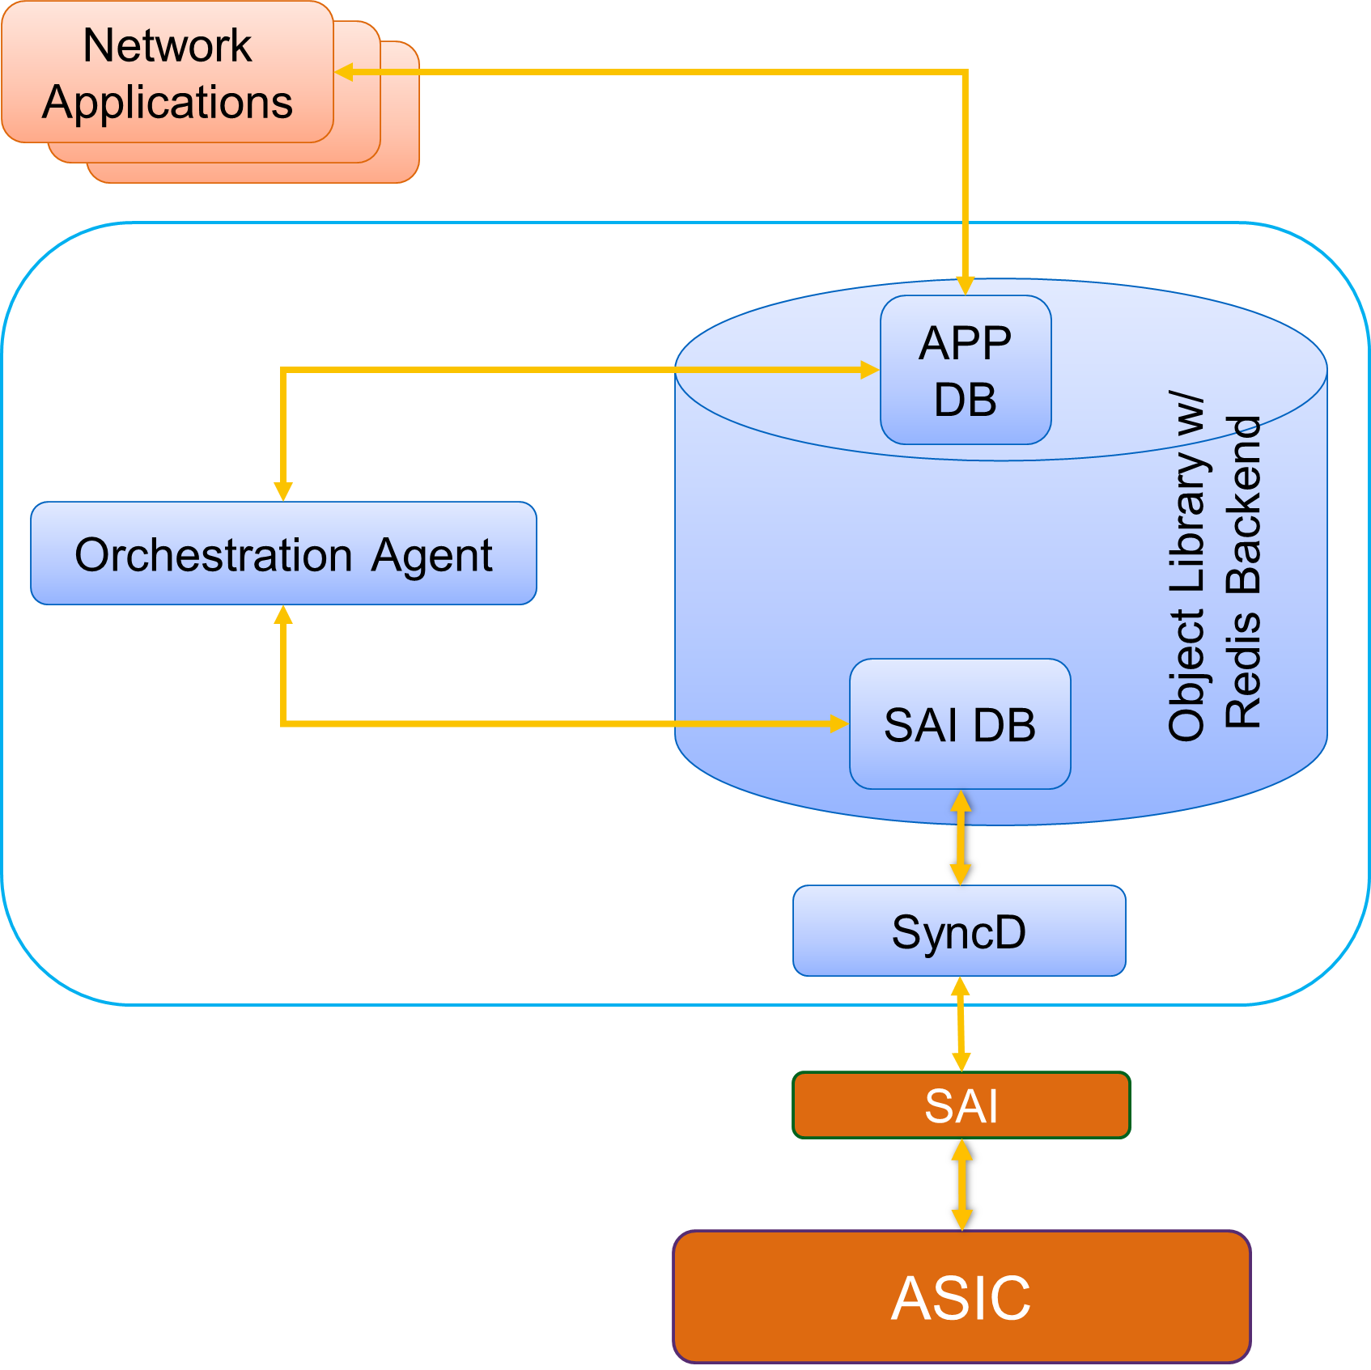
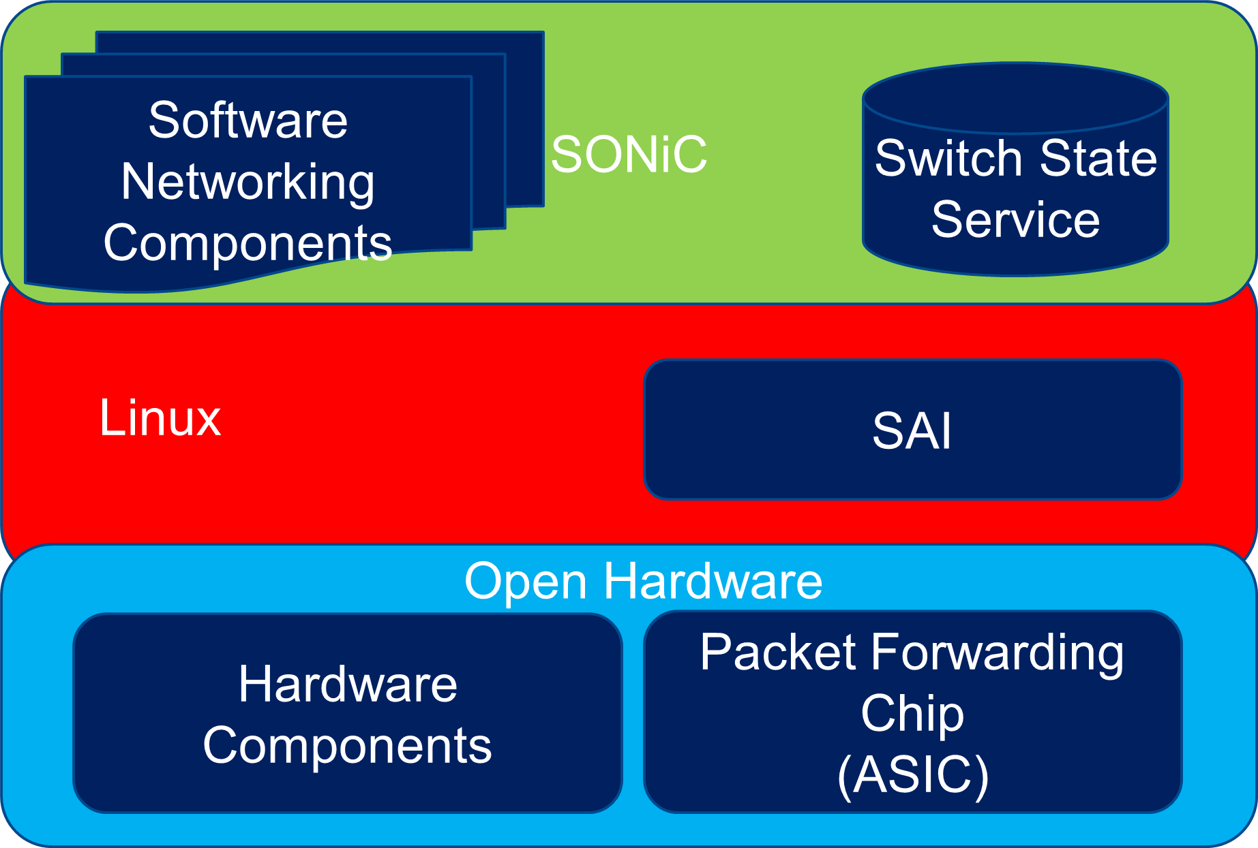
State databases emerging at device level too
SAI and SONiC (OCP)
https://github.com/opencomputeproject/SAI
https://github.com/Azure/SONiC
Switch state service

Slide 18
What is missing from state databases
High-level languages to read and write network state
Program network as a whole, given operator goals
Statesman, SoNIC are low-level
E.g., read/write individual state variables

Slide 19
Enabling abstractions for network programming
Unmet needs
Efficiency
??
OpenFlow, BGP
Policy-compliant forwarding
Network state databases
Bootstrapped, healthy devices
??
Network

Slide 20
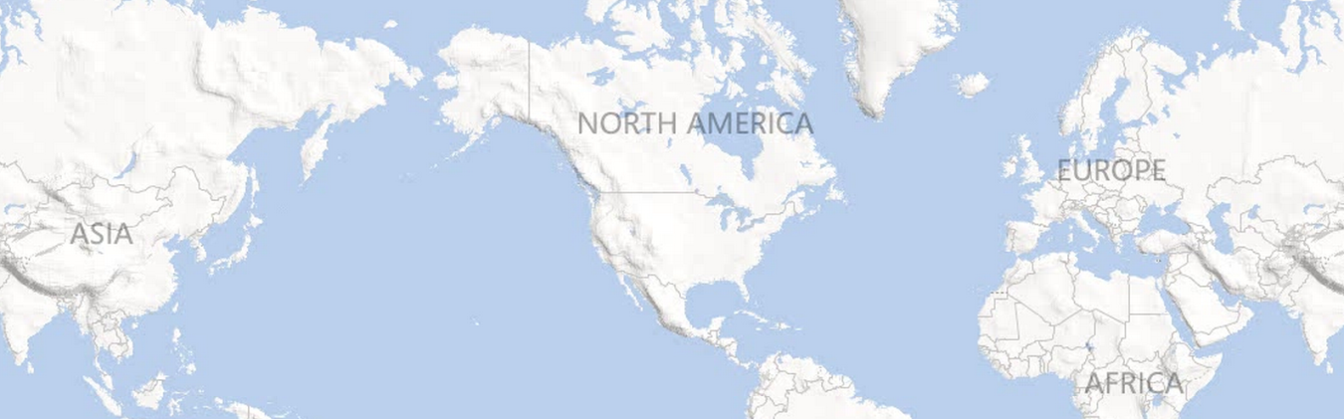
Inter-DC WAN: A critical, expensive resource
Dublin
Seattle
New York
Seoul
Barcelona
Los Angeles
Miami
Hong Kong
But highly inefficient
Notes:
Services need inter-DC WAN for performance and reliability.
100s of Gbps capacity over long distances.
Costs 100s of millions of dollars amortized annually.

Slide 21
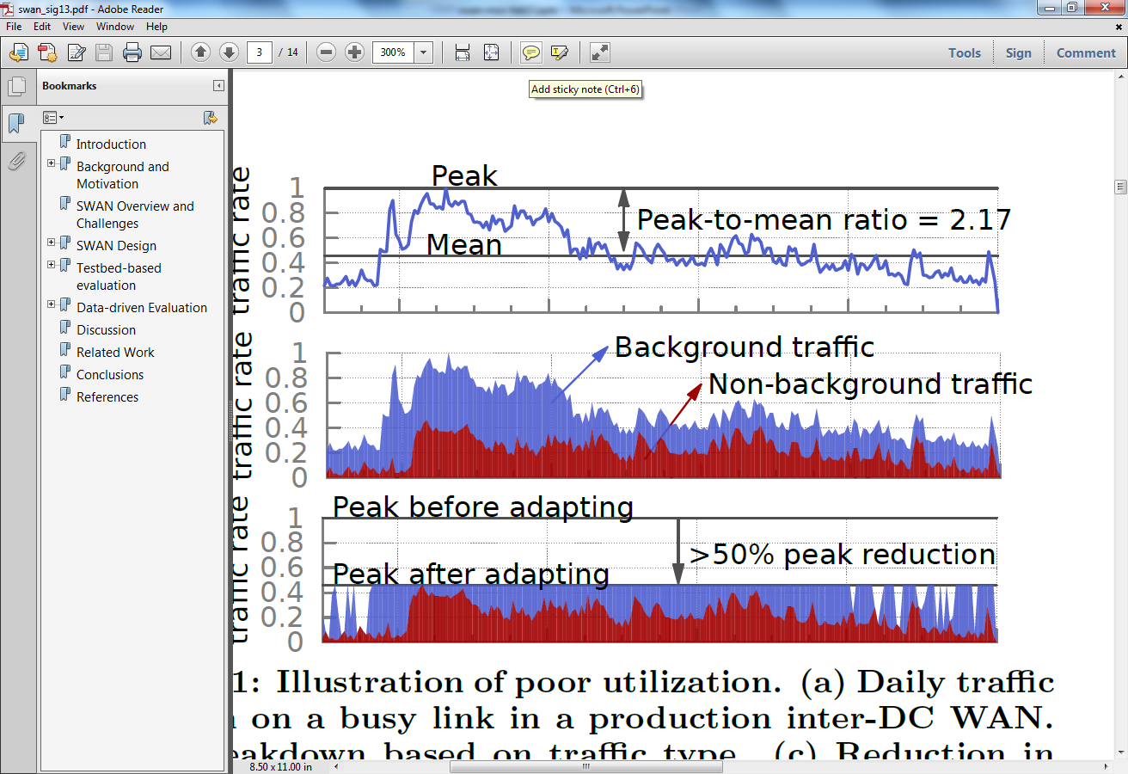
Cause of inefficiency: Lack of coordination
Notes:
Services send when they want and however much they want.
- leads to cycles of over and under-subscription
Poor utilization can be countered by leveraging traffic characteristics.
- some traffic can be delayed
Adapting this traffic will allow a smaller network to carry the same traffic or allow more traffic to be carried over a network.

Slide 22
SWAN: Software-driven WAN
Goals
Key design elements
Highly efficient WAN
Flexible sharing policies
Coordinate across services
Centralize resource allocation
[Achieving high utilization with software-driven WAN, SIGCOMM 2013]
Notes:
Want network utilization to be almost 100%, from the current standard of 40-60%
High efficiency alone is trivial to achieve; must support policies
- Strict priority classes
- Max-min fair within a class

Slide 23




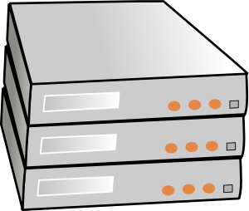
SWAN overview
SWAN controller
Traffic demand
Topology, traffic
BW allocation
Network config.
Service broker
Network agent
Rate limiting
WAN
Service hosts
Notes:
Bandwidth broker represents service hosts. Required for scalability and also allows for service-specific logic and policies.

Slide 24
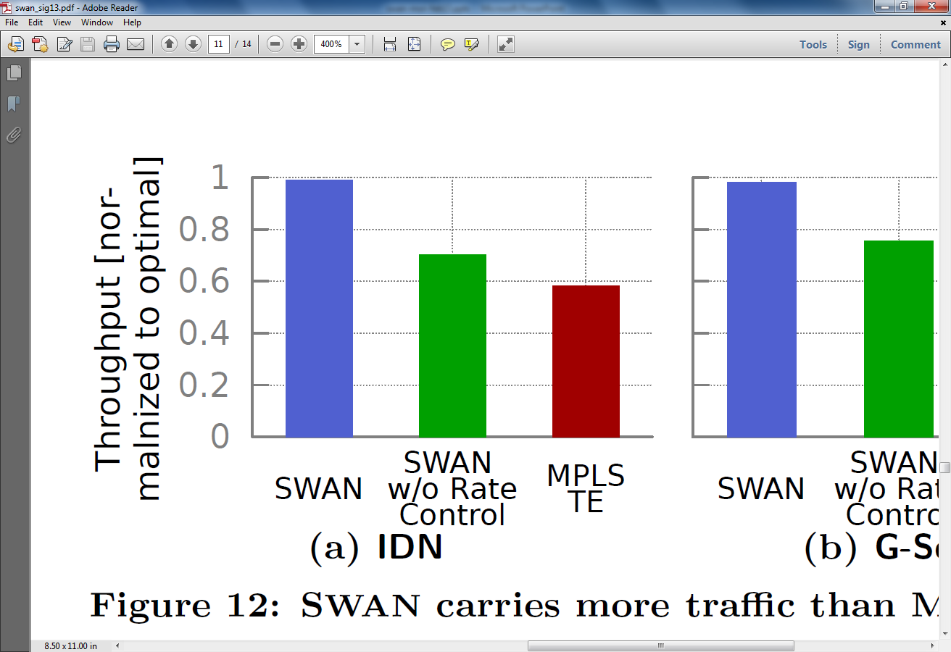
SWAN comes close to optimal
Throughput
(relative to optimal)
SWAN
SWAN
w/o rate control
MPLS TE

Slide 25
Resource allocation in SWAN
Policies
Enabling abstractions
Priority classes
Fairness
Tunnels
Priority queues
Rate limiters
ECN marking
Resources
Link capacities
Switch memory

Slide 26
Enabling abstractions for network programming
Unmet needs
Efficiency
??
Tunnels, priority queues, rate limiters
OpenFlow, BGP
Policy-compliant forwarding
Network state databases
Bootstrapped, healthy devices
Network

Slide 27
Trustworthy validation: A cross-cutting need
Programmatic control often gets gated on validation
Much progress in recent years but challenges remain
Model for design
Where to validate?
Update
Model for validation
Model for validation
Reason in face of dynamics
Permissive validation models
Notes:
Else, automation even if deployed, is run less frequently or with humans in the loop

Slide 28
Opportunistic time to make networks easier to program
Let us focus also on unmet needs and on trustworthy validation
Deployed systems have validated enabling abstractions
Unmet needs
Efficiency
SWAN
Tunnels, priority queues, rate limiters
Policy-compliant forwarding
Statesman, SAI
Bootstrapped, healthy devices
Network state databases

