Slide 1
Mutually Controlled Routing with Independent ISPs
Ratul Mahajan Microsoft Research
David Wetherall University of Washington Intel Research | Tom Anderson University of Washington

Slide 2
Conflict in Internet routing today
ISPs simultaneously cooperate and compete in a contractual framework
Paths are usually decided
by upstream ISPs
ISPs have little control
over incoming traffic
End-to-end paths can
be longer than necessary

Slide 3
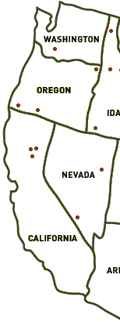
A real incident
Seattle
Sprint
ATT
San Francisco
overload
Paths are longer than necessary because ATT unilaterally controls paths

Slide 4
Goal: Provide joint control over routing
Constraints due to ISP independence
  Be individually beneficial (“win-win”)
  Not require ISPs to disclose sensitive info
  Enable ISPs to optimize for their criteria
Retain contractual framework and low overhead

Slide 5
On protocol design in systems with competing interests
“The most important change in the Internet architecture over the next few years will probably be the development of a new generation of tools for management of resources in the context of multiple administrations.”
-- David Clark, 1988

Slide 6
Our solution: Wiser
1
7
D [1]
D
2
D [3]
3
S
1
11
D [11]
Operates in shortest-path routing framework
  Downstream ISPs advertise “agnostic” costs
  Upstream ISPs select paths based on their own and received costs

Slide 7
Problems with vanilla shortest-path routing
Can be easily gamed
  ISPs can lie about their costs
  ISPs may ignore others’ costs
May not be win-win
  ISPs’ costs may be incomparable

Slide 8
Normalize costs so no ISP dominates
1
10
0.7
7
3
30
2
5
2
11
1
7.3
4.3
110

Slide 9
Monitoring the behavior of upstream ISPs
7
0.7
2/3.3
2
2
1
7.3
7.3/3.3
Downstream ISPs monitor the ratio of average cost of paths used and average announced cost
Contractually limit this ratio

Slide 10

Wiser across multiple ISPs
c3 = c1^{l} + internal path cost
←D, {OG}, c3
O
c1^{l}
c3^{l}
←D, {OG}, c4
←D, {G}, c1
c4^{l}
S
G
B
←D, {G}, c2
c5^{l}
D
←D, {YG}, c5
c2^{l}
Y
Convert incoming costs using the normalization factor
Add internal costs while propagating routes
Announce costs in routing messages
Select paths based on local and received costs

Slide 11
Going from BGP to Wiser
Simple, backward-compatible extensions
  Embed costs in non-transitive BGP communities
  Border routers jointly compute normalization factors and log cost usage
  Slightly modified path selection decision
Retains today’s contractual framework
Benefits even the first two ISPs that deploy it
A prototype in XORP is publicly available

Slide 12
Evaluation
What is the benefit of Wiser?
How much can ISPs gain by cheating?
What is the overhead of Wiser?
Methodology:
  Combine measured data and realistic models
  Topology: city-level maps of 65 ISPs

Slide 13
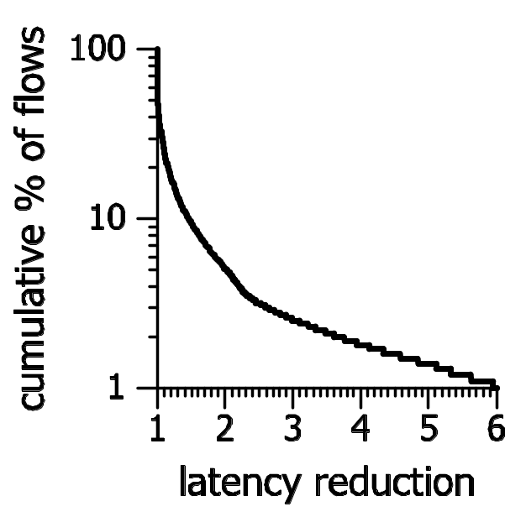
Some paths are very long with BGP
% | length inflation
50 | 1.0
10 | 1.4
5 | 2.0
1 | 5.9
cumulative % of flows
BGP
path length inflation
relative to optimal

Slide 14
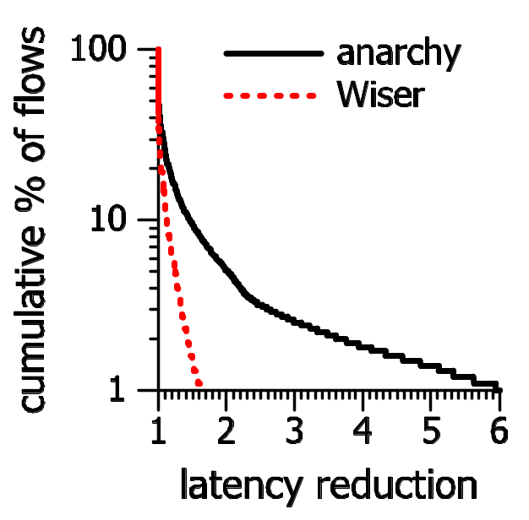
Wiser paths are close to optimal
BGP
Wiser
% | length inflation
 | BGP | Wiser
50 | 1.0 | 1.0
10 | 1.4 | 1.1
5 | 2.0 | 1.2
1 | 5.9 | 1.5
cumulative % of flows
BGP
Wiser
path length inflation
relative to optimal

Slide 15
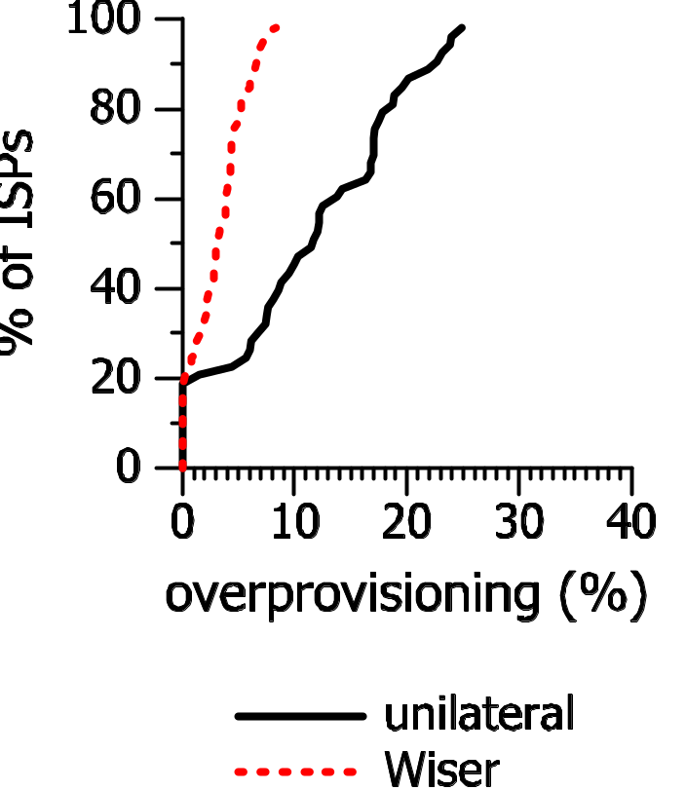
Wiser requires less capacity to handle failures
Wiser
BGP
cumulative % of ISPs
additional capacity (%)
relative to stable load

Slide 16
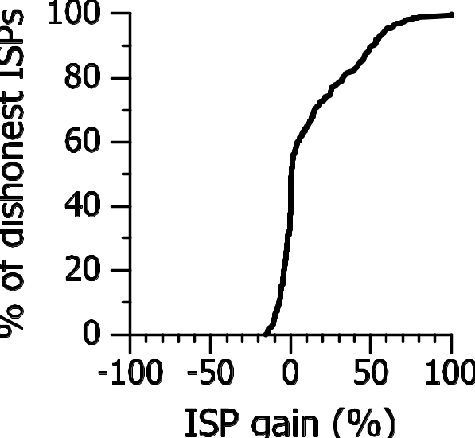
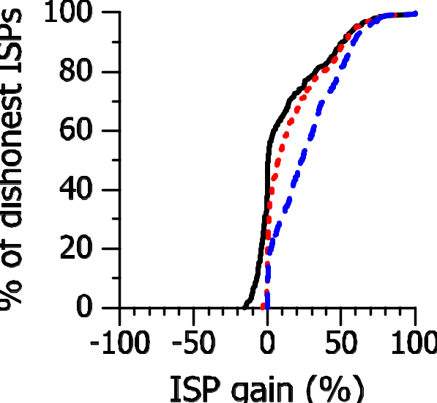
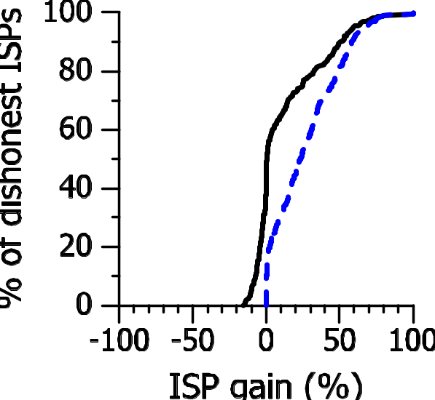
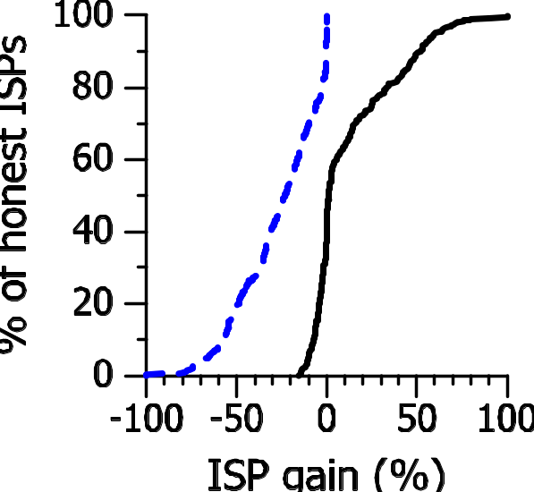
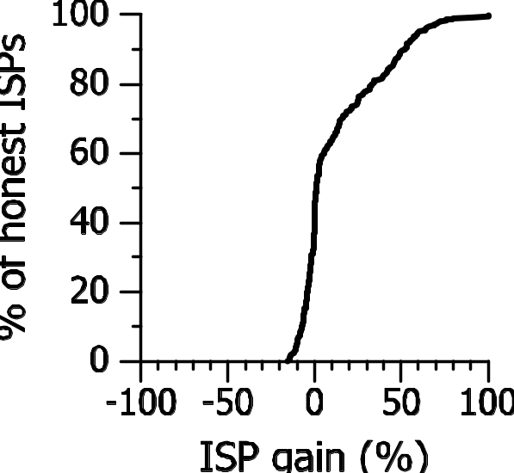
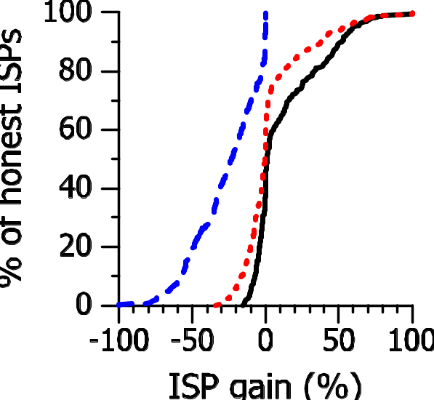
Dishonest ISP
Wiser limits the impact of cheating
Honest ISP
Cumulative % of ISPs
Cumulative % of ISPs
ISP gain (%) relative to BGP
ISP gain (%) relative to BGP
ISP gain (%) relative to BGP
two honest ISPs (Wiser)
one dishonest ISP (no constraints)
one dishonest ISP (Wiser)

Slide 17
Overhead of Wiser
Implementation complexity
  Two implementations: XORP and SSFNet (simulator)
  Less than 6% additional LoC (base ~ 30k)
Computational requirements
  15-25% higher than BGP for normal workload
Convergence time
  Higher than BGP but acceptable even for large failures
Routing message rate
  Comparable to BGP

Slide 18
Concluding thoughts
Wiser provides joint control over routing to ISPs
Competing interests don’t lead to significant efficiency loss in Internet routing
Evidence that practical protocols can harness competing interests

