Slide 1








Bridging centralized programming and distributed control planes
Ryan Beckett | Ratul Mahajan | Todd Millstein | Jitu Padhye | David Walker

Slide 2
Hypothesis on smart solutions in networks
Present
Simple solutions
Overprovision, best effort, optimize mean perf, relaxed (distributed) control, ….
Past
Smart solutions
Intelligent resource allocation, multiple priorities, optimize tail perf, tight (centralized) control, …
Total cost
(eng + ops + $/bit)
Infrastructure size or complexity

Slide 3
Network programming journey
 | Distributed programming | Centralized programming
Distributed control plane
Centralized Control plane
+ Resilience
− Programmability
Notes:
Programmability directly tied to policy compliance and configuration errors

Slide 4
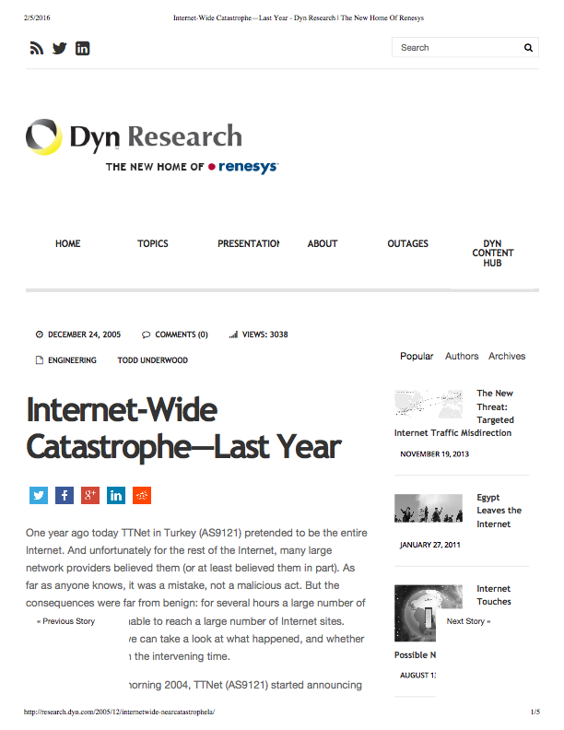
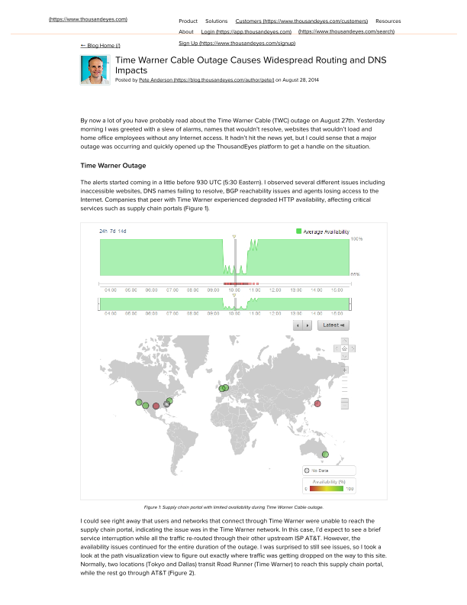

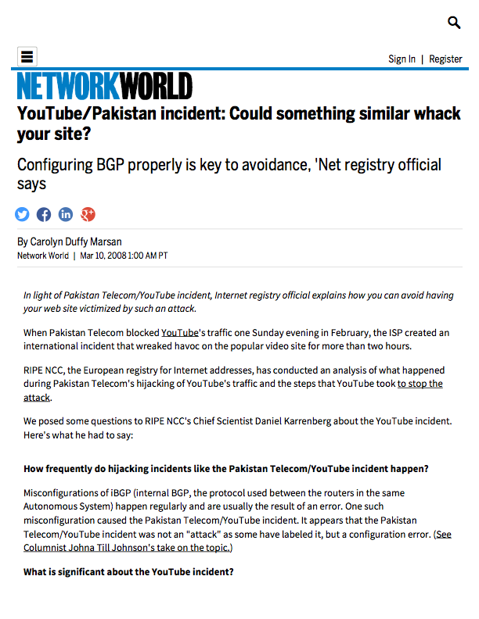
Programming (configuring) networks is error-prone

Slide 5
Programming (configuring) networks is error-prone
60% of network downtime is caused by human error
-Yankee group 2002
50-80% of outages are the result of human error
-Juniper 2008

Slide 6
Network programming journey
 | Distributed programming | Centralized programming
Distributed control plane
Centralized Control plane
+ Resilience
+ Resilience
− Programmability
+ Programmability
− Resilience
+ Programmability
Network verification
Notes:
Programmability directly tied to policy compliance and configuration errors

Slide 7


Programming distributed control planes is hard
Network-wide policies
Prefer one neighbor over another
Don’t use my network as transit
Keep traffic within a region
Aggregate prefixes externally
Router-level mechanisms
Set consistent, per-link preferences
Tag incoming routing info
Program import and export filters based on various route attributes
Prov
Cust
Peer
R2
R3
R1
R4

Slide 8
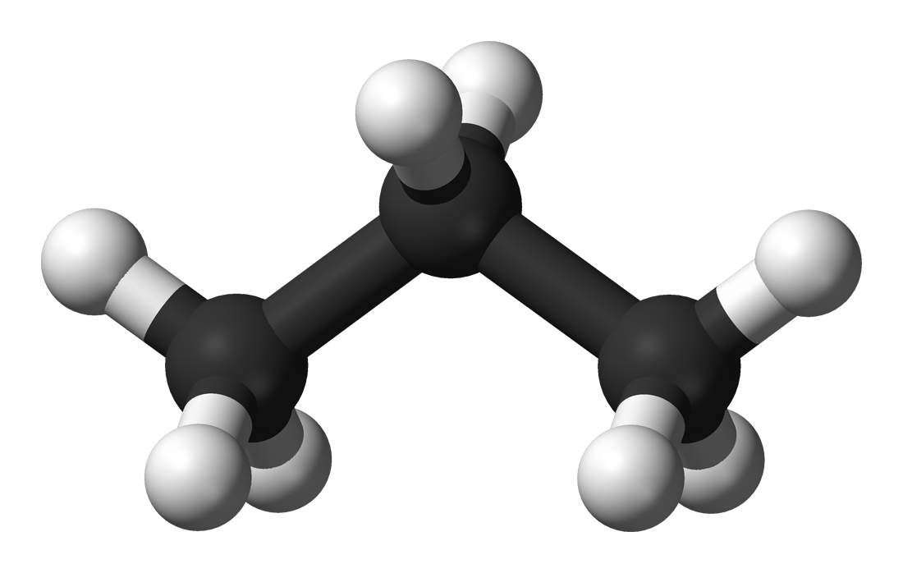
Propane: Centrally programming distributed control planes
A language for expressing of network-level objectives
Path constraints and relative preferences (fallbacks)
A compiler that configures router-level mechanisms
Configurations are policy-compliant under all failures
Notes:
Uniform abstractions for internal and external routing

Slide 9
Example #1: A backbone network
←block “Peer”
→block “Peer”
→tag “Peer”
←tag “Peer”
Peer1
Peer2
LP=99
R1
R2
LP=99
LP=100
LP=101
filter 16.4.0.0/16
filter 16.4.0.0/16
Cust
Goals
No transit between peers
Prefer R2 > R1 > Peer{1,2}
Limit Cust to 16.4.0.0/16
define notransit = {true => not transit({Peer1, Peer2})}
define preference = {true => exit (R2>R1>{Peer1, Peer2})}
define ownership = {16.4.0.0/16 => end(Cust)}
define main = notransit and preference and ownership

Slide 10

Example #2: A data center network
Backbone
Goals
Keep local prefixes internal
Aggregate global prefixes as PG
X
Y
Y
Attempt #1
Don’t export from G, H to external
Aggregate externally as PG
C
D
C
D
G
H
G
H
A
A
B
B
E
F
E
F
PG1
PG2
PL1
PL2
Global
Services
Local
Services

Slide 11
Example #2: A data center network
Backbone
Goals
Keep local prefixes internal
Aggregate global prefixes as PG
X
Y
Y
Attempt #1
Don’t export from G, H to external
Aggregate externally as PG
C
D
C
D
G
H
G
H
A
A
B
B
E
F
E
F
PG1
PG2
PL1
PL2
Global
Services
Local
Services

Slide 12
Example #2: A data center network
Backbone
Goals
Keep local prefixes internal
Aggregate global prefixes as PG
PG
X
Y
Y
Attempt #2
Don’t export from G, H to external
Aggregate externally as PG
Valley-free routing
C
D
C
D
G
H
G
H
A
A
B
B
E
F
E
F
PG1
PG2
PL1
PL2
Global
Services
Local
Services

Slide 13
Example #2: A data center network
Backbone
Goals
Keep local prefixes internal
Aggregate global prefixes as PG
PG
X
Y
Y
Attempt #2
Don’t export from G, H to external
Aggregate externally as PG
Valley-free routing
C
D
C
D
G
H
G
H
A
A
B
B
E
F
E
F
PG1
PG2
PL1
PL2
Global
Services
Local
Services

Slide 14
Example #2: A data center network
Backbone
Goals
Keep local prefixes internal
Aggregate global prefixes as PG
PG
X
Y
PG1 blackholed!
Y
Attempt #2
Don’t export from G, H to external
Aggregate externally as PG
X, Y block routes through the other
C
D
C
D
G
H
G
H
A
A
B
B
E
F
E
F
PG1
PG2
PL1
PL2
Global
Services
Local
Services

Slide 15
Example #2: A data center network
Backbone
Goals
Keep local prefixes internal
Aggregate global prefixes as PG
X
Y
Y
define ownership = {PG1 => end(A),
PG2 => end(B),
PL1 => end(E),
PL2 => end(F)}
define locality = { {PL1, PL2} => always(in)}
control {aggregate(PG, in -> out)}
define main = routing and locality
C
D
C
D
G
H
G
H
A
A
B
B
E
F
E
F
PG1
PG2
PL1
PL2
Global
Services
Local
Services

Slide 16


Propane compiler
Propane
Front End Constraint Language
Regular IR
Regular Expression-based IR
Topology
Product graph
Failure analyses
Abstract BGP
Vendor-independent BGP
Cisco
Juniper
Vendor configurations

Slide 17
Propane Regular IR
Propane
Regular
IR
Step 1: Combine modular constraints Prefix-by-prefix intersection of constraints
define ownership = {PG1 => end(A),
PG2 => end(B),
PL1 => end(E),
PL2 => end(F)}
define locality = { {PL1, PL2} => always(in)}
control {aggregate(PG, in -> out)}
define main = routing and locality
PG1 => end(A)
PG2 => end(B)
PL1 => always(in)and end(E)
PL2 => always(in)and end(F)

Slide 18
Propane Regular IR
Propane
Step 2: Expand constraints in to regular expressions
Regular
IR
any = out*.in+.out*
end(X) = (Σ*.X)
always(X) =
(X)*
exit(X) =
(out*.in*.(X ∩ in).out+)|
(out*.in+.(X ∩ out).out*)
(X.Σ*)
start(X) =
avoid(X) =
(!X)*
(Σ*.X.Σ*)
waypoint(X) =
Step 3: Reduced syntax
true => A.(X >> Y).out*
true => (A.X.out*) >> (A.Y.out*)

Slide 19
PG construction: An Example
Regular IR
Product graph
X
Y
W
A
D
B
C
E
Z
Policy:
(W.A.C.D.out) >> (W.B.in+.out)

Slide 20
PG construction: An Example
Regular IR
Product graph
X
Y
W
A
D
B
C
E
Z
Policy:
(W.A.C.D.out) >> (W.B.in+.out)

Slide 21
PG construction: Reversed policy automata
X
Y
W
A
D
B
C
E
Z
out
D
C
A
W
(W.A.C.D.out)
0
1
2
3
4
5
ACDE
B
out
in
W
B
(W.B.in+.out)
0
1
2
3
4
ACDE

Slide 22
PG construction: Graph generation
Y
start
W
X
A
(W,1,1)
(Z,1,1)
(Y,1,1)
(X,1,1)
D
B
C
E
(A,-,2)
(B,-,2)
(E,-,2)
(D,2,2)
Z
(C,-,2)
(D,-,2)
(C,3,2)
(W.A.C.D.out) >> (W.B.in+.out)
out
D
C
A
W
(B,-,3)
(A,4,2)
0
1
2
3
4
5
(W,-,4)
(W,5,-)
ACDE
B
out
in
W
B
{2}
{1}
0
1
2
3
4
end
ACDE

Slide 23
PG construction: Graph generation
Y
start
W
X
A
(W,1,1)
(Z,1,1)
(Y,1,1)
(X,1,1)
D
B
C
E
(A,-,2)
(B,-,2)
(E,-,2)
(D,2,2)
Z
(C,-,2)
(D,-,2)
(C,3,2)
(W.A.C.D.out) >> (W.B.in+.out)
out
D
C
A
W
(B,-,3)
(A,4,2)
0
1
2
3
4
5
(W,-,4)
(W,5,-)
ACDE
B
out
in
W
B
{2}
{1}
0
1
2
3
4
end
ACDE
Notes:
Compact representation of all paths through the topology subject to policy constraints

Slide 24
PG construction: minimization (loop analysis)
start
start
(W,1,1)
(Z,1,1)
(Y,1,1)
(X,1,1)
(Z,1,1)
(Y,1,1)
(X,1,1)
(A,-,2)
(B,-,2)
(E,-,2)
(D,2,2)
(E,-,2)
(D,2,2)
(C,-,2)
(D,-,2)
(C,3,2)
(C,-,2)
(C,3,2)
(B,-,3)
(A,4,2)
(B,-,3)
(A,4,2)
(W,-,4)
(W,5,-)
(W,-,4)
(W,5,-)
{2}
{1}
{2}
{1}
end
end
Notes:
6 checks
- 3 for nodes
- not on a simple path
- pre-dominated (from start) by another version of yourself
- post-dominated (toward end) by another version of yourself
-

Slide 25
Compilation to ABGP
Product graph
start
Abstract BGP
(Z,1,1)
(Y,1,1)
(X,1,1)
Idea 1: Restrict advertisements to PG edges
(E,-,2)
(D,2,2)
Encode PG state in community tag
Incoming edges — import filters
Outgoing edges — export filters
(C,-,2)
(C,3,2)
(B,-,3)
(A,4,2)
(W,-,4)
(W,5,-)
Let BGP find some allowed path dynamically
{2}
{1}
end

Slide 26
Compilation to BGP
Product graph
start
Abstract BGP
(Z,1,1)
(Y,1,1)
(X,1,1)
(E,-,2)
(D,2,2)
C allows import from D with tag (2,2)
(C,-,2)
(C,3,2)
C exports to A,B with tag (3,2)
(B,-,3)
(A,4,2)
(W,-,4)
(W,5,-)
{2}
{1}
end

Slide 27
Compilation to BGP
start
A better path exists in the
network, but is not used!
(Z,1,1)
(Y,1,1)
(X,1,1)
(E,-,2)
(D,2,2)
X
Y
W
(C,-,2)
(C,3,2)
A
D
B
C
E
(B,-,3)
(A,4,2)
(W,-,4)
(W,5,-)
Z
(W.A.C.D.out) >> (W.B.in+.out)
{2}
{1}
end

Slide 28
Compilation to BGP
start
(Z,1,1)
(Y,1,1)
(X,1,1)
Idea 2: Synthesize local preferences
Direct BGP towards best path
Under all combinations of failures
(E,-,2)
(D,2,2)
(C,-,2)
(C,3,2)
(B,-,3)
(A,4,2)
Let BGP find the best allowed path dynamically
(W,-,4)
(W,5,-)
{2}
{1}
end

Slide 29
Compilation to BGP
Router A
match peer=C comm=(3,2)
export peer←W, comm←(4,2),
comm← noexport, MED←80
Router B
match peer=C
export peer←W, comm←(-,3),
comm←noexport, MED←81
Router C
match[lp=99] peer=E, comm=(-,2)
export peer←B, comm←(-,2)
match[lp=100] peer=D, comm=(2,2)
export peer←A,B, comm←(3,2)
Router D
match regex=(X + Y)
export peer←C, comm←(2,2)
…
start
(Z,1,1)
(Y,1,1)
(X,1,1)
(E,-,2)
(D,2,2)
(C,-,2)
(C,3,2)
(B,-,3)
(A,4,2)
(W,-,4)
(W,5,-)
{2}
{1}
end

Slide 30
Compilation to BGP
Router A
match peer=C comm=(3,2)
export peer←W, comm←(4,2),
comm← noexport, MED←80
Router B
match peer=C
export peer←W, comm←(-,3),
comm←noexport, MED←81
Router C
match[lp=99] peer=E, comm=(-,2)
export peer←B, comm←(-,2)
match[lp=100] peer=D, comm=(2,2)
export peer←A,B, comm←(3,2)
Router D
match regex=(X + Y)
export peer←C, comm←(2,2)
…
start
(Z,1,1)
(Y,1,1)
(X,1,1)
(E,-,2)
(D,2,2)
(C,-,2)
(C,3,2)
(B,-,3)
(A,4,2)
(W,-,4)
(W,5,-)
{2}
{1}
end

Slide 31
Compilation to BGP
Router A
match peer=C comm=(3,2)
export peer←W, comm←(4,2),
comm← noexport, MED←80
Router B
match peer=C
export peer←W, comm←(-,3),
comm←noexport, MED←81
Router C
match[lp=99] peer=E, comm=(-,2)
export peer←B, comm←(-,2)
match[lp=100] peer=D, comm=(2,2)
export peer←A,B, comm←(3,2)
Router D
match regex=(X + Y)
export peer←C, comm←(2,2)
…
start
(Z,1,1)
(Y,1,1)
(X,1,1)
(E,-,2)
(D,2,2)
(C,-,2)
(C,3,2)
(B,-,3)
(A,4,2)
(W,-,4)
(W,5,-)
{2}
{1}
end

Slide 32
Compilation to BGP
Router A
match peer=C comm=(3,2)
export peer←W, comm←(4,2),
comm← noexport, MED←80
Router B
match peer=C
export peer←W, comm←(-,3),
comm←noexport, MED←81
Router C
match[lp=99] peer=E, comm=(-,2)
export peer←B, comm←(-,2)
match[lp=100] peer=D, comm=(2,2)
export peer←A,B, comm←(3,2)
Router D
match regex=(X + Y)
export peer←C, comm←(2,2)
…
start
(Z,1,1)
(Y,1,1)
(X,1,1)
(E,-,2)
(D,2,2)
(C,-,2)
(C,3,2)
(B,-,3)
(A,4,2)
(W,-,4)
(W,5,-)
{2}
{1}
end

Slide 33
Compilation to BGP
Router A
match peer=C comm=(3,2)
export peer←W, comm←(4,2),
comm← noexport, MED←80
Router B
match peer=C
export peer←W, comm←(-,3),
comm←noexport, MED←81
Router C
match[lp=99] peer=E, comm=(-,2)
export peer←B, comm←(-,2)
match[lp=100] peer=D, comm=(2,2)
export peer←A,B, comm←(3,2)
Router D
match regex=(X + Y)
export peer←C, comm←(2,2)
…
start
(Z,1,1)
(Y,1,1)
(X,1,1)
(E,-,2)
(D,2,2)
choice
(C,-,2)
(C,3,2)
(B,-,3)
(A,4,2)
(W,-,4)
(W,5,-)
{2}
{1}
end

Slide 34
Compilation to BGP
Router A
match peer=C comm=(3,2)
export peer←W, comm←(4,2),
comm← noexport, MED←80
Router B
match peer=C
export peer←W, comm←(-,3),
comm←noexport, MED←81
Router C
match[lp=99] peer=E, comm=(-,2)
export peer←B, comm←(-,2)
match[lp=100] peer=D, comm=(2,2)
export peer←A,B, comm←(3,2)
Router D
match regex=(X + Y)
export peer←C, comm←(2,2)
…
start
(Z,1,1)
(Y,1,1)
(X,1,1)
(E,-,2)
(D,2,2)
choice
(C,-,2)
(C,3,2)
X
But there
could be a
failure!
{2}
{1}
Highest preference
obtainable here

Slide 35
Compilation to BGP
Router A
match peer=C comm=(3,2)
export peer←W, comm←(4,2),
comm← noexport, MED←80
Router B
match peer=C
export peer←W, comm←(-,3),
comm←noexport, MED←81
Router C
match[lp=99] peer=E, comm=(-,2)
export peer←B, comm←(-,2)
match[lp=100] peer=D, comm=(2,2)
export peer←A,B, comm←(3,2)
Router D
match regex=(X + Y)
export peer←C, comm←(2,2)
…
start
(Z,1,1)
(Y,1,1)
(X,1,1)
(E,-,2)
(D,2,2)
choice
(C,-,2)
(C,3,2)
(B,-,3)
(A,4,2)
X
(W,-,4)
(W,5,-)
{2}
{1}
end

Slide 36
Compilation to BGP
Router A
match peer=C comm=(3,2)
export peer←W, comm←(4,2),
comm← noexport, MED←80
Router B
match peer=C
export peer←W, comm←(-,3),
comm←noexport, MED←81
Router C
match[lp=99] peer=E, comm=(-,2)
export peer←B, comm←(-,2)
match[lp=100] peer=D, comm=(2,2)
export peer←A,B, comm←(3,2)
Router D
match regex=(X + Y)
export peer←C, comm←(2,2)
…
start
(Z,1,1)
(Y,1,1)
(X,1,1)
(E,-,2)
(D,2,2)
(C,-,2)
(C,3,2)
(B,-,3)
(A,4,2)
(W,-,4)
(W,5,-)
Safe to prefer D
{2}
{1}
end

Slide 37
Propane compiler implementation
Propane
Efficient graph algorithms
Minimization
Failure safety
Aggregation blackholes
Config minimization
5500 LoC (F#)
Regular IR
Product graph
Abstract BGP
Cisco
Juniper
Notes:
Output Quagga

Slide 38
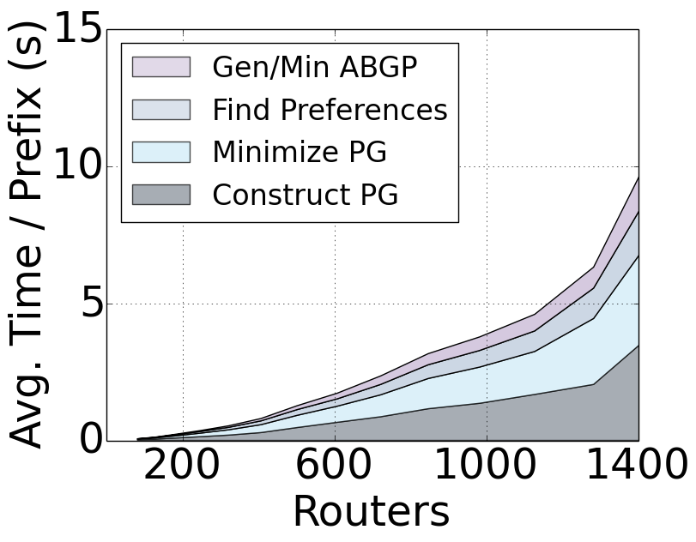
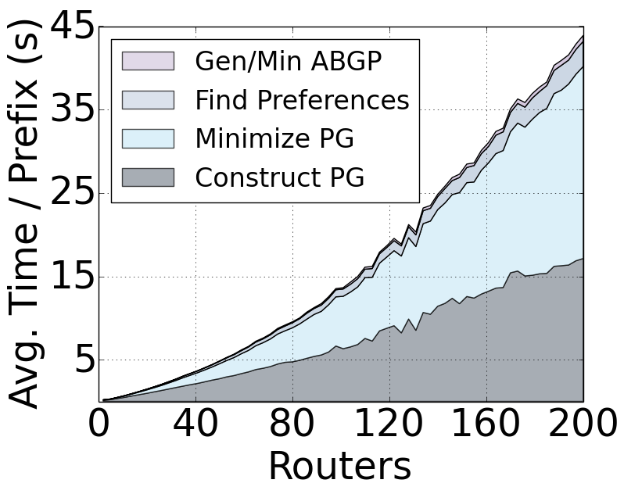
Evaluation on Microsoft network policies
Data center networks
31 lines of Propane
9 mins for 1400 routers
Backbone networks
43 lines of Propane
3 mins for 200 routers
Notes:
Implementation has 5500 lines of F#
Policies translated from English documents

Slide 39
Summary
Centralized programming of distributed control planes
Resilient and programmable networks
Generates BGP configurations from high-level policies
using a product graph abstraction of control plane
Propane
github.com/rabeckett/propane

