Slide 1
Analyzing the MAC-level behavior of wireless networks in the wild
Ratul Mahajan
(Microsoft Research)
Maya Rodrig, David Wetherall, John Zahorjan (University of Washington)

Slide 2

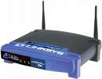
Understanding the MAC of an operational network
How often clients retransmit packets?
Are hidden terminals common? Does RTS/CTS help?
Is the capture effect common?
Does the MAC use the medium efficiently?
How does performance vary with offered load?

Slide 3



Approaches to measure operational networks
Approach | Limitation
Collect packet logs at APs | Not enough detail
Instrument stations | Impractical in many settings
Passively monitor the network | Incomplete information of unknown quality

Slide 4
Why is analysis based on passive monitoring hard?
Inherently incomplete view of network activity
Missing packet reception information
Missing network-level information

Slide 5

Overview of Wit
Merge (halfWit)
Infer (nitWit)
Derive measures (dimWit)

Slide 6
Merging with halfWit
Trace from Monitor 1
Trace from Monitor 2
halfWit
Merged trace: consistent, unified view
.
.
.
Trace from Monitor N

Slide 7
Inference with nitWit
Enhanced trace with:
packet reception status
missing packets
Merged
trace
nitWit
Observation: logged transmissions can reveal both pieces of information

Slide 8
Formal-language approach to inference
If the protocol is a language
  packets are language symbols
  logical protocol exchanges are sentences
Trace contains interleaved, partial sentences
Our task: infer matching complete sentences
  we use an FSM-based inference engine

Slide 9
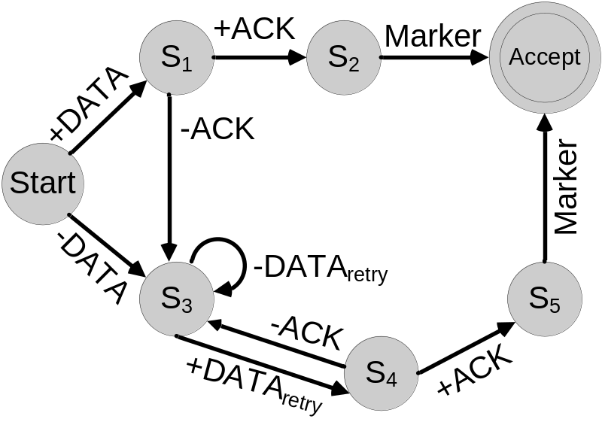
Non-deterministic walk reveals reception status
<start>
DATA
ACK
Marker
Start
<start>
DATA (rcvd)
ACK (rcvd)
Marker
S1
?
S3
S2
S3
Accept

Slide 10
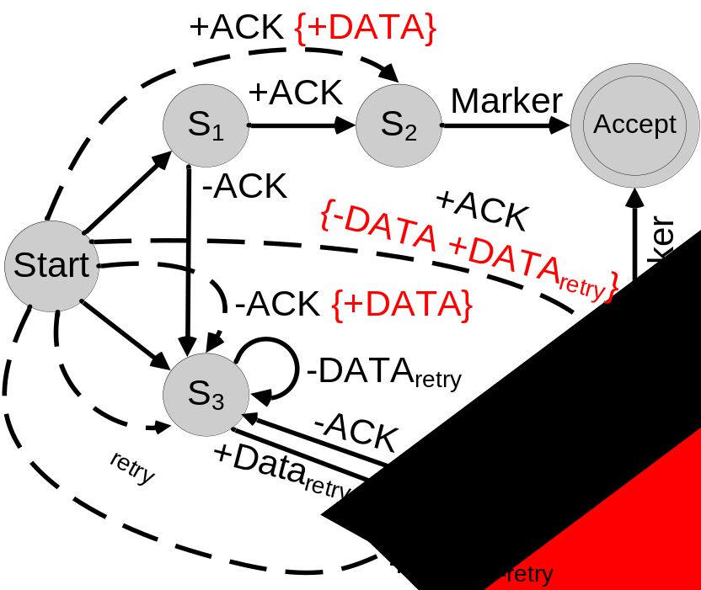
Augmented FSM enables fast inference of missing packets
Start
<start>
ACK
Marker
<start>
DATA (rcvd)
ACK (rcvd)
Marker
S2
S3
S5
Accept
Accept
Accept

Slide 11
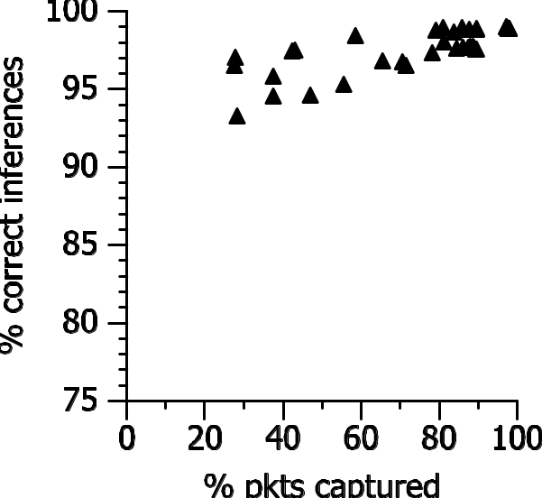
Accuracy of nitWit
% of correctly predicted
pkt reception statuses
% of pkts captured
by the monitors

Slide 12
Deriving measures with dimWit
Trace enhanced by nitWit
dimWit
Measures of MAC behavior: goodput, #contenders, etc.
# of stations contending for the medium is a measure of instantaneous offered load
  estimation challenge: missing relevant state
  approach: view transmissions through the lens of MAC rules

Slide 13
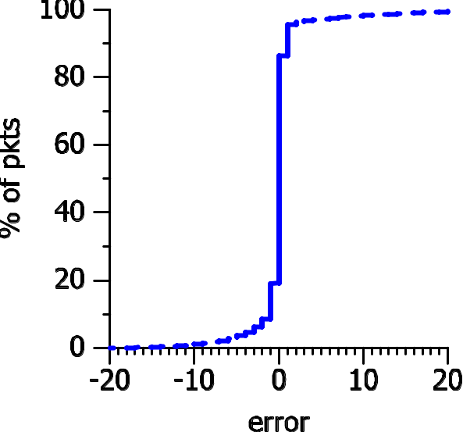
Accuracy of estimate of #contenders
cumulative % of pkt transmissions
(actual – dimWit)
CDF of error in the estimate of # contenders

Slide 14
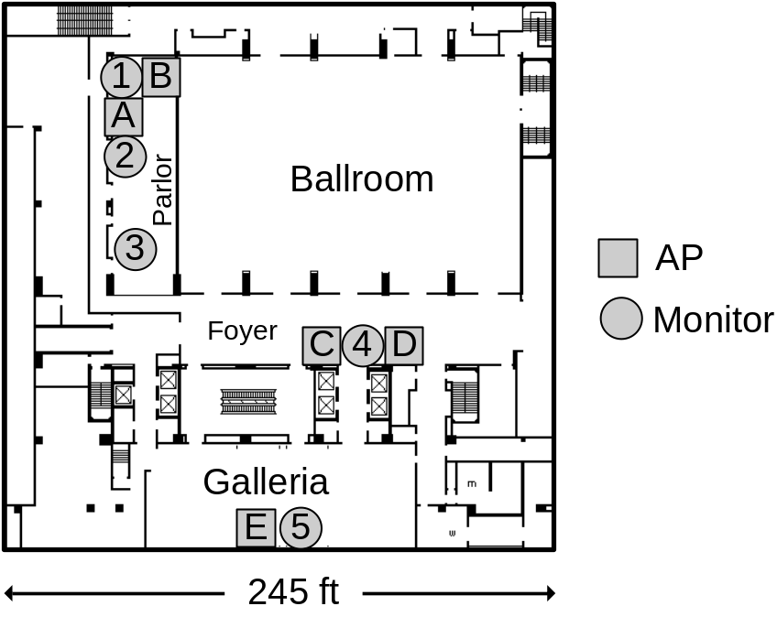
Monitoring the SIGCOMM ’04 network
3 days, 500+ users, 5 official APs, 5 monitors
Focus on analyzing Channel 1 in this talk
  estimated 90% pkts captured in the merged trace

Slide 15
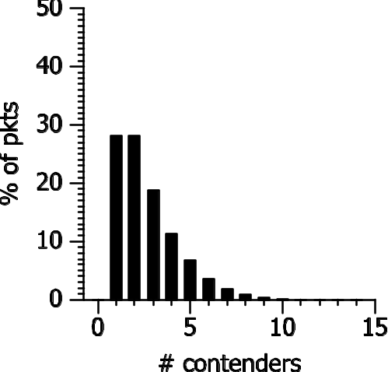
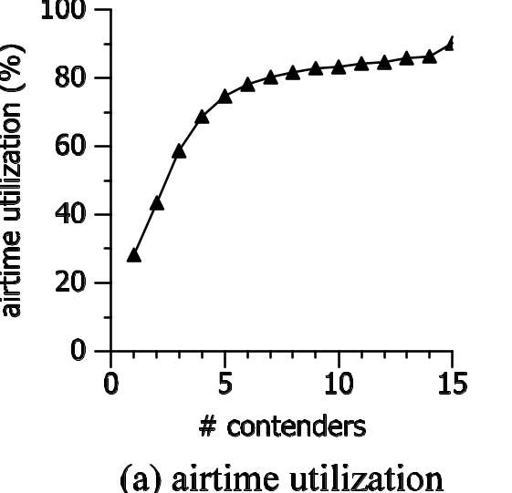
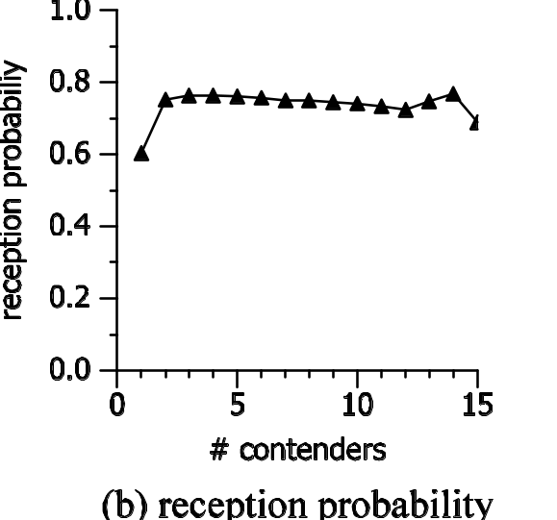
Example results on MAC behavior at the SIGCOMM ’04 network
medium use (%)
reception ratio
% of packets
# contenders
# contenders
# contenders
Low contention was dominant
Poor medium usage at low contention
High contention did not reduce reception ratio

Slide 16
Conclusions
Wit enables detailed MAC-level analysis of operational wireless networks
  merging produces a single, consistent view
  inference helps complete that view
  the enhanced trace enables many new analyses
Code and trace data: http://www.cs.washington.edu/research/
networking/wireless/

