Slide 1

Software-defined networking: Change is hard
Ratul Mahajan
with
Chi-Yao Hong, Rohan Gandhi, Xin Jin, Harry Liu, Vijay Gill, Srikanth Kandula, Mohan Nanduri, Roger Wattenhofer, Ming Zhang

Slide 2
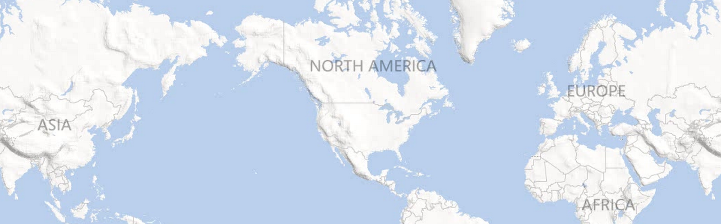
Inter-DC WAN: A critical, expensive resource
Dublin
Seattle
New York
Seoul
Barcelona
Los Angeles
Miami
Hong Kong
Notes:
Services need inter-DC WAN for performance and reliability.
100s of Gbps capacity over long distances.
Costs 100s of millions of dollars amortized annually.

Slide 3
But it is highly inefficient
Notes:
Even the busiest links are used 40-60% of the time.

Slide 4
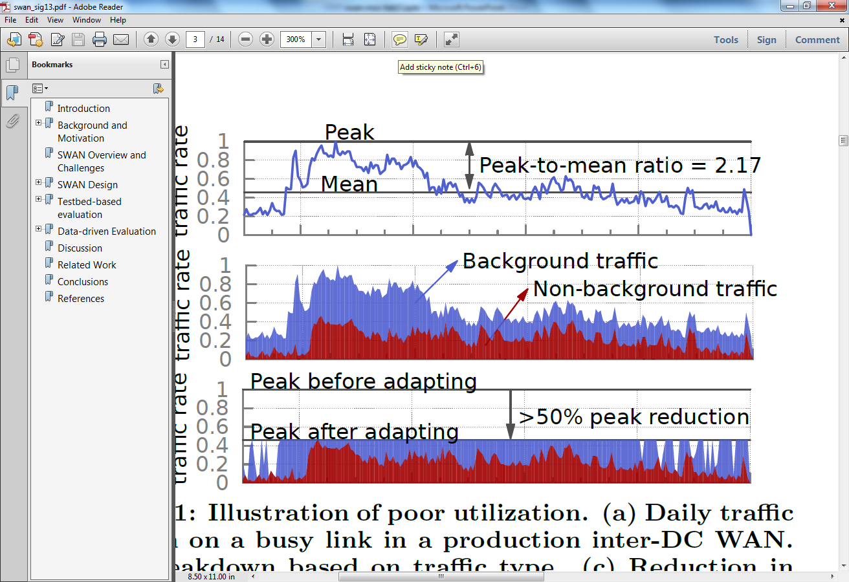
One cause of inefficiency: Lack of coordination
Notes:
Services send when they want and however much they want.
- leads to cycles of over and under-subscription
Poor utilization can be countered by leveraging traffic characteristics.
- some traffic can be delayed
Adapting this traffic will allow a smaller network to carry the same traffic or allow more traffic to be carried over a network.

Slide 5
Another cause of inefficiency: Local, greedy resource allocation
B
C
D
B
C
D
A
A
E
E
H
G
F
H
G
F
Local, greedy allocation
Globally optimal allocation
[Latency inflation with MPLS-based traffic engineering, IMC 2011]
Notes:
Explain MPLS and tunnels. CSPF.
Sub-optimality was observed in practice. [IMC paper]

Slide 6
SWAN: Software-driven WAN
Goals
Key design elements
Highly efficient WAN
Flexible sharing policies
Coordinate across services
Centralize resource allocation
[Achieving high utilization with software-driven WAN, SIGCOMM 2013]
Notes:
Want network utilization to be almost 100%, from the current standard of 40-60%
High efficiency alone is trivial to achieve; must support policies
- Strict priority classes
- Max-min fair within a class

Slide 7




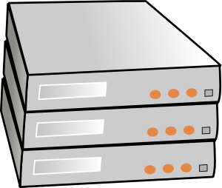

SWAN overview
SWAN controller
Traffic demand
Topology, traffic
BW allocation
Network config.
Service broker
Network agent
Rate limiting
WAN
Service hosts
Notes:
Bandwidth broker represents service hosts. Required for scalability and also allows for service-specific logic and policies.

Slide 8
Key design challenges
Scalably computing BW allocations
Working with limited switch memory
Avoiding congestion during network updates
Notes:
Some expected challenges, some unexpected.
Scalability challenge is due to max-min fairness; solved using an approximate fairness with provable bounds.
Switch memory challenge solved by keeping the “working set” in memory.
Unexpected challenge was the possibility of congestion during network updates.

Slide 9
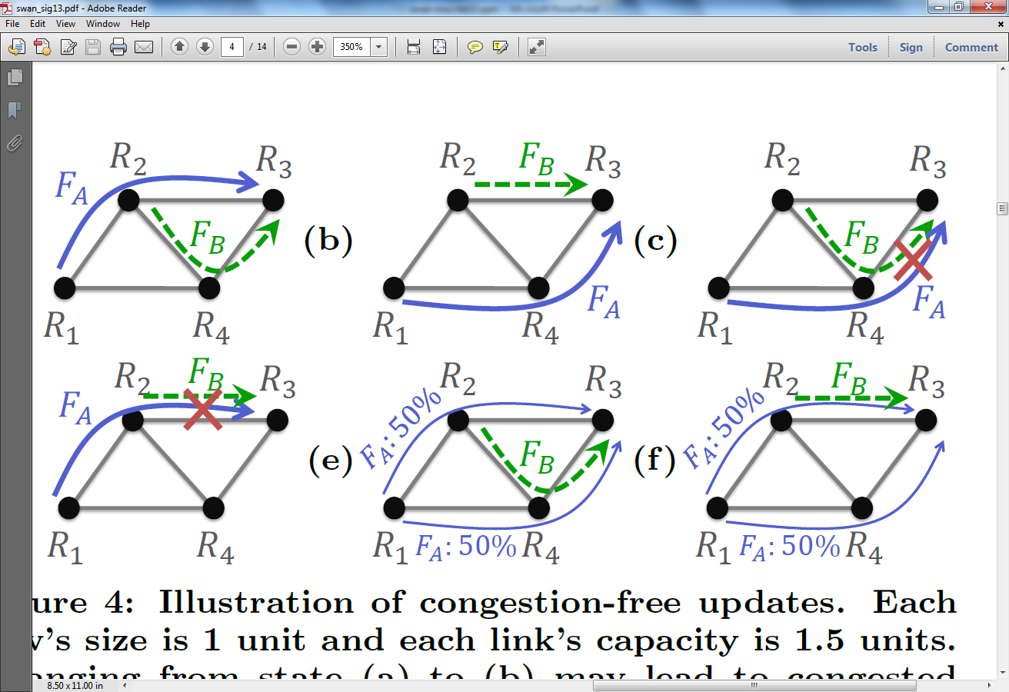
Congestion during network updates
Notes:
Want to go from left to right, perhaps to make room for a new flow on link R2-R4.

Slide 10
Congestion-free network updates

Slide 11
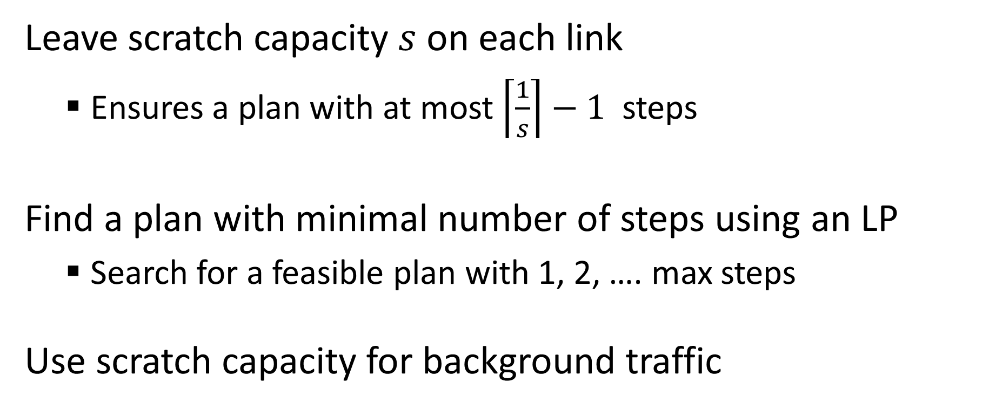
Computing congestion-free update plan
Leave scratch capacity $s$ on each link
Ensures a plan with at most $\left\lceil \frac{1}{s}\right\rceil −1$ steps
Find a plan with minimal number of steps using an LP
Search for a feasible plan with 1, 2, …. max steps
Use scratch capacity for background traffic
Notes:
Does an update plan always exist?
How long can it be?
Final guarantee:
- full network utilization
- protects non-bg traffic and bounded congestion for background traffic

Slide 12
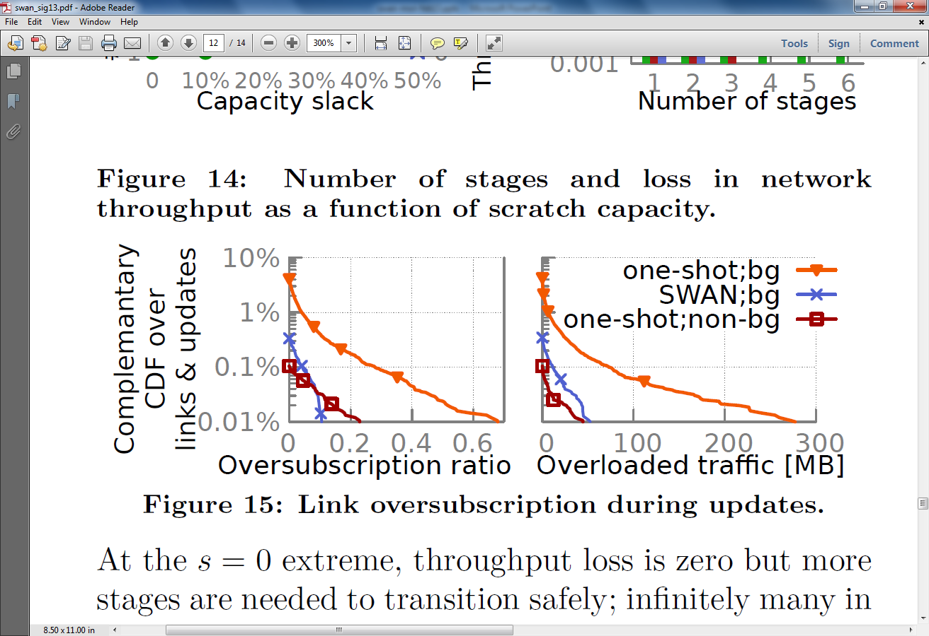
SWAN provides congestion-free updates
Complementary CDF
Oversubscription ratio
Extra traffic (MB)

Slide 13
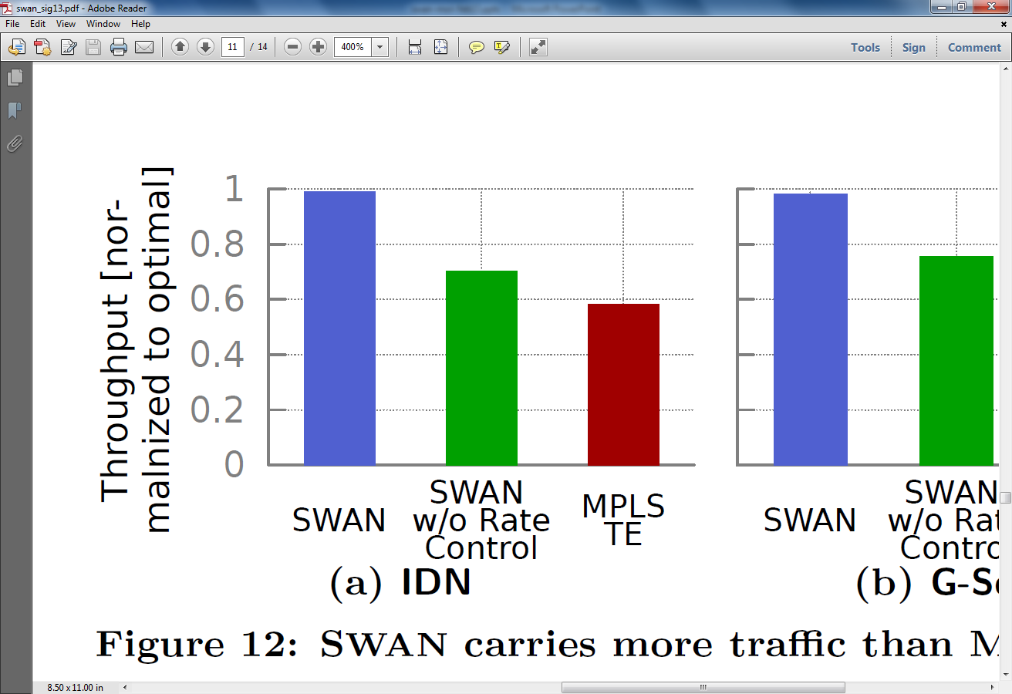
SWAN comes close to optimal
Throughput
(relative to optimal)
SWAN
SWAN
w/o rate control
MPLS TE

Slide 14

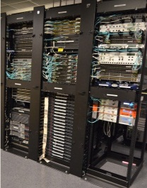

Deploying SWAN
WAN
WAN
Data center
Data center
Partial deployment
Full deployment

Slide 15

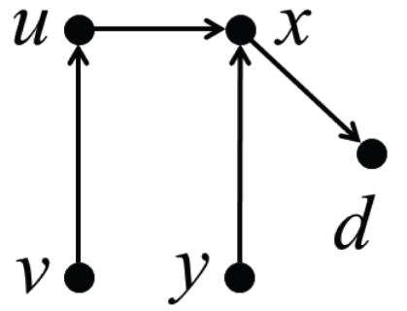


The challenge of data plane updates in SDN
Not just about congestion
Blackholes, loops, packet coherence, …
Notes:
Switch gears a bit.
First off, the problem is not only about congestion.
That all these bad things can happen came as a surprise to me. Promise of SDNs:
- You can configure your network just the way you want it
- Direct control can avoid convergence issues of distributed protocols such as loops, drops, and other uncertainties
Reality today:
- Bad things still happen in between stable states
Change is hard
http://blog.richmond.edu/rapmusic/2012/10/20/tricia-rose-on-obama-2/

Slide 16
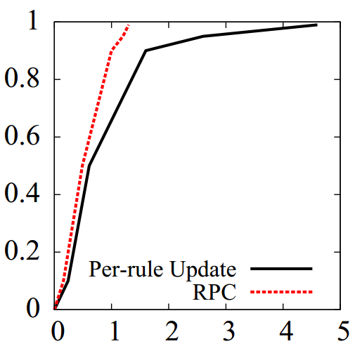
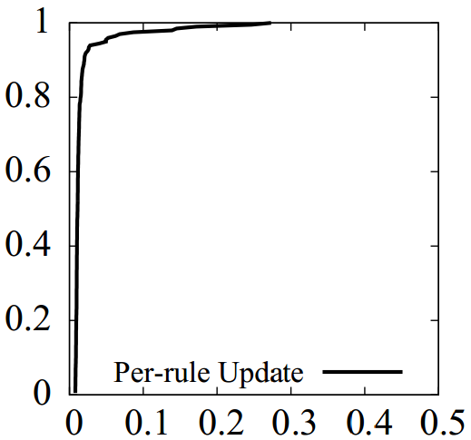
The challenge of data plane updates in SDN
Not just about congestion
Blackholes, loops, packet coherence, …
Real-world is even messier
Google’s B4
Our controlled experiments
CDF
CDF
Latency (seconds)
Latency (seconds)
Notes:
Graph excludes complete failures (0.1 – 1%).
An update can include 100s of rules changes per switch.
Bad conditions can last for a while.
Switches will likely get better over time, but the fact is: when you are trying to update hundreds or even thousands of switches at the same time, some will likely barf.

Slide 17
Many resulting questions of interest
Fundamental
What consistency properties can be maintained and how?
Is property strength and ease of maintenance related?
Practical
How to quickly and safely update the data plane?
Impacts failure recovery time, network utilization, flow response time
Notes:
Raises many questions that we as a community must answer.
Rest of the talk: our first take at these issues.

Slide 18
Minimal dependencies for a consistency property
 | None | Self | Downstream subset | Downstream all | Global
Eventual consistency | Always guaranteed
Blackhole freedom | Impossible | Add before remove
Loop freedom | Impossible |  | Rule dependency forest | Rule dependency tree
Packet coherence | Impossible |  |  | Flow version numbers | Global version numbers
Congestion freedom | Impossible |  |  |  | Staged partial moves
[On consistent updates in software-defined networks, HotNets 2013]
Notes:
Dependencies capture ease of maintenance.
These are results without memory limits.
Not a solved problem yet:
- the table is qualitative
- combinations of properties missing
Memory limits complicate matters

Slide 19
Fast, consistent network updates
Routing policy
Consistency property
Current network state
Desired state generator
Target network state
Update planner
Update plan
Forward fault correction Computes states that are robust to common faults
Dionysus Dynamically schedules network updates

Slide 20
Overview of forward fault correction
Control and data plane faults cause congestion
Today, reactive data plane updates are needed to remove congestion
FFC handles faults proactively
Guarantees absence of congestion for up to k faults
Main challenge: Too many possible faults
Constraint reduction technique based on sorting networks
[Traffic engineering with forward fault correction, SIGCOMM 2014 (to appear)]

Slide 21
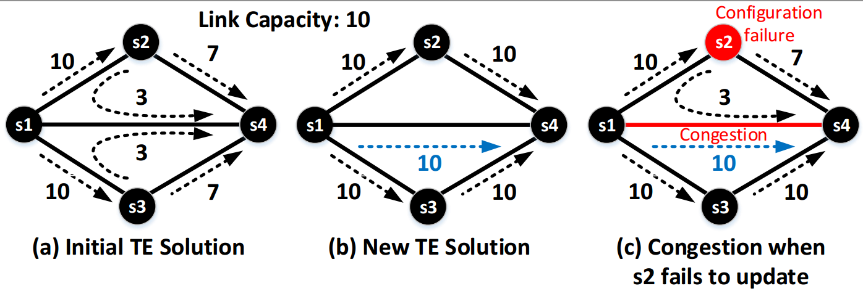
Congestion due to control plane faults
Current State
Target state

Slide 22
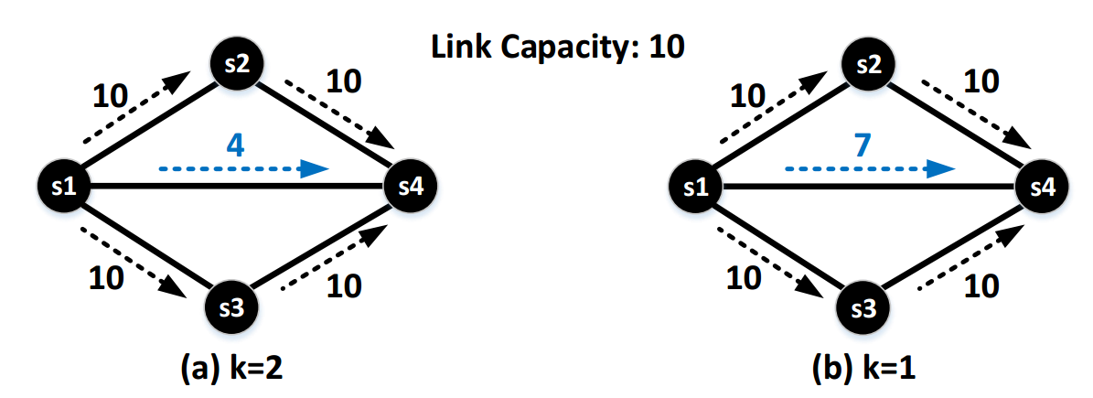
FFC for control plane faults
Robust target state (k=1)
Current State
Vulnerable target state
Robust target state (k=2)
Notes:
Some throughput overhead, just like FEC.
As for FEC, more protection means more overhead.

Slide 23
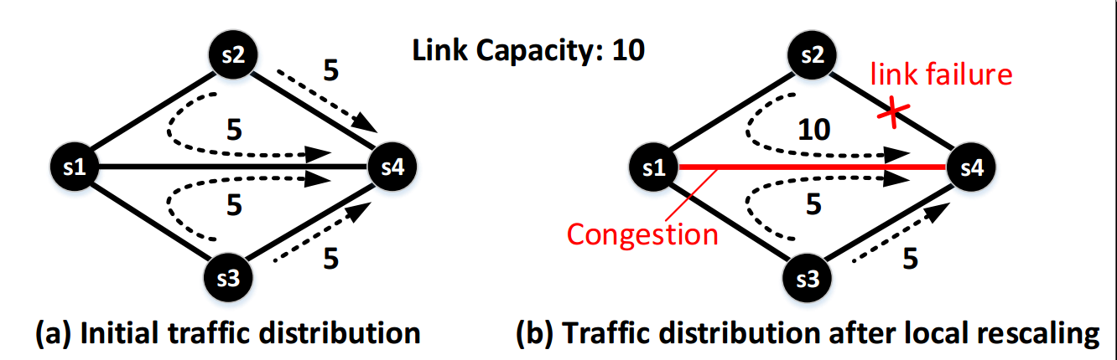
Congestion due to data plane faults
Pre-failure traffic distribution
Post-failure traffic distribution

Slide 24
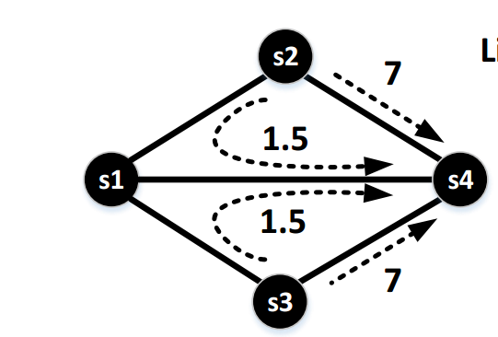
FFC for data plane faults
Vulnerable traffic distribution
Robust traffic distribution (k=1)

Slide 25

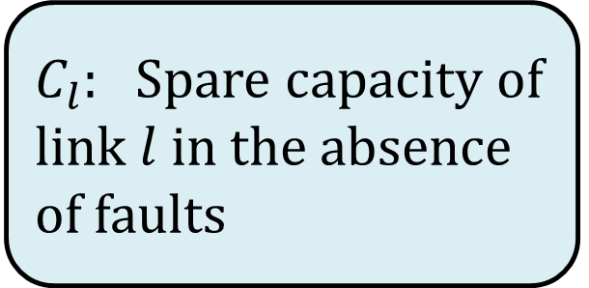
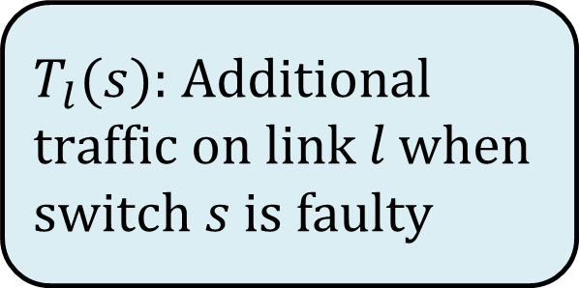
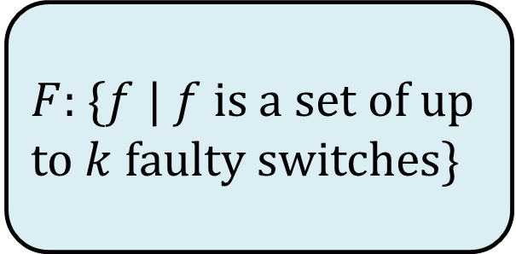
FFC guarantee needs too many constraints
[$∀f∈F] \sum_{s∈f}{T_{l}\left(s\right)≤C_{l}}$
$F$: {$f$ | $f$ is a set of up to $k$ faulty switches}
$$T_{l}(s) \text{: }\text{Additional} \text{traffic} \text{on} \text{link} l \text{when} \text{switch} s \text{is} \text{faulty}$$
$C_{l}:$ Spare capacity of link $l$ in the absence of faults
Number of constraints is $\left({n \atop 1}\right)+ … +\left({n \atop k}\right)$ for each link
Notes:
The exact equations are a little involved but this one captures the essence of the problem

Slide 26
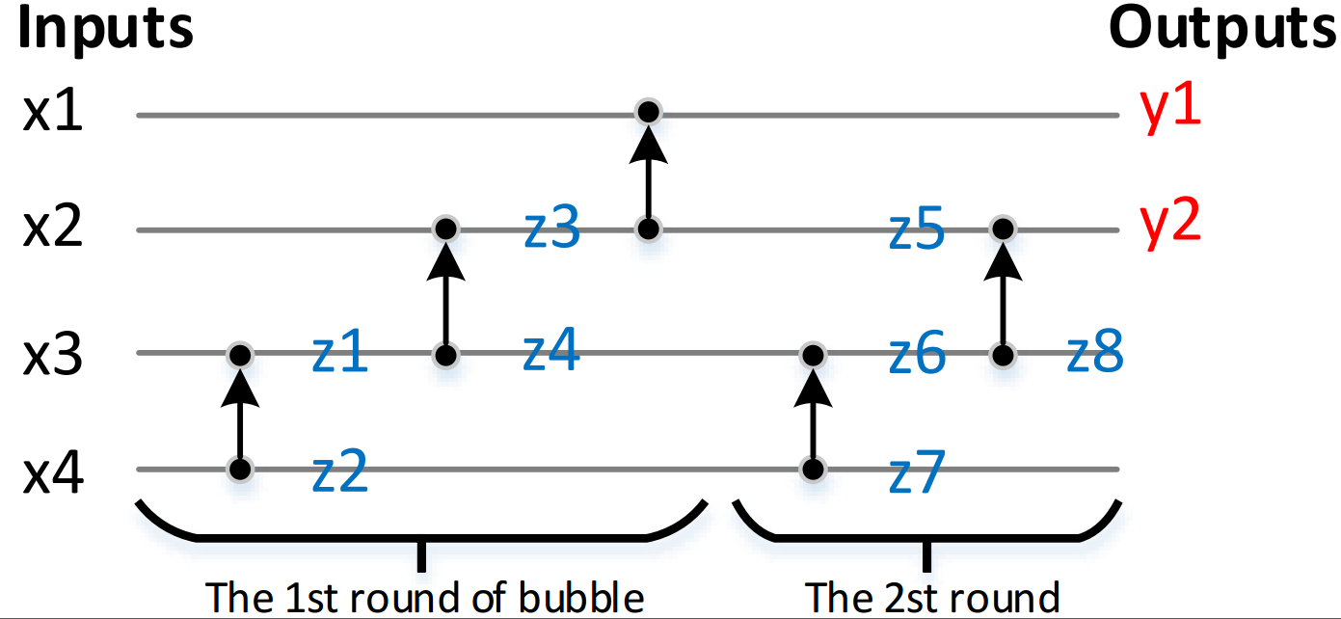
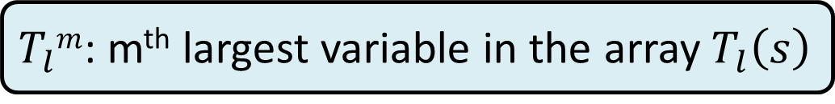
Efficient solution using sorting networks
$\left[∀f∈F\right] \sum_{s∈f}{T_{l}(s)≤C_{l} }$ ➔ $\sum_{m=1}^{k}{T_{l}^{m}≤C_{l} }$
$T_{l}m$: m^{th} largest variable in the array $T_{l}\left(s\right)$
Use bubble sort network to compute linear expressions for k largest variables
O(nk) constraints

Slide 27
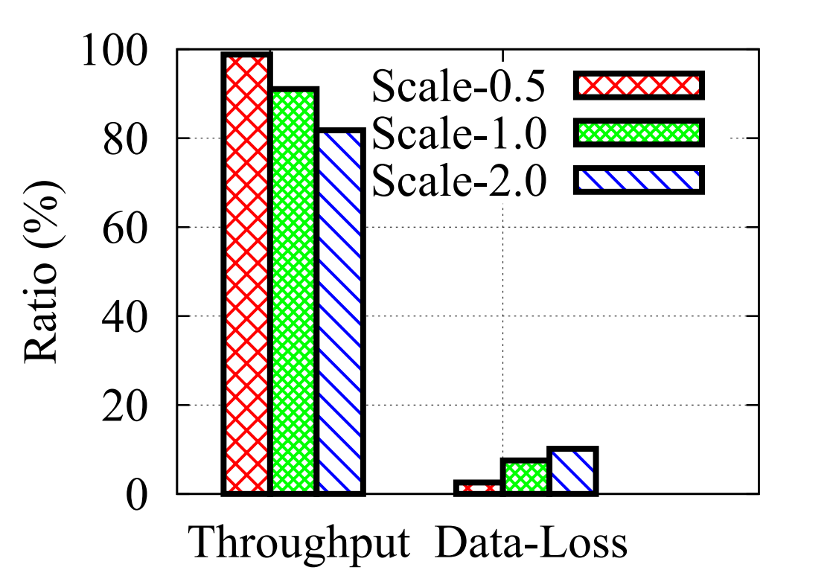
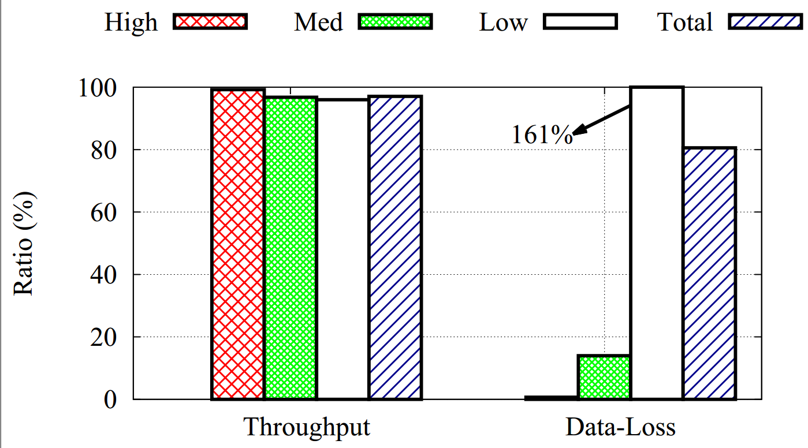

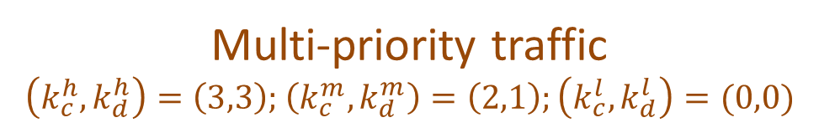
FFC performance in practice
Single-priority traffic ($k_{c}, k_{d})=(2,1)$
Multi-priority traffic
$\left(k_{c}^{h},k_{d}^{h}\right)=\left(3,3\right);$ $\left(k_{c}^{m}, k_{d}^{m}\right)=\left(2,1\right);\left(k_{c}^{l}, k_{d}^{l}\right)=(0,0)$

Slide 28
Fast, consistent network updates
Routing policy
Consistency property
Current network state
Desired state generator
Target network state
Update planner
Update plan
Forward fault correction Computes states that are robust to common faults
Dionysus Dynamically schedules network updates

Slide 29
Overview of dynamic update scheduling
Current schedulers pre-compute a static update schedule
Can get unlucky with switch delays
Dynamic scheduling adapts to actual conditions
Main challenge: Tractably exploring “safe” schedules
[Dionysus: Dynamic scheduling of network updates, SIGCOMM 2014 (to appear)]

Slide 30
Downside of static schedules
Current State
Plan A
F4
F1
Plan B
F4
S1
S2
S3
F3
F2
F3
F2
F1
F2: 5
F3: 10
S1
F1
S1
F1
F1: 5
F4: 5
S2
F2
S2
F2
S4
S5
S3
F3
S3
F3
S4
F4
S4
F4
1
2
3
4
time
1
2
3
4
5
time
Target State
S1
F1
S1
F1
S1
S2
S3
F3: 10
S2
F2
S2
F2
F2: 5
F1: 5
S3
F3
S3
F3
F4: 5
S4
F4
S4
F4
S4
S5
1
2
3
4
time
1
2
3
time

Slide 31
Downside of static schedules
Current State
Static plan A
F4
F1
Static plan B
F4
S1
S2
S3
F3
F2
F3
F2
F1
F2: 5
F3: 10
F1: 5
F4: 5
S4
S5
Dynamic plan
F4
F1
F3
F2
Target State
Low update time regardless of latency variability
S1
S2
S3
F2: 5
F3: 10
F1: 5
F4: 5
S4
S5
Notes:
A dynamic scheduler will schedule F1 as soon as F2 or F4 finish.

Slide 32
Challenge in dynamic scheduling
Current State
F5: 10
S1
S2
S3
F2: 5
Tractably explore valid orderings
Exponential number of orderings
Cannot completely avoid planning
F1: 5
F4: 5
S4
S5
F3: 5
Target State
F5: 10
S1
S2
S3
F2: 5
F3: 10
F1: 5
F4: 5
F3: 5
S4
S5
Notes:
Moving F2 is dangerous

Slide 33
Dionysus pipeline
Consistency property
Current network state
Dependency graph generator
Dependency graph
Update scheduler
Target network state
Notes:
Break it down into two steps.
The dependency graph captures valid orderings that do not lead to inconsistencies.
Update schedulers walks this graph.

Slide 34
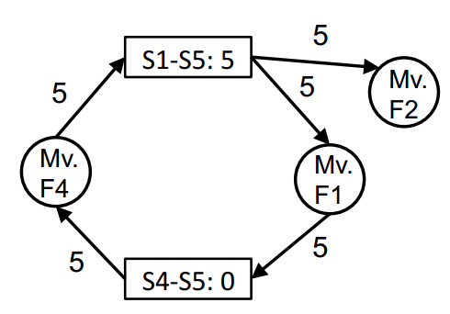
Dionysus dependency graph
Current State
F5: 10
Nodes: updates and resources
Edges: dependencies among nodes
S1
S2
S3
F2: 5
F1: 5
F4: 5
S4
S5
F3: 5
Target State
F5: 10
S1
S2
S3
F2: 5
F3: 10
F1: 5
F4: 5
F3: 5
S4
S5
Notes:
Not all orderings; just many

Slide 35
Dionysus scheduling
NP-complete problem with capacity and memory constraints
Approach
Critical path scheduling
Treat strongly connected components as virtual nodes and favor them
Rate limit flows to resolve deadlocks

Slide 36
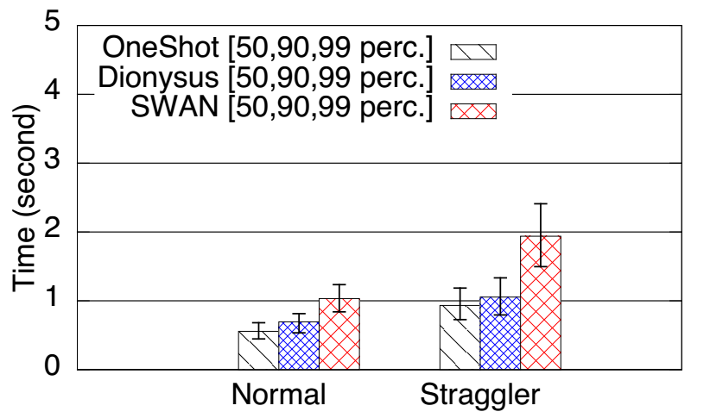
Dionysus leads to faster updates
Median improvement over static scheduling (SWAN): 60-80%

Slide 37
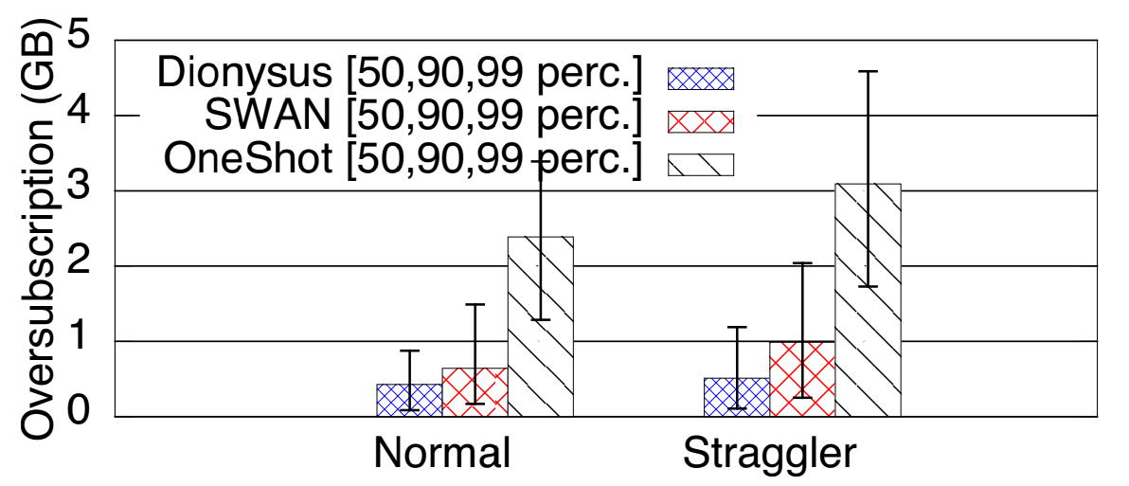
Dionysus reduces congestion due to failures
99th percentile improvement over static scheduling (SWAN): 40%

Slide 38
Fast, consistent network updates
Routing policy
Consistency property
Current network state
Desired state generator
Target network state
Update planner
Update plan
Forward fault correction Computes states that are robust to common faults
Dionysus Dynamically schedules network updates
Notes:
Symbiotic relationship between FFC and Dionysus:
FFC allows Dionysus to end without finishing the updates. Forget about those stragglers.

Slide 39
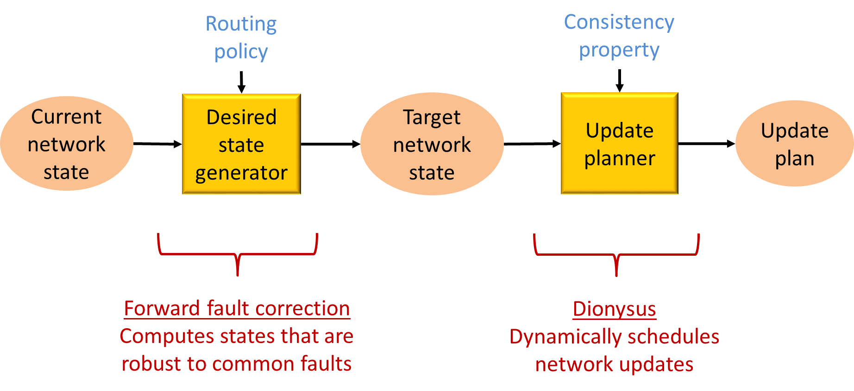
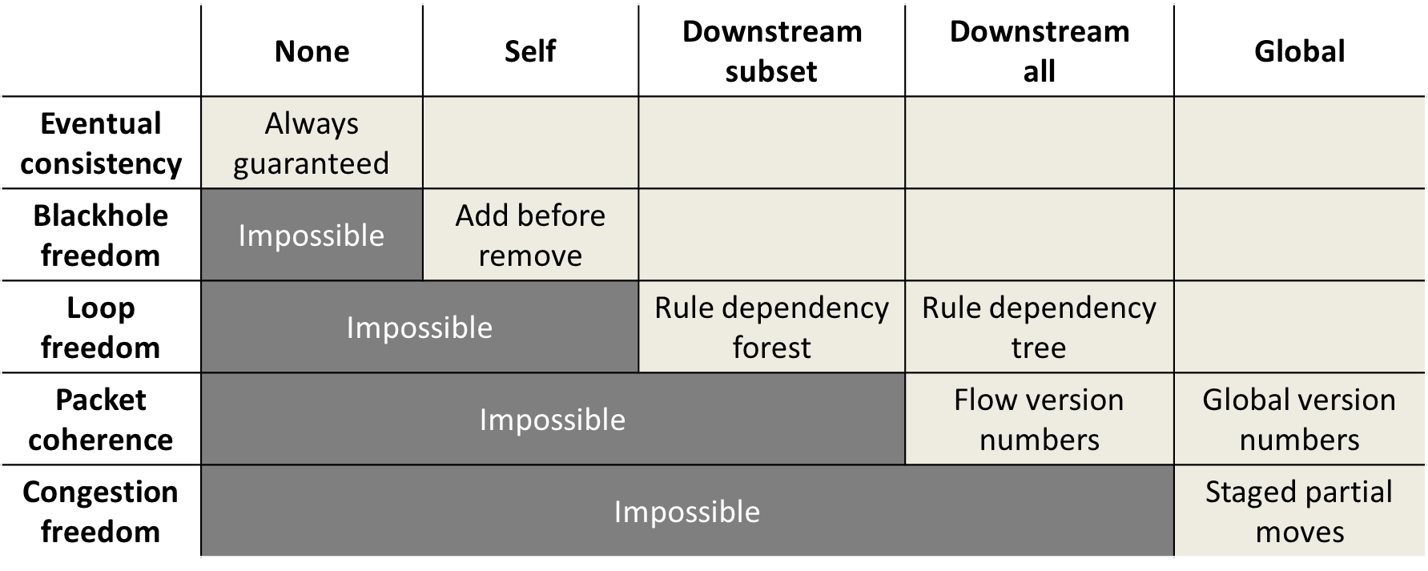
Summary
SDN enables new network operating points such as high utilization
But also pose a new challenge: fast, consistent data plane updates
Notes:
What we’ve found in our work is that SDN can enable new, highly attractive operating points for the network.
Fully realizing its benefits also requires us to address a new challenge.
If we are not careful, the accrued benefits could be lost.
- Today, utilization is kept low so as to avoid congestion after failures.
- But we saw that congestion could occur during data plane updates.
The problem of data plane updates is rich.
- Fundamental results on what is possible and how are waiting to be uncovered.
- As well as practical systems need to be built
I presented some of our early work in this direction.
On the theoretical side, we analyzed minimal dependency structures that are induced by various consistency properties.
On the practical side, we are developing techniques to compute robust data plane states.
And techniques to quickly and safely apply updates.

