Slide 1

SWAN: Software-driven wide area network
Ratul Mahajan

Slide 2


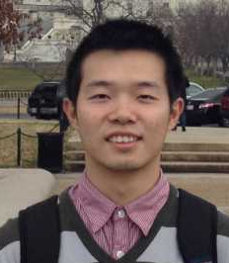





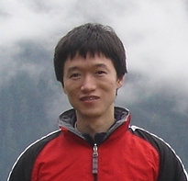

Partners in crime
Chi-Yao Hong
Rohan Gandhi
Xin Jin
Harry Liu
Vijay Gill
Srikanth Kandula
Ratul Mahajan
Mohan Nanduri
Ming Zhang
Roger Wattenhofer

Slide 3
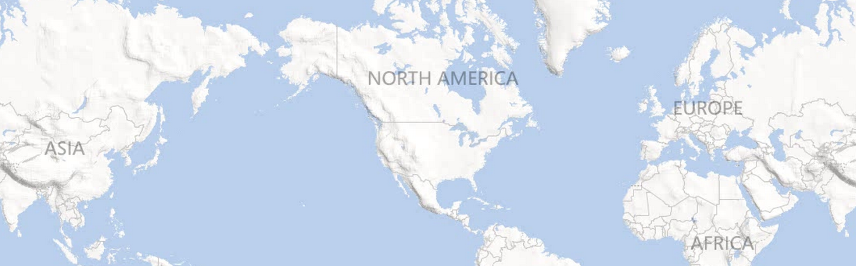
Inter-DC WAN: A critical, expensive resource
Dublin
Seattle
New York
Seoul
Barcelona
Los Angeles
Miami
Hong Kong
Notes:
Services need inter-DC WAN for performance and reliability.
100s of Gbps capacity over long distances.
Costs 100s of millions of dollars amortized annually.

Slide 4
But it is highly inefficient
Notes:
Even the busiest links are used 40-60% of the time.

Slide 5
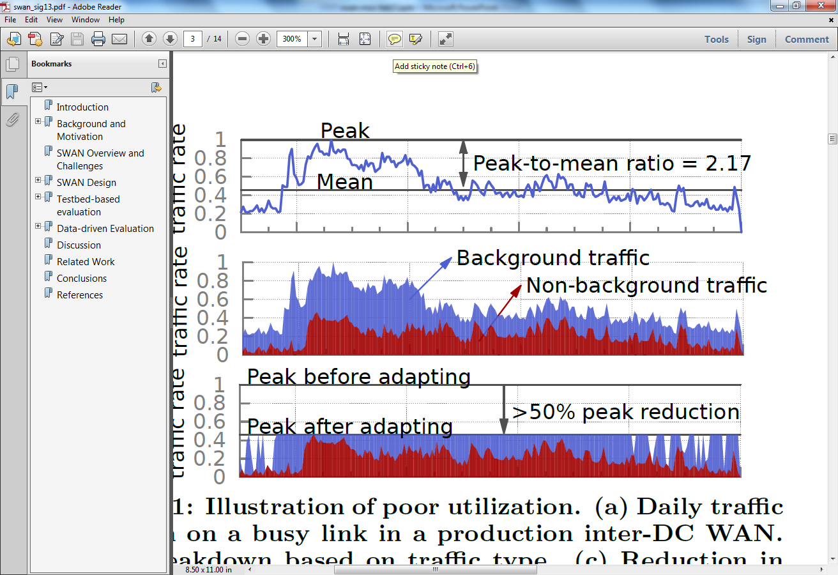
One cause of inefficiency: Lack of coordination
Notes:
Services send when they want and however much they want.
- leads to cycles of over and under-subscription
Poor utilization can be countered by leveraging traffic characteristics.
- some traffic can be delayed
Adapting this traffic will allow a smaller network to carry the same traffic or allow more traffic to be carried over a network.

Slide 6
Another cause of inefficiency: Local, greedy resource allocation
B
C
D
B
C
D
A
A
E
E
H
G
F
H
G
F
Local, greedy allocation
Globally optimal allocation
[Latency inflation with MPLS-based traffic engineering, IMC 2011]
Notes:
Explain MPLS and tunnels.
Sub-optimality was observed in practice. [IMC paper]

Slide 7
SWAN: Software-driven WAN
Goals
Key design elements
Highly efficient WAN
Flexible sharing policies
Coordinate across services
Centralize resource allocation
[Achieving high utilization with software-driven WAN, SIGCOMM 2013]
Notes:
Want network utilization to be upwards of 95% from the current standard of 40-60%
High efficiency alone is trivial to achieve; must support policies.
Strict priority classes
Max-min fair within a class

Slide 8

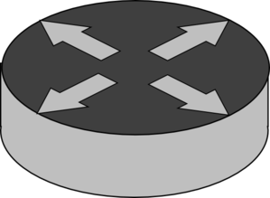

Software-defined networking: Primer
Networks today
Beefy routers
Control plane: distributed, on-board
Data plane: indirect configuration
SDNs
Streamlined switches
Control plane: centralized, off-board
Data plane: direct configuration
Notes:
Beefy routers are expensive
Control logic:
- Distributed means that its inefficient and does not enable direct, flexible control
- On-board means that bugs take a long time to detect and resolve
Streamlined switches:
retain only the forwarding component
Centralized control logic:
Centralized means its direct and flexible
We write it means that we have quickly detect and resolve issues
Network allocation is programmed directly into the forwarding filters

Slide 9



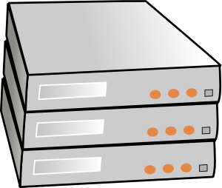
SWAN overview
SWAN controller
Traffic demand
Topology, traffic
BW allocation
Network config.
Service broker
Network agent
Rate limiting
WAN
Service hosts
Notes:
Bandwidth broker represents service hosts. Required for scalability and also allows for service-specific logic and policies.

Slide 10
Key design challenges
Scalably computing BW allocations
Avoiding congestion during network updates
Working with limited switch memory

Slide 11
Scalably computing allocation
Goal: Prefer higher-priority traffic and max-min fair within a class
Challenge: Network-wide fairness requires many MCFs
Approach: Bounded max-min fairness (fixed number of MCFs)
Notes:
Allocate resources to higher priority traffic first, along shorter paths.
Then allocate lower priority traffic.
Path-constrained, multi-commodity flow (MCF) problem
Faireness is hard because the exact solution requires linearly many MCFs
Solutions exist with fancier search functions that reduce the number of LPs
Our solution offers bounded fairness with provable bounds on the degree of unfairness
Fixed number of iterations

Slide 12








Bounded max-min fairness
$$α3U$$
demand $d_{5}$
demand $d_{4}$
$$α2U$$
demand $d_{3}$
$$αU$$
demand $d_{2}$
demand $d_{1}$
Geometrically partition the demand space with parameters $α and U$

Slide 13

Bounded max-min fairness
$$α3U$$
demand $d_{5}$
demand $d_{4}$
$$α2U$$
demand $d_{3}$
$$αU$$
demand $d_{2}$
demand $d_{1}$
Maximize throughput while limiting all allocations below $αU$

Slide 14

Bounded max-min fairness
$$α3U$$
demand $d_{5}$
demand $d_{4}$
$$α2U$$
demand $d_{3}$
$$αU$$
demand $d_{2}$
demand $d_{1}$
Maximize throughput while limiting all allocations below $αU$

Slide 15






Bounded max-min fairness
$$α3U$$
demand $d_{5}$
demand $d_{4}$
$$α2U$$
demand $d_{3}$
$$αU$$
demand $d_{2}$
demand $d_{1}$
Fix the allocation for smaller flows

Slide 16

Bounded max-min fairness
$$α3U$$
demand $d_{5}$
demand $d_{4}$
$$α2U$$
demand $d_{3}$
$$αU$$
demand $d_{2}$
demand $d_{1}$
Continue until all flows fixed

Slide 17


Bounded max-min fairness
$$α3U$$
demand $d_{5}$
demand $d_{4}$
$$α2U$$
demand $d_{3}$
$$αU$$
demand $d_{2}$
demand $d_{1}$
Fairness bound: Each flow is within $\left[\frac{1}{α}, α\right]$ of its fair rate
Number of MCFs: $\log_{α}{\frac{max⁡(di) }{U}}$
Notes:
“practice”

Slide 18
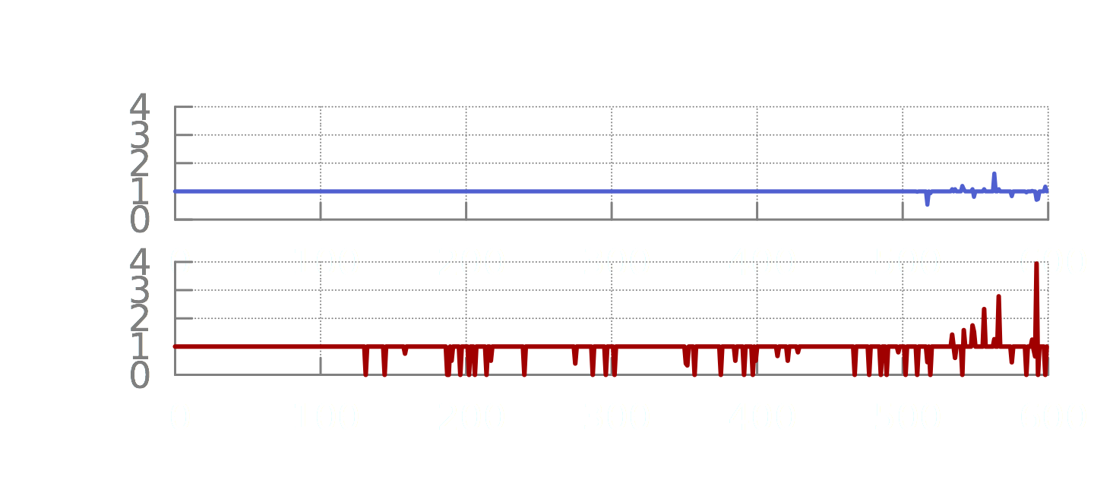
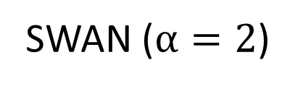
SWAN computes fair allocations
Relative deviation
MPLS TE
Relative deviation
SWAN ($α=2$)
Flows sorted by demand
In practice, only 4% of the flows deviate more than 5%

Slide 19
Key design challenges
Scalably computing BW allocations
Avoiding congestion during network updates
Working with limited switch memory
Notes:
For scalable computations, we played several other tricks too, which I won’t get into.

Slide 20
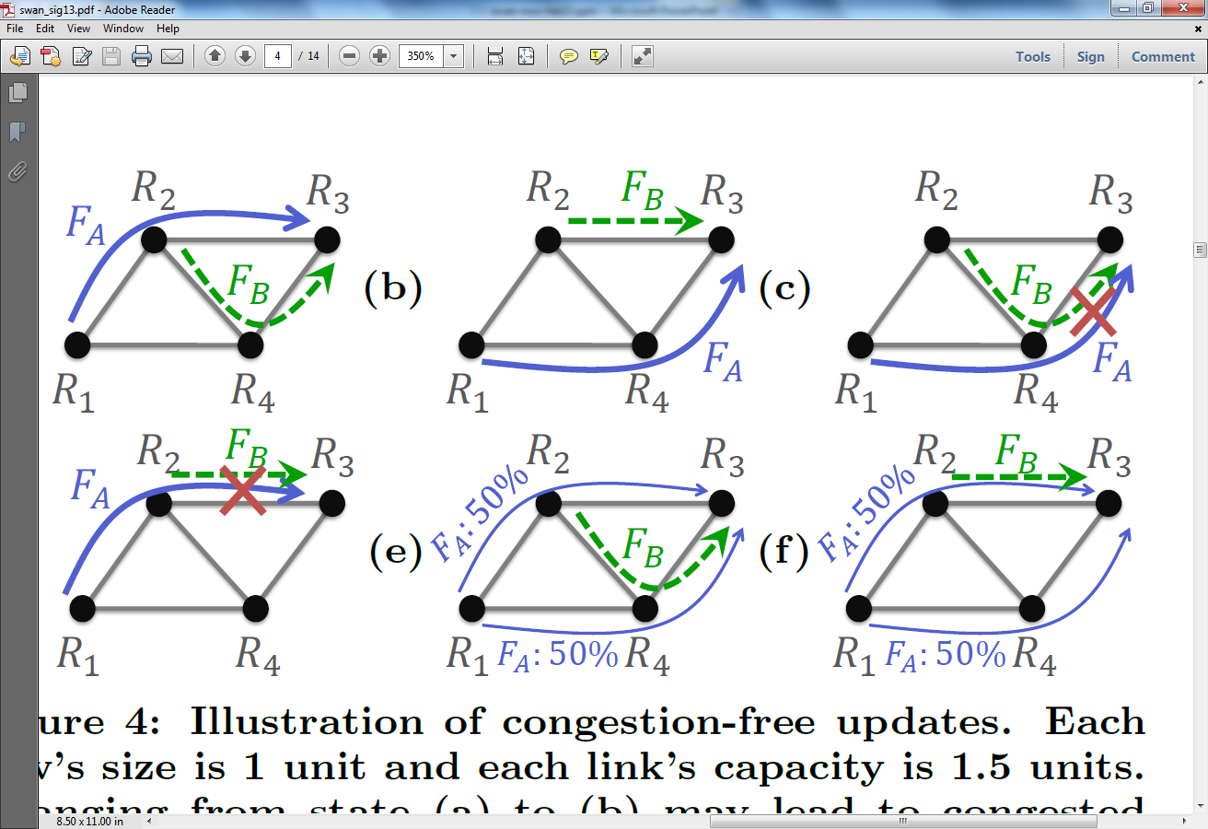
Congestion during network updates

Slide 21
Congestion-free network updates

Slide 22
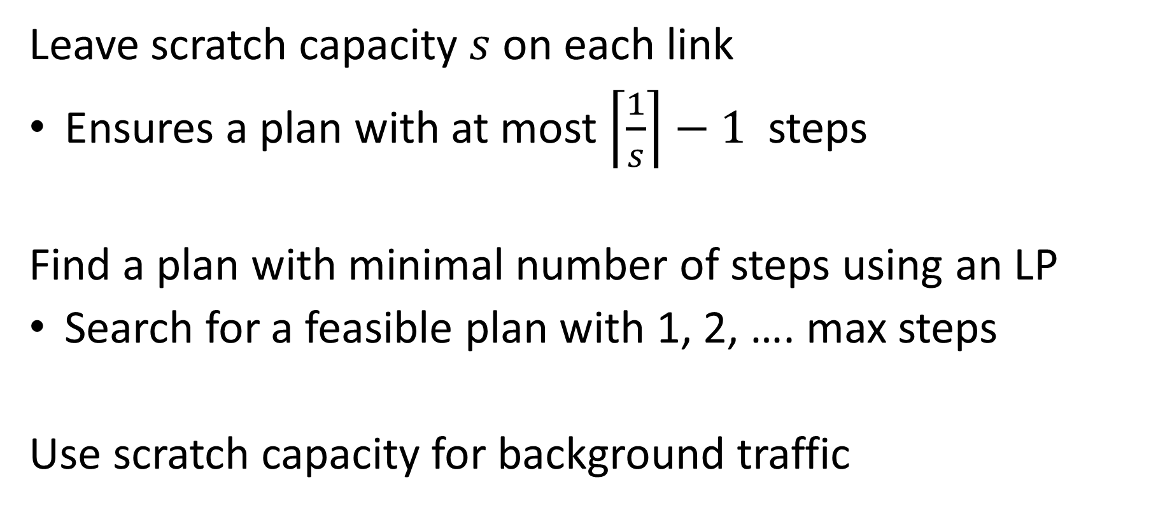
Computing congestion-free update plan
Leave scratch capacity $s$ on each link
Ensures a plan with at most $\left\lceil \frac{1}{s}\right\rceil −1$ steps
Find a plan with minimal number of steps using an LP
Search for a feasible plan with 1, 2, …. max steps
Use scratch capacity for background traffic

Slide 23
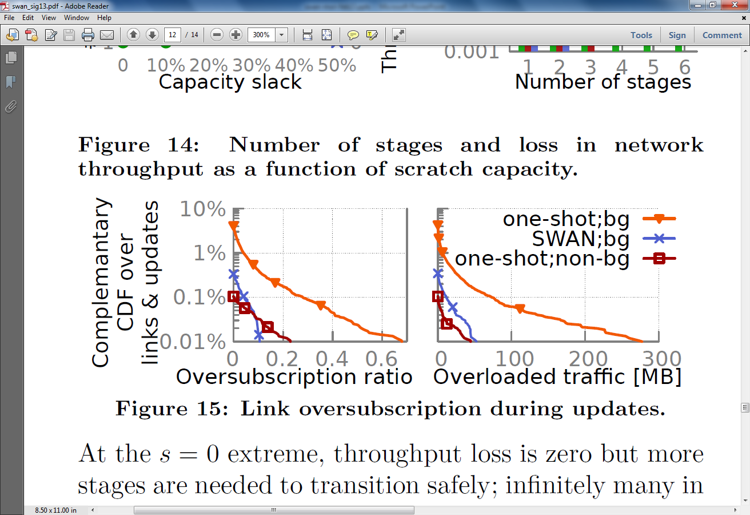
SWAN provides congestion-free updates
Complementary CDF
Oversubscription ratio
Extra traffic (MB)

Slide 24
Key design challenges
Scalably computing BW allocations
Avoiding congestion during network updates
Working with limited switch memory

Slide 25
Working with limited switch memory
Notes:
Fully using capacity requires using many paths through the network.
Each path needs memory at switches.
Analysis shows:
If we take the demand matrix across time, the number of paths required exceeds the capacity of even next generation switches.
Current generation switches will lead to a big loss in utilization.

Slide 26
Working with limited switch memory
Install only the “working set” of paths
Use scratch capacity to enable disruption-free updates to the set
Notes:
Observation: at any given instant the number of paths required is much smaller.

Slide 27
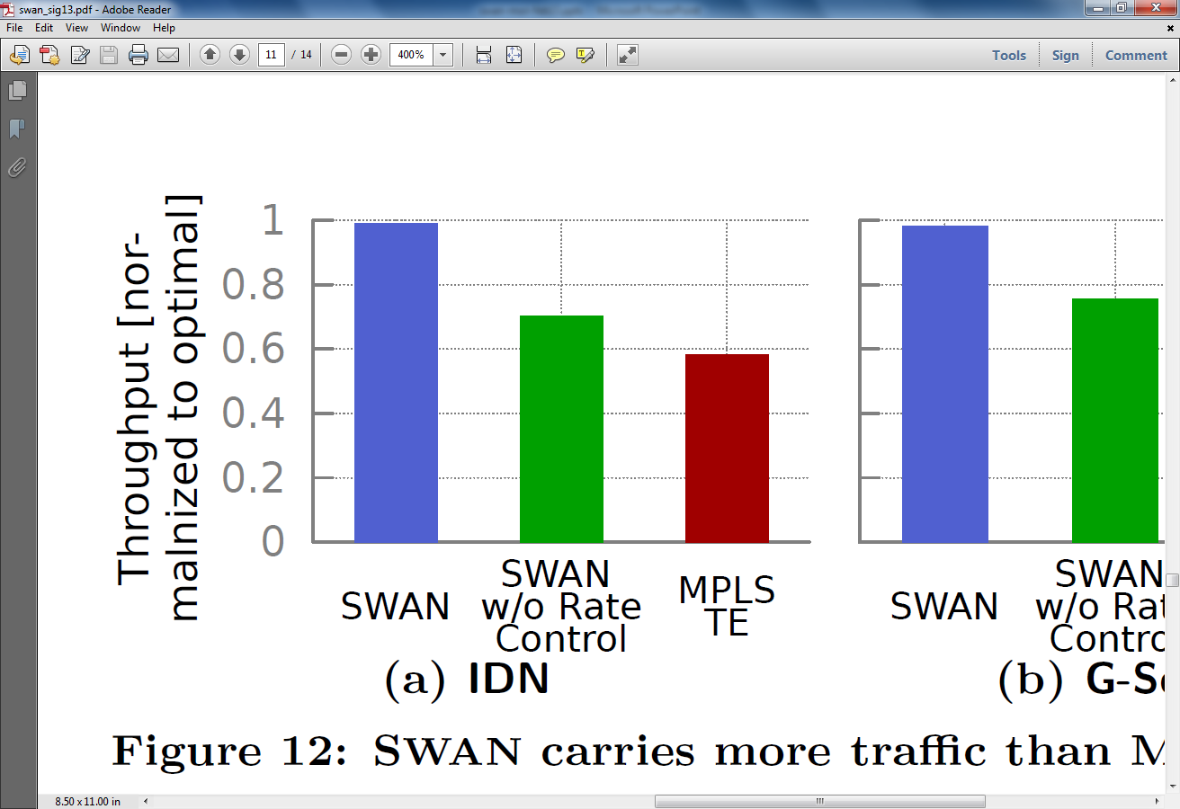
SWAN comes close to optimal
Throughput
(relative to optimal)
SWAN
SWAN
w/o rate control
MPLS TE

Slide 28
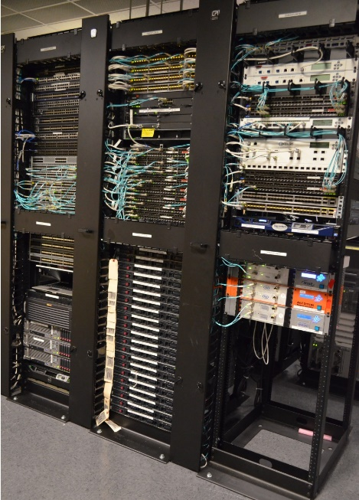

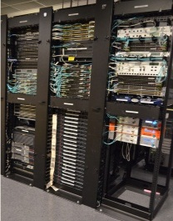

Deploying SWAN in production
WAN
WAN
Data center
Data center
Lab prototype
Partial deployment
Full deployment

Slide 29

Key lesson from using SDNs
Notes:
Promise of SDNs:
- You can configure your network just the way you want it
- Direct control can avoid convergence issues of distributed protocols such as loops, drops, and other uncertainties
Reality today:
- Bad things still happen in between stable states
Change is hard
http://blog.richmond.edu/rapmusic/2012/10/20/tricia-rose-on-obama-2/

Slide 30
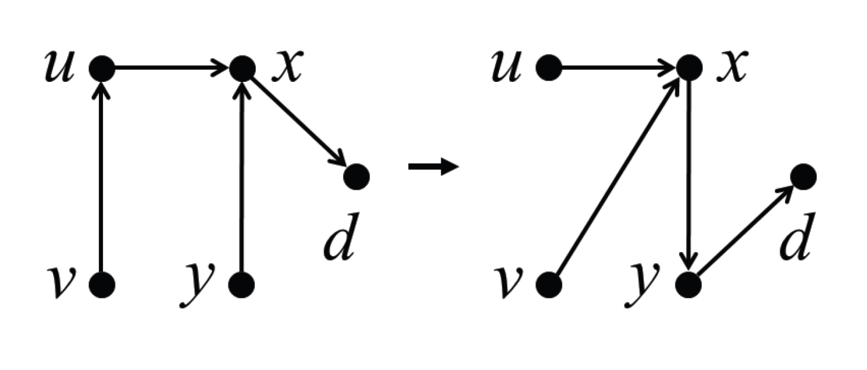
Loops in SDNs
Notes:
The problem is more general than congestion
Loops.
Avoiding these issues requires careful orchestration of updates.
When a switch can be safely updated depends on whether certain other switches have been updated
This thus introduces dependencies between switches

Slide 31
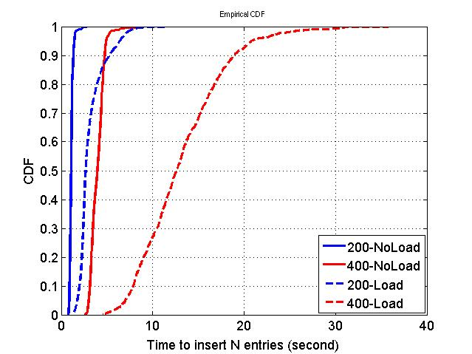
Dependencies are worse than you might think

Slide 32
Ongoing work: Robust, fast network updates
Understand fundamental limits
Develop practical solutions
Notes:
We need to understand fundamental limits: what dependencies are really essential.
And we need to develop practical solutions for network updates that are both fast in the presence of stragglers and robust when switch updates fail entirely.

Slide 33
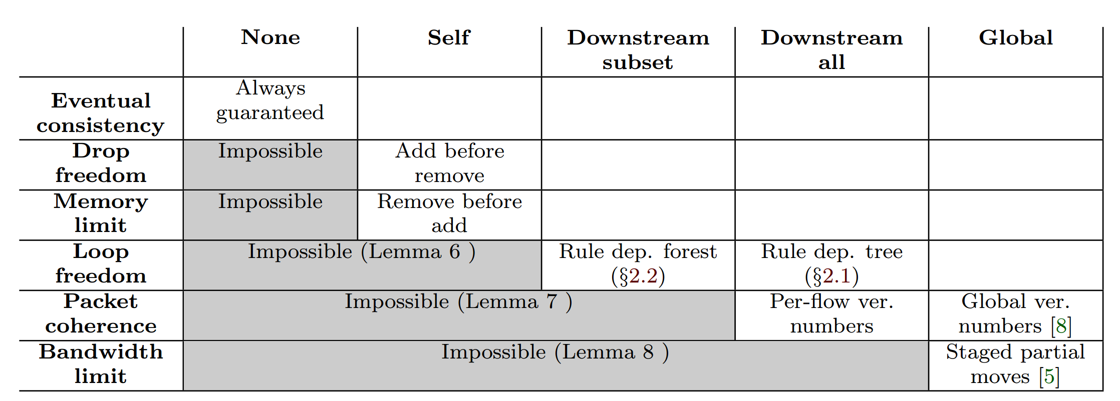
What are the minimal dependencies for a desired consistency property?
[On consistent updates in software-defined networks, HotNets 2013]

Slide 34
Network update pipeline
Routing policy
Consistency property
Network characteristics
Robust rule generation
Dependency graph generation
Update execution

Slide 35
Robust rule generation: Example
Notes:
Two questions:
- how to compute?
- how much throughput is lost?

Slide 36
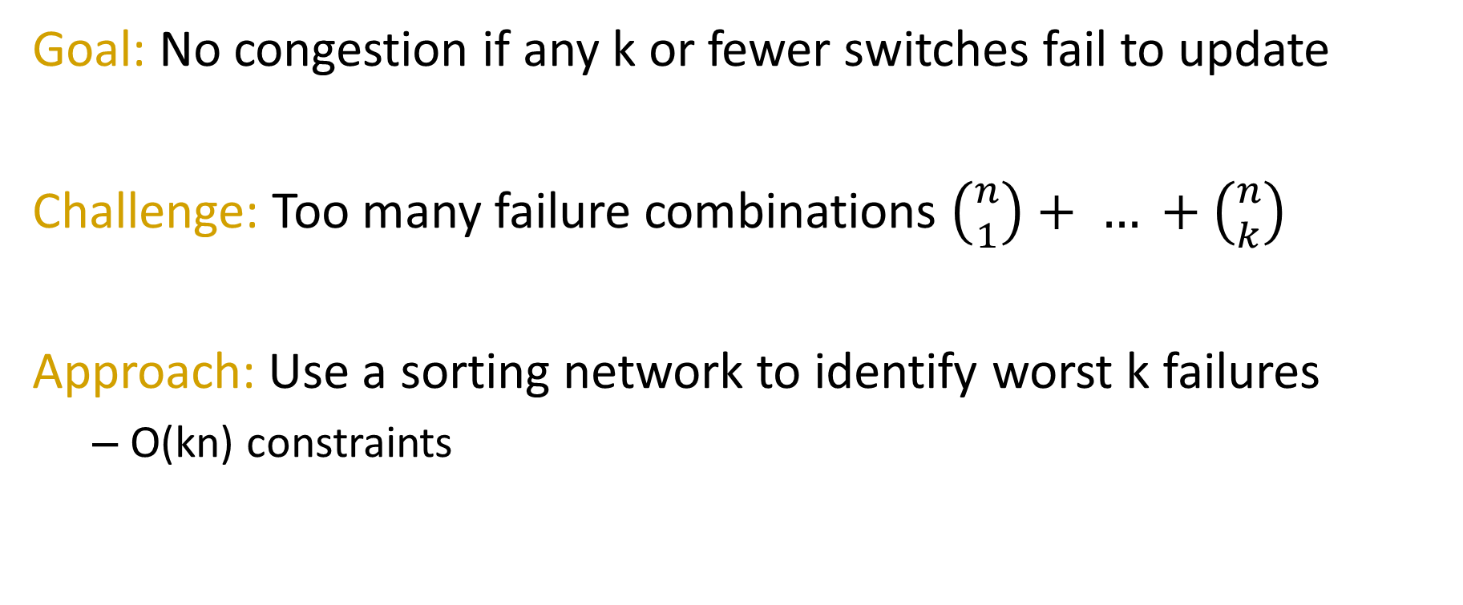
Robust rule generation
Goal: No congestion if any k or fewer switches fail to update
Challenge: Too many failure combinations $\left({n \atop 1}\right)+ … +\left({n \atop k}\right)$
Approach: Use a sorting network to identify worst k failures
O(kn) constraints

Slide 37
Robust rule generation: Preliminary results

Slide 38
Network update pipeline
Routing policy
Consistency property
Network characteristics
Robust rule generation
Dependency graph generation
Update execution

Slide 39
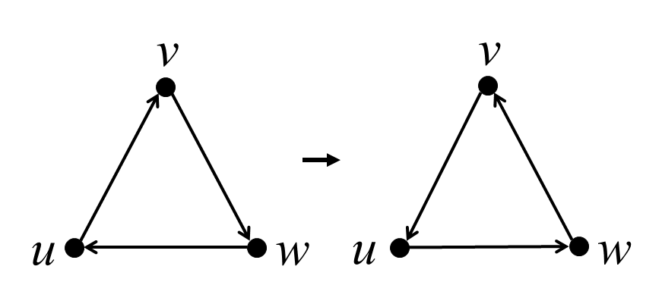



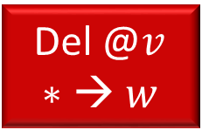

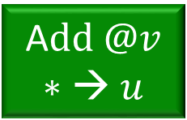
Dependency graph generation
A$dd @u$ $$∗→ w$$
Del @$u$ $$∗→ v$$
A$dd @v$ $$∗→ u$$
Del @$w$ $$∗→ u$$
Add @$w$ $$∗→ v$$
Del @$v$ $$∗→ w$$

Slide 40
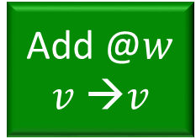
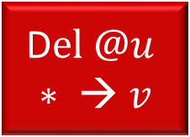
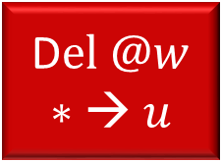
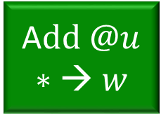
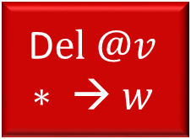
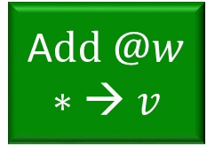
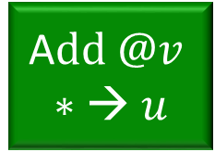
Update execution
Updates without parents can be applied right away
Break any cycles and shorten long chains
Add @$w$ $$v →v$$
A$dd @u$
$$∗→ w$$
D$el @u$
$$∗ → v$$
A$dd @v$
$$∗→ u$$
D$el @w$
$$∗→ u$$
A$dd @w$
$$∗→ v$$
D$el @v$
$$∗ → w$$

Slide 41
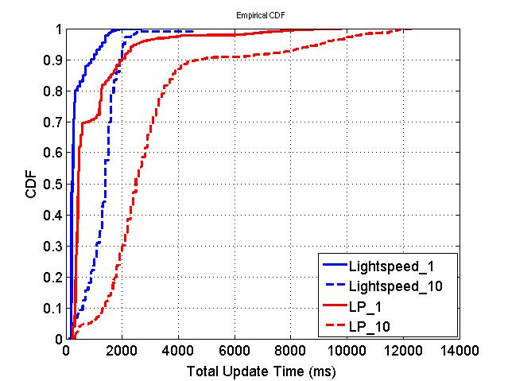
Update execution: Preliminary results

Slide 42
Summary
SWAN yields a highly efficient and flexible WAN
Coordinated service transmissions and centralized resource allocation
Bounded fairness for scalable computation
Scratch capacities for “safe” transitions
Change is hard for SDNs
Need to understand fundamental limits, develop practical solutions
Notes:
We set out to build a wide area network that was highly efficient, raising efficiency from the current levels of under 50% to over 95%.
We realized that the current inefficiency stems from services sending in an uncoordinated manner,
- Drove the network from periods of extremely high usage to periods of low usage.
The opportunity was to fix this by coordinating when and how much services send, thus flattening the overall utilization curve, and filling the valleys with low priority traffic.
In realizing this architecture, we had to address several challenges.

