Slide 1
Using redundancy to enable interactive connectivity for moving vehicles
Ratul Mahajan
Microsoft Research
Collaborators: Aruna Balasubramanian, Jitu Padhye,
Sharad Agarwal, Abhinav Jain, Brian Levine, Arun Venkataramani, John Zahorjan, Brian Zill

Slide 2

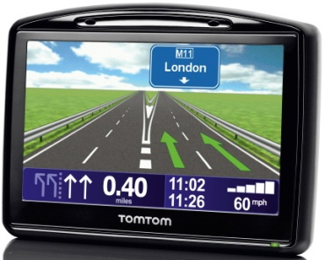
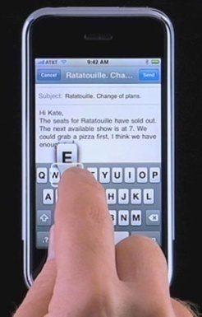
Increasing demand for connectivity from moving vehicles
Commuter Internet access
Seamless access between driving and being stationary
Navigation units
E.g., current traffic conditions
Many novel vehicular applications
E.g., radio guides of current regions

Slide 3
Example devices driving the growth
Smartphones
Navigation units

Slide 4
How to best enable such connectivity?
 | WLAN (E.g., WiFi) | WWAN (E.g., 3G, WiMax)
Cheaper
Higher peak txput
Longer range
More coverage
Interested in popular applications
Web browsing, VoIP, e-mail, …

Slide 5
This talk
Considers each possibility and shows that challenges are similar
Packet loss, inconsistent connectivity lead to poor performance for interactive applications
QoS mechanisms of wired networks do not work
Advocates the use of available redundancy
ViFi uses redundant BSes for WLAN settings
PluriBus uses redundant capacity for WWAN settings
Wiffler uses redundant technology

Slide 6
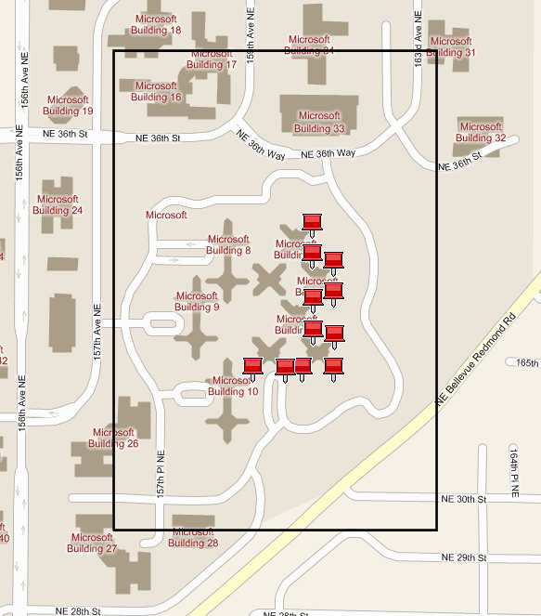
VanLAN: Our vehicular testbed
Uses MS campus shuttles as vehicular clients
WiFi, EVDO (Sprint), WiMax (Clearwire)
Zero driving overhead but limited control
11 WiFi basestations

Slide 7
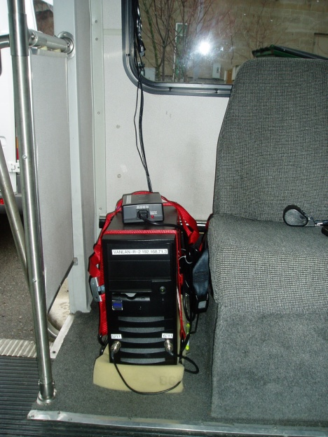
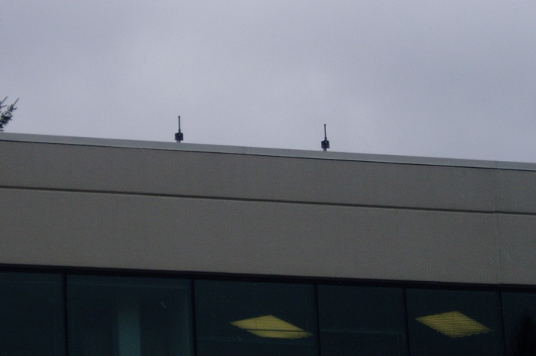
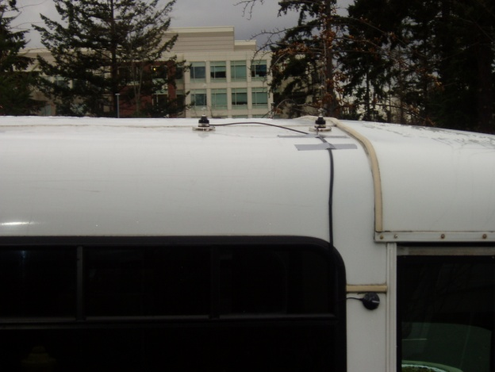
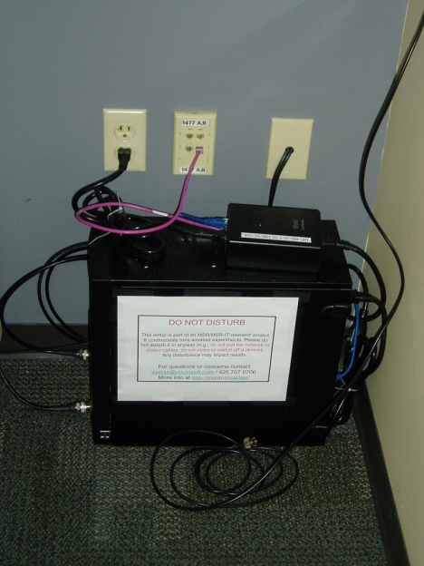
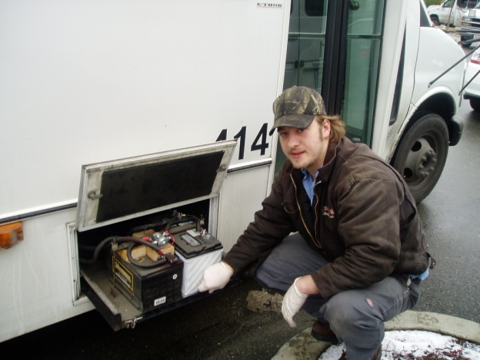
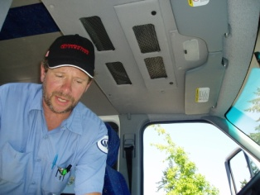
Deployment of VanLAN

Slide 8
WiFi and moving vehicles
Motivation for using WiFi:
Inexpensive, higher peak throughput
Increasing ubiquity can make it a useful option
City-wide meshes, enterprise campuses, hotspots and open APs
Key question: Can popular applications be supported using WiFi today?
E.g., VoIP, Web browsing
Our answer: Yes, by leveraging base station redundancy

Slide 9
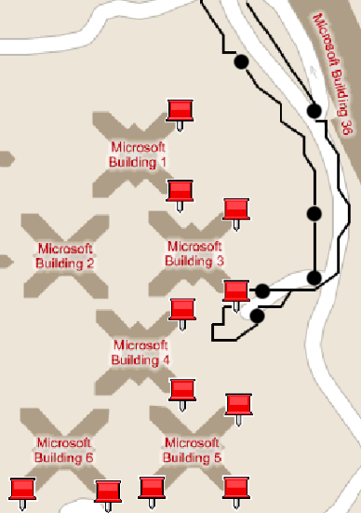
Experience of a moving vehicle using WiFi
Disruptions (high packet loss)
Disruptions have small impact on non-interactive apps
But really hurt interactive apps

Slide 10
How to reduce disruptions?
Traditional mechanisms have limited effectiveness
Prioritization
Over provisioning
Retransmissions
Use redundant BSes in the vicinity

Slide 11


Wireless handoffs
Hard handoff
Clients talk to exactly one BS
Current 802.11
Soft handoff
Clients talk to multiple BSes

Slide 12
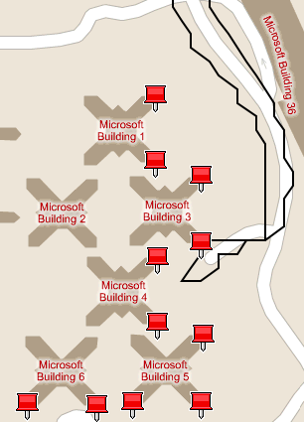
Comparing the two handoff policies
Disruption
Hard handoff
Soft handoff (ideal)

Slide 13
Designing a practical soft handoff policy
Internet
Goal: Leverage multiple BSes in range
Inter-BS backplane is bandwidth-constrained
Ensure timely delivery of packets
Cannot do fine-grained scheduling of packets
These constraints rule out known diversity solutions

Slide 14
ViFi overview
C
Vehicle chooses anchor BS
Anchor responsible for vehicle’s packets
Vehicle chooses a set of BSes in range to be auxiliaries
Leverage packets overheard by auxiliaries
A
B
D
Internet

Slide 15
ViFi protocol
C
Downstream (to vehicle)
Source
Source transmits a packet
If destination receives, it transmits an ack
If auxiliary overhears packet but not ack, it probabilistically relays to destination
If destination received relay, it transmits an ack
If no ack within retransmission interval, source retransmits
A
B
Dest
D
C
Upstream (from vehicle)
Dest
A
B
Source
D

Slide 16
Why is relaying effective?
Losses are bursty
Losses are independent
Different senders → receiver
Sender → different receivers
C
C
A
B
A
B
D
D
Downstream: To vehicle
Upstream: From vehicle

Slide 17
Probability computation
Based on the knowledge of available auxiliaries and their connectivity to the destination
Makes a collective decision and limit the total number of relays
Prefers auxiliaries with better connectivity to destination
No per-packet coordination

Slide 18
ViFi implementation and evaluation
Implementation requires only software changes
Built on top of ad hoc mode
Uses broadcast mode transmissions
Evaluation based on deployment on VanLAN
Results verified on another testbed

Slide 19
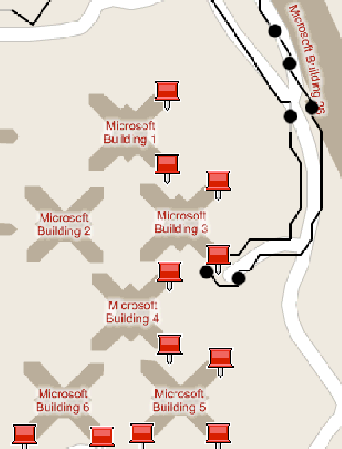
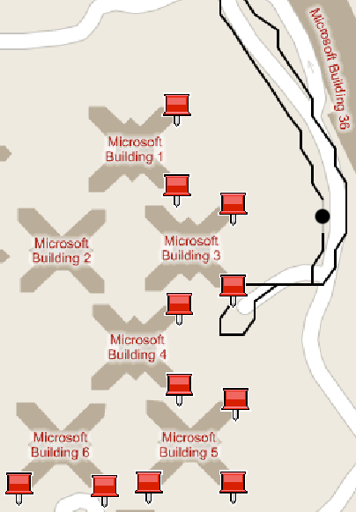
ViFi reduces disruptions
WiFi
ViFi

Slide 20
ViFi improves VoIP performance
> 100%
Length of voice call before disruption (seconds)
ViFi
WiFi
Traffic generated per G.729 codec
Disruption: when MoS < 2

Slide 21
ViFi improves Web browsing performance
> 50%
> 100%
ViFi
WiFi
ViFi
WiFi
Number of transfers before a stalled download
Median transfer time (seconds)
Workload: Repeated downloads of a 10 KB file

Slide 22
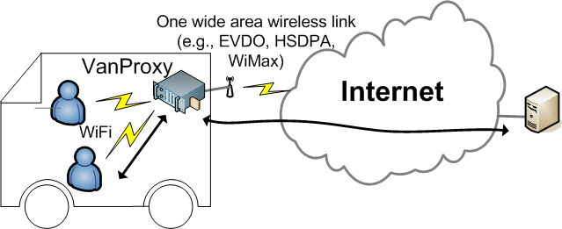
WWAN and moving vehicles
Motivation for using WWAN:
Almost ubiquitous
All-you-can-eat plans
Key question: Can applications that need a high degree of reliability be supported?
Our answer: Yes, by leveraging redundant capacity

Slide 23
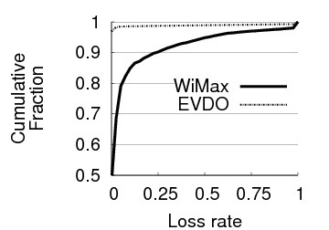
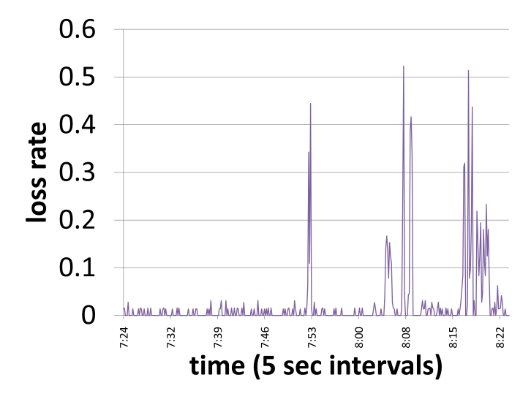
Packet loss in the WWAN environment
WiMax
Expectation setting by network operators:
“there can be lapses in the backhaul coverage or system congestion”
“cancel a failed download and re-try in approximately 5 minutes”
Paths can have high loss rates

Slide 24
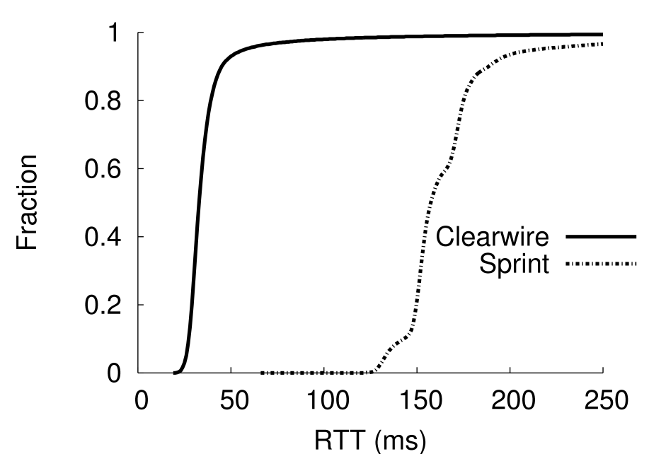
How to combat packet loss?
Traditional mechanisms have limited effectiveness
Prioritization
Over provisioning
Retransmissions
No control over BSes
Uses redundant path capacity through erasure coding
WiMax
CDF
EVDO
RTT (ms)

Slide 25
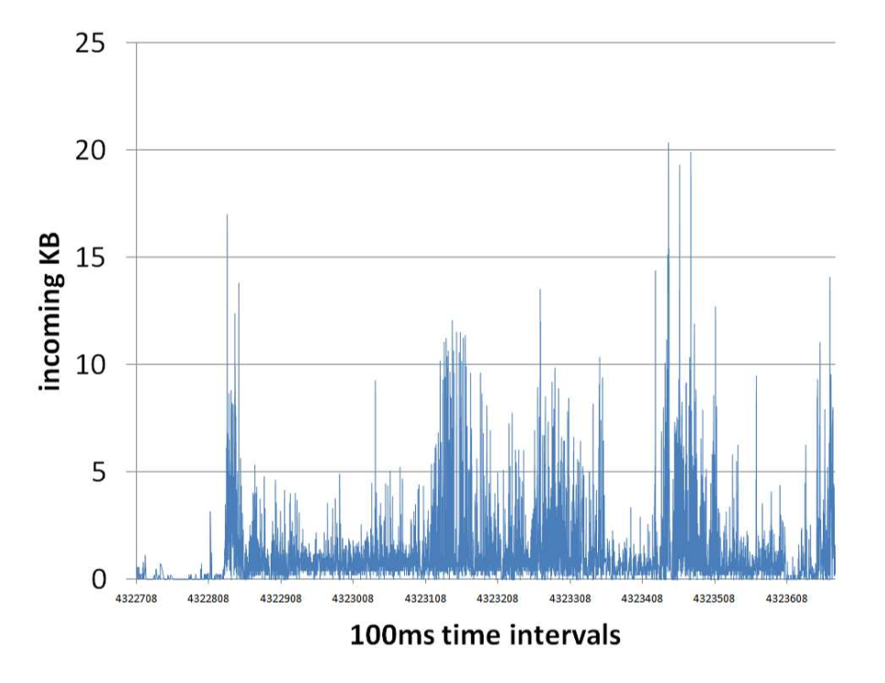
Existing erasure coding systems
Amount of overhead independent of load
Redundant packets can steal capacity from data packets
Under-protect even where additional capacity is available
Rely on receiving a threshold number of packets
Hard to guarantee when losses and data rate are bursty

Slide 26
Opportunistic erasure coding
Send coded packets when and only when there is instantaneous spare capacity in the system
Minimal interference and maximal protection for data
→
Evolution codes greedily maximize the amount of data recovered by each coded packet
No reliance on receiving a threshold number of packets
→

Slide 27
Evolution codes (1/2)
Encode over a window of packets sent in the last round trip time
Aim for greedy, partial recovery of packets
Let W = window of packets; and r = fraction of packets at the receiver
Assume all packets have the same probability
Use the XOR operator for encoding packets

Slide 28
Evolution codes (2/2)
What should be the degree of a coded packet?
Expected yield with degree x Y(x) = x ∙ (1 – r) ∙ r^{x-1}
The yield is maximized for x = -1 / log(r)
Higher r => higher degree

Slide 29
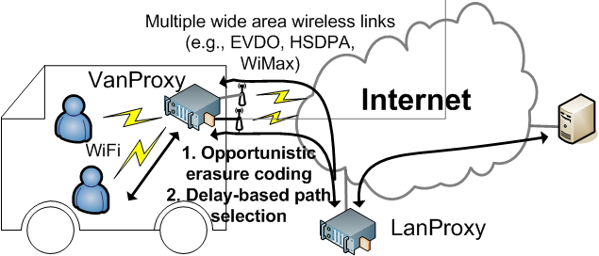
Implementation of PluriBus

Slide 30
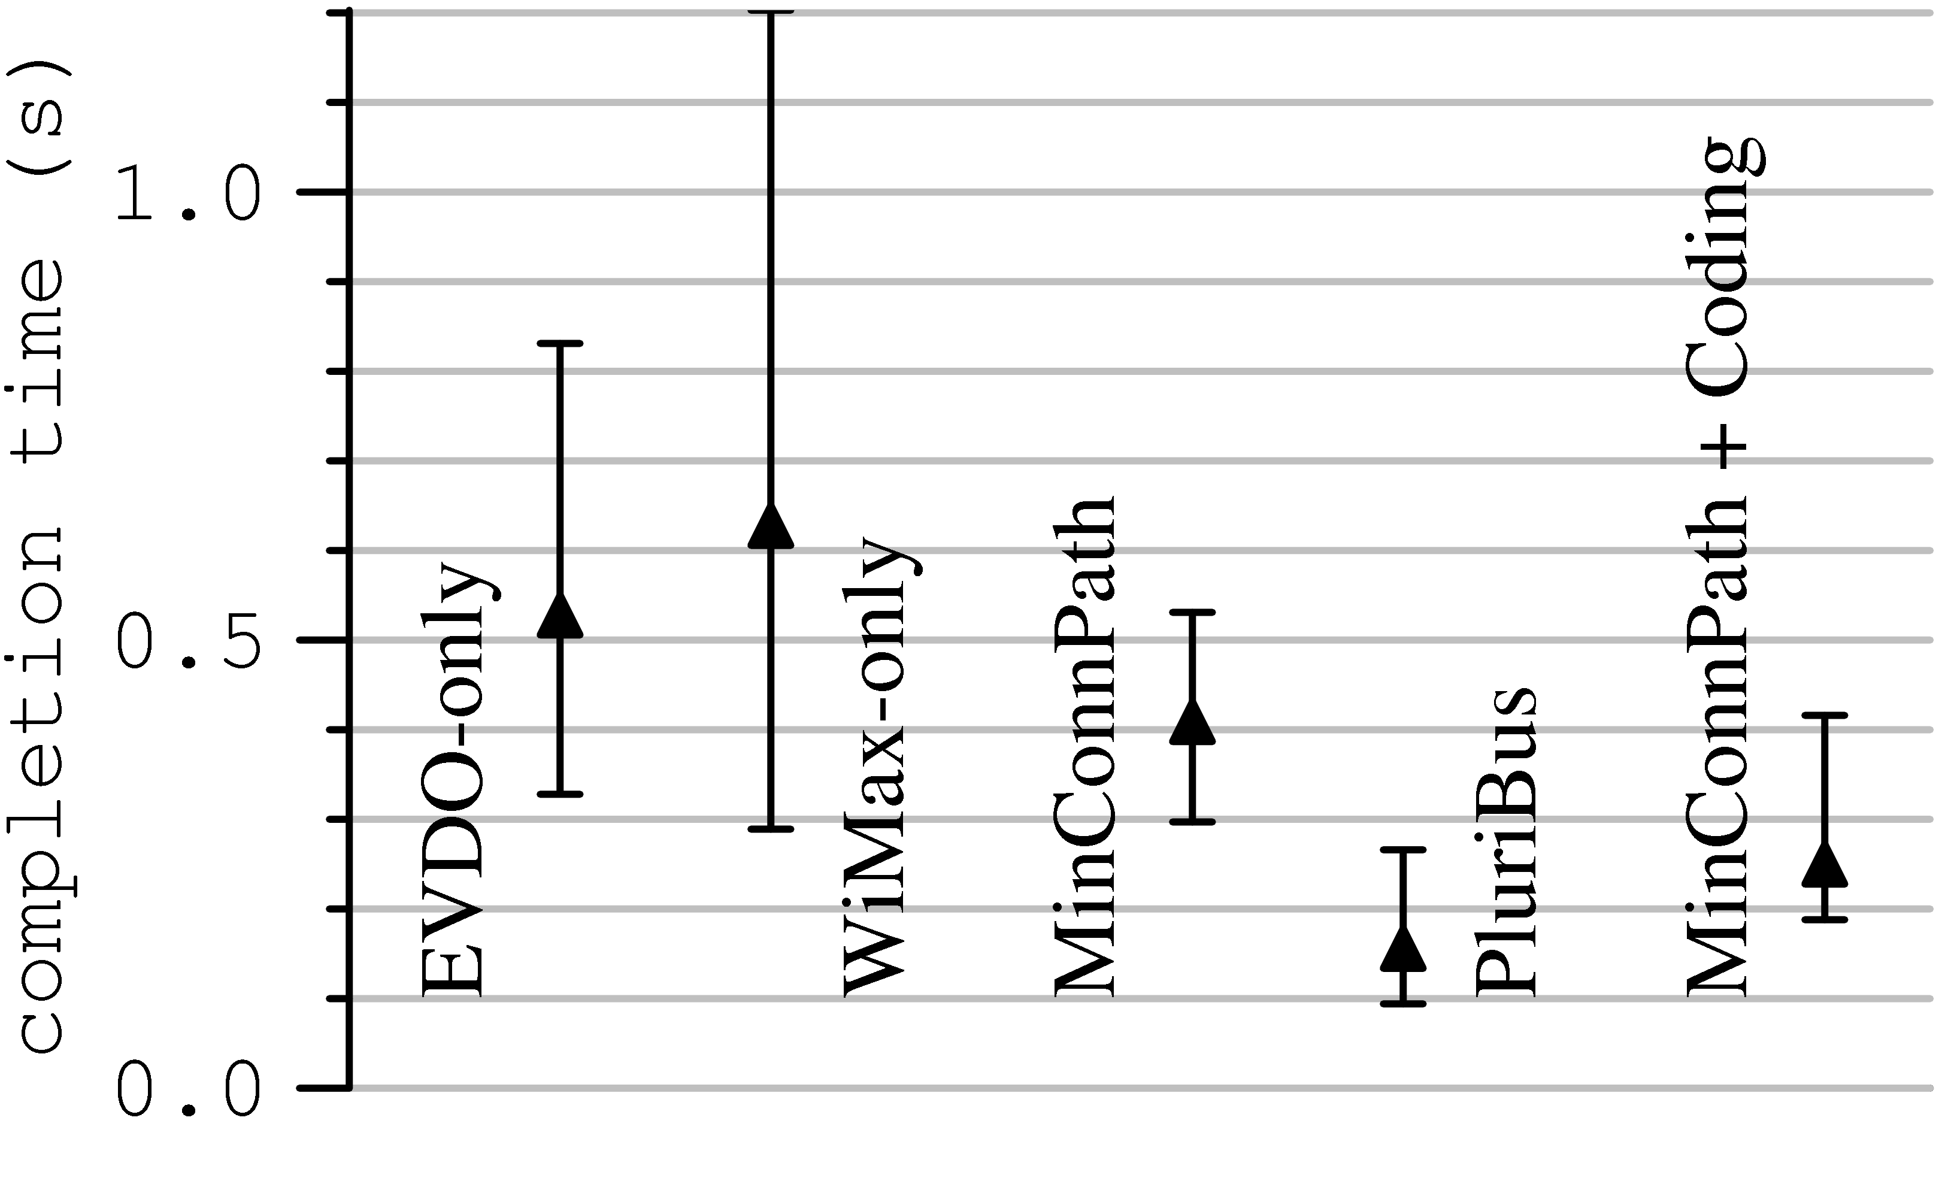
Performance of PluriBus
Workload mimics that observed on the MS Connector

Slide 31
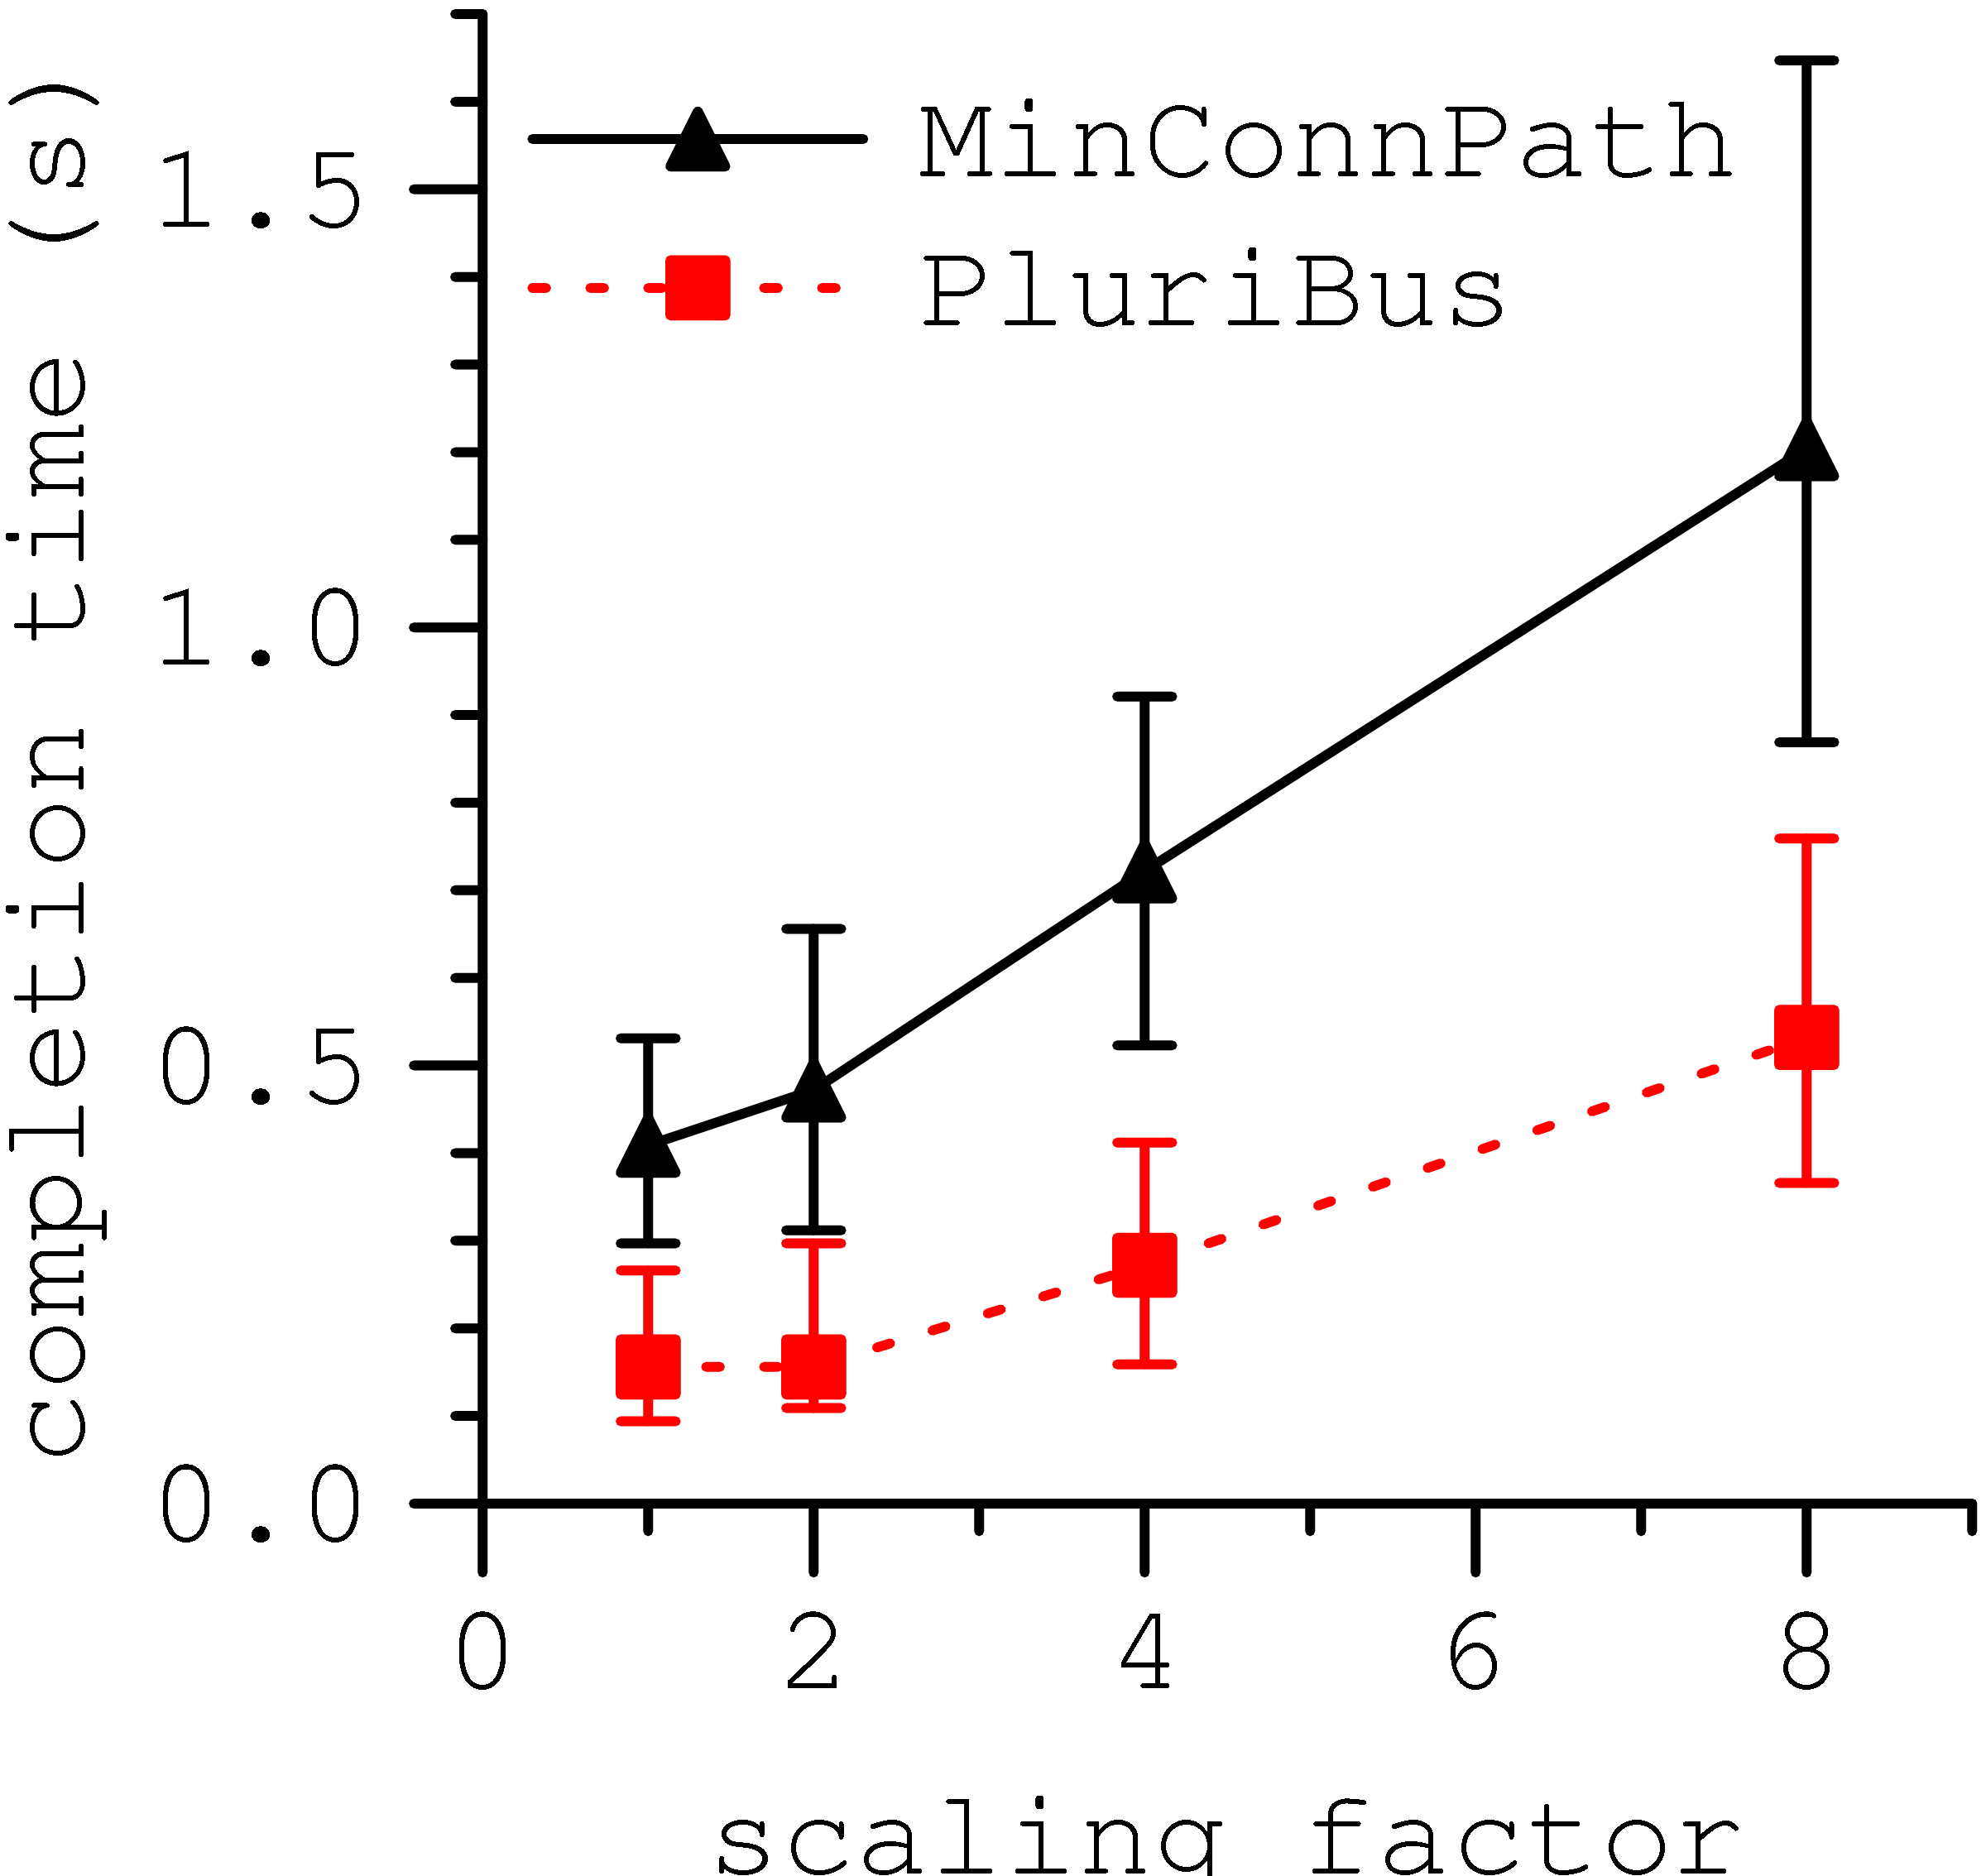
Performance as a function of load

Slide 32
WiFi or 3G?
 | WiFi | 3G
Cheap
Coverage
The two have disparate features
Why not use both?
WiFi where available, 3G as backup
Use of redundancy in technology
Early results on Wiffler
Negative correlation between WiFi and 3G availability
Application patience helps immensely
 | WiFi + 3G
Cheap
Coverage

Slide 33
Conclusions
Providing high performance connectivity aboard moving vehicles is particularly challenging for interactive apps
Traditional mechanisms to counter packet losses are not effective
Using available redundancy is a promising approach
ViFi uses redundant base stations
PluriBus uses redundant capacity
Both systems deployed and tested on a real vehicular testbed
More details at http://research.microsoft.com/vanlan/

