Slide 1
Augmenting Mobile 3G Using WiFi
Aruna Balasubramanian
Ratul Mahajan Arun Venkataramani
University of Massachusetts Microsoft Research

Slide 2
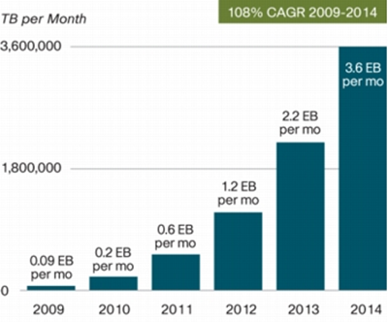
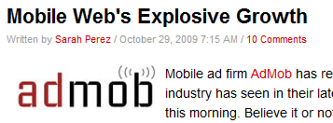
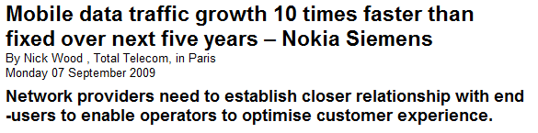
Mobile data is growing exponentially
http://www.readwriteweb.com
http://www.totaltele.com
CISCO VNI 2010
Notes:
Cisco: 39 times between 2009-2014
Admob: Three times over the past year
Nokia: growing ten times faster than fixed
All of this is understandable given the massive adoption of mobile devices such as smartphones.

Slide 3
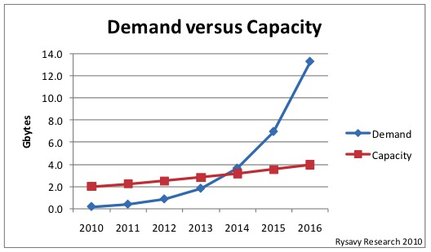
Demand projected to outstrip capacity
Notes:
Per person estimate by Peter Rysavy, based on allocated and allocated but unused capacity
In our smartphone measurements, some users are already consuming about 0.5GB a day.

Slide 4
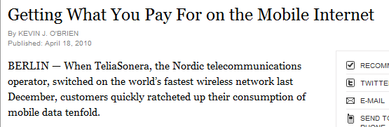
Is more spectrum the answer?
Current allocation | 409.5 MHz
Available but unallocated | 50 MHz
Projected demand by 2016 | 800-1000 MHz
“In light of the limited natural resource of spectrum, we have to look at the ways of conserving spectrum” -- Mark Siegel (AT&T)
http://www.nyt.com
Notes:
Demand can never be met given the drawn out process of reclaiming spectrum.
Carriers understand this and are already looking for other mechanisms.
All projections are based on current networks. But actual demand may be even higher.

Slide 5
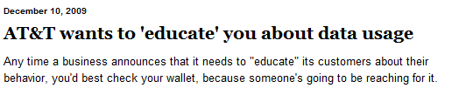
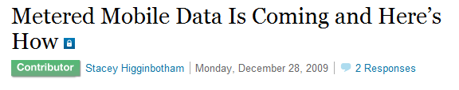

The BET of spectrum scarcity
http://blogs.chron.com/
Behavioral
Economic
Technical
Increase efficiency
Reduce usage
http://pro.gigaom.com/
http://connectedplanetonline.com
Notes:
All three are probably needed.
Our focus is on reducing usage.

Slide 6

Augmenting Mobile 3G using WiFi
Offload data to WiFi when possible
We look at vehicular mobility
Notes:
We are surrounded by WiFi and most devices have multiple interfaces.
Inspired by T-Mobile @ home
Particularly challenging case and increasing demand because of navigation-based applications. Offloading is less of a challenge when you are stationary – you can either do it or not – we wanted to see how much data can you offload when you are out and about.
Agnostic to business model

Slide 7
Our work
First joint study of 3G and WiFi connectivity
Can WiFi usefully augment 3G capacity?
Conducted across three cities
Wiffler: A system to offload data to WiFi
Increase offloaded data but respect app constraints
Deployed on 20 vehicles
Notes:
WiFi APs have short range and are typically not deployed to cover roads. Quality might be very poor.
The study shows that WiFi availability is low and its quality is poor.
A simplistic design …………..
With this in mind, we design Wiffler

Slide 8
Measurement study
Vehicular nodes with 3G and WiFi (802.11b) radios
Amherst: 20 buses
Seattle: 1 car
SFO: 1 car

Slide 9
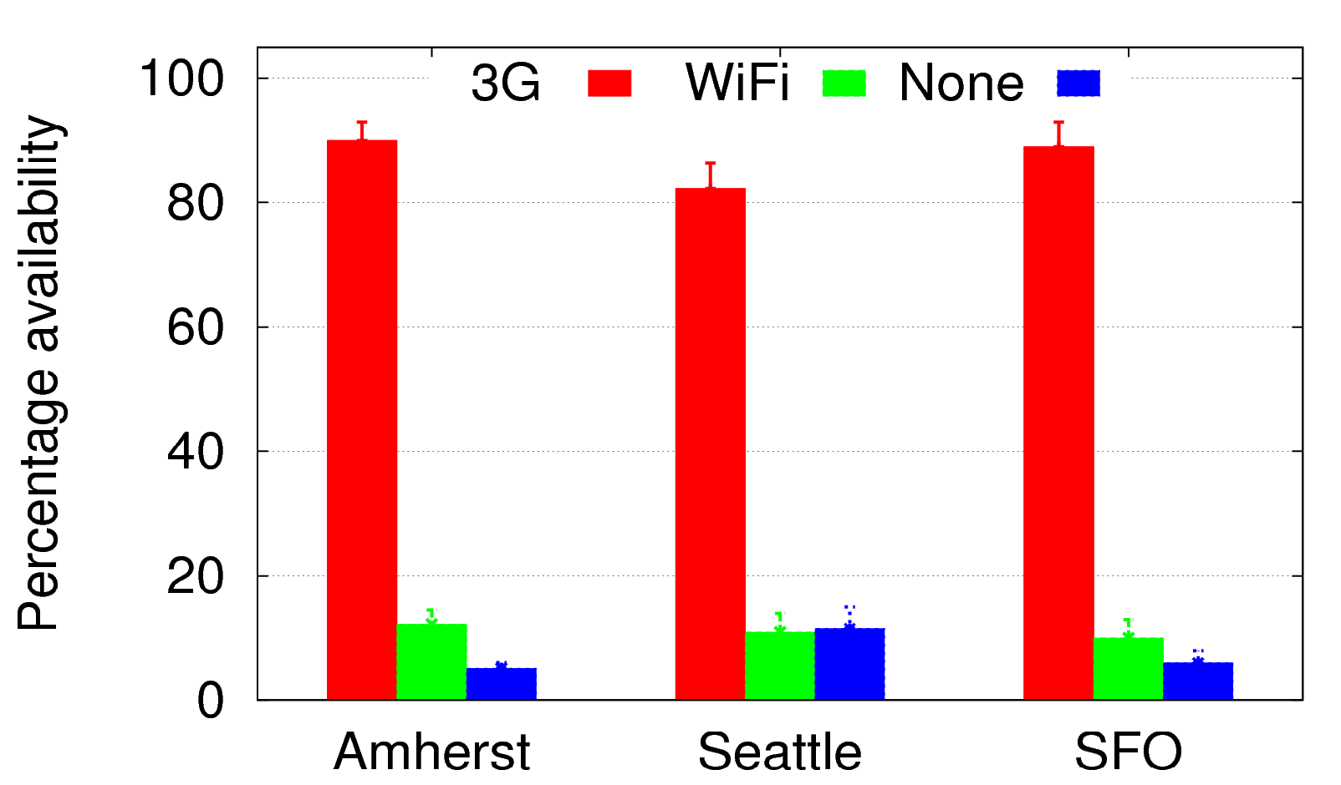
WiFi availability is low
Availability (%)
90
12
5

Slide 10
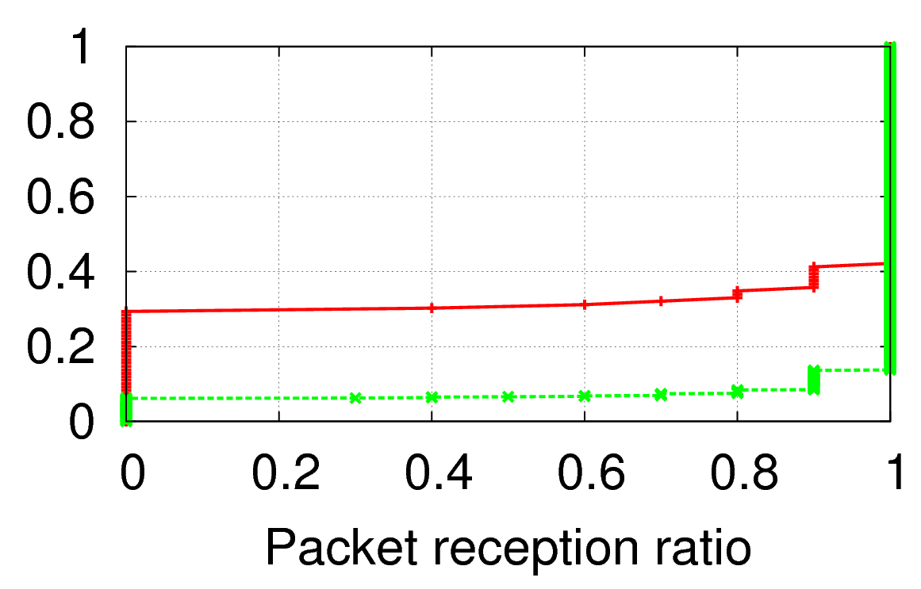
WiFi loss rate is higher
Cumulative fraction
WiFi
3G

Slide 11
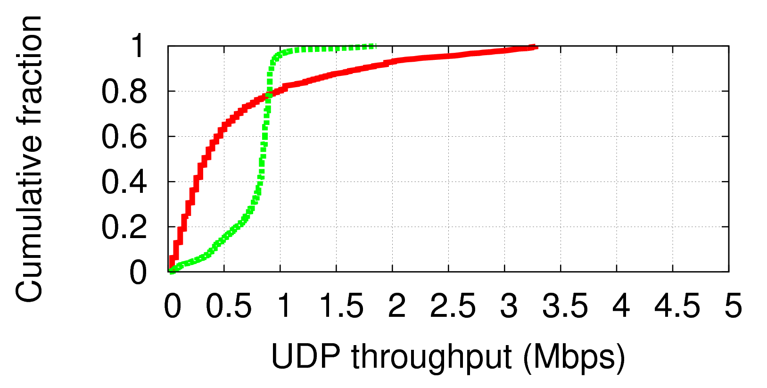
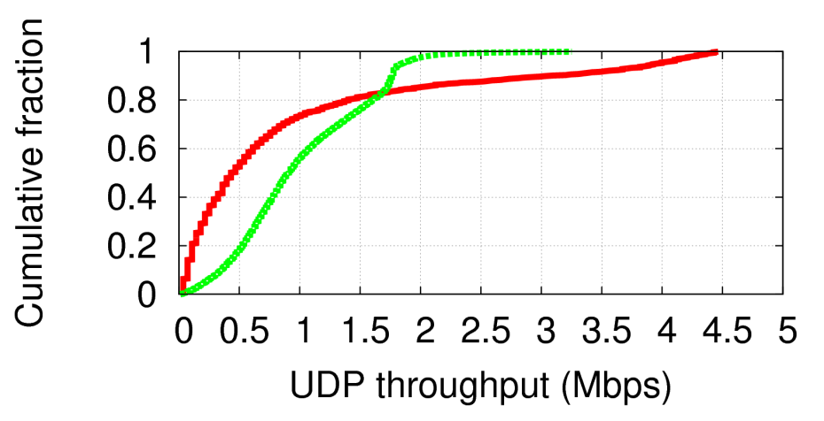
WiFi (802.11b) throughput is lower
Cumulative fraction
WiFi
3G
Upstream
Cumulative fraction
WiFi
3G
Downstream

Slide 12
Implications for offloading data to WiFi
Straightforward design: use WiFi when available
Offloads only 10% of the data
Hurts application performance

Slide 13
Key techniques in Wiffler
Prediction-based offloading
Exploit the delay tolerance of apps to increase data offloaded to WiFi
Fast switching
Combat poor WiFi connectivity
Notes:
Not worrying about energy for now.
These techniques are very simple and yet close to optimal for what they do. In the beginning, we played with some more complicated versions but found them to not worth it.

Slide 14
Prediction-based offloading
Delay data transfers only if that reduces 3G usage
Transfer requirements: S bytes by D seconds
W = Predicted WiFi capacity over future D seconds
Send data on 3G only when (W < S · c)
Send data on WiFi whenever available

Slide 15
Predicting WiFi capacity
Based on (# of APs) x (capacity per AP)
Observation: future AP encounters depend on recent past
Predict # of APs based on the last N encounters

Slide 16
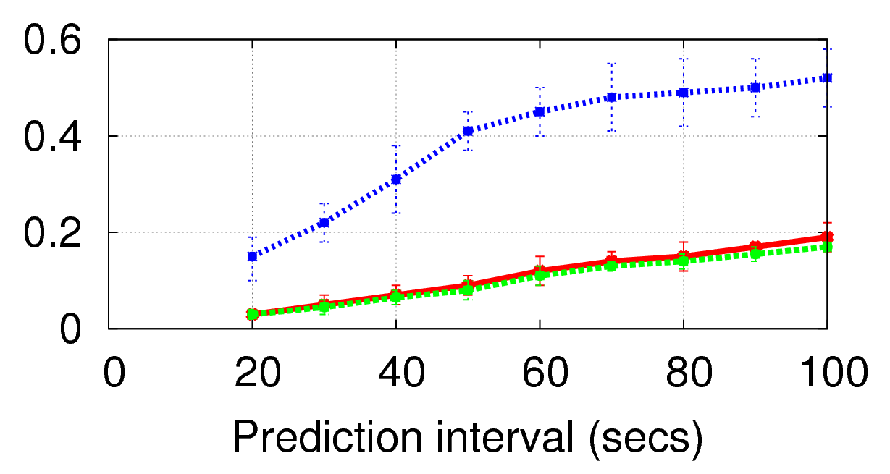
Error in predicting # of APs
N=1
Relative error
N=4
N=8

Slide 17
Fast switching
Poor WiFi connectivity will hurt demanding apps such as VoIP and video streaming
Send the packet on 3G if WiFi does not succeed within a threshold
Link-layer retransmissions take time
Losses are bursty
Notes:
A different way of bonding multiple interfaces

Slide 18

Implementation of Wiffler
Wiffler proxy
Notes:
A proxy is coming for a host of other reasons as well.

Slide 19
Evaluation
Deployment on 20 vehicular nodes
Trace-driven simulations

Slide 20
Deployment results
 | Data offloaded to WiFi
Prediction-based offloading | 30%
WiFi when available | 10%
Transfer size: 5MB; Delay tolerance: 60 secs; Inter-transfer gap: random with mean 100 secs
 | Time w/ good voice quality
Fast switching | 68%
WiFi when available | 42%
VoIP-like traffic: 20-byte packet every 20 ms

Slide 21
Trace-driven evaluation
Yields results comparable to deployment
Vary workload, AP density, delay tolerance, switching threshold
Alternative strategies
Impatient: use WiFi when available
Patient: waits until the delay threshold
Breadcrumbs: mobility prediction + location history
Oracle: perfect future knowledge

Slide 22
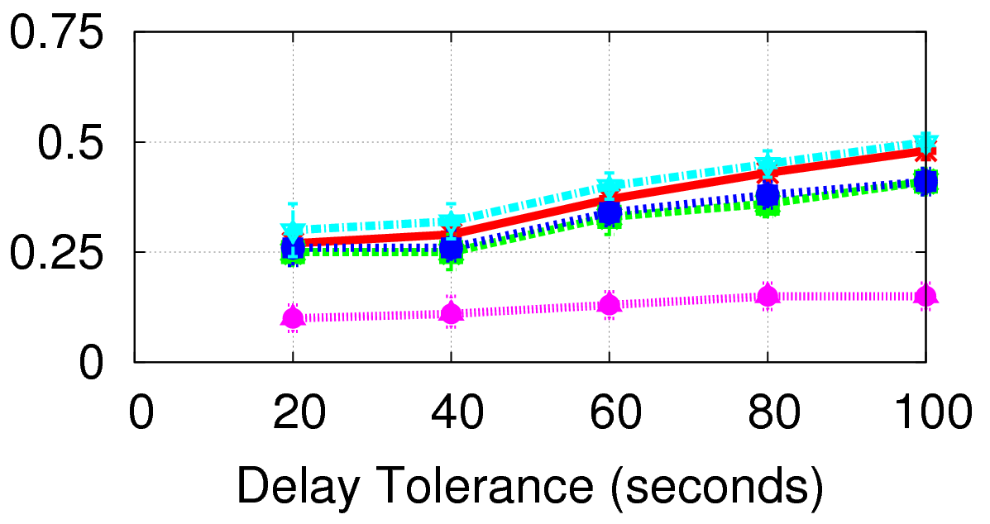
Wiffler increases data offloaded to WiFi
Patient, Oracle
Breadcrumbs
Wiffler
Impatient
Fraction of data offloaded to WiFi
Performance of Wiffler is comparable to optimal
More complicated predictions do not help

Slide 23
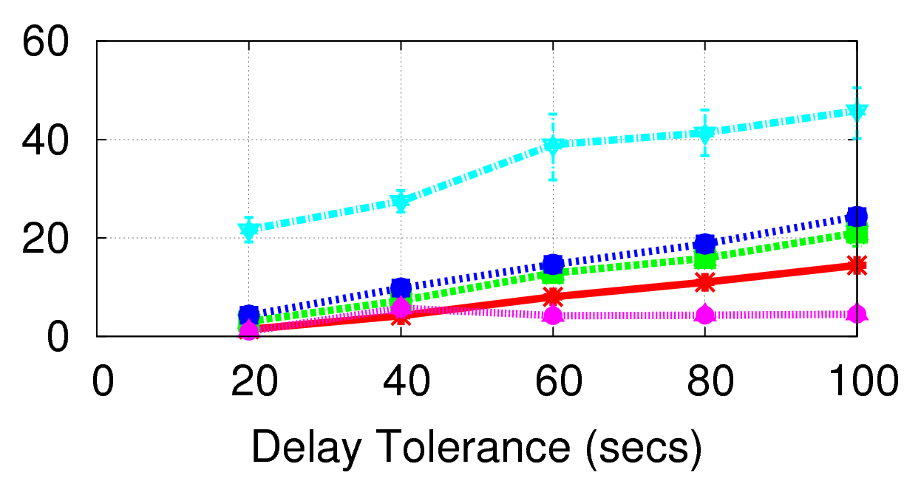
Prediction reduces completion time
Patient
Wiffler
Breadcrumbs
Oracle
Impatient
Completion time (secs)

Slide 24
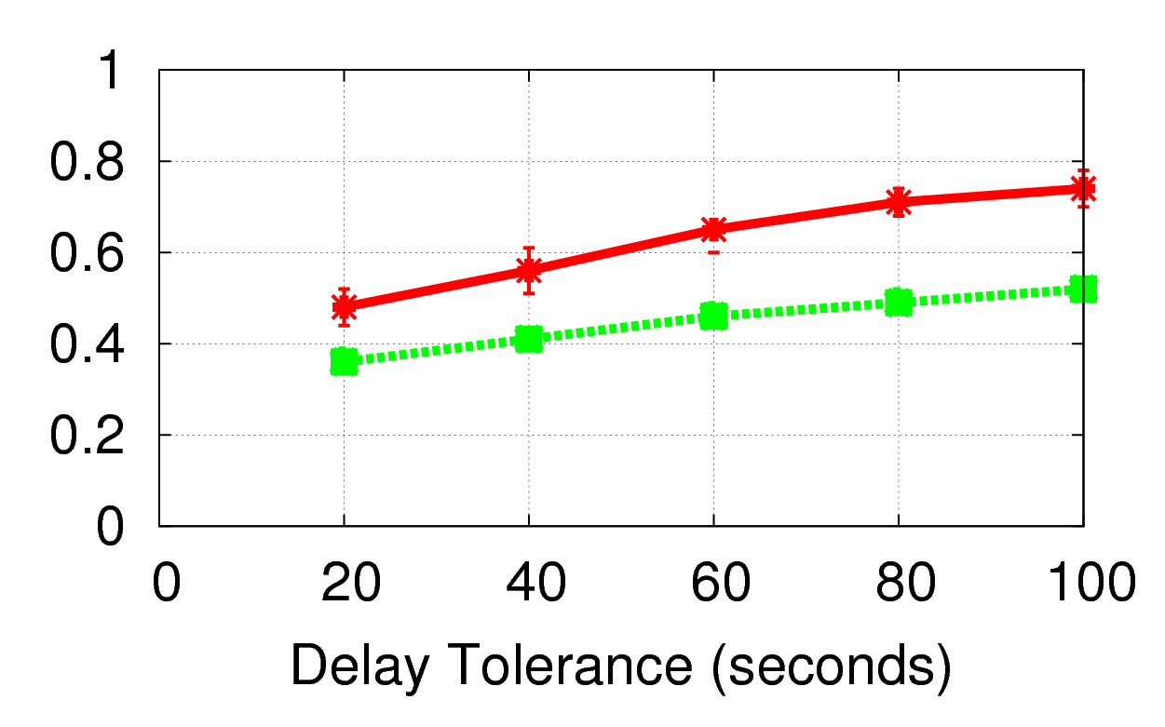
More offloading in urban centers
24% WiFi availability
Fraction of data offloaded to WiFi
12% WiFi availability

Slide 25
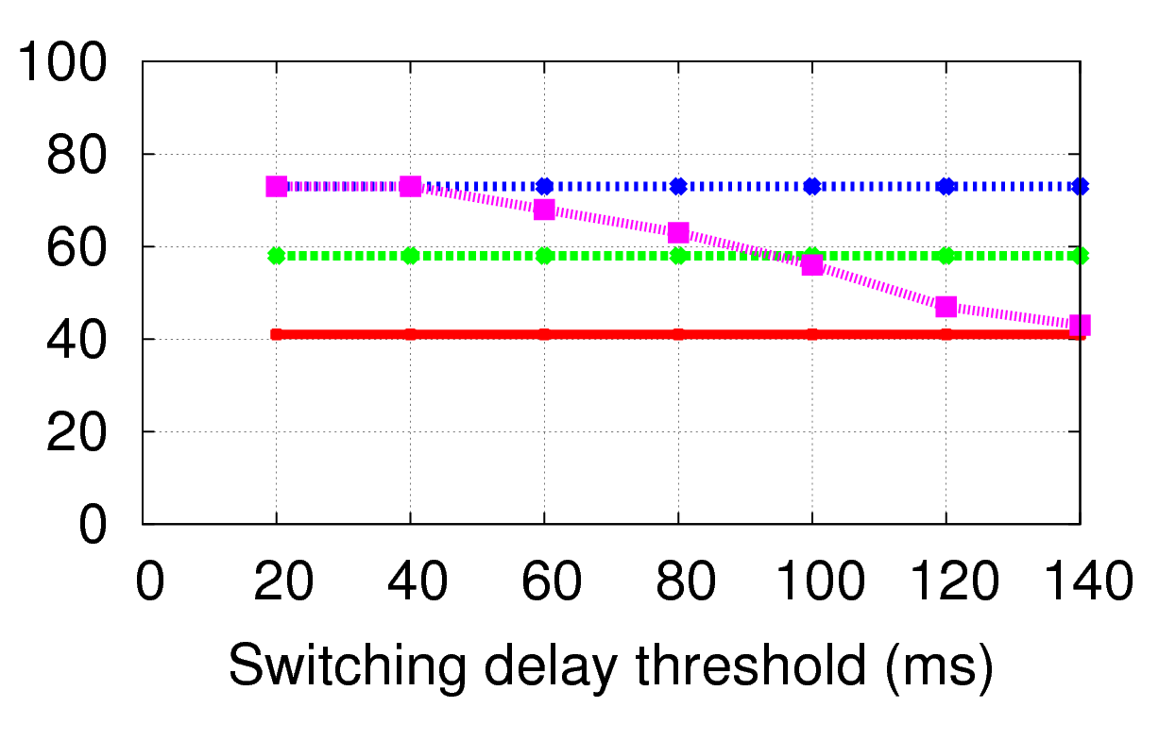
Fast switching improves performance of demanding applications
Oracle
Only 3G
Wiffler
No switching
% time with good voice quality

Slide 26
Possible extensions
Reduce energy cost of searching for usable WiFi
Predict what a user will access and prefetch
Recommend content to users based on what is cached (courtesy Romit Roy)

Slide 27
Conclusions
Offloading to WiFi can augment mobile data transfer capacity and reduce pressure on cellular spectrum
But must overcome the low WiFi availability and performance
Prediction-based offloading and fast switching can tackle these challenges
Offloads a third of the data if 1-min delays are tolerable

