Slide 1
Artificial Intelligence
Constraint Satisfaction Problems

Slide 2
Constraint satisfaction problems(CSP)
Finite set of variables X₁, X₂, …, X_{n}
Nonempty domain of possible values for each variable D₁, D₂, … D_{d}
Finite set of constraints C₁, C₂, …, C_{m}
Each constraint C_{i} limits the values that variables can take, e.g., X₁ ≠ X₂
A state is defined as an assignment of values to some or all the variables.
Consistent assignment: assignment does not violate the constraints.

Slide 3
Constraint satisfaction problems
An assignment is complete when every variable is assigned a value.
A solution to a CSP is a complete assignment that satisfies all the constraints.
Some CSPs require a solution that maximizes an objective function.
Applications:
Scheduling problems
Job shop scheduling
Scheduling the Hubble Space Telescope
Floor planning for VLSI
Map coloring

Slide 4
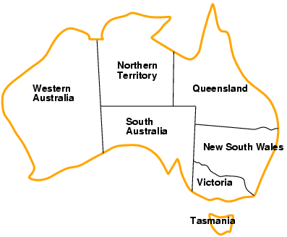
Example: Map-Coloring
Variables: WA, NT, Q, NSW, V, SA, T
Domains: D_{i} = {red, green, blue}
Constraints: adjacent regions must have different colors
e.g., WA ≠ NT
So (WA,NT) must be in {(red,green),(red,blue),(green,red), …}

Slide 5
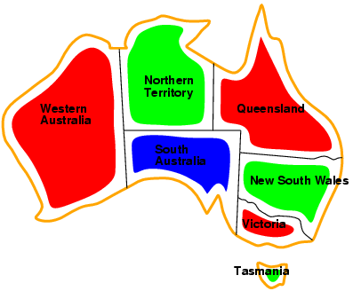
Example: Map-Coloring
Solutions are complete and consistent assignments,
e.g., WA = red, NT = green,Q = red,NSW = green, V = red,SA = blue,T = green
(A possible complete and consistent solution)

Slide 6
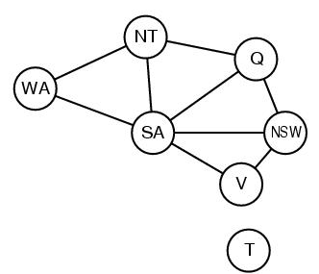
Constraint graph
WA ≠ NT
NT ≠ Q
NT ≠ SA
NSW ≠ Q
NSW ≠ SA
Binary CSP: each constraint relates two variables
Constraint graph:
nodes are variables
arcs are constraints
CSP benefits
Standard representation pattern: variables with values
Generic goal and successor functions
Generic heuristics (no domain specific expertise).
Graph can be used to simplify search.
e.g. Tasmania is an independent subproblem.
WA ≠ SA
NSW ≠ v
v ≠ SA

Slide 7
Varieties of CSPs
finite domains:
n variables, domain size d 🡪 O(d^{n}) complete assignments
e.g., Boolean CSPs, includes Boolean satisfiability (NP-complete)
Line Drawing Interpretation
infinite domains:
integers, strings, etc.
e.g., job scheduling, variables are start/end days for each job
need a constraint language, e.g., StartJob₁ + 5 ≤ StartJob₃

Slide 8
Varieties of constraints
Unary constraints involve a single variable,
e.g., SA ≠ green
Binary constraints involve pairs of variables,
e.g., SA ≠ WA
Higher-order constraints involve 3 or more variables
e.g., crypt-arithmetic column constraints
Preference (soft constraints) e.g. red is better than green can be represented by a cost for each variable assignment
Constrained optimization problems.

Slide 9
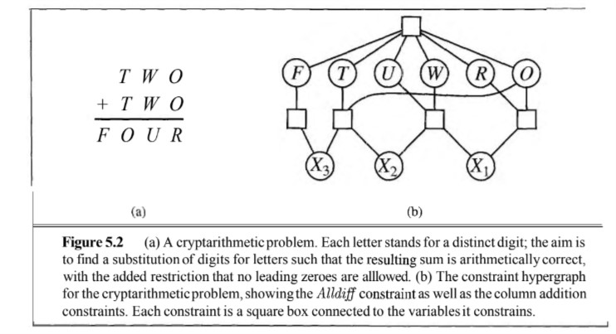
Example: Cryptarithmetic Puzzles
Each letter stands for a distinct digit;
The aim is to find a substitution of digits for letters such that the resulting sum is arithmetically correct, with the added restriction that no leading zeros are allowed.

Slide 10
Example: Cryptarithmetic Puzzles
For the case in above figure:this would be represented as the six-variable constraint Alldiff (F, T, U, W, R, O).
Alternatively, it can be represented by a collection of binary constraints such as F≠T.

Slide 11
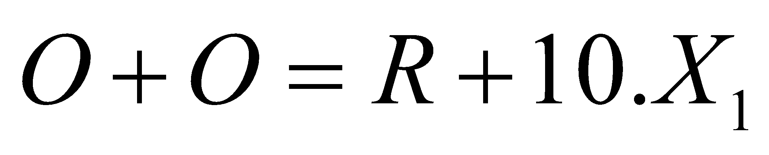
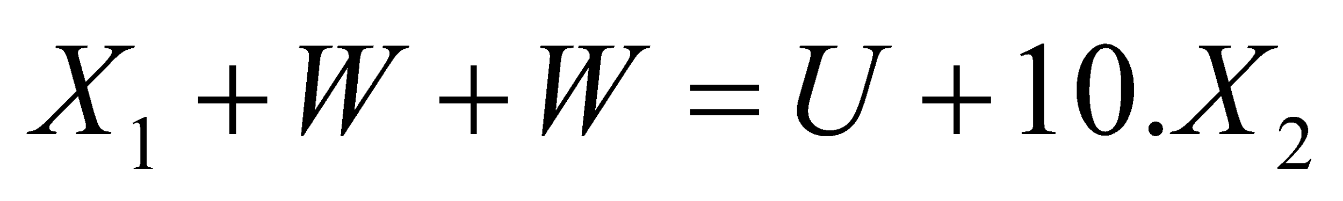
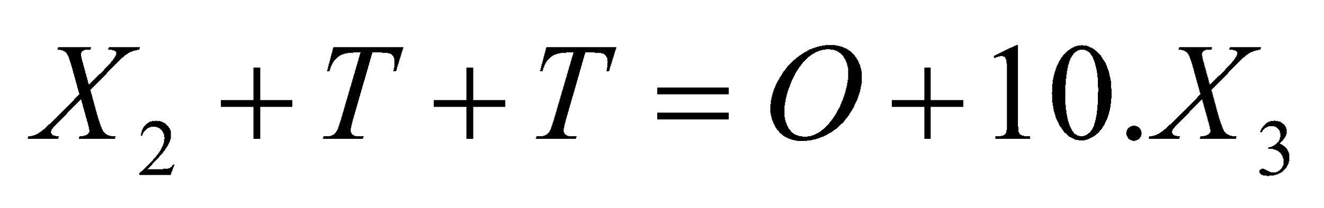
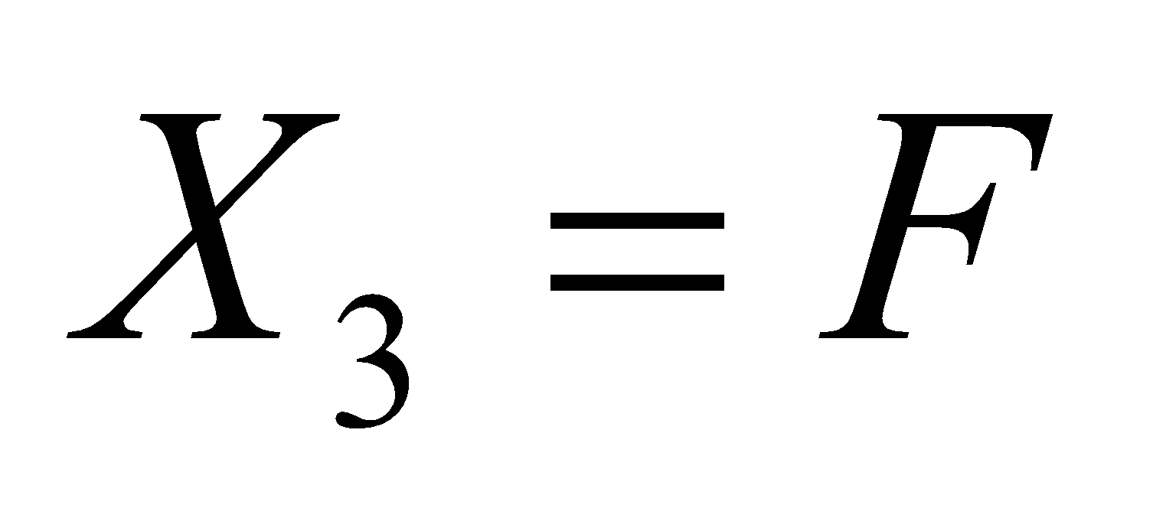
Example: Cryptarithmetic Puzzles
The additional constraints on the four columns of the puzzle also involve several variable and can be written as,
Where, X₁, X₂, and X₃ are auxiliary variables representing the digit (0 or 1) carried over into the next column.

Slide 12
CSP as a standard search problem
A CSP can easily be expressed as a standard search problem, as we have seen
Initial State: the empty assignment { }.
Successor function: Assign value to unassigned variable provided that there is not conflict.
Goal test: the current assignment is complete.
Path cost: a constant cost for every step.
Solution is found at depth n , for n variables
Hence depth first search can be used

Slide 13
Backtracking search
Note that variable assignments are commutative
Eg [ step 1: WA = red; step 2: NT = green ] equivalent to [ step 1: NT = green; step 2: WA = red ]
Only need to consider assignments to a single variable at each node
🡪 b = d and there are d^{n} leaves
Depth-first search for CSPs with single-variable assignments is called backtracking search
Backtracking search is the basic uninformed algorithm for CSPs

Slide 14

Backtracking example
Notes:
‹#›

Slide 15
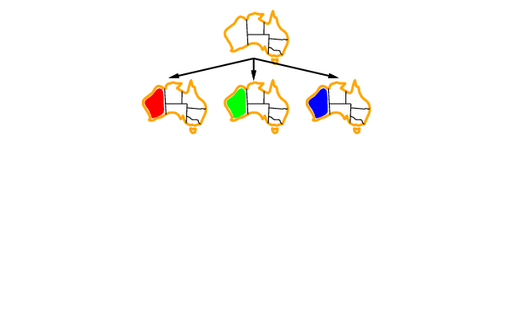
Backtracking example
Notes:
‹#›

Slide 16
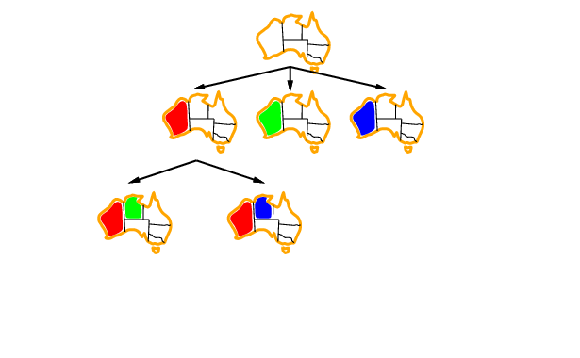
Backtracking example
Notes:
‹#›

Slide 17
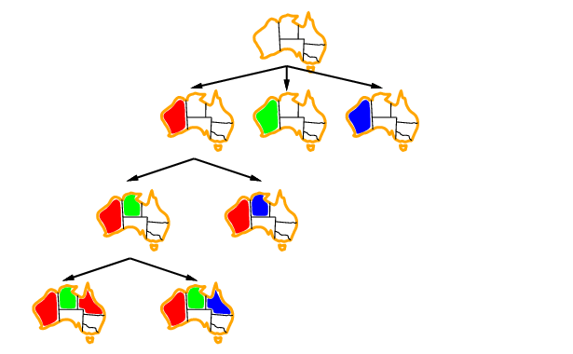
Backtracking example
Notes:
‹#›

Slide 18
Improving backtracking efficiency
General-purpose methods can give huge gains in speed:
Which variable should be assigned next?
In what order should its values be tried?
Can we detect inevitable failure early?
Heuristics:
Most constrained variable
Most constraining variable
Least constraining value
Forward checking

Slide 19

Heuristic 1: Most constrained variable
Most constrained variable:
choose the variable with the fewest legal values
a.k.a. minimum remaining values (MRV) heuristic
2
3
2
Information shown for some of the places/countries
2
1
Notes:
‹#›

Slide 20

Heuristic 2: Most constraining variable
Most constraining variable:
choose the variable with the most constraints on remaining variables
3
2
3
3
5
Information shown for some of the places/countries

Slide 21
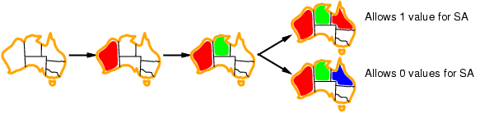
Heuristic 3: Least constraining value
Given a variable, choose the least constraining value:
the one that rules out the fewest values in the remaining variables
Combining these heuristics makes 1000 queens feasible
Least constraining value

Slide 22
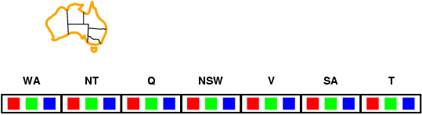
Heuristic 4: Forward checking
Idea:
Keep track of remaining legal values for unassigned variables
Terminate search when any variable has no legal values
Edge & Arc consistency are variants
Notes:
‹#›

Slide 23
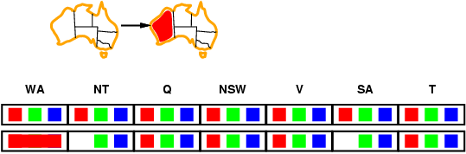
Forward checking
Idea:
Keep track of remaining legal values for unassigned variables
Terminate search when any variable has no legal values
Notes:
‹#›

Slide 24
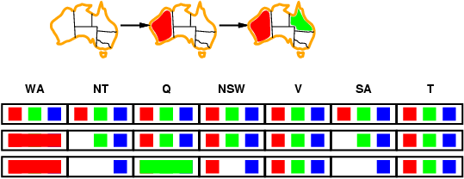
Forward checking
Idea:
Keep track of remaining legal values for unassigned variables
Terminate search when any variable has no legal values
Notes:
‹#›

Slide 25
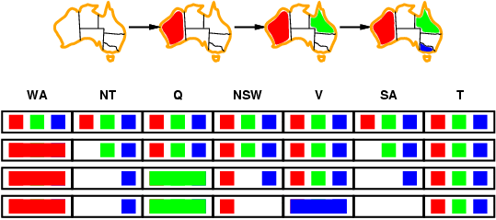
Forward checking
Idea:
Keep track of remaining legal values for unassigned variables
Terminate search when any variable has no legal values
A Step toward AC-3: The most efficient algorithm
Notes:
‹#›

Slide 26
Example: 4-Queens Problem
x1= First column’s possible row placements
x2= second column’s possible row placements …..
X1
{1,2,3,4}
X2
{1,2,3,4}
1
2
3
4
1
2
3
4
X3
{1,2,3,4}
X4
{1,2,3,4}
Notes:
‹#›

Slide 27
Example: 4-Queens Problem
X1
{1,2,3,4}
X2
{1,2,3,4}
1
2
3
4
1
2
3
4
X3
{1,2,3,4}
X4
{1,2,3,4}
Notes:
‹#›

Slide 28
Example: 4-Queens Problem
X1
{1,2,3,4}
X2
{ , ,3,4}
1
2
3
4
1
2
3
4
X3
{ ,2,,4}
X4
{ ,2,3, }
Notes:
‹#›

Slide 29
Example: 4-Queens Problem
X1
{1,2,3,4}
X2
{ , ,3,4}
1
2
3
4
1
2
3
4
X3
{ ,2, ,4}
X4
{ ,2,3, }
Notes:
‹#›

Slide 30
Example: 4-Queens Problem
X1
{1,2,3,4}
X2
{ , ,3,4}
1
2
3
4
1
2
3
4
X3
{ , , , }
X4
{ ,2, , }
Backtrack!!!
Notes:
‹#›

Slide 31
Example: 4-Queens Problem
X1
{ ,2,3,4}
X2
{1,2,3,4}
1
2
3
4
1
2
3
4
X3
{1,2,3,4}
X4
{1,2,3,4}
Notes:
‹#›

Slide 32
Example: 4-Queens Problem
X1
{ ,2,3,4}
X2
{ , , ,4}
1
2
3
4
1
2
3
4
X3
{1, ,3, }
X4
{1, ,3,4}
Notes:
‹#›

Slide 33
Example: 4-Queens Problem
X1
{ ,2,3,4}
X2
{ , , ,4}
1
2
3
4
1
2
3
4
X3
{1, ,3, }
X4
{1, ,3,4}
Notes:
‹#›

Slide 34
Example: 4-Queens Problem
X1
{ ,2,3,4}
X2
{ , , ,4}
1
2
3
4
1
2
3
4
X3
{1, , , }
X4
{1, ,3, }
Notes:
‹#›

Slide 35
Example: 4-Queens Problem
X1
{ ,2,3,4}
X2
{ , , ,4}
1
2
3
4
1
2
3
4
X3
{1, , , }
X4
{1, ,3, }
Notes:
‹#›

Slide 36
Example: 4-Queens Problem
X1
{ ,2,3,4}
X2
{ , , ,4}
1
2
3
4
1
2
3
4
X3
{1, , , }
X4
{ , ,3, }
Notes:
‹#›

Slide 37
Example: 4-Queens Problem
X1
{ ,2,3,4}
X2
{ , , ,4}
1
2
3
4
1
2
3
4
X3
{1, , , }
X4
{ , ,3, }
Notes:
‹#›

Slide 38
Constraint propagation
Forward checking propagates information from assigned to unassigned variables, but doesn't provide early detection for all failures:
NT and SA cannot both be blue!
Constraint propagation repeatedly enforces constraints locally

Slide 39
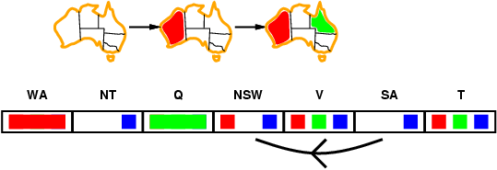
Arc consistency: The General Case
Simplest form of propagation makes each arc consistent
X 🡪Y is consistent iff
for every value x of X there is some allowed y

Slide 40
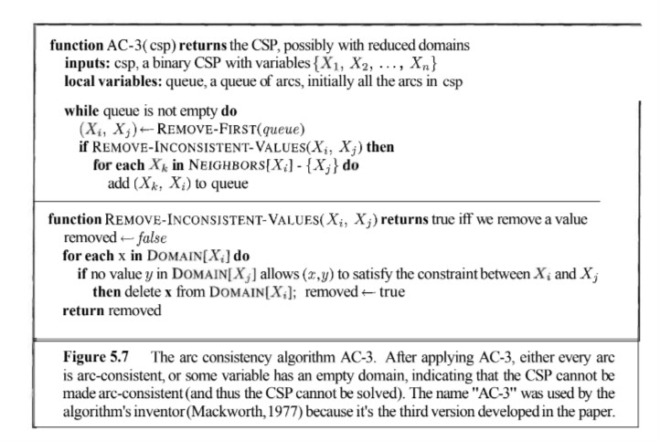
Arc Consistency
Complexity, O (n²d³)
O(d) times each edge insertion
O(d²)

