Slide 1
Ebola Modeling
SMAO, FHI
2014-10-21
riwh@fhi.no

Slide 2
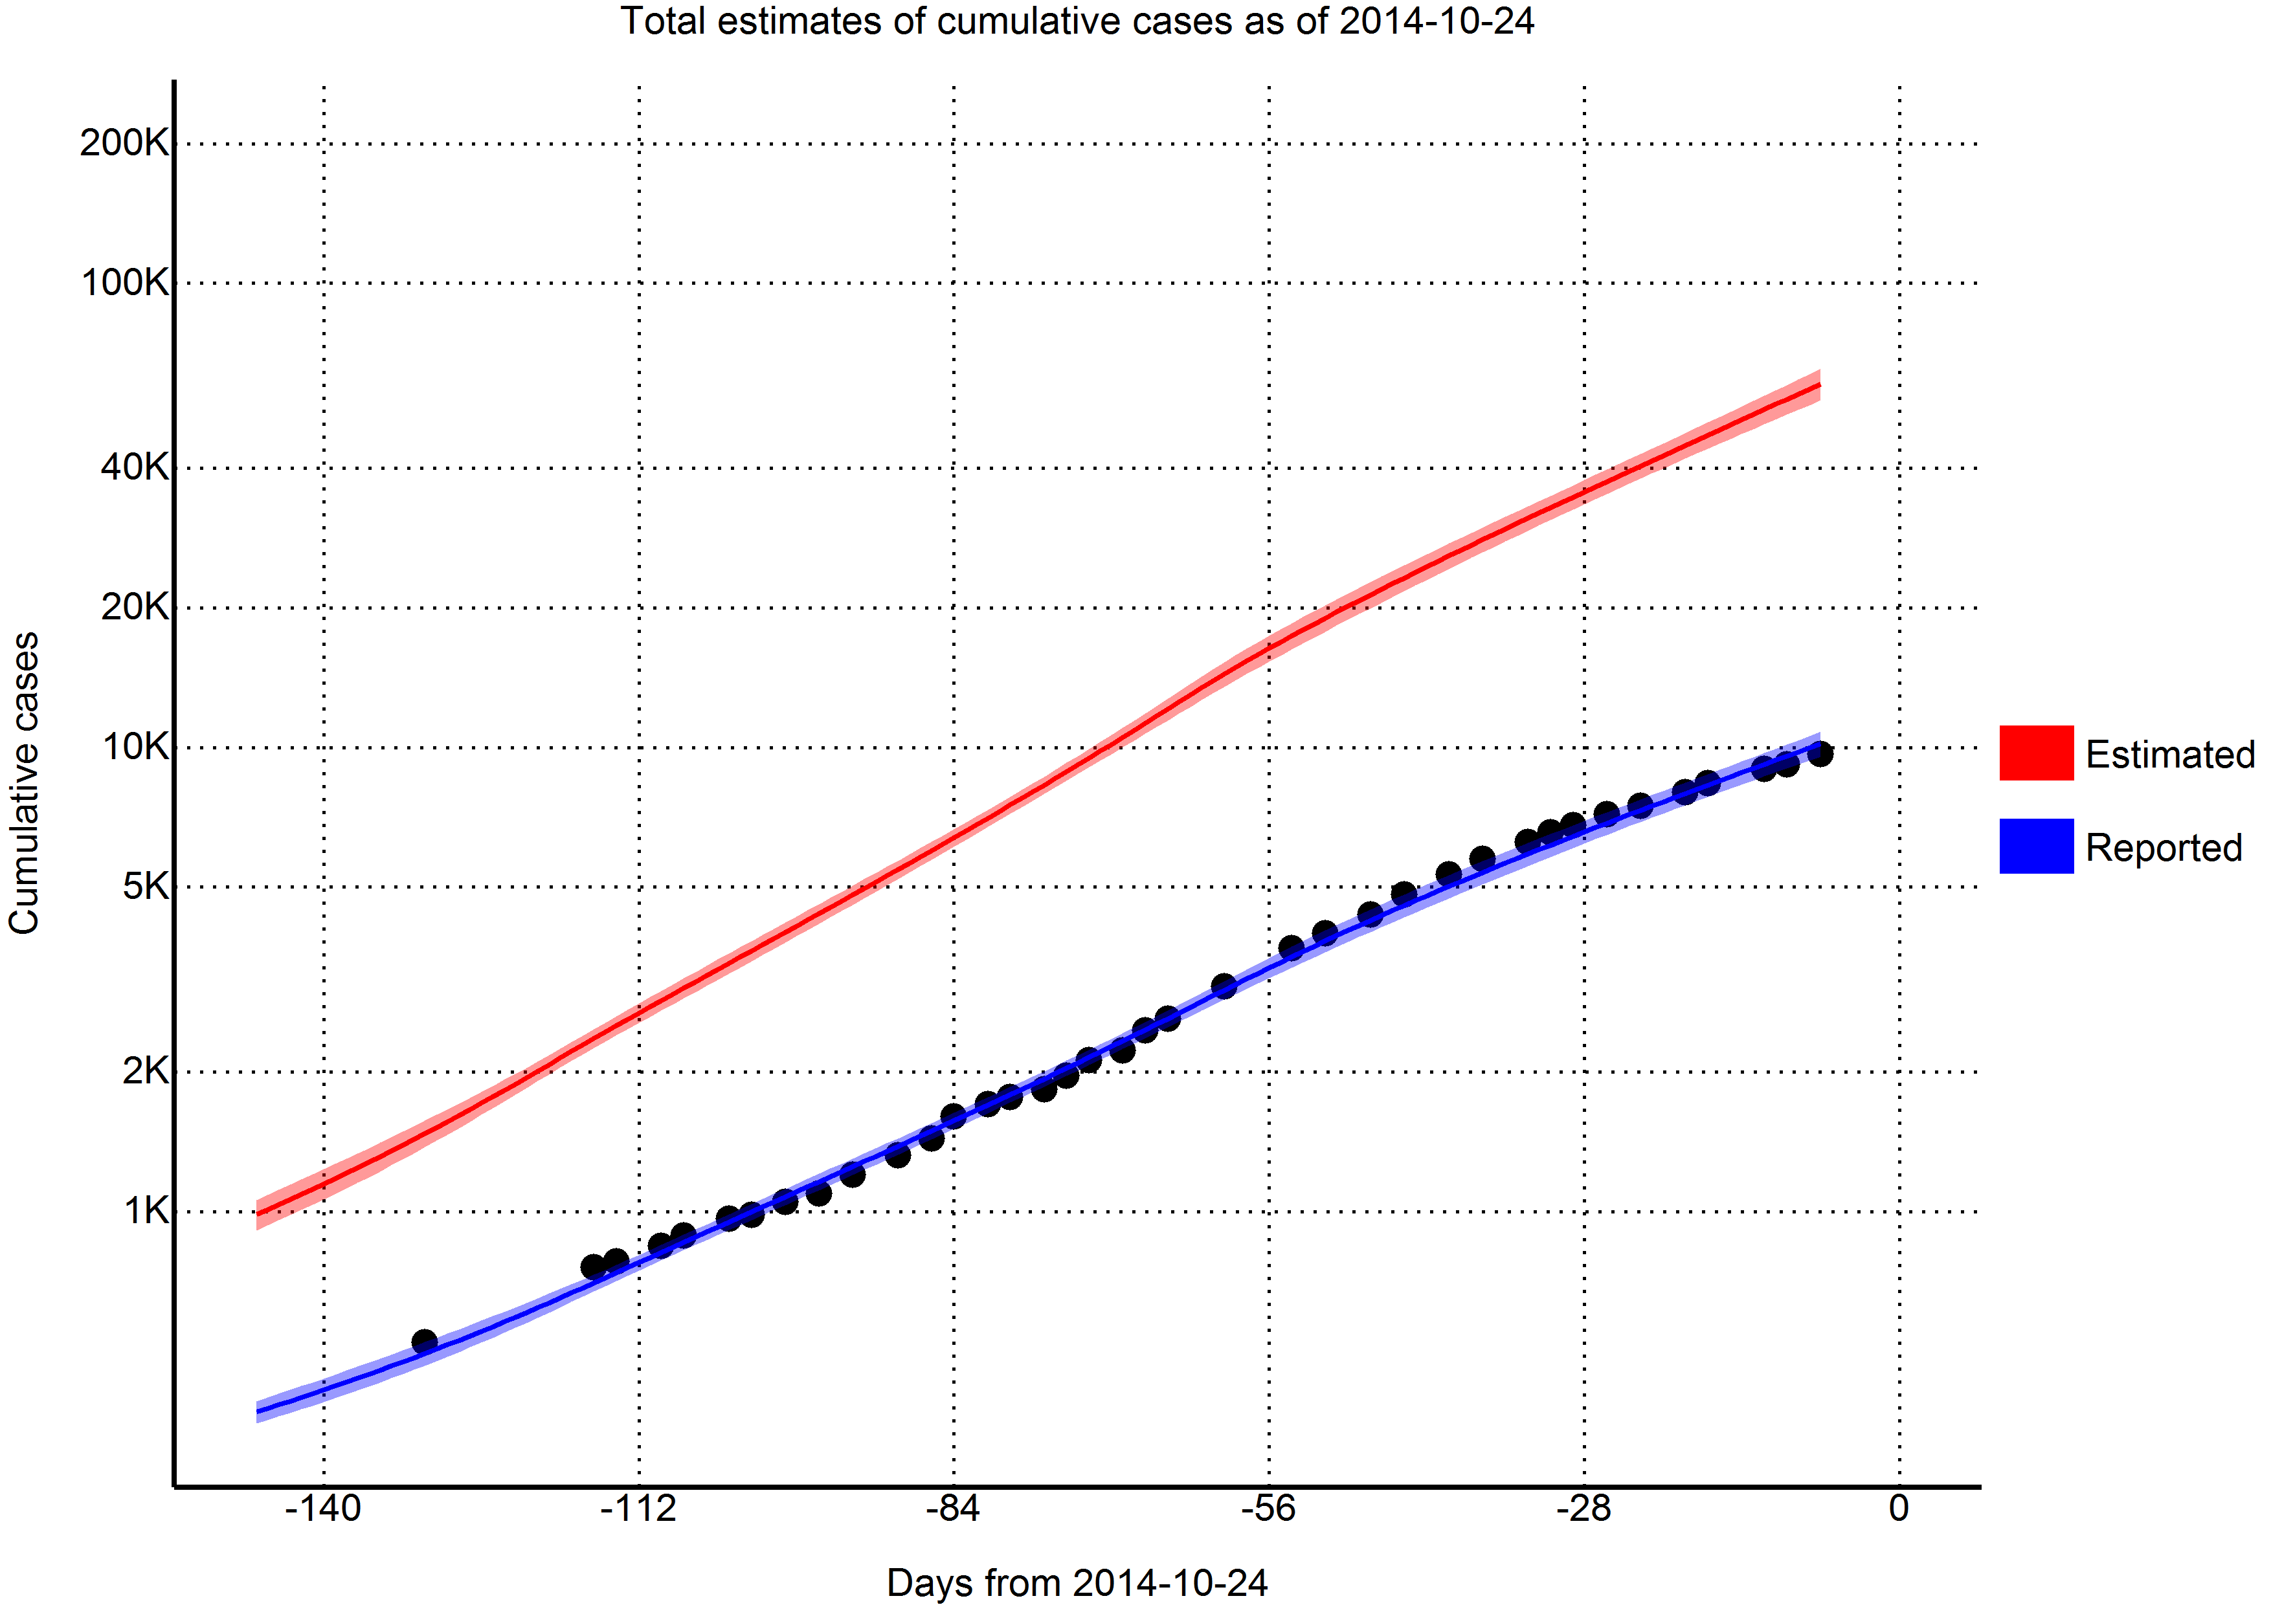
Validation of model

Slide 3
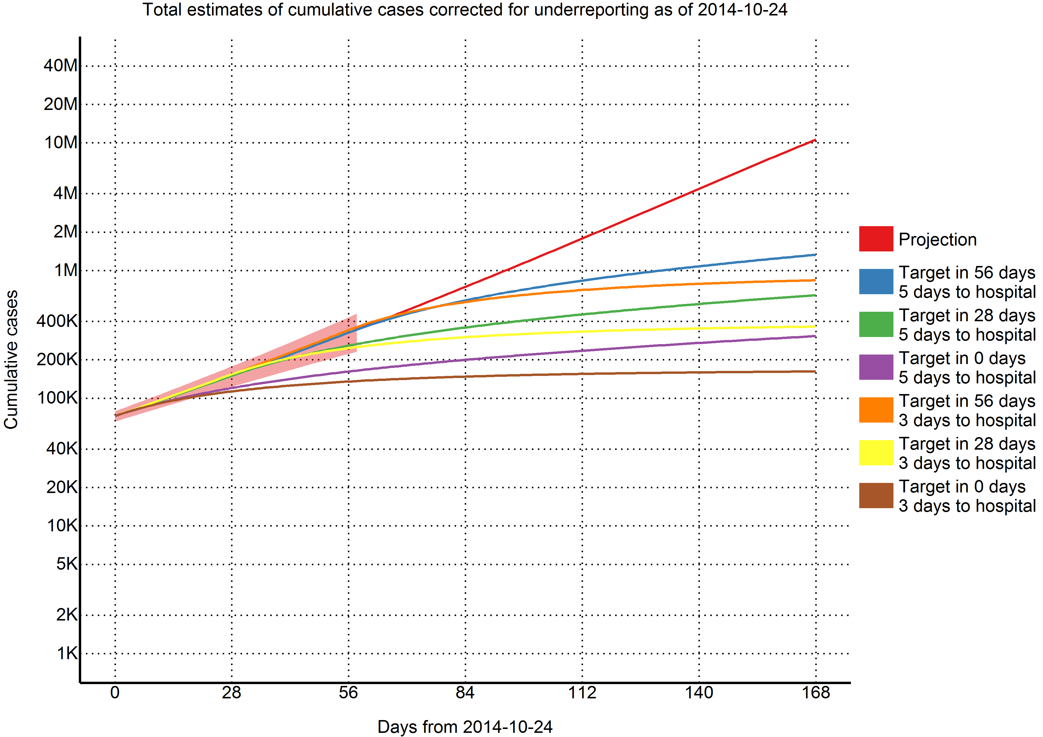
Effect of interventions

Slide 4
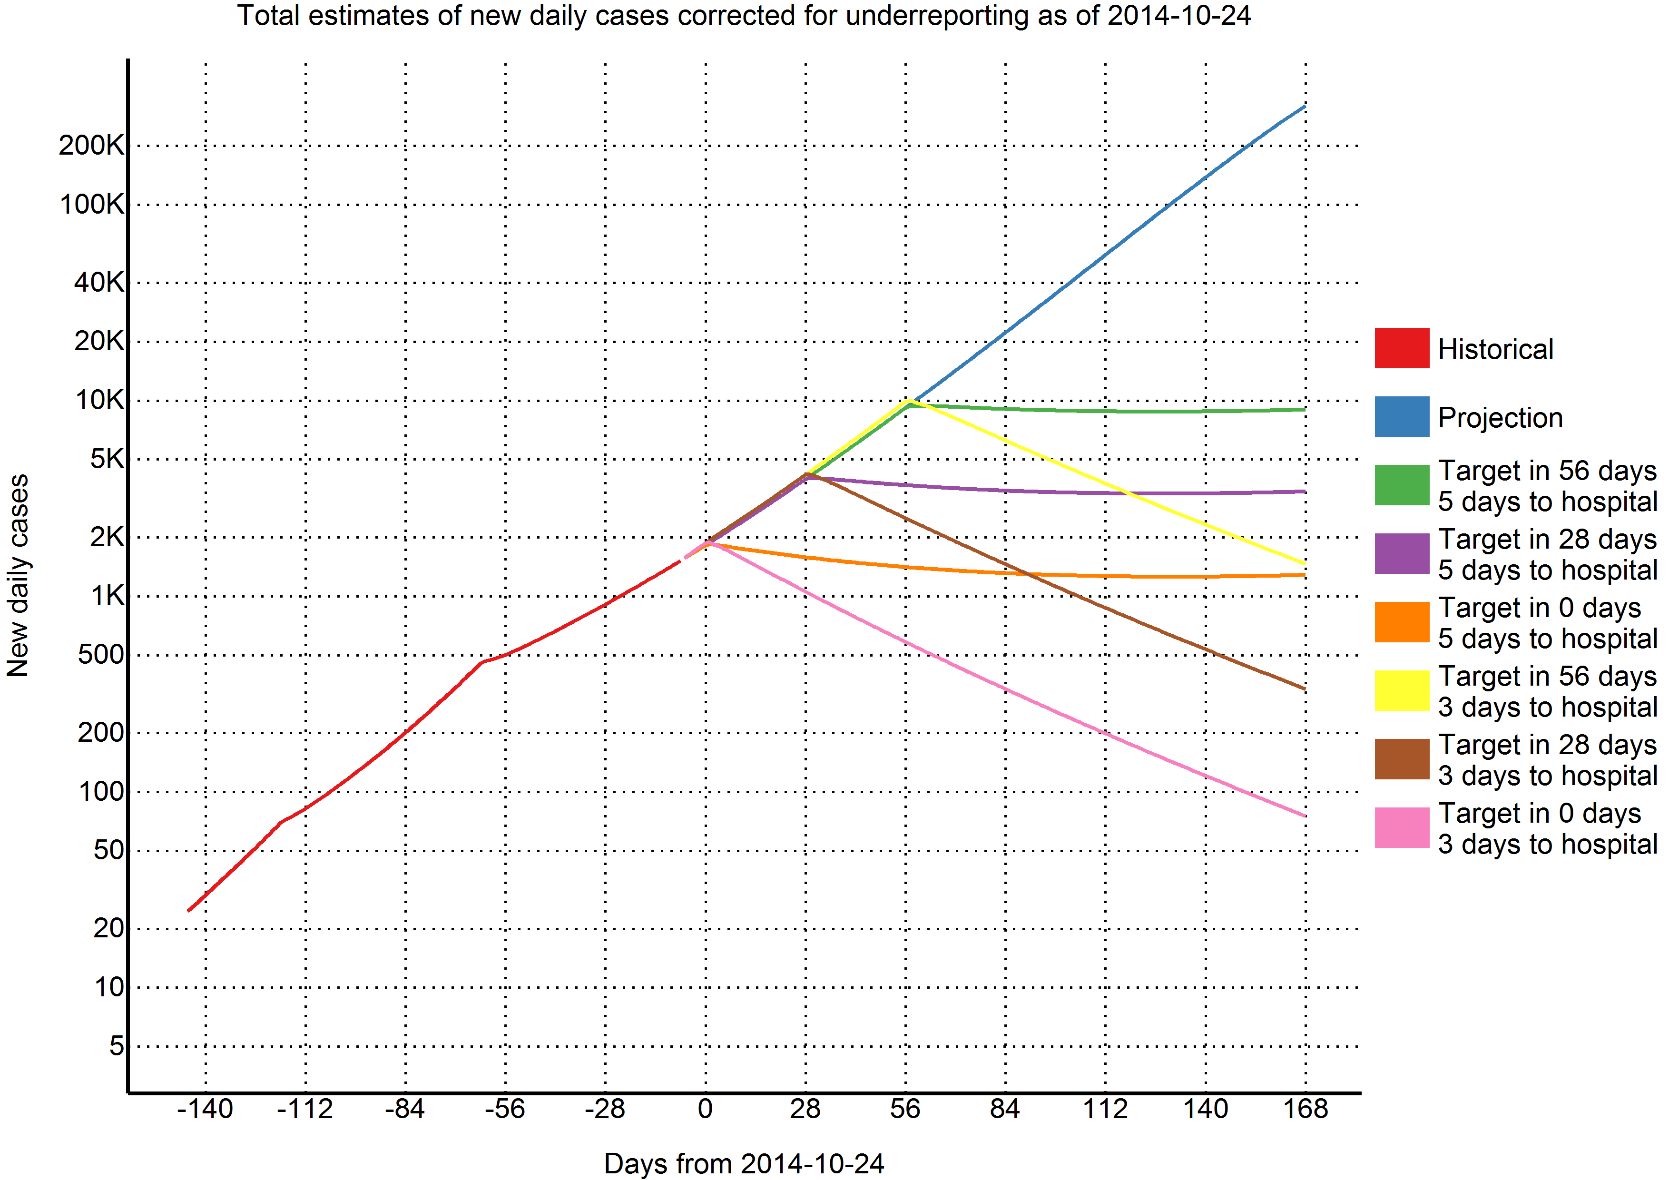
Effect on new daily cases

Slide 5
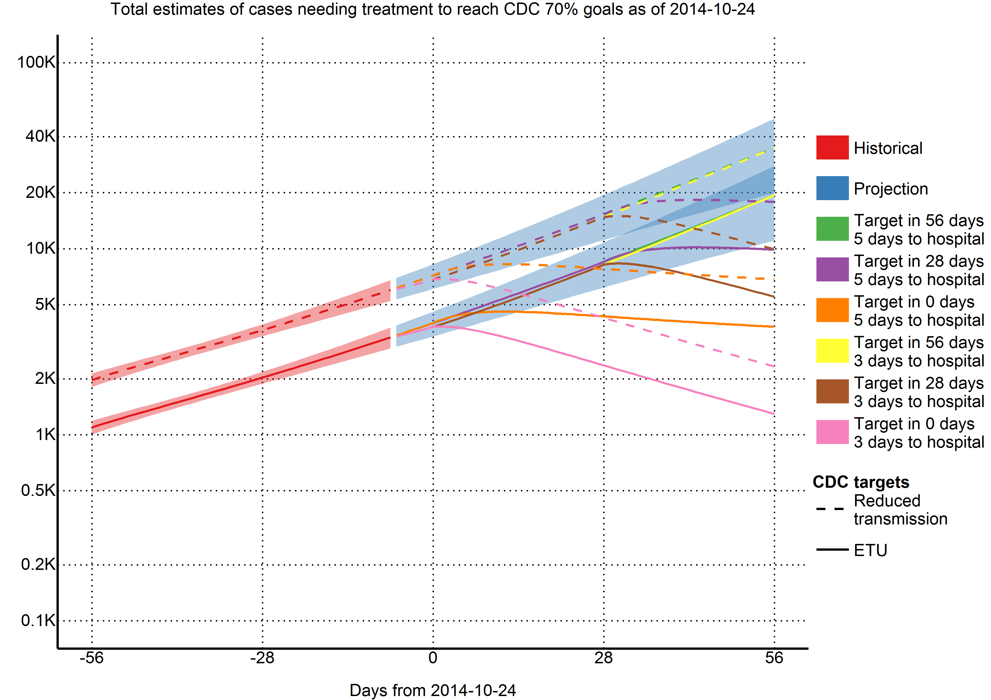
Requirements to achieve target

Slide 6
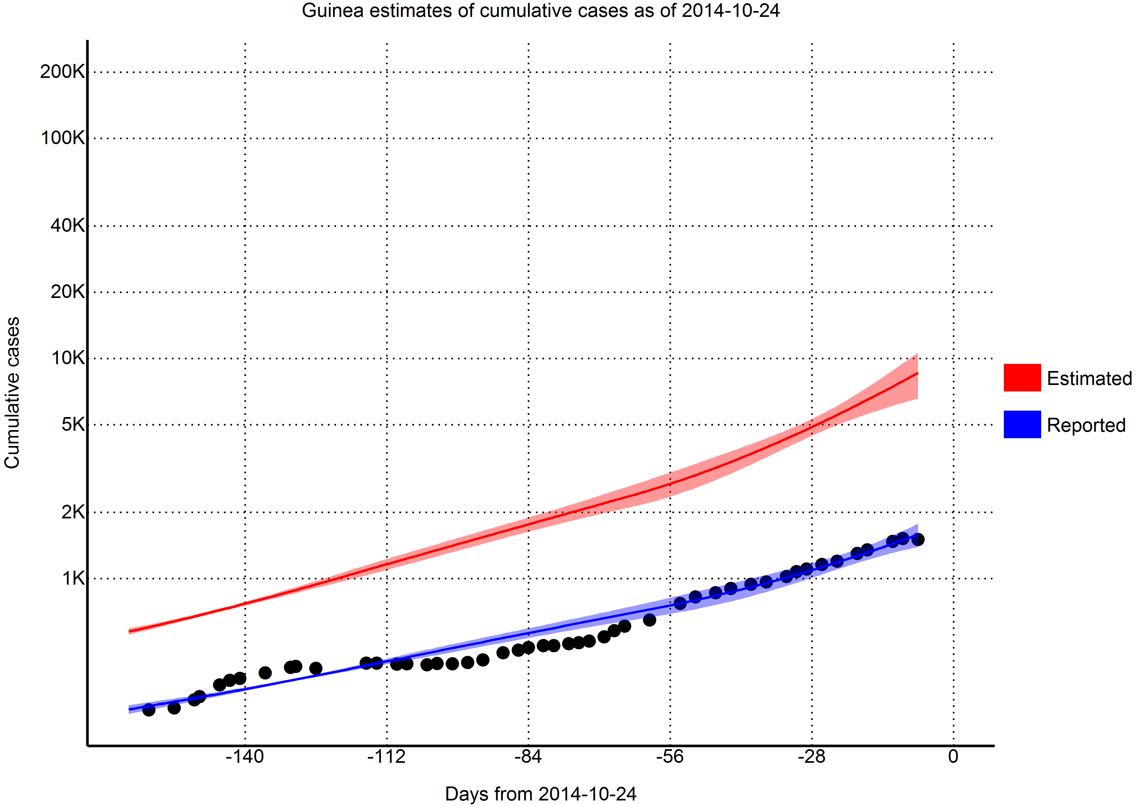
Validation of model

Slide 7
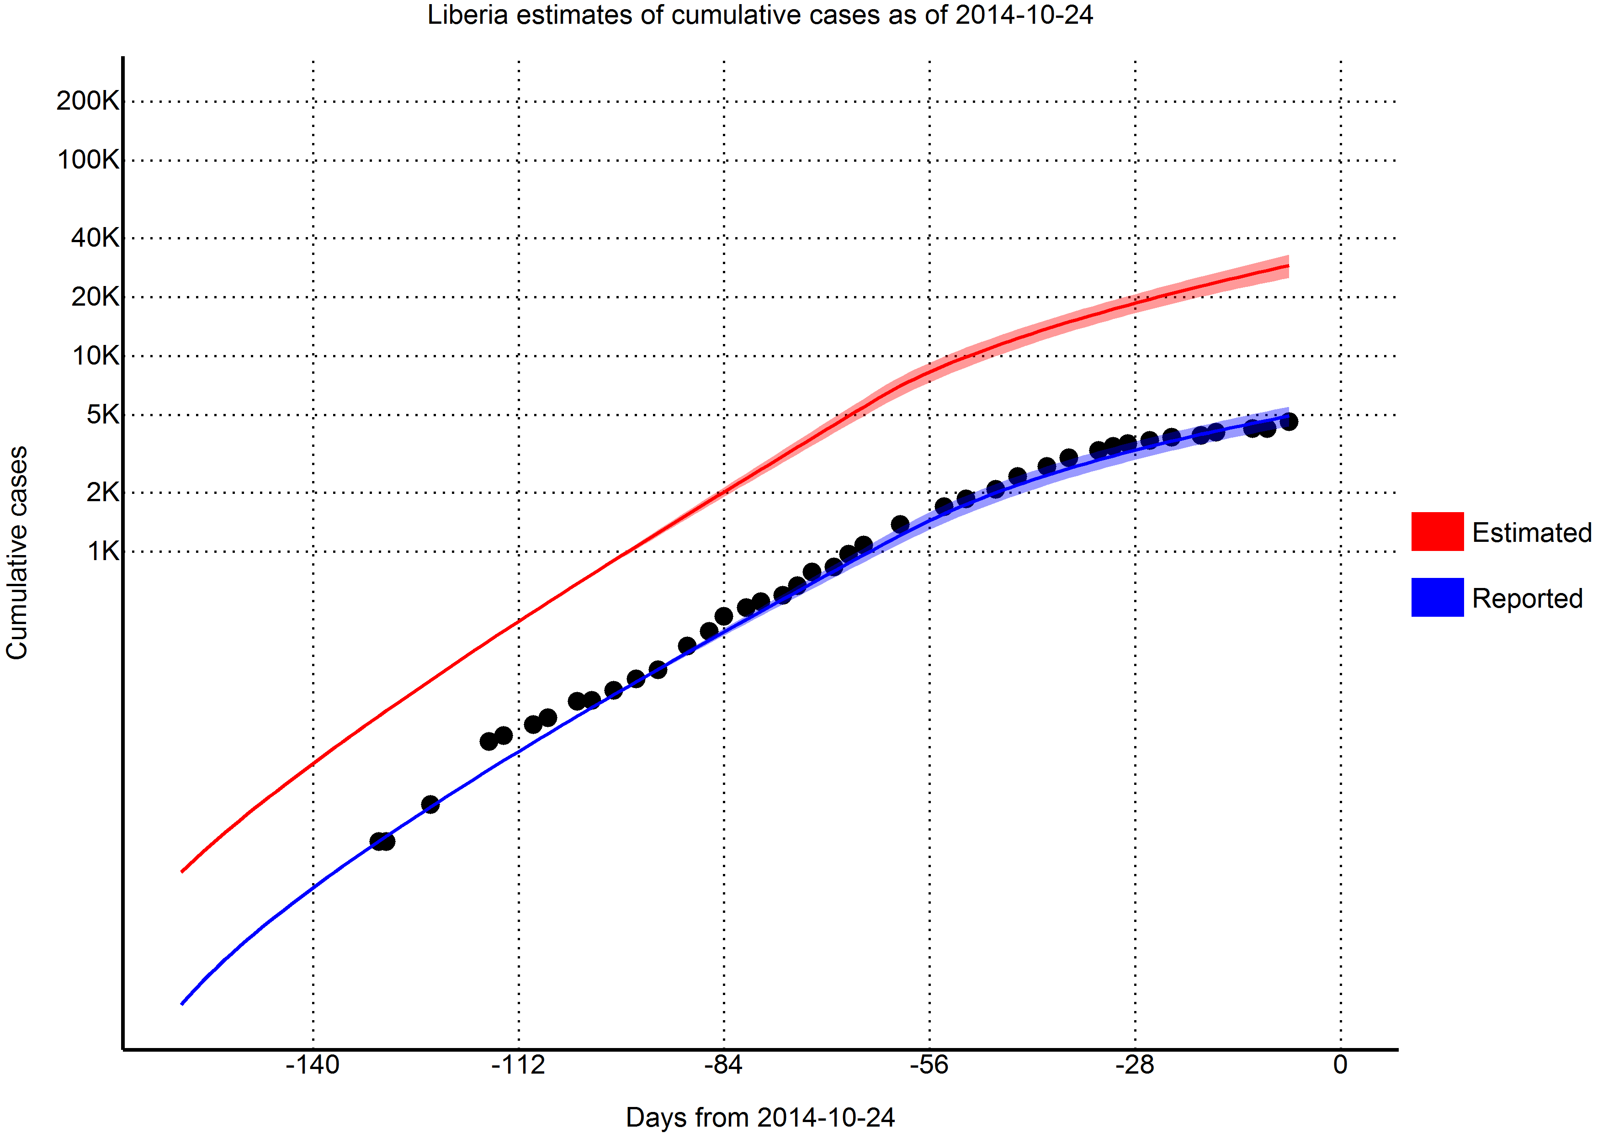
Validation of model

Slide 8
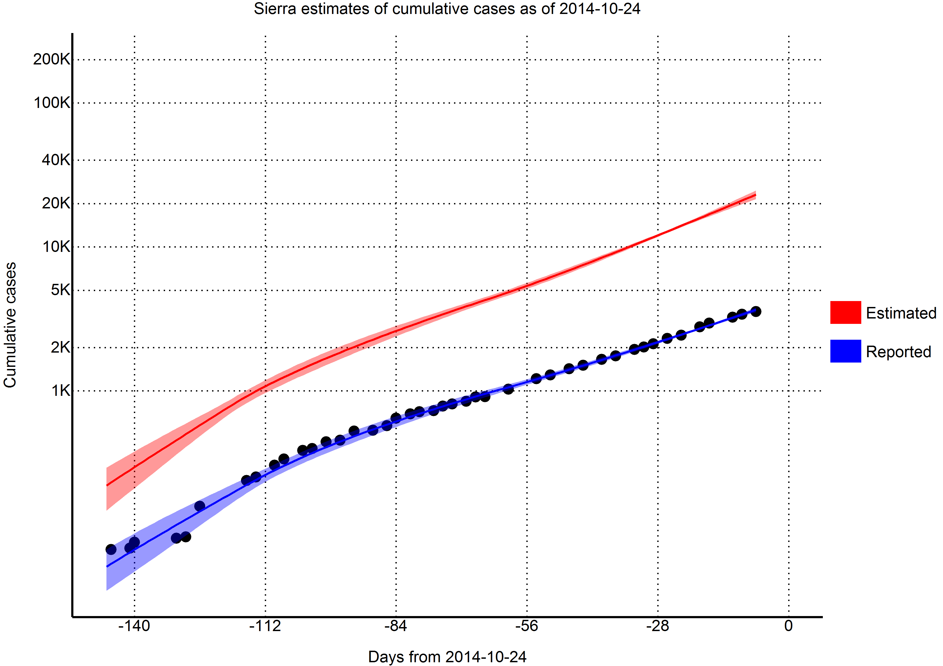
Validation of model

Slide 9
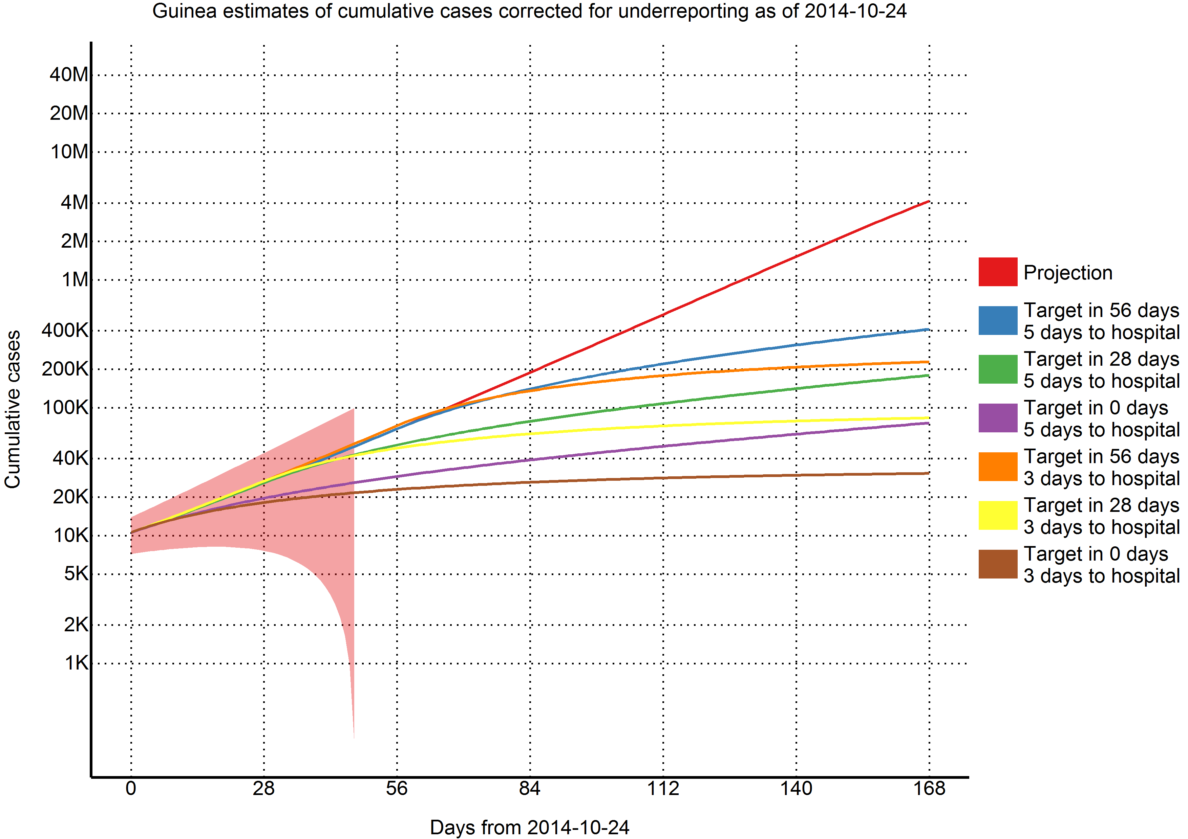
Effect of interventions

Slide 10
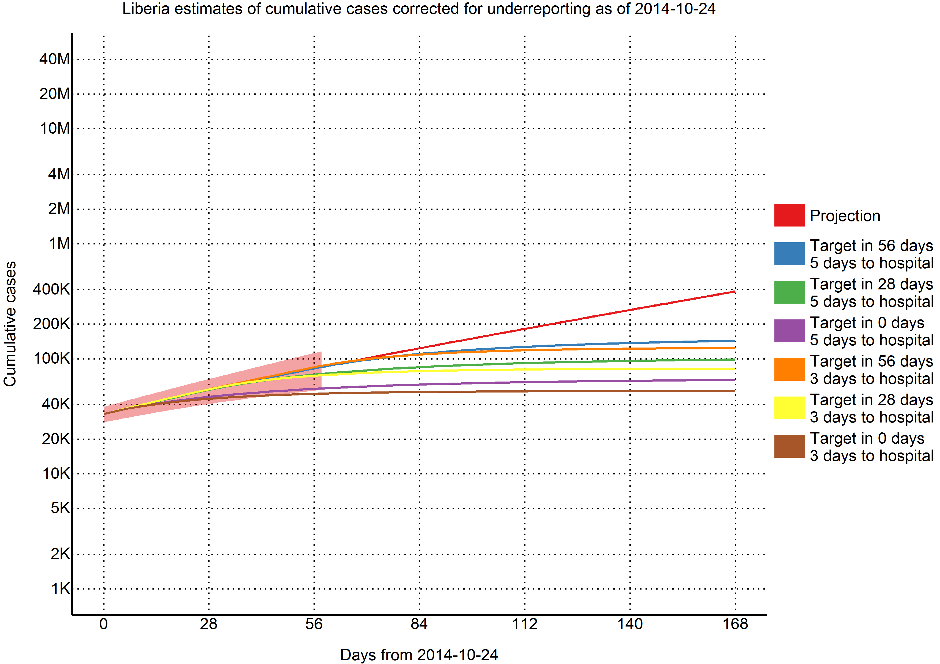
Effect of interventions

Slide 11
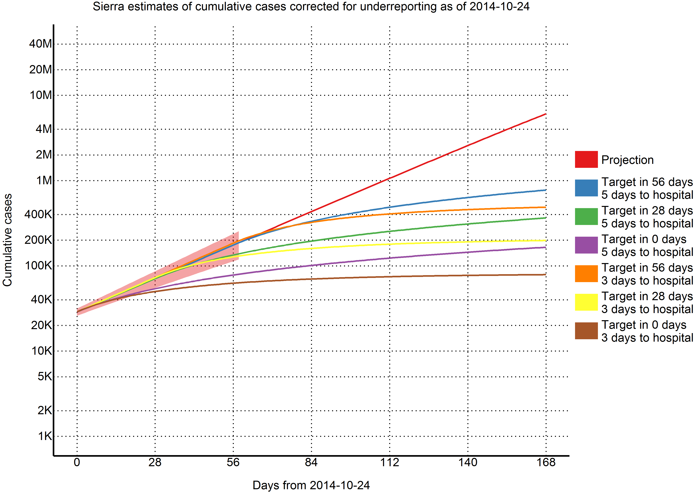
Effect of interventions

Slide 12
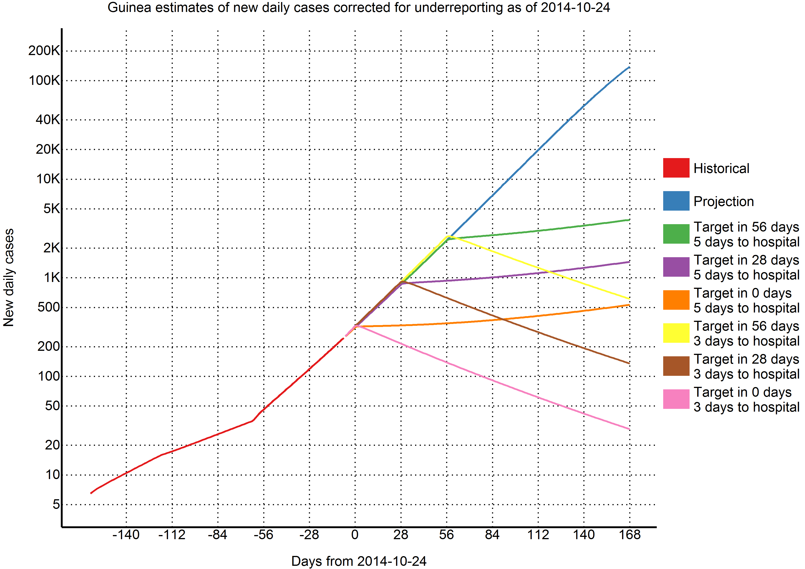
Effect on new daily cases

Slide 13
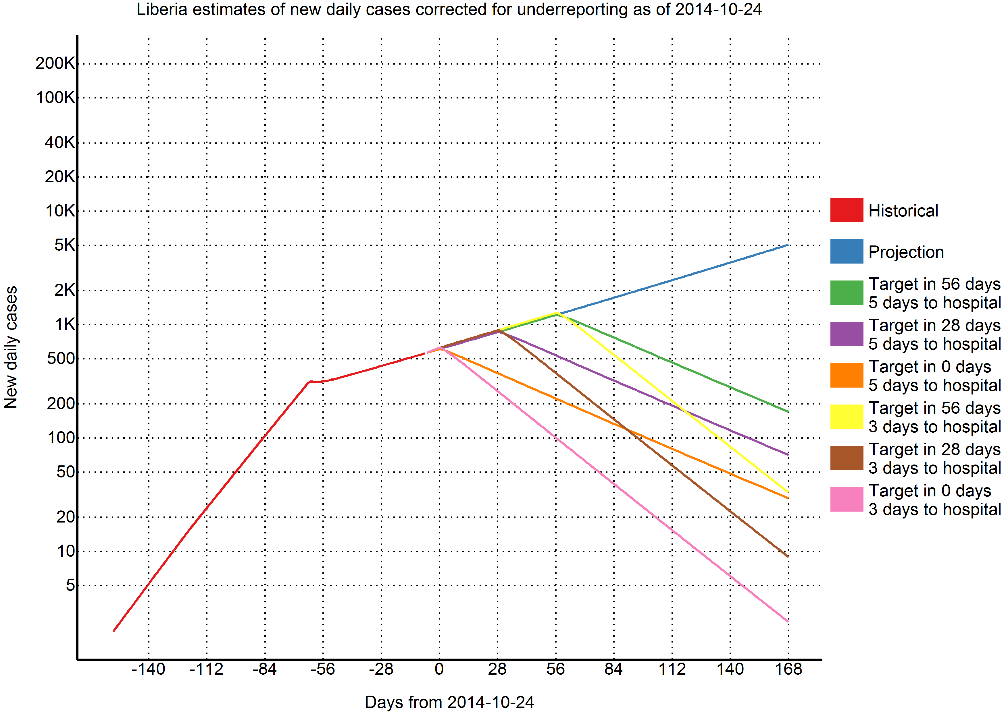
Effect on new daily cases

Slide 14
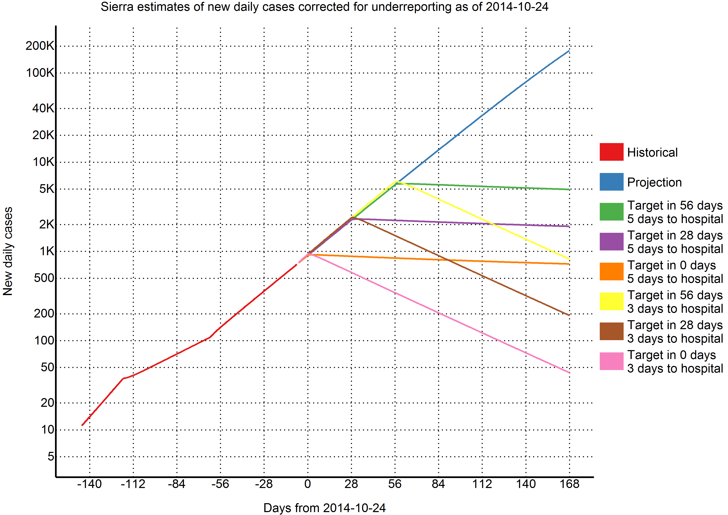
Effect on new daily cases

Slide 15
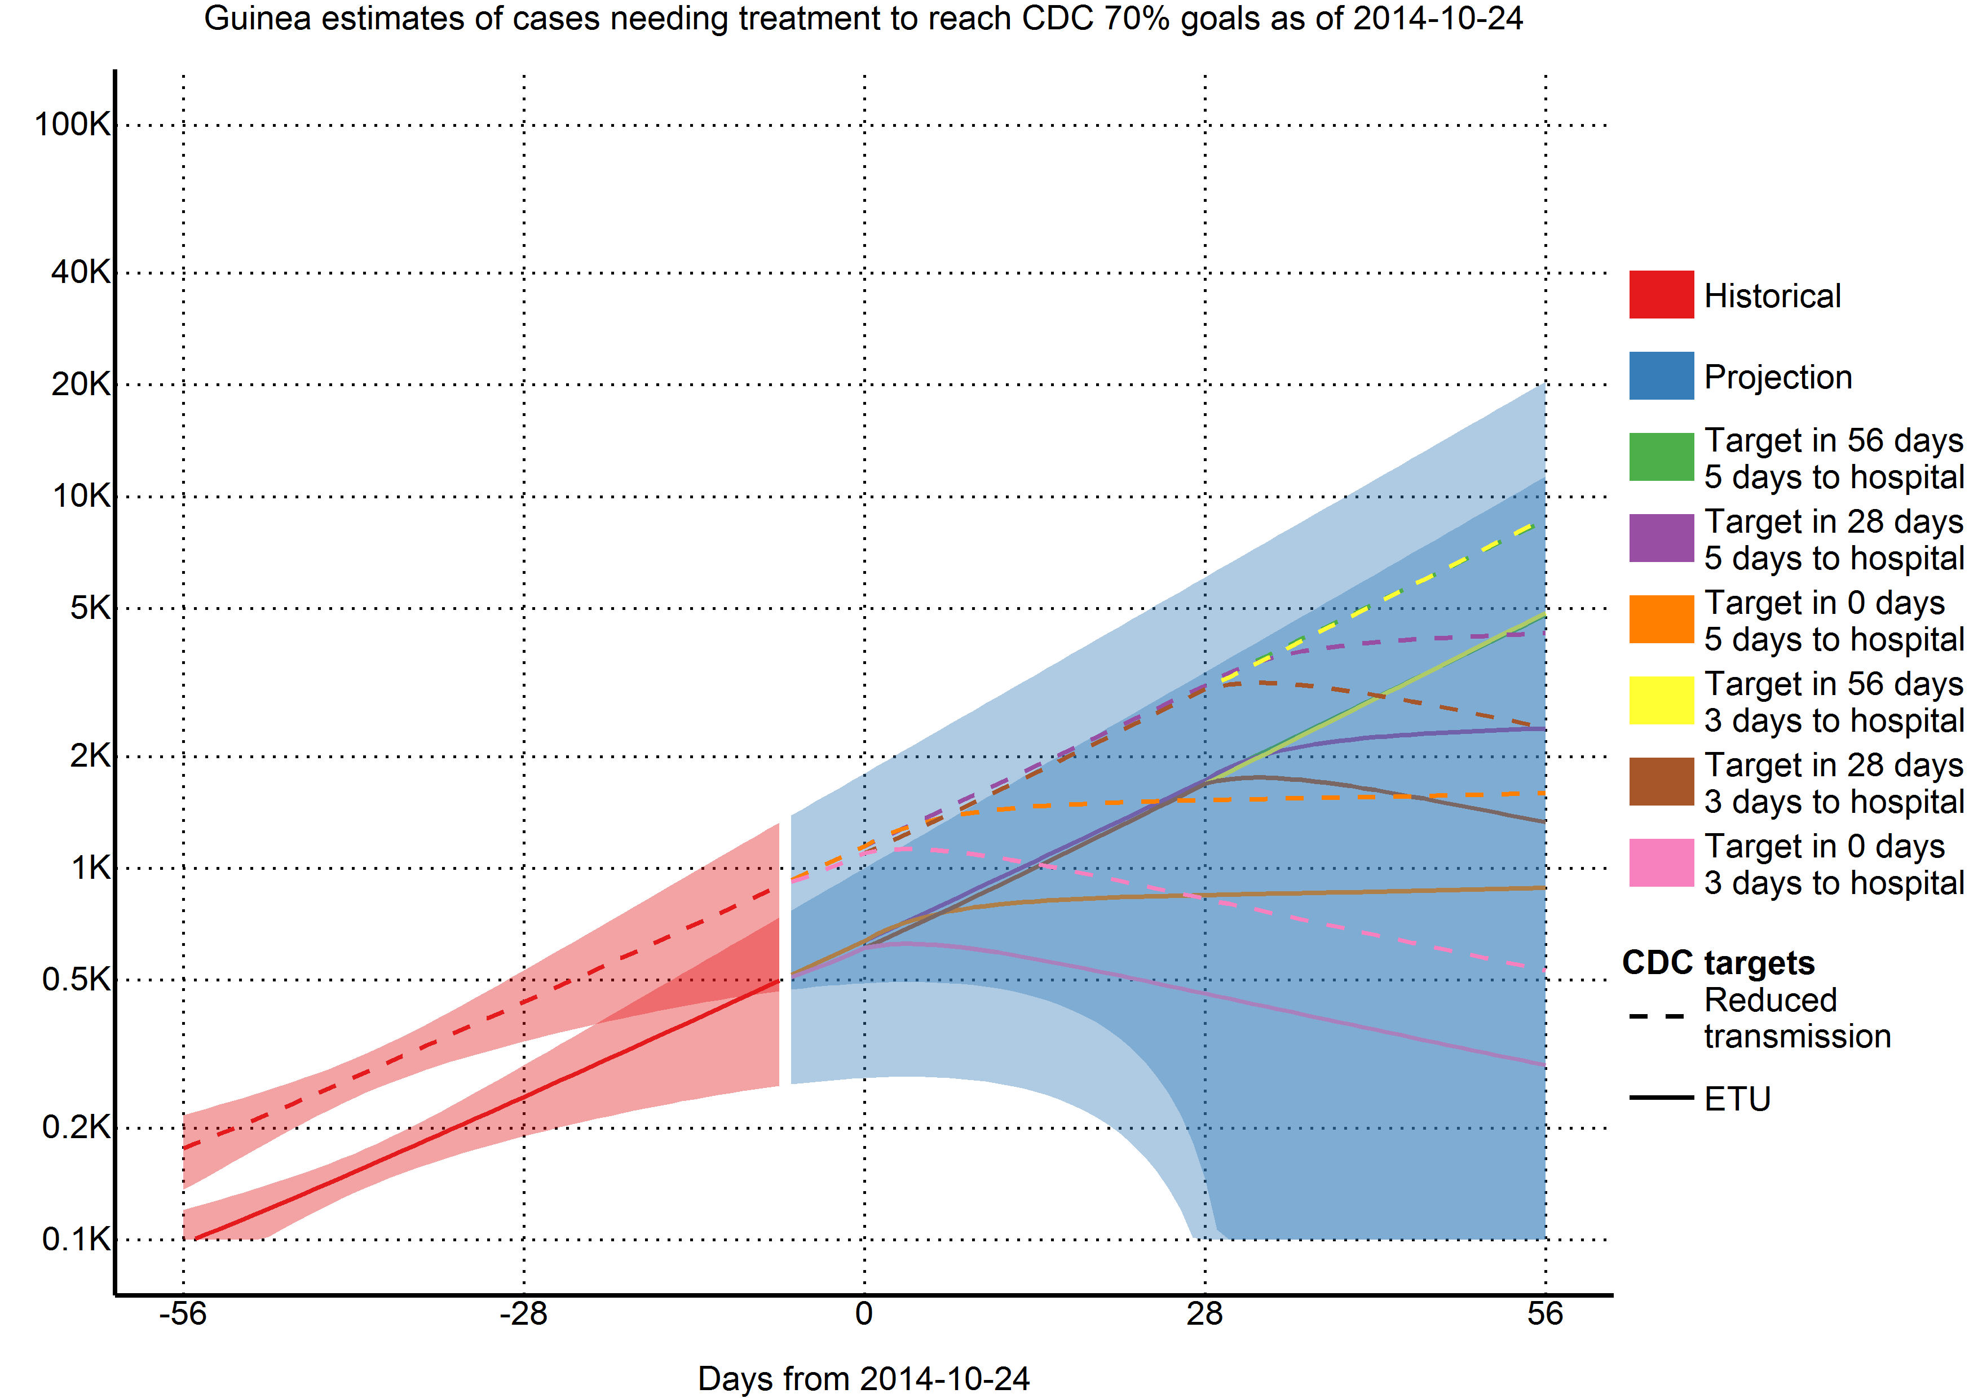
Requirements to achieve target

Slide 16
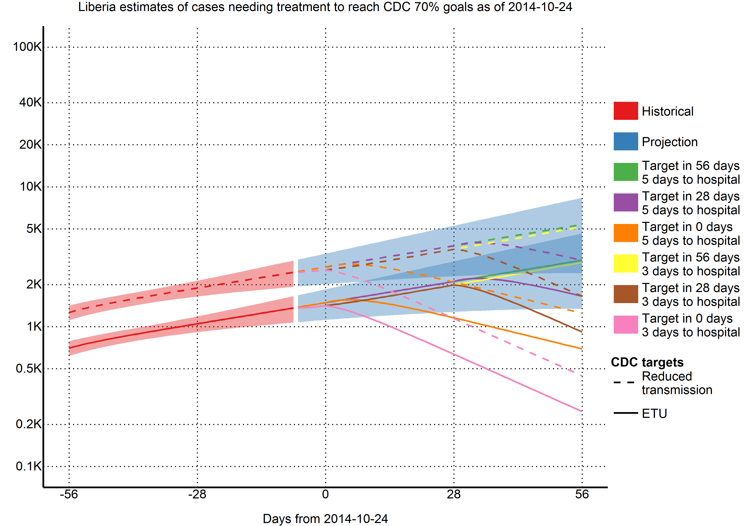
Requirements to achieve target

Slide 17
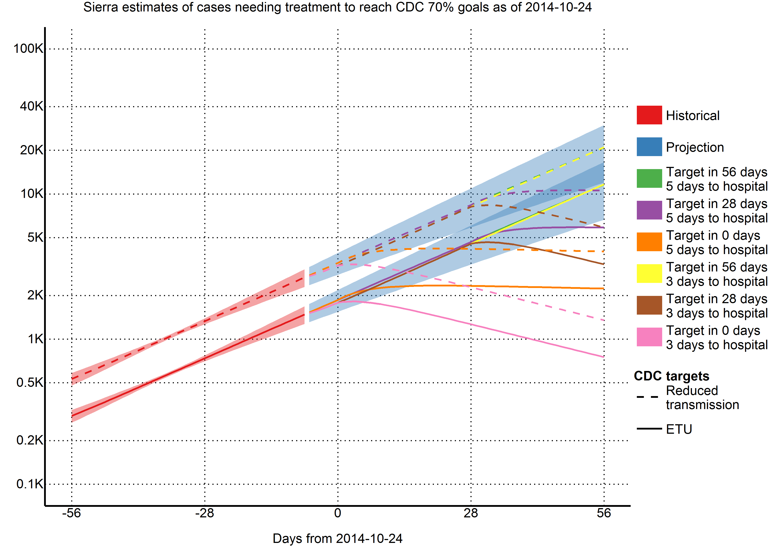
Requirements to achieve target

