Slide 1
Tumor Prediction on Gigapixel Pathology Images
By
Praditya Raudi Avinanto (pra2118)

Slide 2
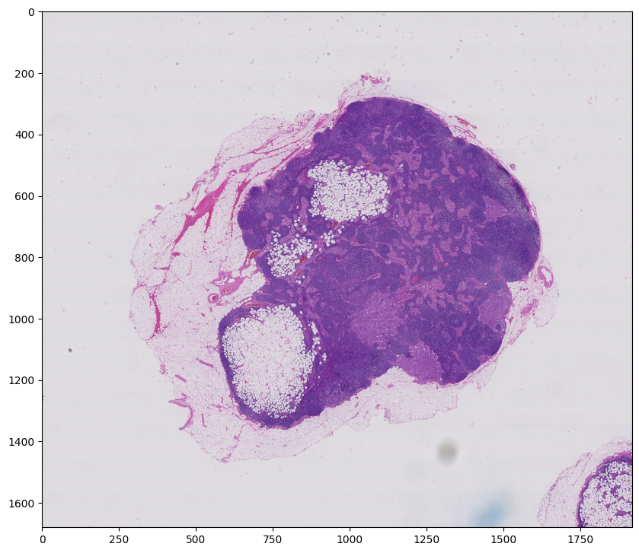
Objective

Slide 3
Workflow
Dataset
Generation
Model
Training
Prediction

Slide 4
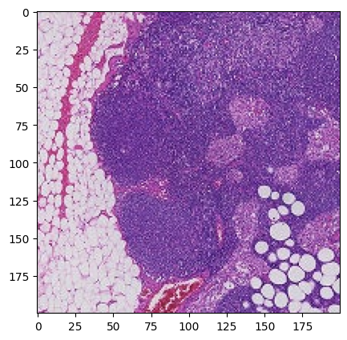
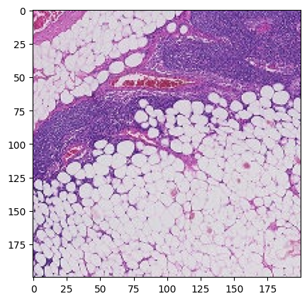
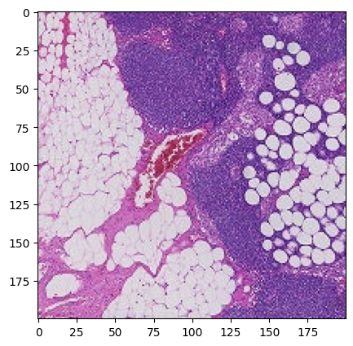
Dataset Generation
Tumor
Healthy

Slide 5
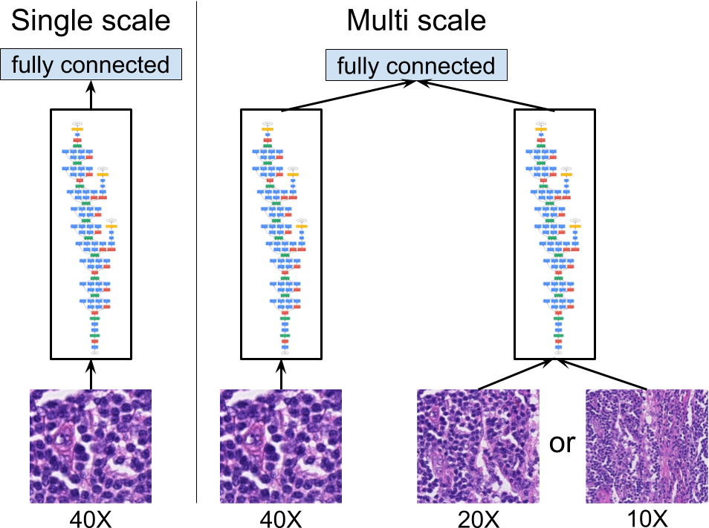
Model Training

Slide 6
Prediction

