Slide 1







Trending Technologies
Rauf Mifteev
2024

Slide 2



OUTLINE
Executive Summary
Introduction
Methodology
Results
Visualization – Charts
Dashboard
Discussion
Findings & Implications
Conclusion
Appendix

Slide 3

EXECUTIVE SUMMARY
Top programming languages in demand:
JavaScript, HTML/CSS, SQL, Bash/Shell, Python
Top databases in demand:
MySQL, MS SQL, PostgreSQL, SQL Lite, MongoDB
Most popular platforms:
Windows, Linux, Docker, AWS, Slack
Most popular Web frameworks:
jQuery, Angular, React.js, ASP.NET
Important technology trends:
Python increases its popularity
PostgreSQL and MongoDB are growing
React.js is overtaking jQuery

Slide 4

INTRODUCTION
The world of technology is constantly evolving.
It is crucial to be aware of the trends of this development.
Comparing todays and next year’s most popular technologies will provide us with great insight into these trends.
This study look into four main technology fields:
Most popular programming languages
Most popular database systems
Most popular platforms
Most popular Web frameworks

Slide 5

METHODOLOGY
The analysis in this report is based on data from Stack Overflow Developers Survey 2019. It involved over 80 thousand developers from 179 countries.
Data analysis went through stages such as: Data Preparation, Data Exploration, Preliminary Analysis and Visualization.
Jupiter Notebook was used for most of data analysis and Google Looker Studio - for most visualizations.

Slide 6
RESULTS
Among programming languages Python gaining popularity due to Data Science, most likely.
Open source databases (Postgres and MongoDB) are taking over and pushing out proprietary systems like MS SQL and Oracle.
Web development is still most in demand, React is overtaking jQuery.
Men represent over 90% of professional developers. Vast majority of them are young – below the age of 35.
Around 2/3 of respondents hold a university degree - Bachelor’s or Master’s.

Slide 7
PROGRAMMING LANGUAGE TRENDS
Current Year
Next Year
<Bar chart of top 10 programming languages for the current year goes here.>
< Bar chart of top 10 programming languages for the next year goes here.>

Slide 8
PROGRAMMING LANGUAGE TRENDS - FINDINGS & IMPLICATIONS
Findings
JavaScript & HTML/CSS are top programming languages
Python moves from 5th position to 3rd position in top 10.
PHP and C++ are falling out of top 10
Implications
Web programming will maintain its dominance in the near future.
Data Science is making Python more important in the near future
Legacy language such as PHP, C++, etc. are gradually losing their importance.

Slide 9
DATABASE TRENDS
Current Year
Next Year
< Bar chart of top 10 databases for the current year goes here >
< Bar chart of top 10 databases for the next year goes here.>

Slide 10
DATABASE TRENDS - FINDINGS & IMPLICATIONS
Findings
MongoDB & PostgreSQL are quickly moving up in the top 10.
Microsoft SQL Server is losing it’s position in the top 10.
Oracle is falling out of the top 10.
Implications
Open source databases become more and more popular.
Relational databases are leading and will be in the near future.
Non-relational databases will be increasingly important in the future.

Slide 11

DASHBOARD
You can find the link to the Google Looker Studio dashboard here:
https://github.com/rauf-mifteev/IBM_DA_Capstone_Project/blob/main/Capstone_5_2_Google_Looker_Dashboard.pdf

Slide 12
DASHBOARD TAB 1
Screenshot of dashboard tab 1 goes here

Slide 13
DASHBOARD TAB 2
Screenshot of dashboard tab 2 goes here

Slide 14
DASHBOARD TAB 3
Screenshot of dashboard tab 3 goes here

Slide 15
DISCUSSION
Emerging Technology Trends: The analysis shows a shift towards emerging technologies like TypeScript, Python, PostgreSQL, and MongoDB. Organizations should consider integrating these technologies to stay competitive and meet future demands.

Slide 16
OVERALL FINDINGS & IMPLICATIONS
Findings
Modern technologies
Python and Postgres overtaking classics like Oracle, MS SQL and C++.
Big Data and Cloud
Growing interest to MongoDB, Redis and cloud platforms.
Implications
Importance of investing in the modern technologies to stay up to date.
Importance of strategies for Big Data and Cloud integration to enhance decision-making and scalability.

Slide 17

CONCLUSION
Adopt Modern Technologies
Python, MongoDB, PostgreSQL.
Focus on Cloud and Big Data
AWS, Google Cloud, Redis etc.
Strengthen Web Development
JavaScript, TypeScript, React.
Stay informed and adapt.

Slide 18
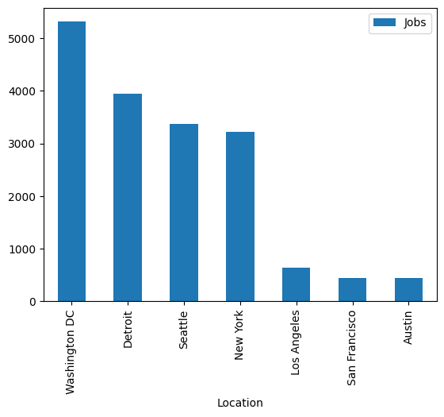
JOB POSTINGS
In Module 1 we have collected the job posting data using Job API. Here is a bar chart representing the number of job postings in different areas.

Slide 19
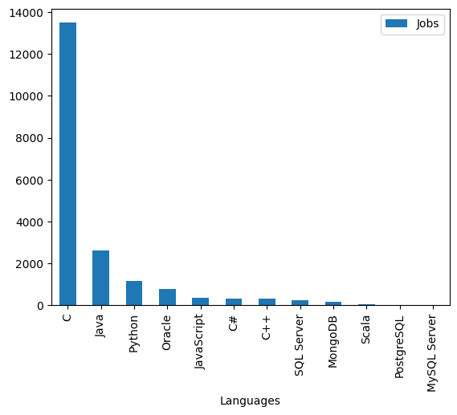
POPULAR LANGUAGES
In Module 1 we have collected the job postings data using web scraping. Here is that data on number of job postings for different languages in a form of a bar chart.

