Slide 1
AXI4-to-APB Bridge
Dual-agent UVM verification
UVM final project | Synopsys VCS L-2016.06, UVM 1.1d
GitHub: rauf25026/AXI2APB_UVM_VERIFICATION

Slide 2
The DUT: what the bridge does
Converts AXI4 read/write requests into APB transfers (single outstanding transaction)
FSM with 5 states: IDLE, WAIT_W_PREADY, WAIT_R_PREADY, SEND_B_RESP, DONE_SINGLE_RD
Every AXI channel passes through a FIFO (depth 4)
Read has priority over write; a write needs AW and W together
PSEL is always 1 and PENABLE rises in the first request cycle (no APB setup phase)
PSLVERR, WSTRB and WLAST are not used; BRESP/RRESP are always OKAY; only single-beat transfers
2 / 9

Slide 3
Flow and repository
M0
Git repo
+ README
M1
Compile
DUT
M2
Lint
M3
Verif. plan
M4-5
UVM env
+ agents
M6-7
Scoreboard
SVA, cov.
M8-10
Tests
regression
Folders: rtl/ tb/ uvm/ sequences/ tests/ assertions/ scripts/ docs/ logs/ results/
Makefile + build.flist for VCS; DUT RTL is not modified
Small meaningful commits and a daily docs/progress.md on GitHub
3 / 9

Slide 4
Compile and lint
Clean compile and elaboration with default parameters; DUT-only smoke run passes reset
VCS +lint=all: 36 messages, all reviewed (docs/lint_summary.md)
Tag | Count | Meaning / decision
VCDE | 19 | Compiler directive notice, informational
SVA-UA | 8 | Unnamed assertions in FIFO (style)
UI | 5 | Unused inputs: PSLVERR (real finding), testmode_i (DFT)
NS | 3 | Double semicolon in RTL, 2 in smoke top
INTFDV | 1 | Selective VCD dump of interface (testbench)
Manual review: the FSM next-state signal has no default assignment (latch if synthesized); simulation behaves correctly.
4 / 9

Slide 5
Verification plan
plan items, each traced to a test, a checker and a coverage item
sections: reset, AW/W/B, AR/R, wait states, ID/USER, priority, back-to-back, PSLVERR, unsupported features
Traceability tables: tests, 17 planned assertions, scoreboard checks, coverage groups
8 items marked TBC (to be confirmed by simulation) instead of assuming behaviour
Not implemented by choice: FIFO-full, burst, parameter-width and mid-transaction reset tests
5 / 9

Slide 6
UVM architecture
Test (bringup, wr/rd wait, b2b, mixed, pslverr, random wide)
Env
AXI master agent
sequencer, driver,
monitor
APB slave agent
reactive driver + memory,
monitor
DUT
axi2apb bridge
Scoreboard
AXI vs APB
Functional coverage
Monitors send transactions to the scoreboard and coverage; assertions (SVA) watch the pins.
6 / 9

Slide 7
Checking: scoreboard, assertions, mutation
Scoreboard compares AXI and APB: address, data, response, ID, read-beat count, queue left-overs
11 SVA assertions: APB stable during wait, VALID/READY stability, RLAST, OKAY response, PSEL
Mutation (fault injected) | Result
Address bit flipped | caught (6 errors)
Write / read data bit flipped | caught (3 + 3)
APB write removed | caught (1)
BRESP set to SLVERR | caught (3)
RID changed | caught (3)
Assertion A_RESP_OKAY_B reversed | failed as expected (3)
7 / 9

Slide 8
Results
8
0
directed and random tests, all PASS
UVM errors, scoreboard mismatches, assertion failures
functional coverage AXI / APB (random wide test)
Tests: wait states (writes, reads), back-to-back, mixed traffic, PSLVERR, wide random
APB slave delays of up to 8 extra cycles; every write and read matched by the scoreboard
Key finding: PSLVERR high on 15 of 30 APB transfers, yet BRESP and RRESP stayed OKAY
8 / 9

Slide 9
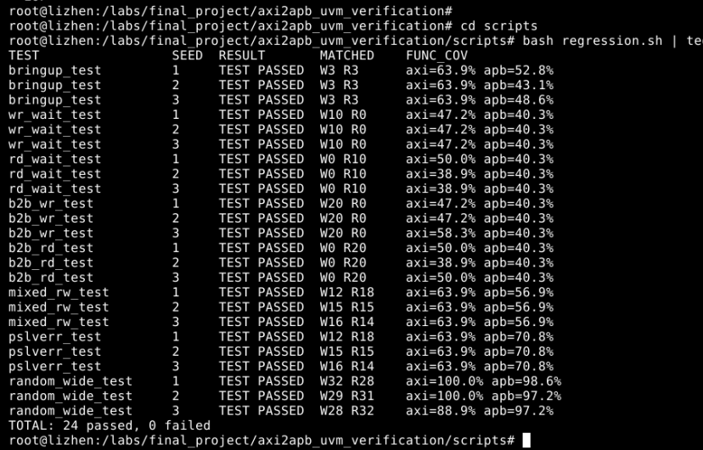
Regresstion Result
Findings
Limitations
PSLVERR is ignored by the RTL
FSM next-state has no default (latch if synthesized)
Non-standard APB: PSEL always 1, PENABLE in first cycle
AXI driver has no BREADY/RREADY delays; tests are one transaction at a time
No burst, FIFO-full, 64-bit or mid-reset tests
Monitors checked through logs, not independently
Next: 3-seed regression and code coverage report, BREADY/RREADY backpressure and priority tests, final report.
9 / 9

