Slide 1
Timesheet Data Model
Star Schema Overview

Slide 2
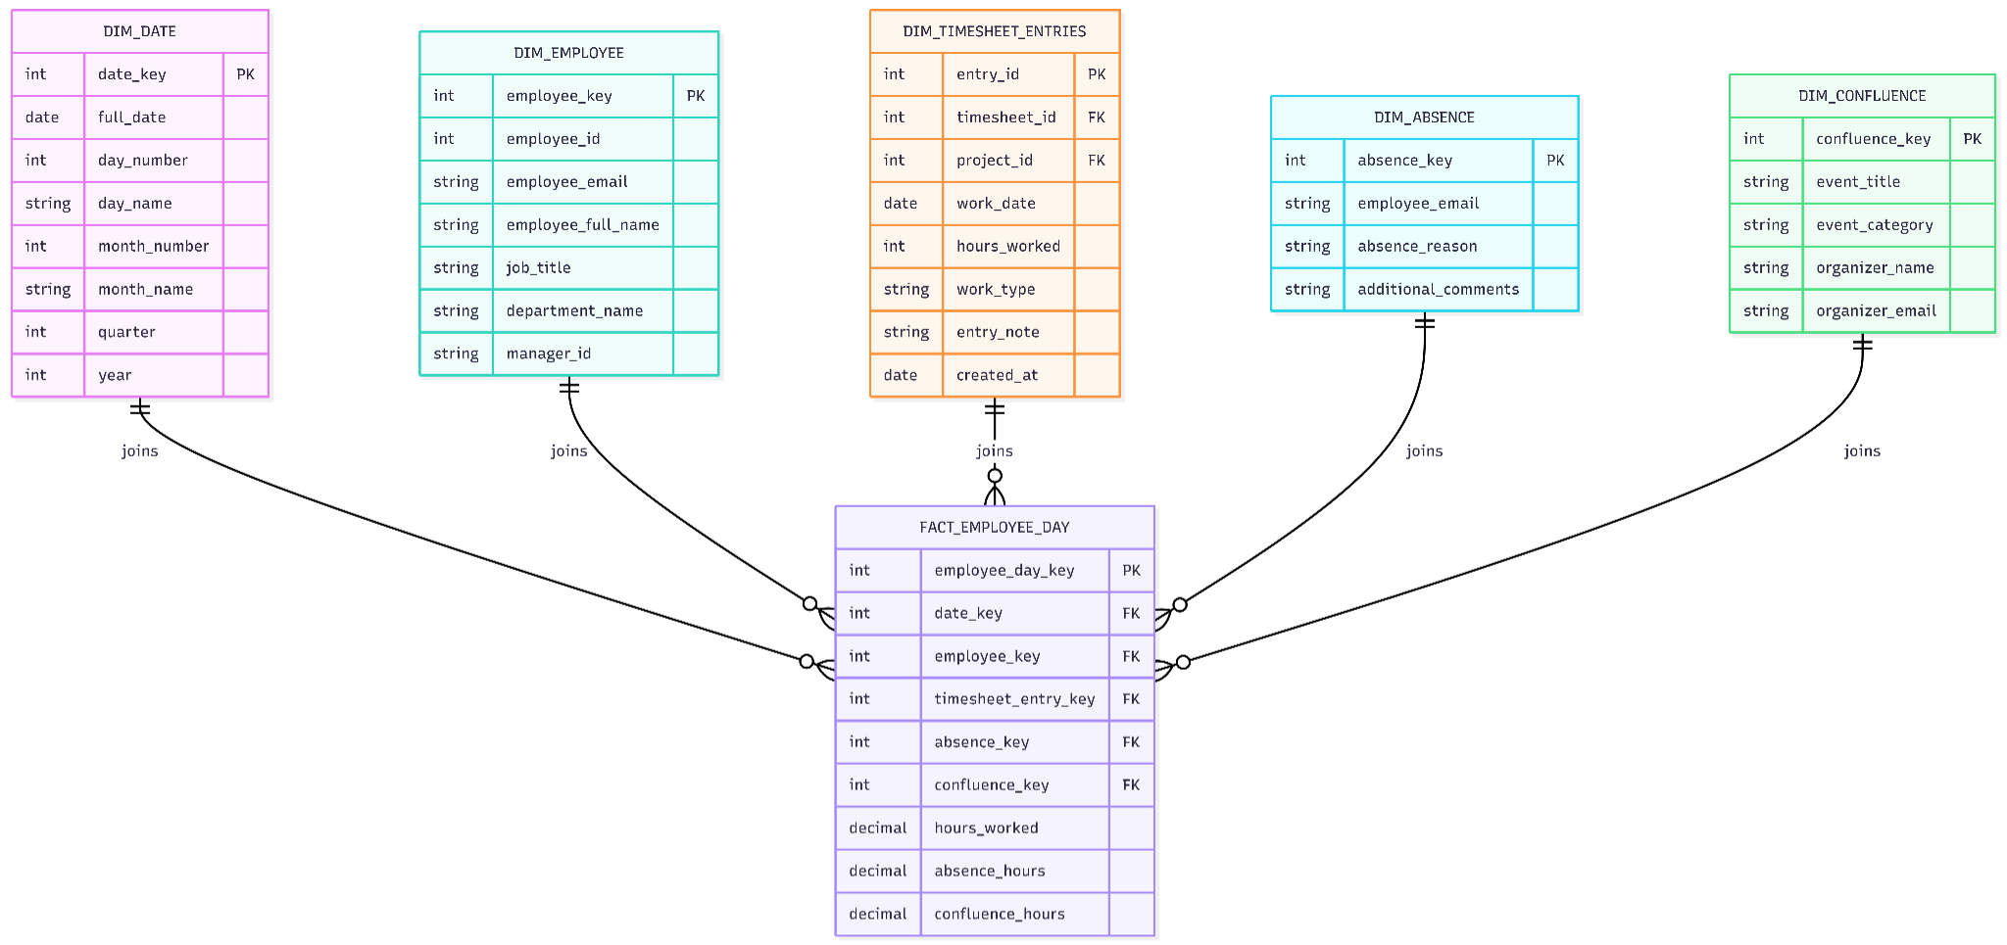
Initial Data Model

Slide 3
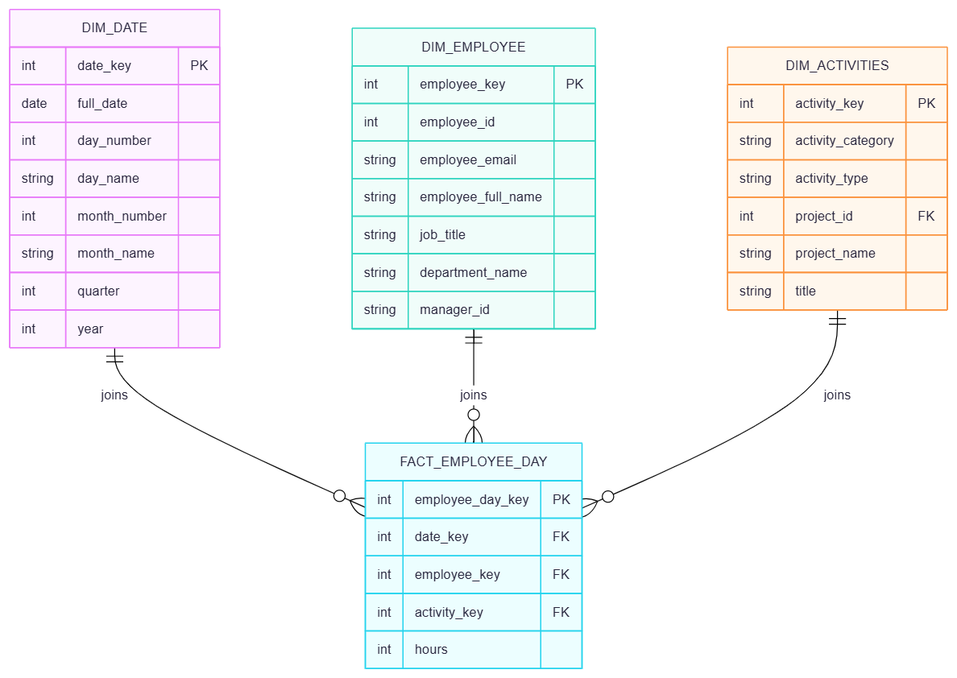
Simplified Data Model

Slide 4
