Slide 1




R INTRODUCTION FOR DATA SCIENCE
Database Characterization Report
Medicare Inpatient Hospitals
Raul Vieira

Slide 2
Background:
The Centers for Medicare & Medicaid Services (CMS) has prepared a public dataset, the Medicare Inpatient Hospitals;
It has information on services and procedures provided to Medicare beneficiaries by hospital facilities;
Latest data available: 2021
Data source: Centers for Medicare & Medicaid Services - https://data.cms.gov/provider-summary-by-type-of-service/medicare-inpatient-hospitals/medicare-inpatient-hospitals-by-provider-and-service
Number of Records: 151,989
Size: 38.576 KB

Slide 3

Provider Name
Provider City
Provider State
Diagnosis Definition
Diagnosis Description
LISTING
Total Discharges
Variables.
Total Covered Charges
Avg Total Payments
Avg Medicare Payments

Slide 4
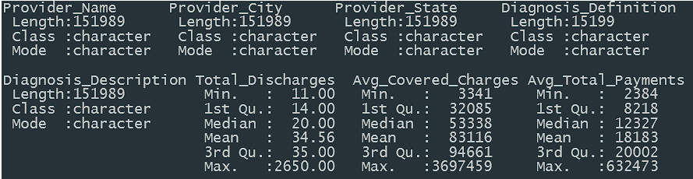
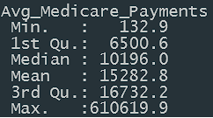
Summary()

Slide 5
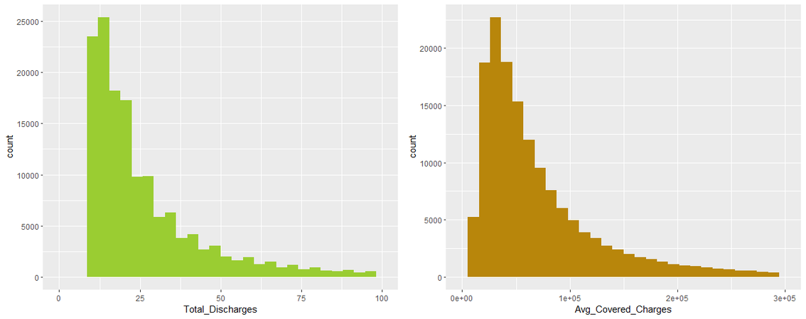
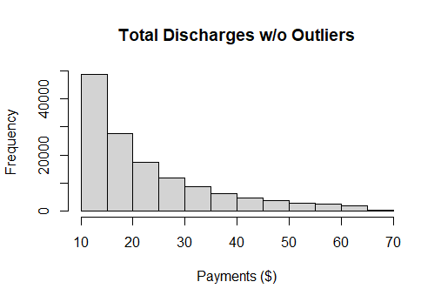
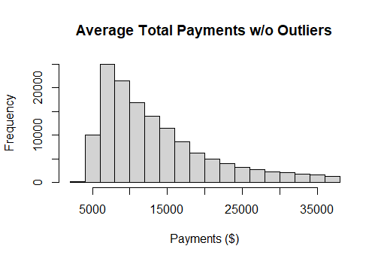
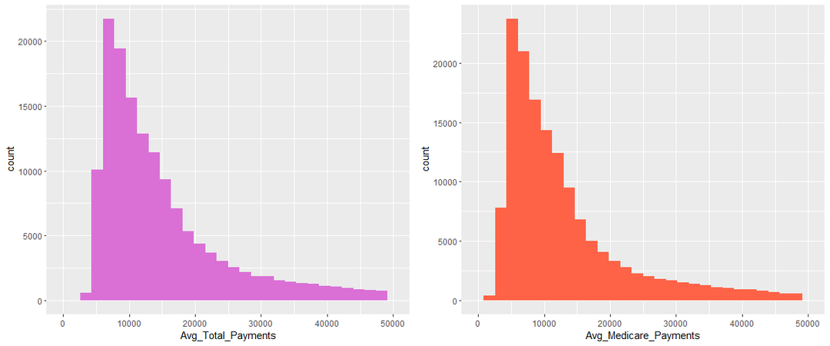
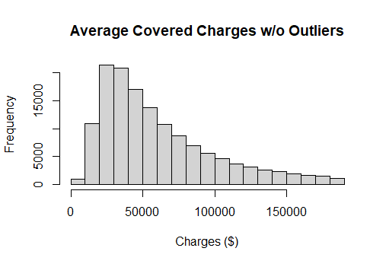
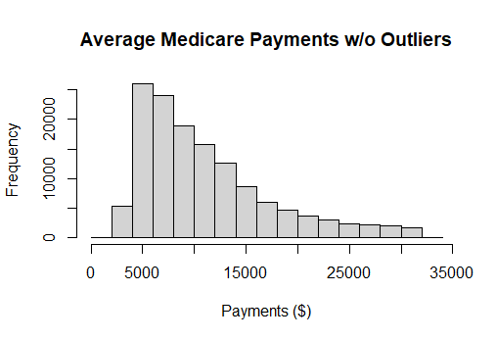
Data Visualization.
Histograms

Slide 6
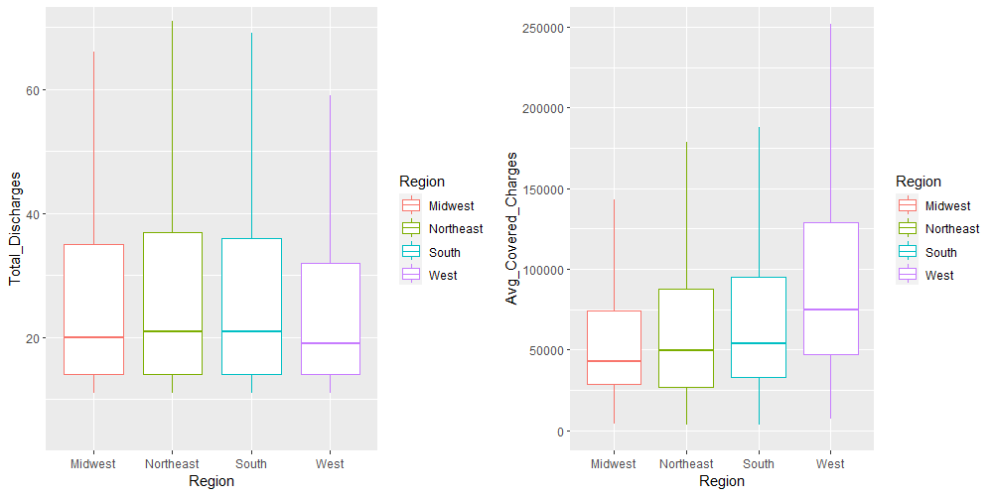
Data Visualization.
Boxplots

Slide 7
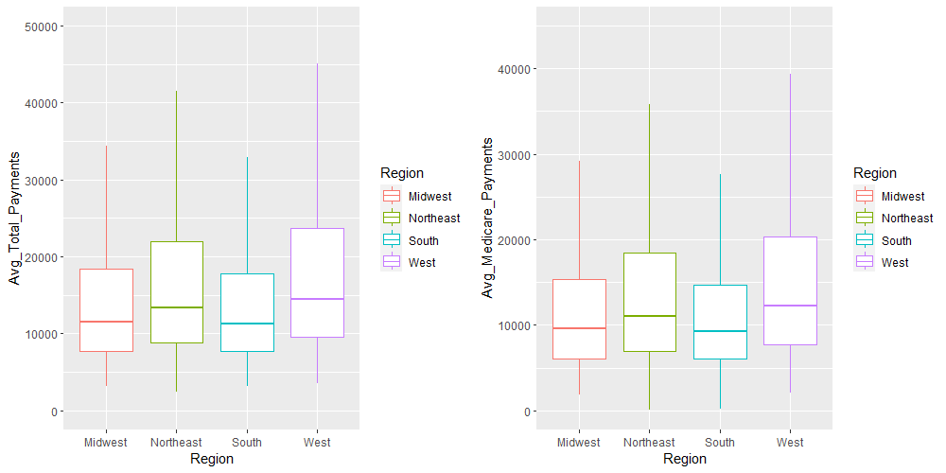
Data Visualization.
Boxplots

Slide 8
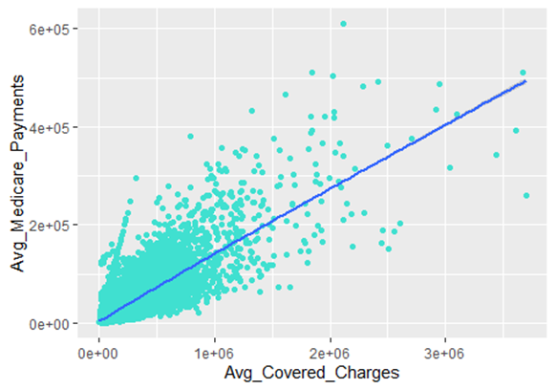
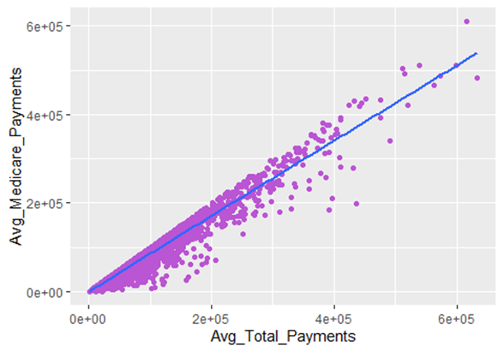
Data Visualization.
Scatter Plots with tendency line

Slide 9
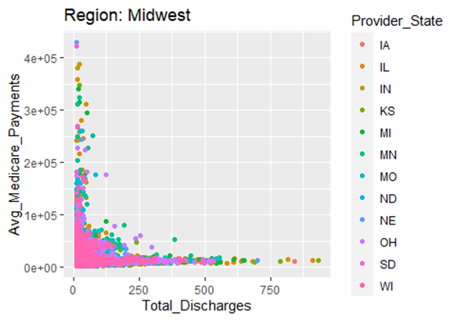
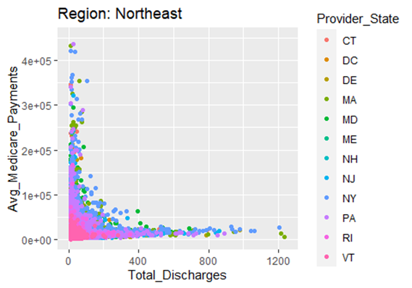
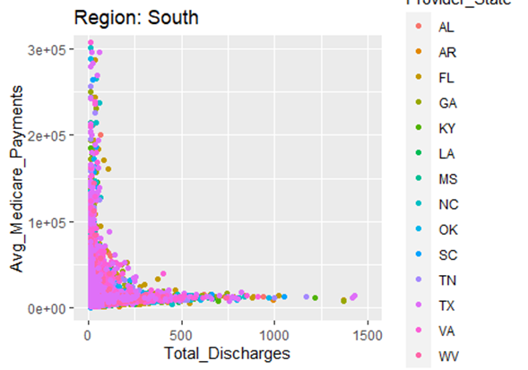
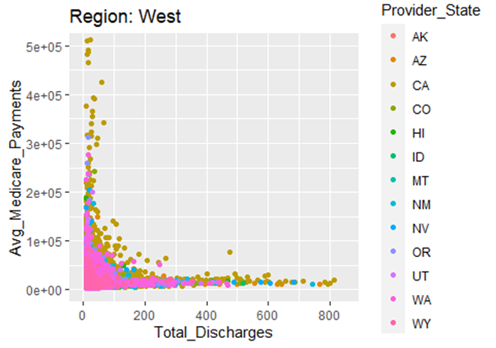
Data Visualization.
Other Scatter Plots

Slide 10
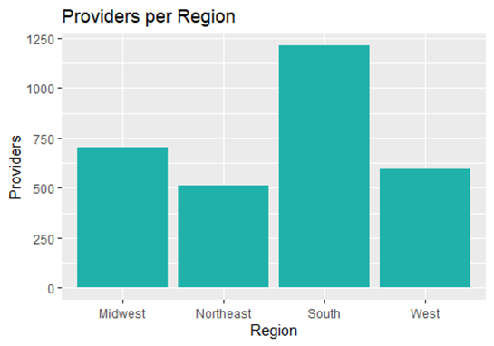
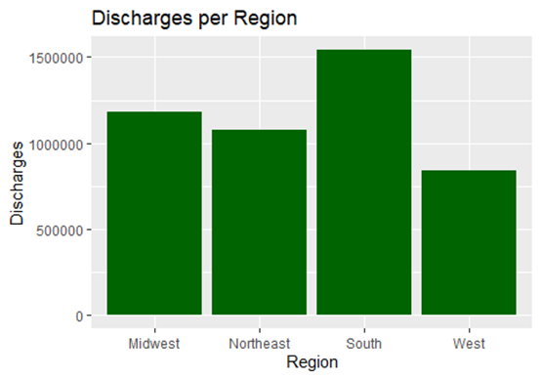
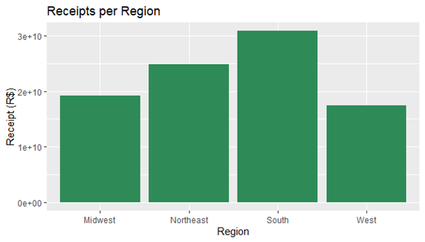
Data Visualization.
Barplots

Slide 11
Exploring Data.
LIVER TRANSPLANT WITH MCC OR INTESTINAL TRANSPLANT is the most expensive service registered, charged in $ 3697459,00;
ALCOHOL, DRUG ABUSE OR DEPENDENCE, LEFT AMA is the cheapest service registered, charged in $ 3340,84;
Grouping the data by Region, South has more number of discharges than the others, and West has less;
South region also has more providers, Northeast has less;
For higher costs of providers services, less discharges are registered. Cheaper treatments are more common.
There is a high positive correlation (+0.81) between charges and medicare payments, it means that for higher charges, higher are medicare payments;
There is a very high correlation between total and medicare payments (+0.98), as expected;
In northeast, Baltimore is the city with more providers, 14 registered;
In south, Houston is the city with more providers, 18 registered;
In midwest, Chicago is the city with more providers, 25 registered;
In west, Los Angeles is the city with more providers, 16 registered;
RESPIRATORY INFECTIONS AND INFLAMMATIONS WITH MCC is the most provided service, by 2830 hospitals;
Total number of Hospitals registered in this base: 2979;
There was a 92.29 billion dollars total receipt from all hospitals;
South has the major receipt (over 30 billion dollars), while west has the lowest (over 17 billion dollars)

