Slide 1
OkCupid
CSCI E-96 DATA MINING
RAHUL GHOSH

Slide 2
AGENDA
Introduction
Agenda
Information about the Data
Conclusion

Slide 3

Introduction
OkCupid is a U.S.-based, internationally operating online dating, friendship, and formerly also a social networking website and application. It features multiple-choice questions to match members.
We have been provided with a Data Set called profiles.csv and we will be analyzing the data to provide insightful information that can help in marketing the site and understand where our user base is coming from and what we can do in order to improve the user experience
Data set has around 60k objects or records and 22 variables (sex, orientation, height, etc.)

Slide 4

Data
From the data-set we see total number of people based on their sexual orientation
BISEXUAL | GAY | STRAIGHT
2767 | 5573 | 51606

Slide 5

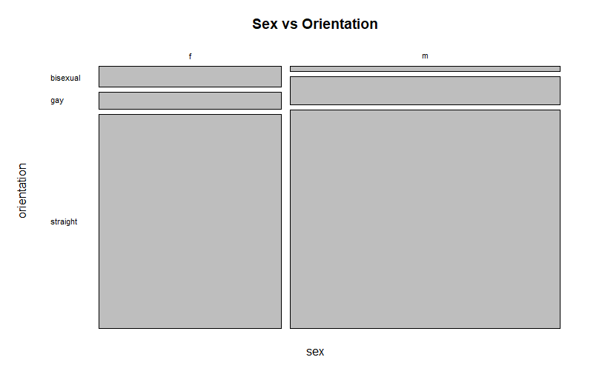
DATA
Relationship Between Sex and Sexual Orientation
sex bisexual gay straight
f 1996 1588 20533
m 771 3985 31073

Slide 6
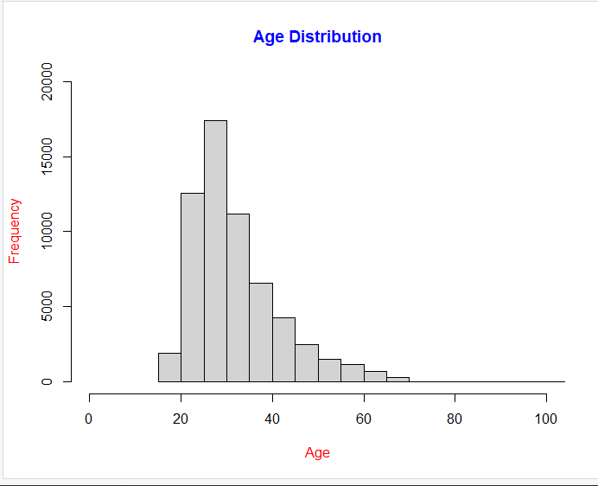
DATA
Age Distribution of Ok Cupid users – 21-40 age range and then it tapers off
Age Percent
21 -40 77.6%
23-35 58.8 %

Slide 7

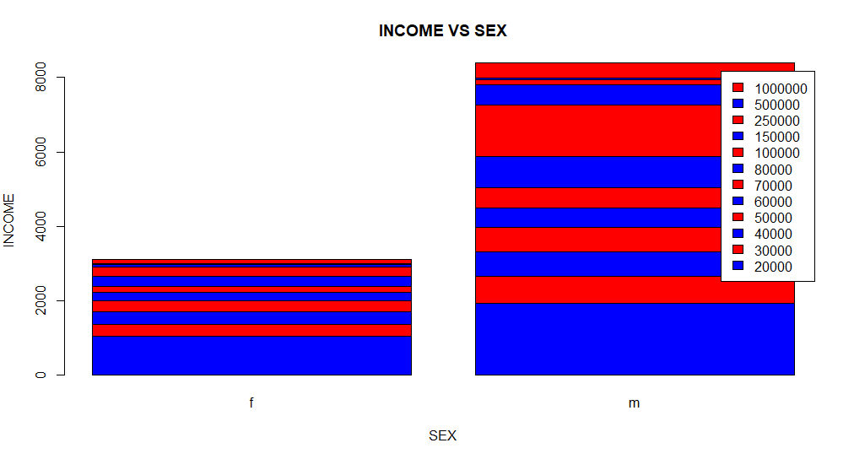

Data Income VS Sex Shows that men are making more money than females

Slide 8
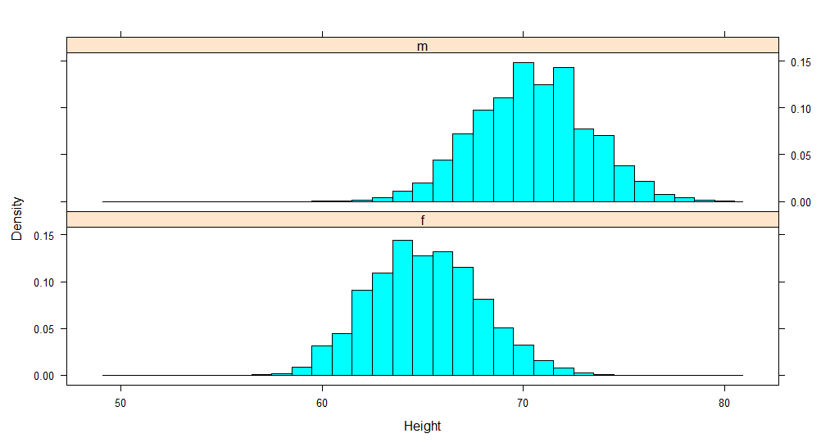
DATA Height Distribution Height between 50 -80 shows males in average are taller

Slide 9
Conclusion
We were able to get valuable information from the data
Help in making better business decisions
Bring valuable change within OkCupid users

Slide 10
Thank you

