Slide 1

Notes:
Hello Everyone, Good afternoon.
Present the team.

Slide 2

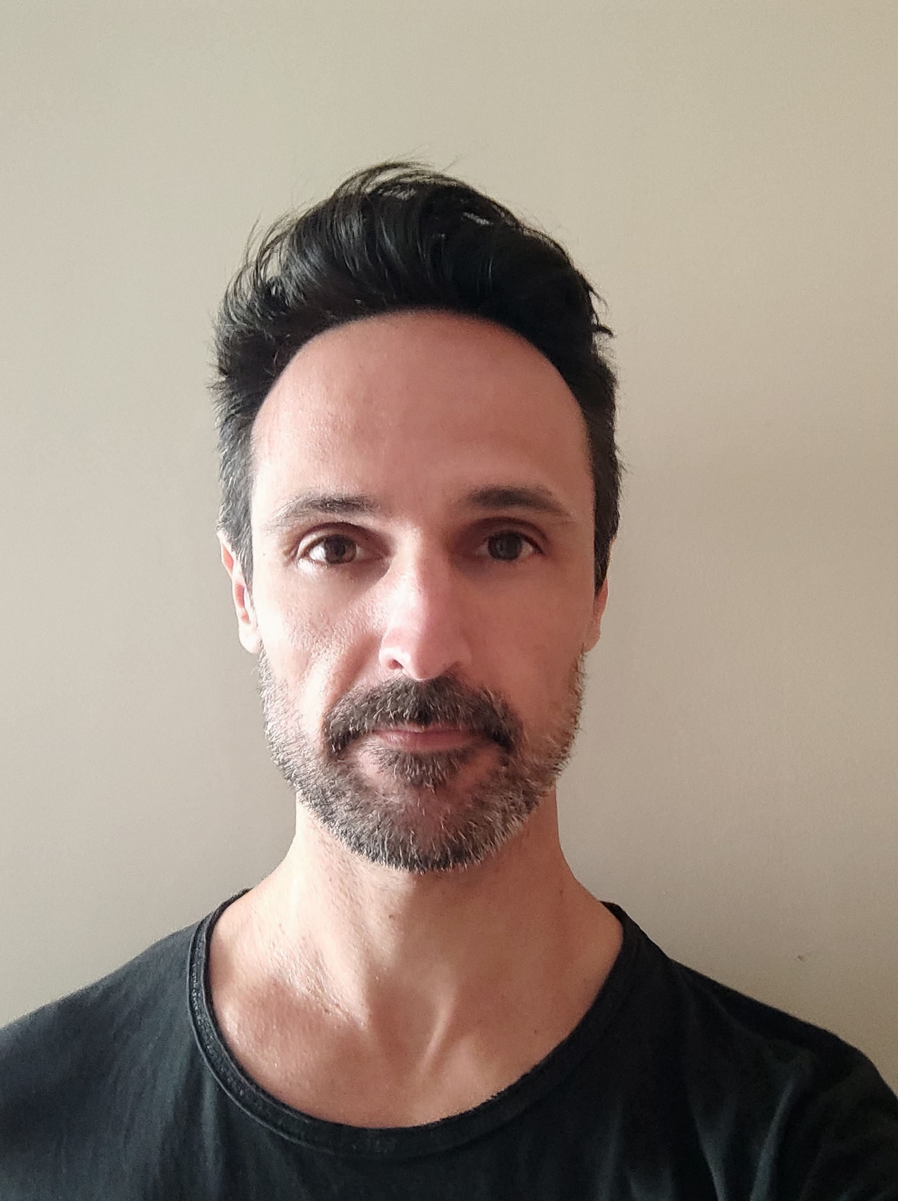
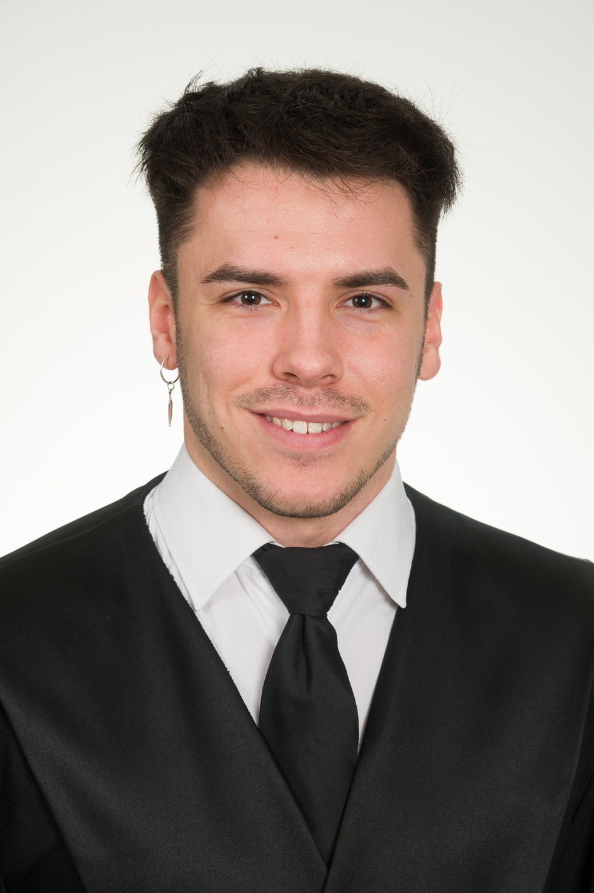
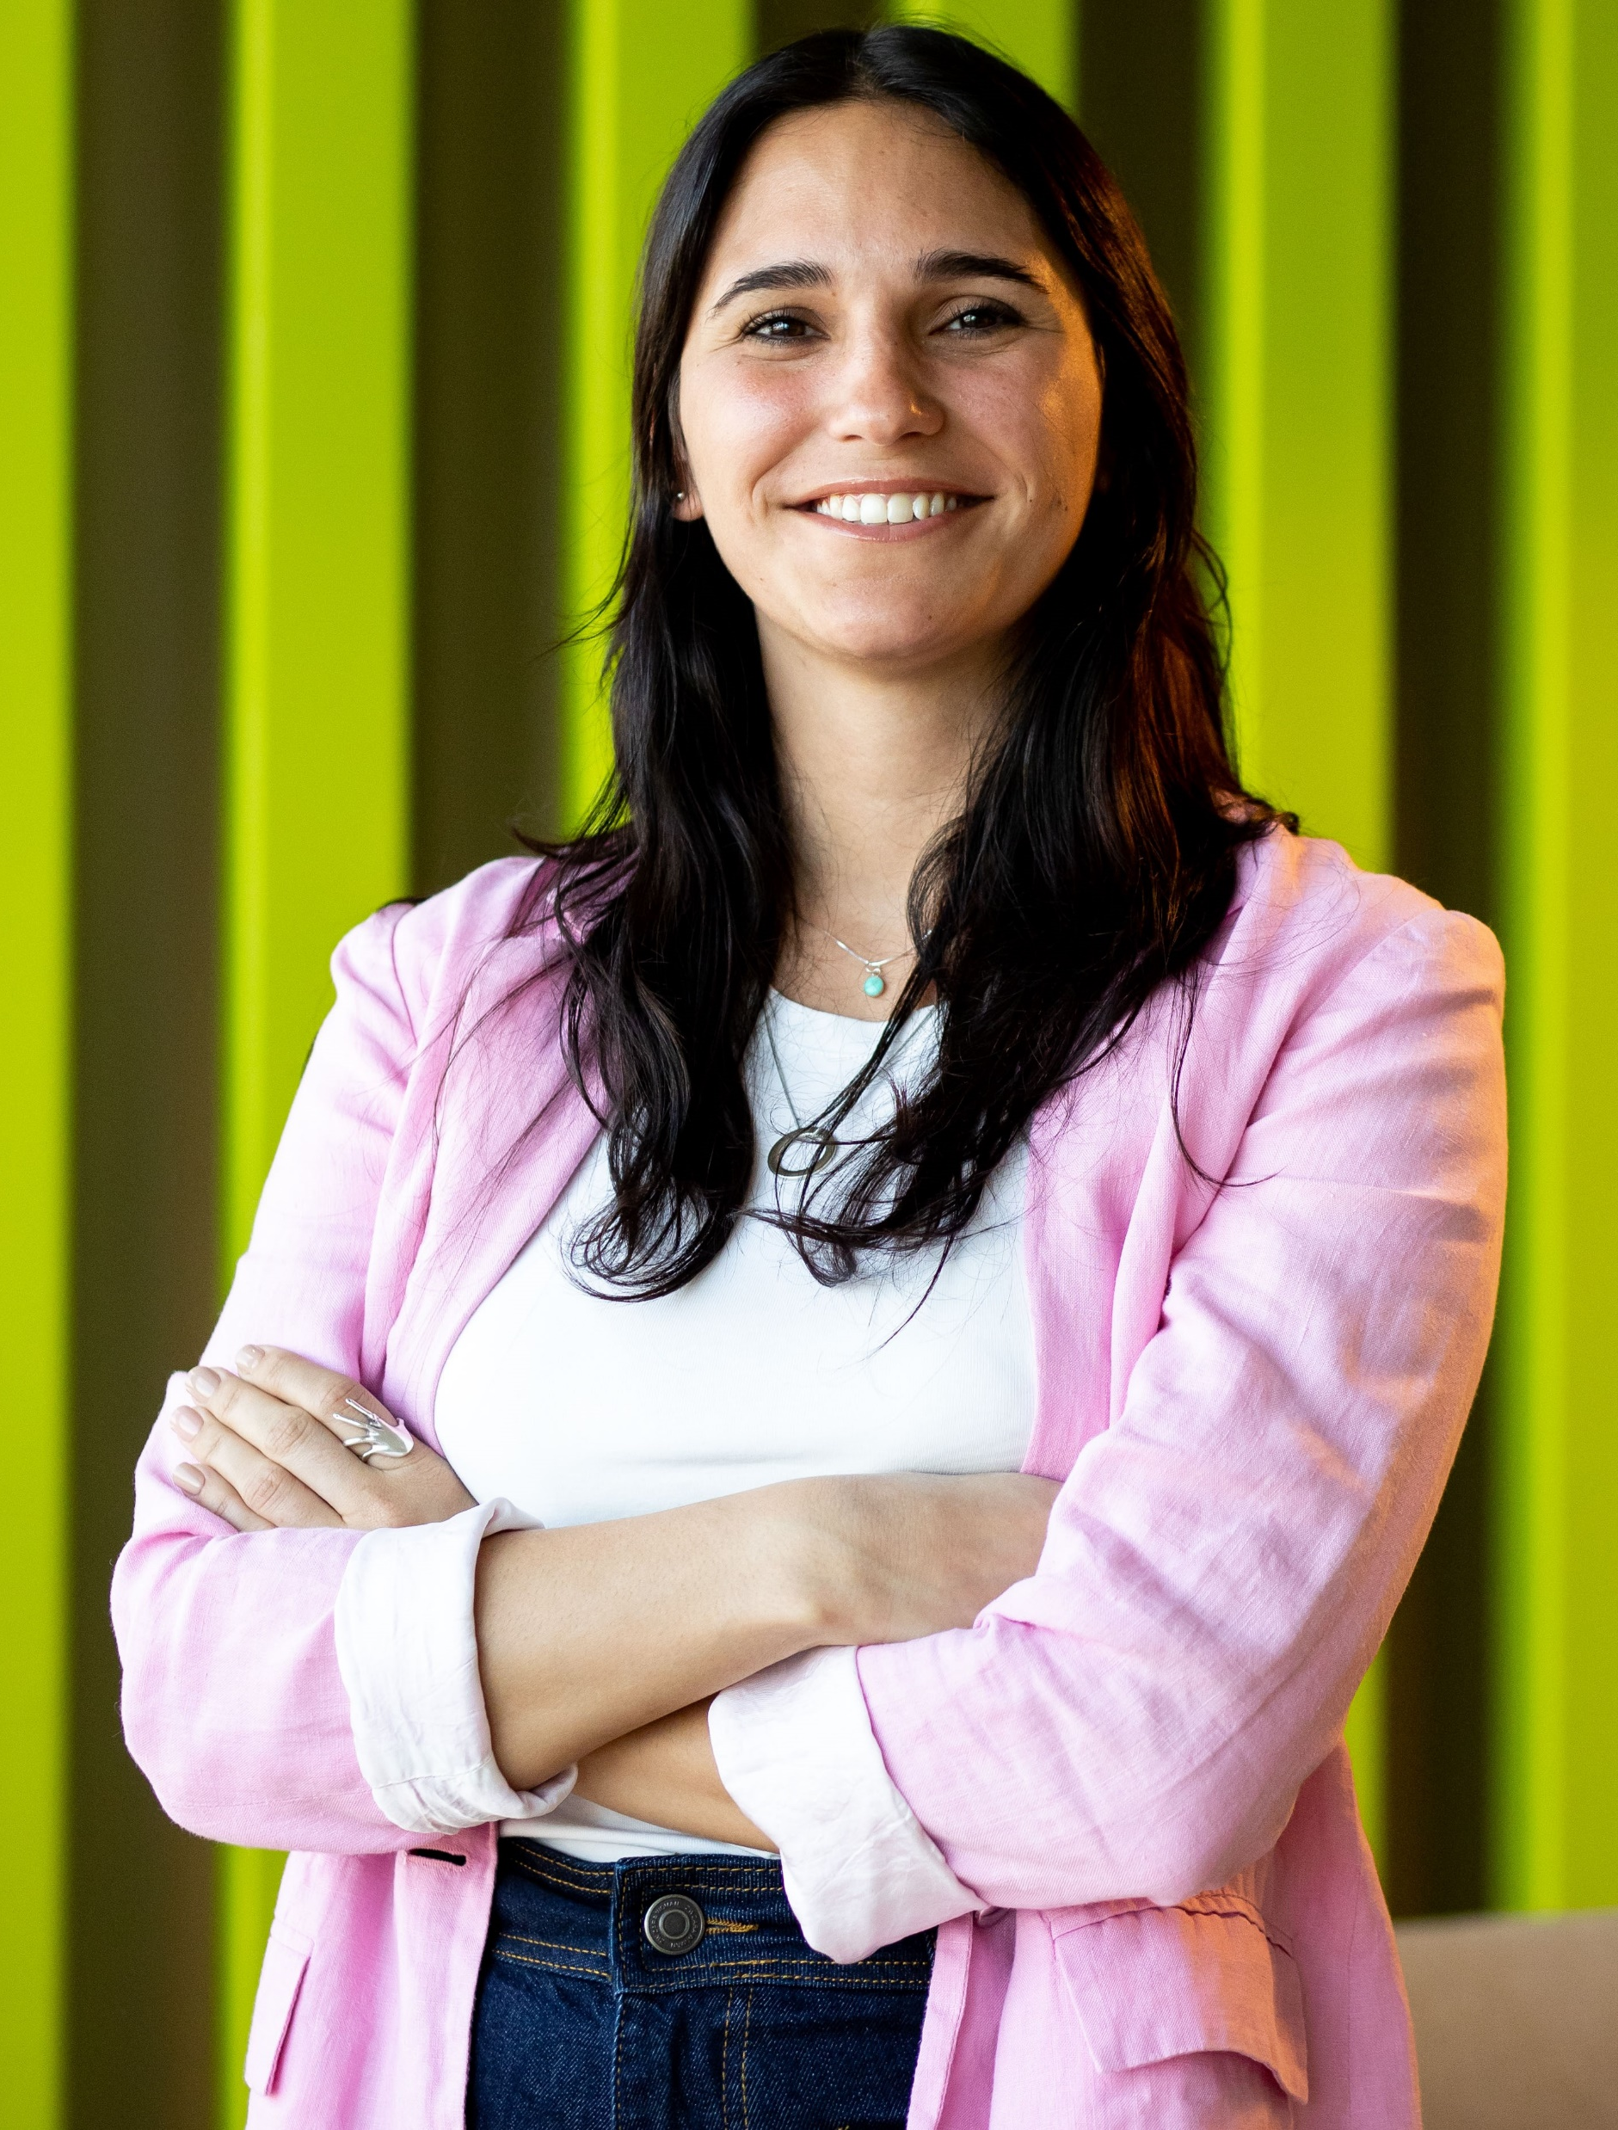
Our Team
Raúl Alhena
Eduard Ferré
Abril Garay
Notes:
This is our team.

Slide 3
Introducing Streamboost
Who are we?
Company providing services to Streaming platforms
What do we do?
Elevate your streaming experience to new heights! Say Good bye to low Quality streaming!
How do we do it?
Dedicated support team working behind the scenes to maximize your stream's potential, increasing your streaming quality on demad everytime you need it and supporting the environment
Notes:
I Will give you a short introduction of our company and then you Will have the chance to see a demo of our product.
We are a company dedicted to provide Services to streaming platforms.
Which is the Service provided? Nowadays is really common that for example you would like to see any evento, fight, launch via streaming because you dont have the chance to acces becasue there are no more tickets or tiket are expensive, so you go to your favourite streamer and live the evento through them…
How many times you tried to see any stream and the Quality was not Good or there were lags, not clear sound or image…
Well, streaboost has a solution for this. This solution Will not also impact on the final user that is the audience, but also for the streamer and for the platform. Its a win win for everyone.
Basically we are going to be able to manage the conection Quality in order to increase the Quality of the streaming depending on the evento you are and on the location. I Will leave the flor to my colleagues, they Will explain on detail how this is done.

Slide 4
Thank you for your time!

