Slide 1
Object Oriented - Cont
Done mainly in Java

Slide 2
Admin Things
Install Java/IntelliJ:
http://www.oracle.com/technetwork/java/javase/downloads/index.html
https://www.jetbrains.com/idea/download/

Slide 3
Abstractions
An abstract class is something which is incomplete and you can not create an instance of the abstract class. If you want to use it you need to make it complete or concrete by extending it. A class is called concrete if it does not contain any abstract method and implements all abstract method inherited from abstract class or interface it has implemented or extended. By the way, Java has a concept of abstract classes, abstract method but a variable can not be abstract in Java.
Let's take an example of Java Abstract Class called Vehicle. When I am creating a class called Vehicle, I know there should be methods like start() and Stop() but don't know start and stop mechanism of every vehicle since they could have different start and stop mechanism e.g some can be started by a kick or some can be by pressing buttons.
The advantage of Abstraction is if there is a new type of vehicle introduced we might just need to add one class which extends Vehicle Abstract class and implement specific methods. The interface of start and stop method would be same.

Slide 4
Example
Create a new class called SquarePizza that extends Pizza. Since now we have 2 completely different types of pizzas. We can’t calculate the surface in the base class. Make the PizzaArea method abstract and implement it in the SmallPizza and the SquarePizza accordingly. Compare using ComparePizzas the 2 instances of SmallPizza and SquarePizza.
Note: you might need to refactor a lot of code since the Pizza class can’t be instantiated. For simplicity, try to just rename it to SquarePizza.

Slide 5
Interfaces
The interface keyword takes the concept of abstractness one step further
An interface says, "All classes that implement this particular interface will look like this." Thus, any code that uses a particular interface knows what methods might be called for that interface, and that’s all. So the interface is used to establish a "protocol" between classes. (Some object-oriented programming languages have a keyword called protocol to do the same thing.)

Slide 6
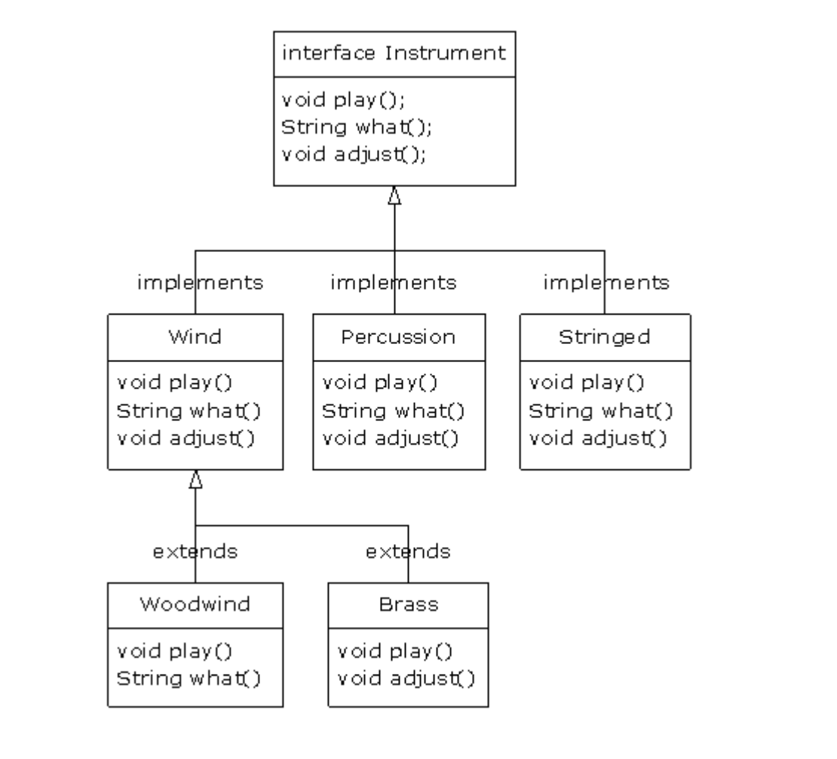

Slide 7
Excercise
Implement an interface called Food that has 2 methods:
String WhatAmI
Boolean EatableRaw
Implement the interface in Pizza in the following way:
WhatAmI returning ”Pizza”
EatableRaw returning false

Slide 8
Exercise
Create a new package called ingredients
A new interface called Ingredient
With 1 method: int Cost()
The following ingredients as classes:
Corn, Mushrooms, Salami, Tomatoes
Each class implements the following interfaces: Ingredient and Food
(optional) In addition to WhatAmI overwrite the toString method in the same way

Slide 9
Exercise
In the App create an instance of each Ingredient
Display the sum of all ingredients (by calculating it)
List all ingredients

Slide 10
Collections
The Java Collections API's provide Java developers with a set of classes and interfaces that makes it easier to handle collections of objects. In a sense Collection's works a bit like arrays, except their size can change dynamically, and they have more advanced behavior than arrays.
Rather than having to write your own collection classes, Java provides these ready-to-use collection classes for you

Slide 13
Collections
The following interfaces (collection types) extends the Collection interface:
List
Set
SortedSet
NavigableSet
Queue
Deque

Slide 14
List
The java.util.List interface is a subtype of the java.util.Collection interface. It represents an ordered list of objects, meaning you can access the elements of a List in a specific order, and by an index too. You can also add the same element more than once to a List.
Since List is an interface you need to instantiate a concrete implementation of the interface in order to use it. You can choose between the following List implementations in the Java Collections API:
java.util.ArrayList
java.util.LinkedList
java.util.Vector
java.util.Stack

Slide 15
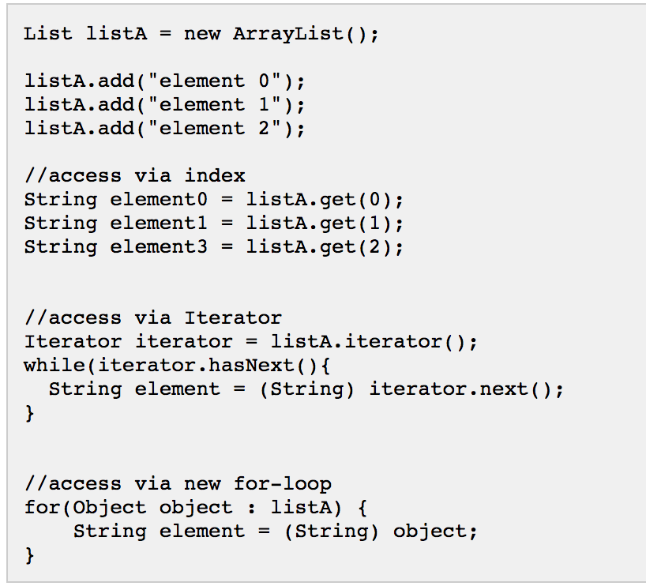
Example

Slide 16
Exercise
In the Pizza class create an ArrayList of Ingredients
Create a getter setter for that list
The add 3 (any 3) ingredients to the newPizza – the example already has that object.
Create a getter in the Pizza class that calculates the cost of a pizza based on the ingredients.
Make sure there is no member in the class that stored the cost (at the point we consider that an anti-pattern)
Display the cost and the list of ingredients
Keep in mind that the cost and WhatAmI are in 2 different Interfaces

Slide 17
Other types of Lists
Set is a subtype of the java.util.Collection interface. It represents set of objects, meaning each element can only exists once in a Set.
SortedSet interface is a subtype of the java.util.Set interface. It behaves like a normal set with the exception that the elements are sorted internally. This means that when you iterate the elements of a SortedSet the elements are returned in the sorted order.
NavigableSet interface is a subtype of the java.util.SortedSet interface. It behaves like a SortedSet with the exception you have navigation methods available in addition to the sorting mechanisms of the SortedSet.

Slide 18
Maps
The java.util.Map interface represents a mapping between a key and a value. The Map interface is not a subtype of the Collection interface. Therefore it behaves a bit different from the rest of the collection types.
Implementations:
java.util.HashMap
java.util.Hashtable
java.util.EnumMap
java.util.IdentityHashMap
java.util.LinkedHashMap
java.util.Properties
java.util.TreeMap
java.util.WeakHashMap

Slide 19
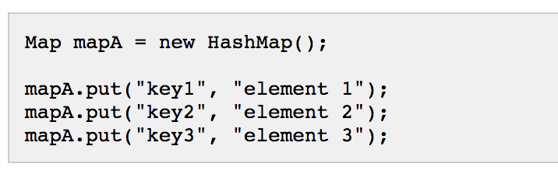

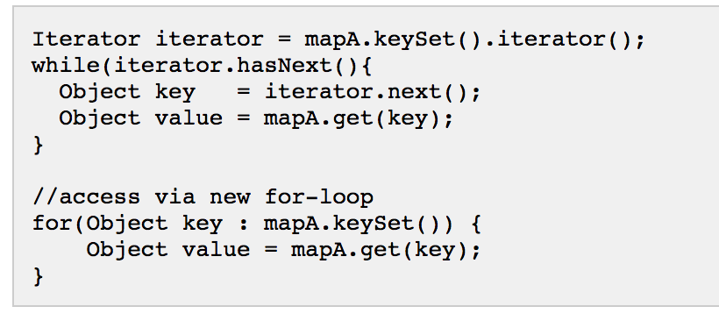
HashMap
Adding Elements
Getting a value from a Map
Iterate though keys to get the values

Slide 20
Exercise
Refactor the Ingredients implementation using HashMaps

Slide 21
Other Types of Maps
SortedMap interface is a subtype of the java.util.Map interface, with the addition that the elements stored in the map are sorted internally.
NavigableMap interface is a subtype of the java.util.SortedMap interface. It has a few extensions to the SortedSet which makes it possible to navigate the map.

Slide 22
Queue
The java.util.Queue interface is a subtype of the java.util.Collection interface. It represents an ordered list of objects just like a List, but its intended use is slightly different. A queue is designed to have elements inserted at the end of the queue, and elements removed from the beginning of the queue. Just like a queue in a supermarket.
Implementations:
java.util.LinkedList
java.util.PriorityQueue

Slide 23
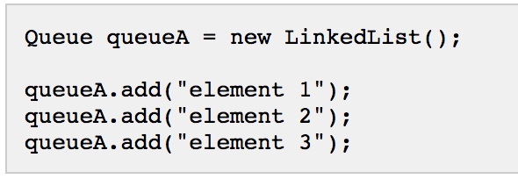


Queue
Creating a Linked list
Peeking in the first element
”Using” the first element

Slide 24
Exercise
In the SmallPizza class implement a LinkedList (static) to store orders that are sent to the customer
In the App remove those orders by printing them.

Slide 25
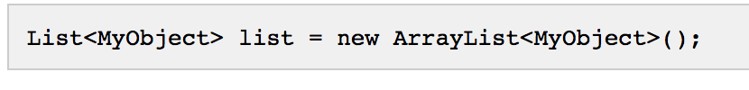
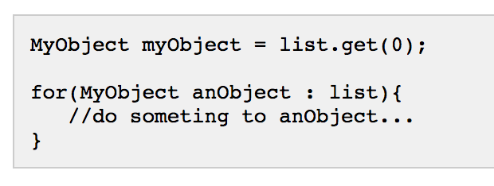
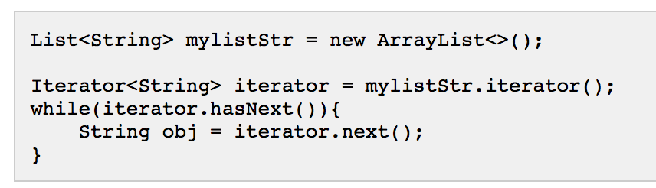
Generic Lists and Maps
By default you can put any Object into a List, but from Java 5, Java Generics makes it possible to limit the types of object you can insert into a List.
Here is an example

Slide 26
Homework
Refactor the implementation using either a generic List or a generic Map
How would it work if we want to use only 1 List or Map? Considering that a Generic List can only be casted to one Interface. What kind of refactoring would we have to do?

