Slide 1
Artificial Intelligence
Knowledge Representation
Gerardo Ayala
2017

Slide 2
Knowledge Representation
Problem Solving (SEARCHING) requires knowledge.
Knowledge is
what to do in a given situation.
The basic architecture of an AI system:
Searching Engine + Knowledge Base.
Knowledge representation
became an area of AI.

Slide 3
Knowledge Engineering
The design and development of Knowledge Based Systems (KBSs).
Analysis of real world knowledge.
Knowledge aquisition.
Computational modeling of knowledge (knowledge representation).
Knowledge manipulation by an inference engine for problem solving or educational purposes.
Knowledge Management.

Slide 4
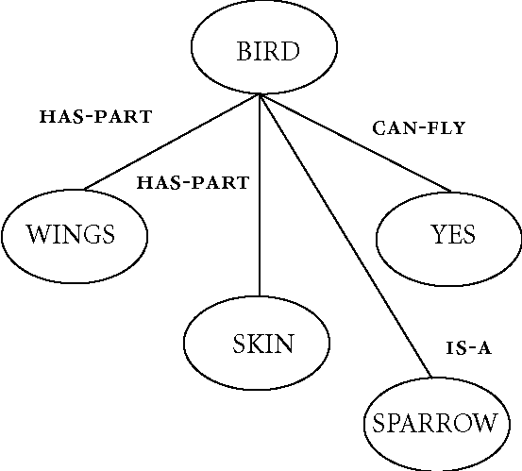
Semantic Networks
Semantic relations guide the searching process.
is-a (inheritance)
has-part/part-of
..and others
¿Does a sparrow have wings?
¿Can a sparrow fly?

Slide 5
Declarative Knowledge
Knowledge about something.
Declarative knowledge is applied in a situation
when the system needs to provide information.
Paris is the capital city of France.
The distance from Mexico City
to Puebla is 132 kms.
IF grade < 7.5 AND you can still quit the course
THEN you better quit

Slide 6
Procedural Knowledge
Knowledge about what to do or how to do something.
Procedural knowledge is applied in a situation
when the system needs to perform an action
or a sequence of actions.
In order to provide the price of the product we need to
Calculate the cost of materials
Calculate production time and cost of hand work
Determine productionCost = cost of material + cost of hand work
Define the % of income
Determine priceIncludingTaxes = productionCost + income +
(cost + income)* 1.16

Slide 7
Logic Predicates
PROLOG (PROgrammin in LOGig).
Knowledge represented with logic predicates.
1972
Facts and Rules.
A program in PROLOG is a deductive database.
Data = code.
There is an inference engine that manipulates the facts and rules.
The inference engine responds if a predicate is TRUE or not, and under which values is true.

Slide 8
Logic Predicates Examples
FACTS
distance(mexico, puebla, 132).
grade(“Pedro”, 7.2).
canQuit.
A RULE betterQuit:-
grade(“Pedro”, Y),
Y < 7.5,
canQuit.
QUERIES
distance(mexico, puebla, X)?
-> X = 132
betterQuit? -> YES

Slide 9
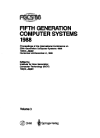
The Fifth Generation Computer
Japanese national project (1982 – 1992)
In a Knowledge Society, computers should be
knowledge manipulation machines.
Processor = Inference Engine
Databases = Deductive Databases
Machine Language = PROLOG
It was ahead of its time.
Poor support from software and
hardware companies.
Huge expectations, poor results.

Slide 10
Expert Systems
AI applications, based on the means ends analysis basic architecture.
Rule based knowledge bases and an inference engine.
Popular tools for knowledge engineering.
Usually diagnosis and classification applications.
Expert systems development environment = rule editor + inference engine.
NEXPERT

Slide 11

Connectionism
“Elephants don’t play chess”
1990s
Parallel Distributed Processing (Rumelhart and McClelland)
AI systems must be able to interact
with the real world.
Pattern recognition.
“The map is not the territory”
Situated cognition vs knowledge representation.
(William Clancey)
Intelligence without representation (Rodney A. Brooks)

Slide 12

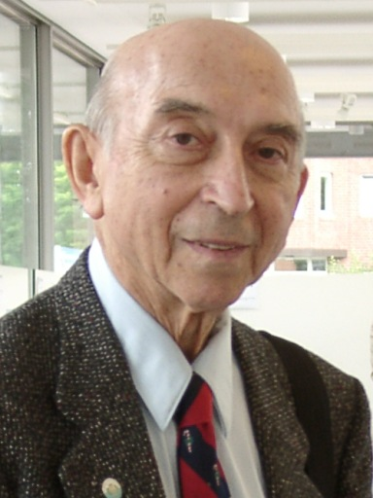

Soft Computing
“…inexact solutions to computationally
hard tasks… tolerant of imprecision,
uncertainty, partial truth,
and approximation.
In effect, the role model for soft computing
is the human mind. “
Neural Networks (John Hopfield)
Fuzzy Systems (Lofti Zadeh)
Genetic Algorithms (David Goldberg)

Slide 13

Distributed AI
Internet appears…
and AI moved towards collaboration and cooperation.
Multiagent systems
Intelligence emerges from the collaboration
of non intelligent agents.
(cannibals and missionaries example)
Intelligent Agents
Agents that deliberate
Agent Oriented Programming (AOP)
(Yoav Shoham)

