Slide 1
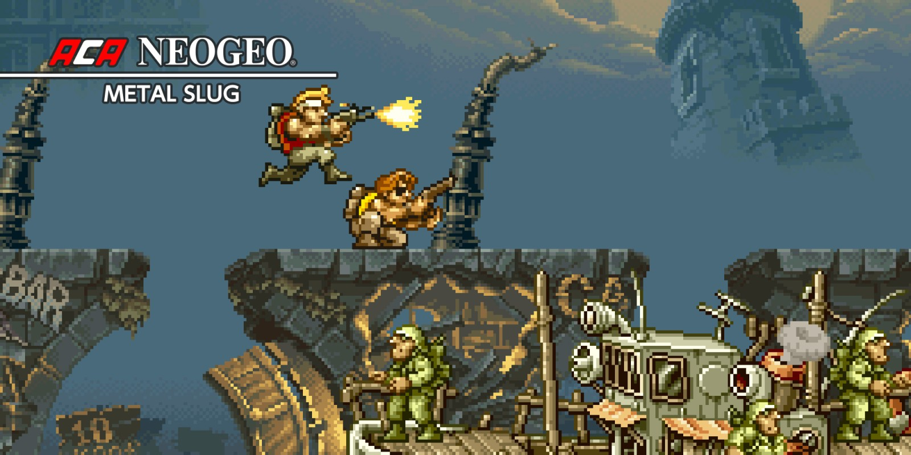
FIRST GAME
METAL SLUG

Slide 2
Why is interesting?
Shoot’em up and Run and Gun game.
Dynamic and frenetic.
Tons of fun with friends or alone.
Use of “slugs” (vehicles or power ups)
Humour

Slide 3
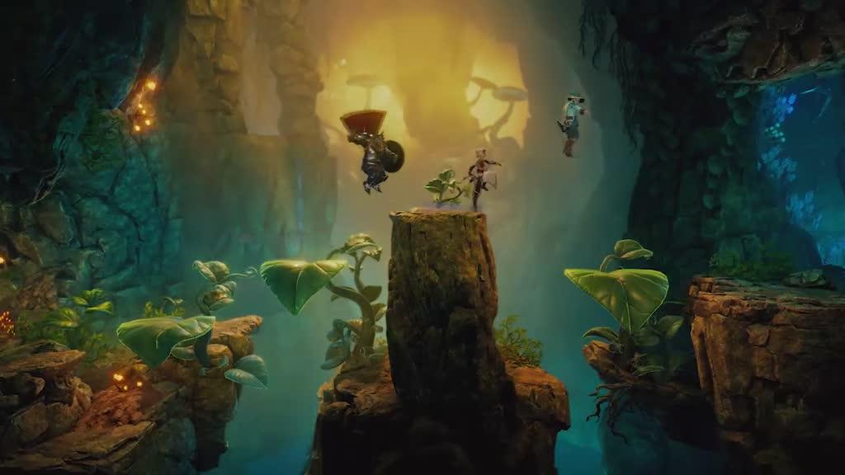
SECOND GAME
TRINE 4
SECOND GAME

Slide 4
Why is interesting?
Medieval inspiration.
Specialization of characters.
Puzzle game with enviromental mechanics.
You can’t pass the level without the other characters.
Awesome bosses.

Slide 5
Game 1 + mechanic
Transformation of zombie / monkey.
Gives the player special attacks.

Slide 6
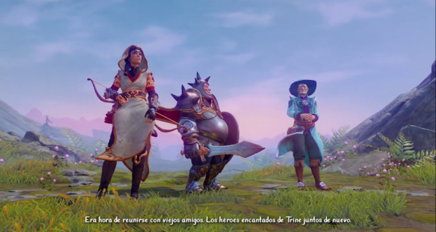
Game 2 + mechanic
Unique kind of characters, very clear each role.
You can’t pass the level without the other character.

Slide 7
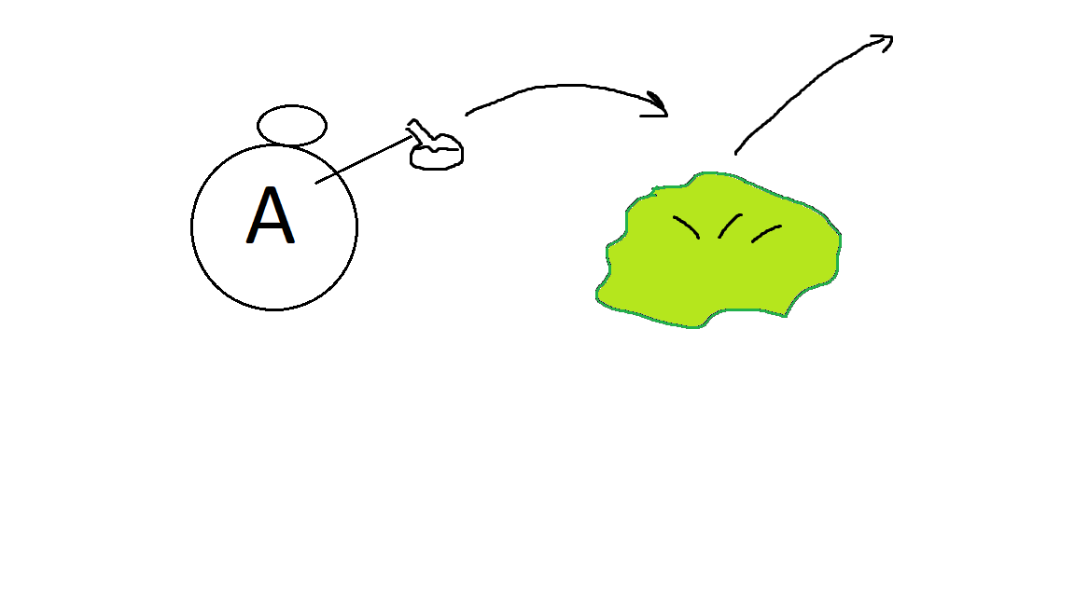

Slide 8
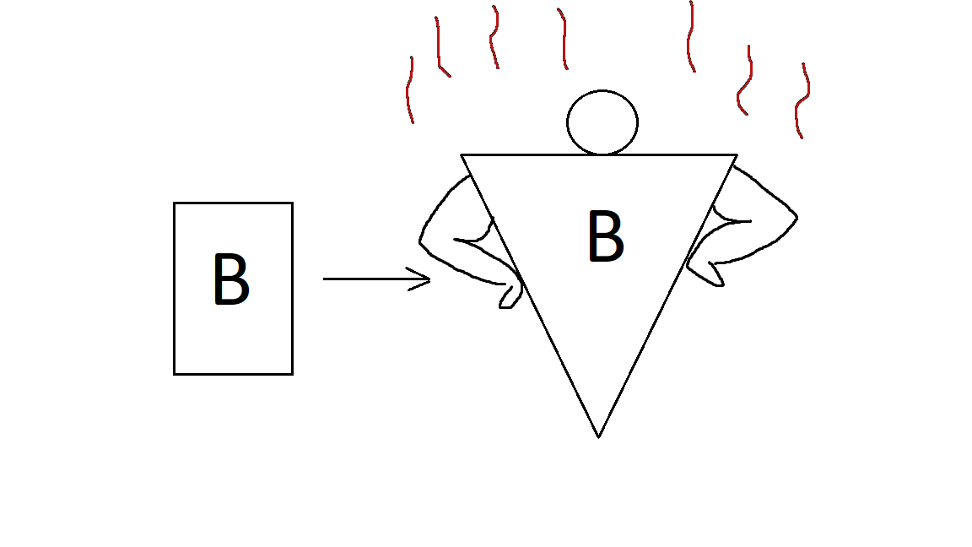

Slide 9
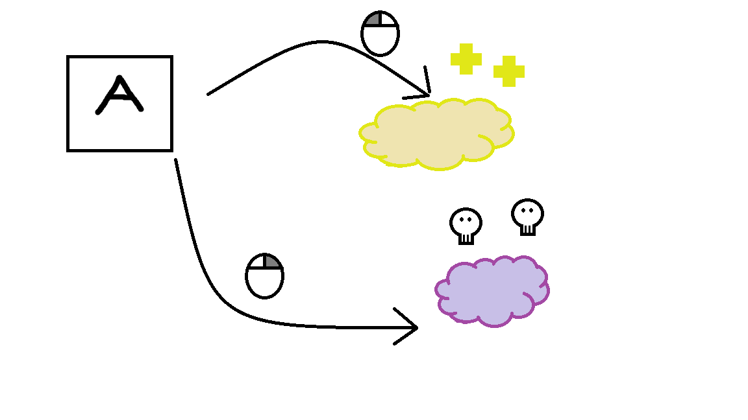

Slide 10
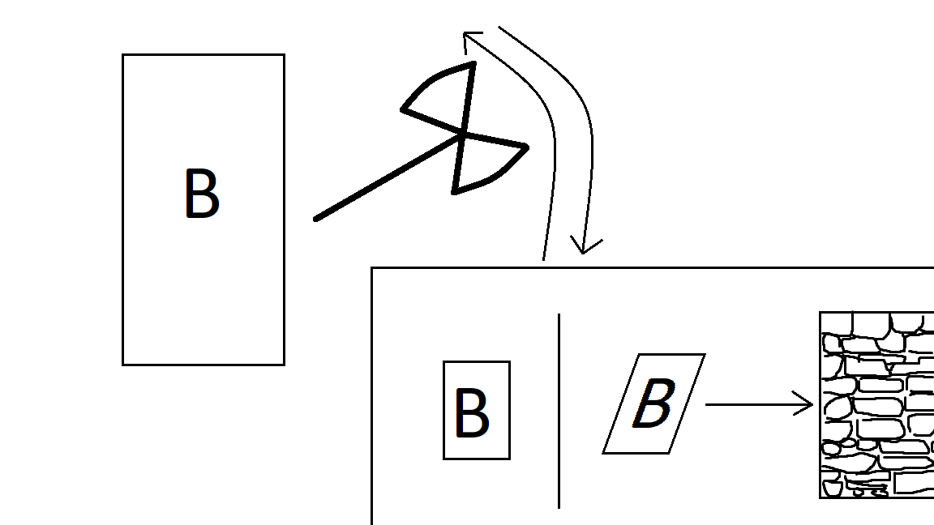

Slide 11

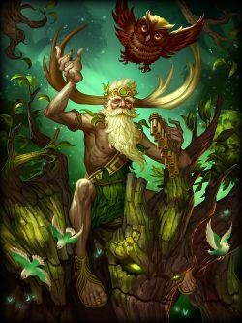
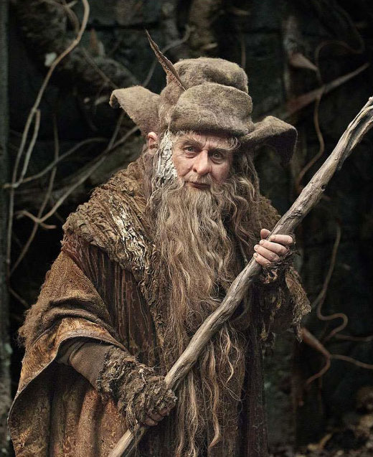
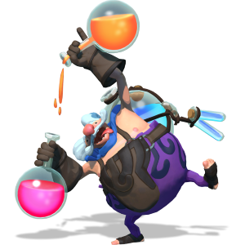
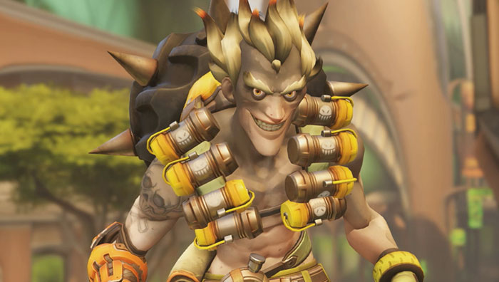

Slide 12
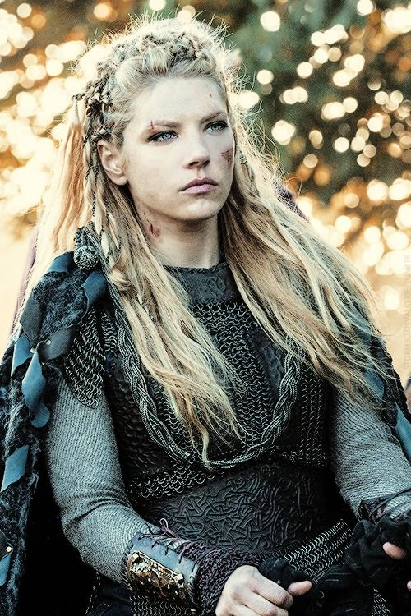
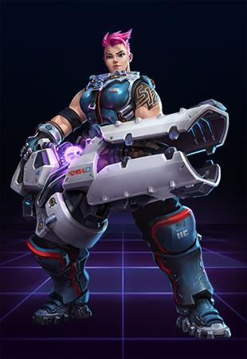
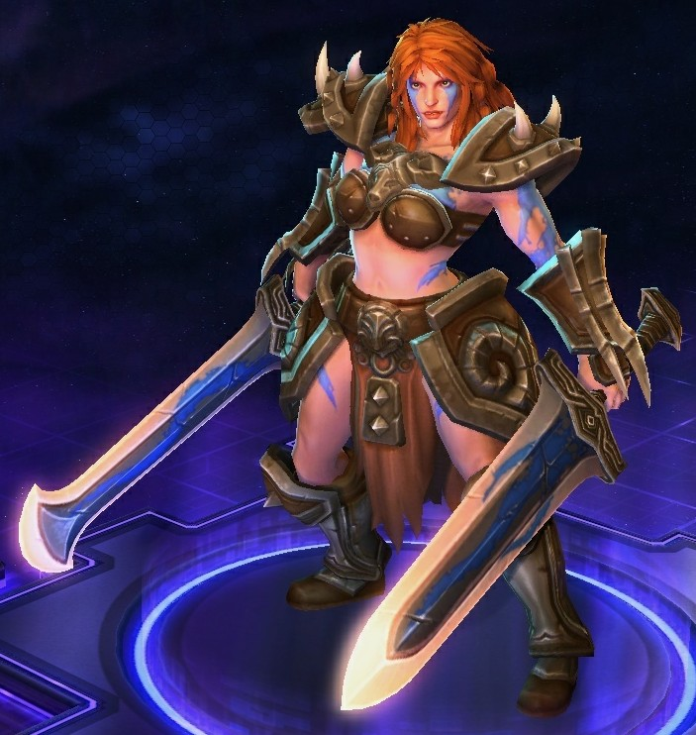
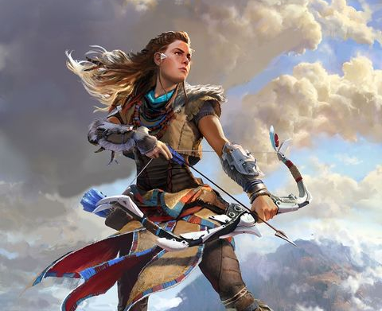
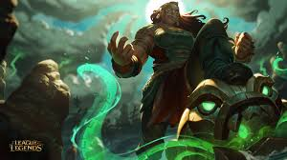

Slide 13
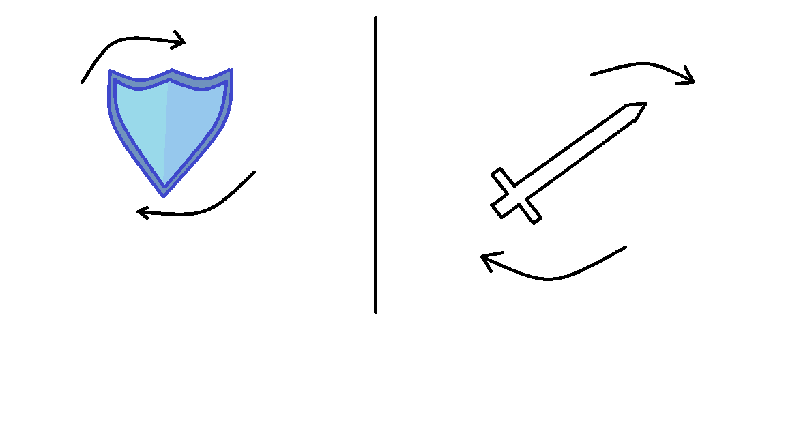
ARMOR
POWER

Slide 14
