Slide 1
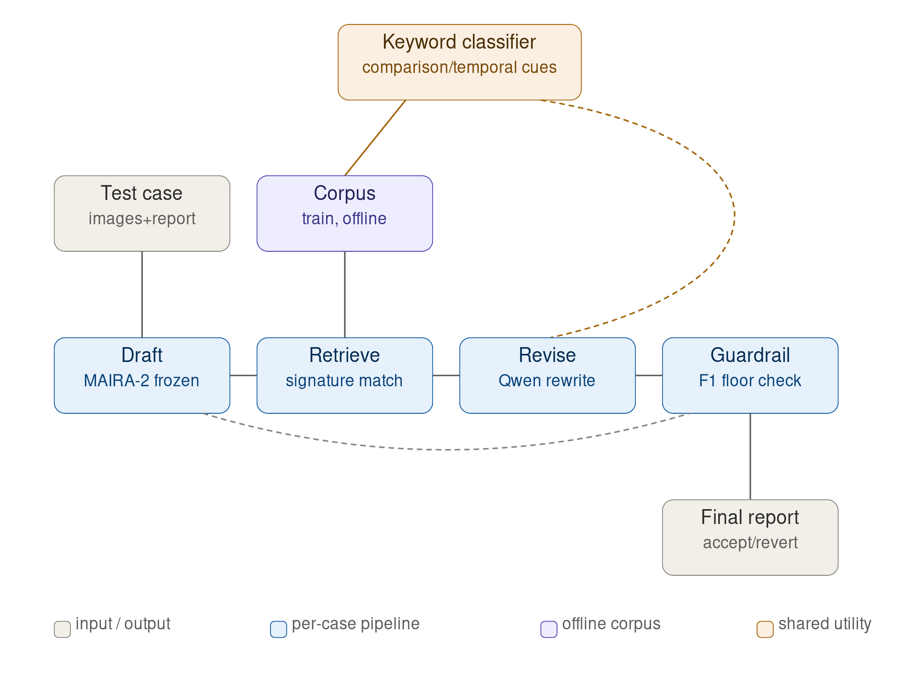
ICL retrieve-then-revise pipeline
Training-free alternative to fine-tuning: MAIRA-2 drafts, Qwen2.5-7B-Instruct revises only the comparison sentences, a CheXbert-F1 guardrail keeps it monotonic.
n = 1,786
BLEU-4 / ROUGE-L ↓
RadGraph-F1 ↓
Verdict: no net gain
full test set
(1,578 change, 208 no-change)
both p<0.001
robust, survives correction
p=0.014
soft signal, reverses n=70 preview
surface + RadGraph down
CheXbert-F1 rise is guardrail-guaranteed
ULCX / MIMIC-CXR longitudinal report generation — MAIRA-2 + Qwen2.5-7B-Instruct — full test-set evaluation via score.py, 1000-resample bootstrap

