Slide 1
Data On Swiss Residential PV Generation
Pitfalls of joining several open data sources
Raul Hochul, University of Basel, raul.hochuli@unibas.ch
10.11.2026
solkat
solkat month
gwr
pv
Notes:
Title slide. Replace the bracketed author / affiliation placeholders.

Slide 2
Data Sources
01
Notes:
Generated from slides_git_history.json. Intro: 236 of 997 commits touched the data-aggregation code; 114 commits (incl. topology build and calibration preprep) document adjustments to merge or clean solkat, solkat month, gwr and pv. Most telling 44, quoted verbatim.

Slide 3
Four sources, four units of observation
Source | Unit of observation | Rows, CH-wide | Data Source | Size on local disk
solkat (solfacade) | roof surface (spatial polygons) | 10,071,755 roofs 3,844,000 buildings (SB_UUID) | GeoPackage (gpkg) https://opendata.swiss/de/dataset/eignung-von-hausdachern-fur-die-nutzung-von-sonnenenergie | Download: 1.5 GB gpkg.zip parquet only: 0.77GB
solkat month | roof surface × month (table, no geometry) | 120,861,060 rows (= 10,071,755 × 12) | GeoPackage (gpkg) https://opendata.swiss/de/dataset/eignung-von-hausdachern-fur-die-nutzung-von-sonnenenergie | Download: 5.7 GB gpkg.zip parquet only: 4.7 GB
gwr | building (EGID); Dwelling (apartments, EWID) (table, opt. spatial points) | 3,253,788 buildings 5,199,292 dwellings | not on opendata.swiss (only cantonal copies); BFS: housing-stat.ch/de/madd/public.html | Download: 0.95 GB ch.zip parquet + GeoJSON: 4.8 GB
pv | production plant (spatial points) | 239,214 pv plants (snapshot to Aug 2024) | GeoPackage (gpkg) https://opendata.swiss/de/dataset/elektrizitatsproduktionsanlagen | parquet + GeoJSON: 48 MB
Notes:
Overview of the four sources. Rows: metadata reads of the project's CH-wide extracts (data/input_split_data_geometry, split run 5 Feb 2026) and of gwr data.sqlite (export 15 Aug 2024). Size on local disk: gwr = data/input/GebWohnRegister.CH; solkat, solkat month and pv = project extracts in data/input_split_data_geometry (the raw GeoPackages are no longer on disk). Download sizes: HTTP HEAD, 9 Nov 2026. 1 GB = 10⁹ bytes. All geometries LV95 (EPSG:2056). Observations and key attributes per source on the next slide; evidence in data_sources_facts.md.

Slide 4
How the four sources feed topo
spatial location - «main
source of truth»
topo
one entry per building (EGID)
gwr buildings · points
solkat roof surfaces · polygons
3,253,788
buildings (EGID)
3,253,788
buildings (EGID)
10,071,755
roof surfaces (DF_UID)
19.9 %
of roofs without GWR_EGID
EGID
EGID
KEY ATTRIBUTES USED
Spatial join (EGID in solkat polygons)
KEY ATTRIBUTES USED
EGID
GGDENR
GKODE
GKODN
GSTAT
DF_UID
SB_UUID
GWR_EGID
geometry
month – hour year / rad to param
Extension from 12 months to 8760 hours
GKLAS
GBAUJ
GAREA
GWAERZH1
FLAECHE
AUSRICHTUNG
NEIGUNG
GENH1
WAZIM
WAREA
MSTRAHLUNG
GSTRAHLUNG
STROMERTRAG
xtf_id -> EGID
Spatial join, 10m buffer around gwr point
DF_UID
solkat extension from 1 df_uid to 8760 hours
pv production plants · points
solkat month roof × month · table
radiation data
239,214
pv plants, snapshot to 7 Aug 2024
7.2 %
without point geometry (17,295)
120,861,060
rows (roof × month)
floored to non‑negative
hourly roof radiation
8,760
hours of a year
radiation in W
KEY ATTRIBUTES USED
KEY ATTRIBUTES USED
meteo_location
xtf_id
BeginningOfOperation
TotalPower
DF_UID
MONAT
A_PARAM · direct
hour_of_year
InitialPower
SubCategory
PlantCategory
B_PARAM · diffuse
C_PARAM
direct_rad
geometry
diffuse_rad
Notes:
Join logic derived from src/MAIN_data_aggregation.py. solkat month -> solkat: DF_UID key join, 1 roof : 12 months, monthly rows inherit BFS_NUMMER from a de-duplicated DF_UID map (L1584-1599). solkat -> gwr: GWR_EGID as delivered (0..1) plus spatial matching; roof shapes unioned per EGID / SB_UUID proxy, gpd.sjoin with gwr_gdf, cases 1-5, FLAECHE and STROMERTRAG divided by the number of EGIDs (L1113-1523). pv -> gwr: gwr_all_building_gdf buffered by SOLKAT_GWR_EGID_buffer_size = 10, sjoin predicate 'within', duplicates resolved by nearest centroid, output Map_egid_pv (L1704-1739). gwr -> topo: the pvalloc topology is keyed on EGID. radiation data -> solkat month: monthly roof radiation = A_PARAM * rad_direct + B_PARAM * rad_diffuse + C_PARAM (src/pvalloc/pvalloc_initialization.py L463-472); rad_direct / rad_diffuse come from the meteo columns 'Basel Direct / Diffuse Shortwave Radiation' (MAIN_pvallocation_Class.py L130-131), matched via meteo_loc. Not drawn: solkat and pv get BFS_NUMMER from a 'within' join with swissBOUNDARIES3D (L281-293); gwr uses its own GGDENR. Grey chips are de-emphasised attributes.
SOLKAT: BFE (Swiss Federal Office of Energy), Sonnendach.ch roof suitability; modelled by Meteotest on swisstopo swissBUILDINGS3D 2.0. Where: opendata.swiss/de/dataset/eignung-von-hausdachern-fur-die-nutzung-von-sonnenenergie (https://opendata.swiss/de/dataset/eignung-von-hausdachern-fur-die-nutzung-von-sonnenenergie); STAC: data.geo.admin.ch › ch.bfe.solarenergie-eignung-daecher (https://data.geo.admin.ch/api/stac/v0.9/collections/ch.bfe.solarenergie-eignung-daecher); Map viewer: www.sonnendach.ch (https://www.sonnendach.ch). Access: Bulk download: GeoPackage (1.5 GB zip) or FileGDB; WMS/WMTS for maps. LV95, files dated 19 Apr 2023. Merge pitfall: GWR_EGID is 0..1 per building: if several GWR records fall into one swissBUILDINGS3D building, one EGID is picked at random (BFE doc v1.5, p. 13). Row houses lose EGIDs, so the pipeline unions roof shapes per EGID (or SB_UUID proxy) and re-assigns GWR EGIDs spatially (L1113–1469). Evidence: Evidence: counts from pyarrow metadata/column reads of data/input_split_data_geometry/solkat_pq.parquet (10,071,755 rows; DF_UID unique per split log; 3,844,000 distinct SB_UUID; GWR_EGID null count 2,007,606 from row-group statistics; 1,830,954 distinct non-null GWR_EGID). Download URLs and sizes verified via the STAC API and HTTP HEAD on 9 Nov 2026. GWR_EGID cardinality and random pick: data/input_documentation/9665-Sonnendach.ch_Dokumentation_Datenmodell_DE_V1.5.pdf, Table 3, p. 13. Code: src/MAIN_data_aggregation.py L318-334 (import + split), L1113-1523 (EGID repair).
SOLKAT MONTH: BFE, same Sonnendach.ch release; separate asset with monthly values and radiation parameters. Where: opendata.swiss/de/dataset/eignung-von-hausdachern-fur-die-nutzung-von-sonnenenergie (https://opendata.swiss/de/dataset/eignung-von-hausdachern-fur-die-nutzung-von-sonnenenergie); Asset: solarenergie-eignung-daecher_2056_monthlydata.gpkg.zip (https://data.geo.admin.ch/ch.bfe.solarenergie-eignung-daecher/solarenergie-eignung-daecher/solarenergie-eignung-daecher_2056_monthlydata.gpkg.zip); Data model: Sonnendach doc v1.5, Table 4 (pp. 14–15). Access: Bulk download only: GeoPackage (5.7 GB zip) or FileGDB. Attribute table without geometry; 1 roof : 12 rows. Merge pitfall: No municipality and no geometry: the table can only be cut to the study area by a key join to solkat. In the May 2026 preprep output 170,652 (DF_UID, MONAT) pairs are duplicated (the DF_UID→BFS map is now de-duplicated, L1595) and 76,823 solkat roofs of BS (BFS 2701–2703) have no monthly rows. Evidence: Evidence: solkat_month_pq.parquet has 120,861,060 rows; MONAT value counts are 10,071,755 for each of the 12 months and DF_UID has 10,071,755 distinct values (pyarrow column reads). 1:12 relation: Sonnendach doc v1.5 p. 8; A/B/C_PARAM definition p. 15. Asset size 5,678,663,781 bytes (HTTP HEAD). Duplicates: data/preprep/preprep_BLSO_15to24_extSolkatEGID__May26/solkat_month.parquet (6,796,332 rows, 552,140 distinct DF_UID; 170,652 duplicated DF_UID-MONAT pairs). Code: L338-340, L1584-1599; src/pvalloc/pvalloc_initialization.py L456-472.
GWR: BFS (Federal Statistical Office); public “level A” GWR data, offered as bulk download since 1 April 2022. Where: www.housing-stat.ch/de/madd/public.html (https://www.housing-stat.ch/de/madd/public.html); public.madd.bfs.admin.ch/ch.zip (all of Switzerland, about 0.95 GB) (https://public.madd.bfs.admin.ch/ch.zip); Feature catalogue: Merkmalskatalog GWR (data/input_documentation). Access: Zip per canton or for CH, refreshed daily: CSV (building, dwelling, entrance), data.sqlite, GeoJSON, codes. Merge pitfall: A building is one point (GKODE/GKODN), not a footprint, so every link to roofs and PV is spatial. Dwellings are 1:n (416,169 rows for 243,722 EGIDs in BL+SO) and must be aggregated; missing values are empty strings that are cast to 0 (L907, L927, L984). Evidence: Evidence: SELECT COUNT(*) on data/input/GebWohnRegister.CH/data.sqlite: building 3,253,788; dwelling 5,199,292; entrance 3,342,223; codes 405; _metadata datetime 2024-08-15T01:22:14, scope CH; 2,133 distinct GGDENR. Bulk download described in GebWohnRegister.CH/readme.pdf; ch.zip verified by HTTP HEAD (949,328,152 bytes, last-modified 9 Nov 2026). Selection numbers: summary_data_selection_log of the May26 preprep (243,722 -> 231,760 after GSTAT -> 138,240 after GKLAS). Code: sql_gwr_data L871-1065.
PV: BFE, geodata set 221.1 “Elektrizitätsproduktionsanlagen”; data kept by Pronovo AG in the guarantee-of-origin (HKN) register. Where: opendata.swiss/de/dataset/elektrizitatsproduktionsanlagen (https://opendata.swiss/de/dataset/elektrizitatsproduktionsanlagen); STAC: data.geo.admin.ch › ch.bfe.elektrizitaetsproduktionsanlagen (https://data.geo.admin.ch/api/stac/v0.9/collections/ch.bfe.elektrizitaetsproduktionsanlagen); www.bfe.admin.ch/en/electricity-production-plants (https://www.bfe.admin.ch/en/electricity-production-plants). Access: Bulk download: GeoPackage, CSV (zip) or INTERLIS XTF, LV95. Only plants in operation and in HKN (>30 kVA, subsidised, or >2 kW voluntary). Merge pitfall: The snapshot has no building ID: EGIDs come from a 10 m buffer around GWR points, and 3,717 of 14,998 plants (24.8 %) hit more than one buffer (nearest centroid wins, L1705–1739). The Sep 2026 release adds an EGID column (330,114 of 337,455 PV plants); its GeoPackage holds only 100,000 rows. Evidence: Evidence: pv_pq.parquet 239,214 rows, all SubCategory subcat_2, BeginningOfOperation 1989-10-20 to 2024-08-07; pv_geo.geojson: 17,295 null geometries = the 17,295 rows without BFS_NUMMER. Subset and buffer duplicates: preprep_log of the May26 preprep (11,281 unique + 3,717 duplicates = 14,998; 0.18 % without EGID). HKN scope and point/address rule: 10449-221.1 model documentation pp. 2-3, 9. Current release (downloaded 9 Nov 2026): CSV ElectricityProductionPlant.csv 339,499 plants, 337,455 PV, 330,114 PV with EGID; GeoPackage layer ElectricityProductionPlant exactly 100,000 rows (latest PV start 2023-09-14), i.e. apparently truncated. Code: L297-302, L1548-1568, L1704-1739.

Slide 5
Split And Partition Data Early!
02
Notes:
Generated from slides_git_history.json. Intro: 236 of 997 commits touched the data-aggregation code; 114 commits (incl. topology build and calibration preprep) document adjustments to merge or clean solkat, solkat month, gwr and pv. Most telling 44, quoted verbatim.

Slide 6
Splitting solkat and processing it in tranches
SOLKAT · STORAGE AND TRANCHES
1
Split geometry from attributes
Split data and geometry for all geo data frames for faster importing
2
Partition by EGID
100 EGIDs per tranche, only necessary data
Loop: transform
one tranche at a time
solkat df + gdf
3
4
Store again
one file per tranche
DF_UID
SB_UUID
GWR_EGID
FLAECHE
…
geometry
d1
e1
d2
e1
tranche 1
for each tranche
tranche 1 · adjusted
d3
e2
d4
e3
tranche 2
read tranche
tranche 2 · adjusted
d5
e3
all columns except geometry
DF_UID + geometry
Apply changes
⋮
⋮
write parquet + GeoJSON
DF_UID
SB_UUID
GWR_EGID
FLAECHE
…
DF_UID
geometry
tranche n
tranche n · adjusted
d1
e1
d1
d2
e1
d2
d3
e2
d3
solkat adjusted df
d4
e3
d4
5
Concatenate to two data sets again
solkat adjusted gdf
d5
e3
d5
solkat_pq.parquet
all attributes
parquet (polars / pandas)
solkat_geo.geojson
DF_UID, BFS_NUMMER, geometry
GeoJSON (GeoPandas)
Notes:
Split (src/MAIN_data_aggregation.py L318-334): the national GeoPackage (layer SOLKAT_CH_DACH) is read once; all columns except geometry go to solkat_pq.parquet, DF_UID + BFS_NUMMER + geometry go to solkat_geo.geojson (docstring L264: 'Split data and geometry for all geo data frames for faster importing later on'). Note: the matching step reads the BS/BL/SO geometry subset solkat_bsblso_geo.geojson (L1125), so it only works inside these cantons.
Partition (L1162-1186): rows of the scenario municipalities; missing EGIDs get a proxy egid_proxysbuuid_<SB_UUID> (L1151-1157); unique EGIDs sorted and cut into tranches of 100 (stepsize = 100). Each tranche's parquet rows are inner-joined with the geometry on DF_UID and written as solkat_partitioned_tranche_k.geojson. Partitioning is by EGID, not DF_UID, because all roof partitions of an EGID are unioned together (L1165).
Loop (L1210-1454): for each tranche file: read, union roof shapes per EGID, sjoin with gwr points, cases 1-5 (keep, re-assign EGID, copy roof partitions to further EGIDs with FLAECHE/STROMERTRAG divided), write solkat_postadjust_tranche_k.parquet and .geojson; tranches without any gwr match are renamed x_NO_GWR_MATCH__... (L1453).
Concatenate (L1458-1509): all postadjust parquet tranches -> solkat.parquet; all postadjust GeoJSON tranches -> solkat_gdf.geojson; both read again at L1580-1581.
Illustration: d1-d5 are DF_UIDs, e1-e3 EGIDs (several roof partitions per building).

Slide 7
One static topo file, hourly profiles in tranches
1
Store gwr + solkat once
static data, one row per EGID - df_uid pair
3
Select EGIDs
grey: pv installed or grid node closed
4
Loop over tranches
one file at a time
gwr
solkat
gwr
solkat
for each tranche
EGID
GKLAS
GAREA
…
df_uid
FLAECHE
AUSRICHTUNG
…
EGID
df_uid
e1
d1
e1
d1
tranche 1
keep selected EGIDs
join static data
sum peak-hour pvprod
e1
d2
e1
d2
tranche 2
e2
d3
e2
d3
tranche 3
e3
d4
e3
d4
tranche 4
e3
d5
e4
d5
tranche 5
× 8,760 hours
tranche n
Hourly pv profiles in tranches
8,760 rows per EGID – df_uid pair
5
Collect results
same rows, extended by peak-hour production (kWh)
2
tranche 1 · EGIDs 1–250
gwr
solkat
new
radiation
8,760 hours
EGID
df_uid
t
pvprod_kW
tranche 2
EGID
df_uid
peak pvprod
Why: static data is stored once in topo; hourly files keep only keys and hourly values and get the static data joined back when read.
e1
d1
t_1
tranche 3
e1
d1
312
e1
d1
t_2
tranche 4
e1
d2
287
solkat month
A, B, C per roof
⋮
⋮
⋮
⋮
tranche 5
e2
d3
–
tranche n
e3
d4
195
e1
d1
t_8760
e4
d5
–
e1
d2
t_1
Notes:
Static topo: the topology dict (one entry per EGID: gwr_info, solkat_partitions, pv_inst, grid_node, demand info) is stored once as topo_egid.json and flattened to topo_df, one row per EGID-df_uid pair (src/pvalloc/pvalloc_initialization.py L312-357).
Hourly tranches (L396-828): EGIDs are cut into tranches of ALGOspec_topo_subdf_partitioner = 250 (MAIN_pvallocation_Class.py L328). Each tranche is joined with the hourly meteo series (rad_direct, rad_diffuse, t = t_1 ... t_8760) and, for 'dfuid_ind', with solkat_month A/B/C per df_uid and month (radiation = A*rad_direct + B*rad_diffuse + C, floored at 0, L455-484); pvprod_kW follows from radiation, roof area and efficiencies. Static columns are dropped (ALGOspec_drop_cols_topo_time_subdf_list, MAIN_pvallocation_Class.py L352) before writing topo_time_subdf/topo_subdf_<i>to<j>.parquet (L814-820).
Loop (src/pvalloc/pvalloc_core.py L1062-1488): EGIDs without pv (no_pv_egid) and, if enabled, not at closed grid nodes are selected; every topo_subdf file is read, filtered to the selected EGIDs, extended with static data from topo (add_static_topo_data_to_subdf, src/auxiliary_functions.py L338-377, 'safe disk space'), and NPV is computed per EGID; results are concatenated to npv_df (L1488) and written as npv_df.parquet (L1543). The slide shows a generic derived column instead of NPV: production potential in peak hours (sum of pvprod_kW over peak hours), illustrative only; the results table holds only the selected EGIDs, the greyed rows are shown without a value for comparison.
Illustration: e1-e4 are EGIDs, d1-d5 df_uids (roof partitions); peak pvprod values (kWh) are made up. The overlapping cards stand for the many tranche files (one per 250 EGIDs).

Slide 8
Current PV Installations
03
pv
=>
gwr[EGID]
Notes:
Generated from slides_git_history.json. Intro: 236 of 997 commits touched the data-aggregation code; 114 commits (incl. topology build and calibration preprep) document adjustments to merge or clean solkat, solkat month, gwr and pv. Most telling 44, quoted verbatim.

Slide 9
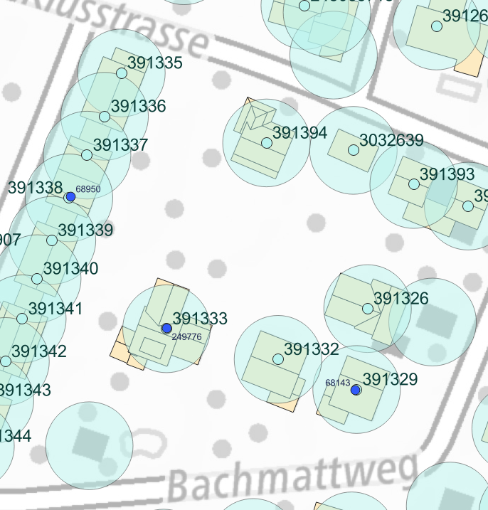
Spatial Join On Buffered EGIDs
Spatial coordinates of PV installations quite good
Buffered gwrEGID by 10 metters and assigned installtions
  Single match -> intended case
  Multiple matches -> to closest gwrEGID within match
Notes:
Numbers: (1) solkat_pq.parquet GWR_EGID null count; (2) pv_geo.geojson null geometries; (3)-(4) preprep_log_preprep_BLSO_15to24_extSolkatEGID__May26.txt lines 1774-1776; (5)-(6) summary_data_selection_log_preprep_BLSO_15to24_extSolkatEGID__May26.txt (omitt_gwregid_gdf, omitt_solkat_gdf). The May26 run predates later fixes in the code, so (5)-(6) describe that output.

Slide 10
«EGID» Mismatch
03
gwr[EGID]
=/=
solkat[GWR_EGID]
Notes:
Generated from slides_git_history.json. Intro: 236 of 997 commits touched the data-aggregation code; 114 commits (incl. topology build and calibration preprep) document adjustments to merge or clean solkat, solkat month, gwr and pv. Most telling 44, quoted verbatim.

Slide 11
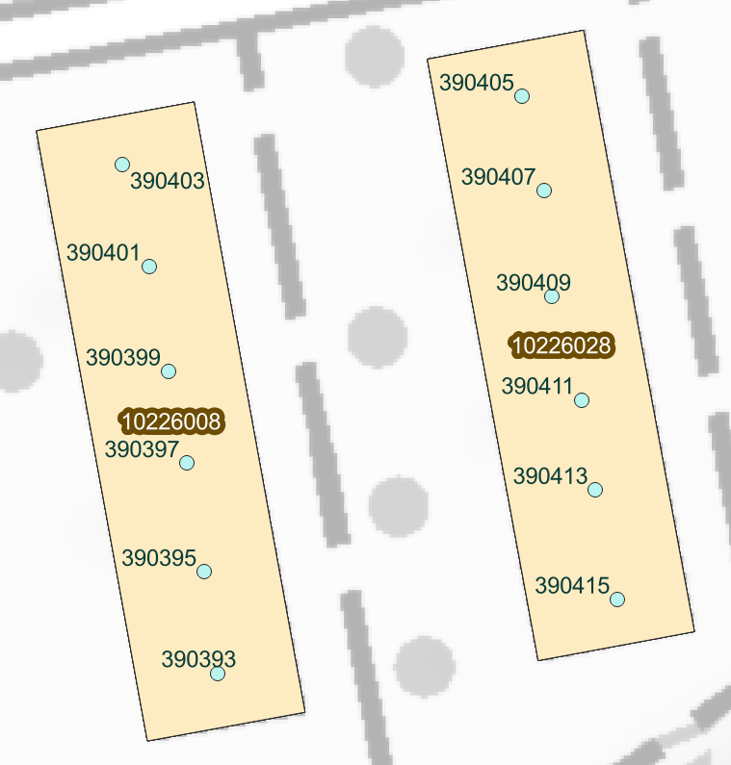
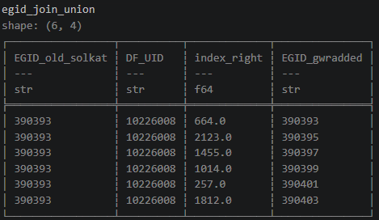
Single solkat Polygon, But Multiple EGIDs
Notes:
Numbers: (1) solkat_pq.parquet GWR_EGID null count; (2) pv_geo.geojson null geometries; (3)-(4) preprep_log_preprep_BLSO_15to24_extSolkatEGID__May26.txt lines 1774-1776; (5)-(6) summary_data_selection_log_preprep_BLSO_15to24_extSolkatEGID__May26.txt (omitt_gwregid_gdf, omitt_solkat_gdf). The May26 run predates later fixes in the code, so (5)-(6) describe that output.

Slide 12
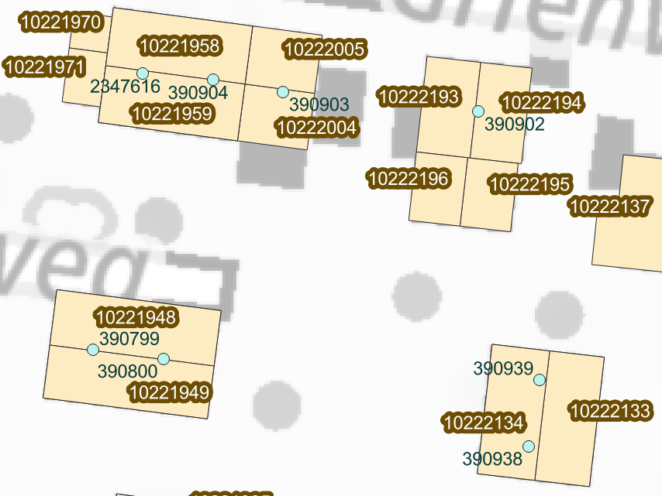
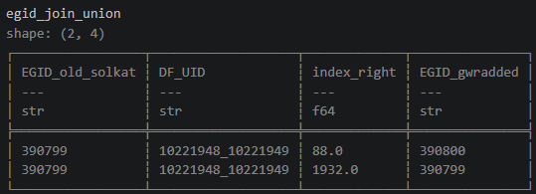
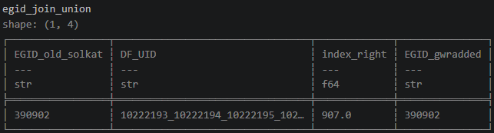
Multiple solkat Polygons
Notes:
Numbers: (1) solkat_pq.parquet GWR_EGID null count; (2) pv_geo.geojson null geometries; (3)-(4) preprep_log_preprep_BLSO_15to24_extSolkatEGID__May26.txt lines 1774-1776; (5)-(6) summary_data_selection_log_preprep_BLSO_15to24_extSolkatEGID__May26.txt (omitt_gwregid_gdf, omitt_solkat_gdf). The May26 run predates later fixes in the code, so (5)-(6) describe that output.

Slide 13
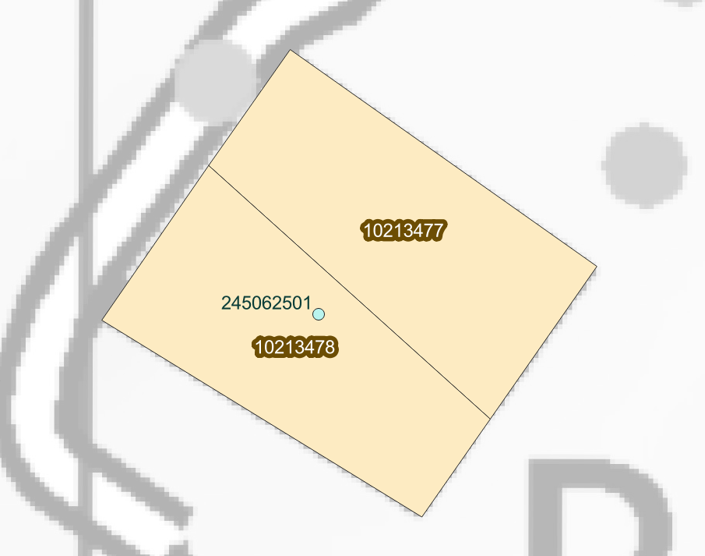
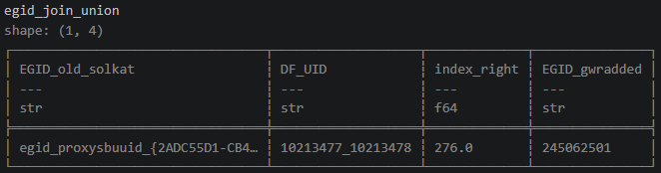
Missing solkat.GWR_EGID
Taking SB_UUID instead of GWR_EGID as a union proxy
Notes:
Numbers: (1) solkat_pq.parquet GWR_EGID null count; (2) pv_geo.geojson null geometries; (3)-(4) preprep_log_preprep_BLSO_15to24_extSolkatEGID__May26.txt lines 1774-1776; (5)-(6) summary_data_selection_log_preprep_BLSO_15to24_extSolkatEGID__May26.txt (omitt_gwregid_gdf, omitt_solkat_gdf). The May26 run predates later fixes in the code, so (5)-(6) describe that output.

Slide 14
solkat Adjustments
Copy and concatenate solkat partitiones for n EGIDs
Set gwr based EGID as actual EGIDs
Devide relevant columns (FLAECHE, STROMERTRAG etc.) by n EGIDs in shape
gwr
solkat
EGID
GKLAS
GAREA
…
df_uid
FLAECHE
AUSRICHTUNG
…
e1
d1
e2
d1
Copy & concatenate
e3
d1
e4
d1
e5
d1
Notes:
Numbers: (1) solkat_pq.parquet GWR_EGID null count; (2) pv_geo.geojson null geometries; (3)-(4) preprep_log_preprep_BLSO_15to24_extSolkatEGID__May26.txt lines 1774-1776; (5)-(6) summary_data_selection_log_preprep_BLSO_15to24_extSolkatEGID__May26.txt (omitt_gwregid_gdf, omitt_solkat_gdf). The May26 run predates later fixes in the code, so (5)-(6) describe that output.

Slide 15
Watch Out: solkat
Take care when matching solkat based time series data to the adjusted static solkat df
  can lead to unintended duplication (nEGIDs x overestimation of PV production.
DF_UID indentifier needs to remain «untouched» for solkat_month matching
gwr
solkat
EGID
GKLAS
GAREA
…
df_uid
FLAECHE
AUSRICHTUNG
…
e1
d1
e2
d1
e3
d1
e4
d1
e5
d1
Notes:
Numbers: (1) solkat_pq.parquet GWR_EGID null count; (2) pv_geo.geojson null geometries; (3)-(4) preprep_log_preprep_BLSO_15to24_extSolkatEGID__May26.txt lines 1774-1776; (5)-(6) summary_data_selection_log_preprep_BLSO_15to24_extSolkatEGID__May26.txt (omitt_gwregid_gdf, omitt_solkat_gdf). The May26 run predates later fixes in the code, so (5)-(6) describe that output.

Slide 16
GWR data
03
gwr
Notes:
Generated from slides_git_history.json. Intro: 236 of 997 commits touched the data-aggregation code; 114 commits (incl. topology build and calibration preprep) document adjustments to merge or clean solkat, solkat month, gwr and pv. Most telling 44, quoted verbatim.

Slide 17
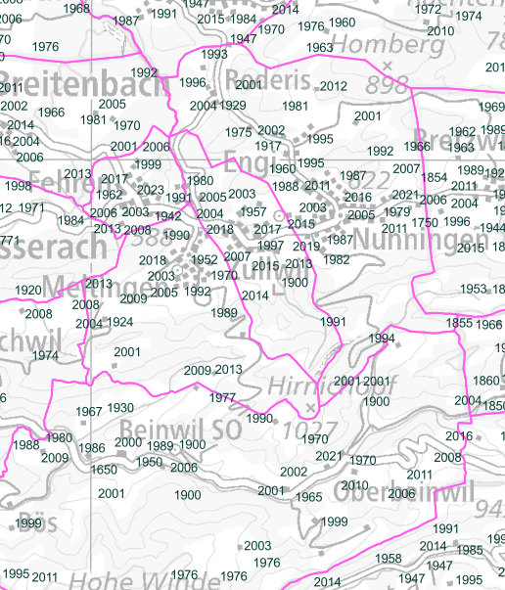
Watch Out: gwr
Inconsistencies accross features (e.g. GBAUJ)
  Silently drops certain EGIDs
  Workarounds (building status GSTAT more accurate than GBAUJ)
Two data sources
  «Single» Buildings (EGID)
  Multi-Apartment / Dwellings in Buildings (EGID + EWID)
    EWID registery features EGID, so within apartment destinction possible
    Also here inconsistencies accross features
=> Use standardized checksums to ensure you don’t miss too many buildings along the way
Notes:
Numbers: (1) solkat_pq.parquet GWR_EGID null count; (2) pv_geo.geojson null geometries; (3)-(4) preprep_log_preprep_BLSO_15to24_extSolkatEGID__May26.txt lines 1774-1776; (5)-(6) summary_data_selection_log_preprep_BLSO_15to24_extSolkatEGID__May26.txt (omitt_gwregid_gdf, omitt_solkat_gdf). The May26 run predates later fixes in the code, so (5)-(6) describe that output.

