Slide 1

CHURN DATA ANALYSIS PRESENTATION
Presented By Rahul Maurya

Slide 2

INTRODUCTION
In this presentation, we will navigate the intricacies of our churn data, revealing patterns that are crucial to understanding our business landscape.
Through careful examination of our data, several key insights have emerged, shedding light on shifts in market preferences, fluctuations in customer behavior, and regional variations in churn rates.

Slide 3
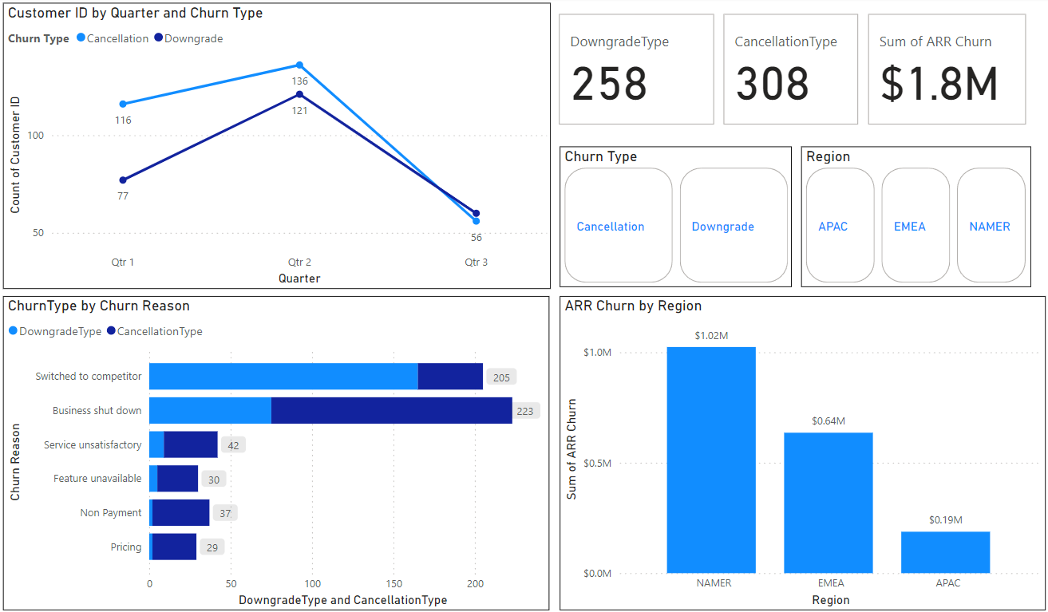
A Broader Look…

Slide 4
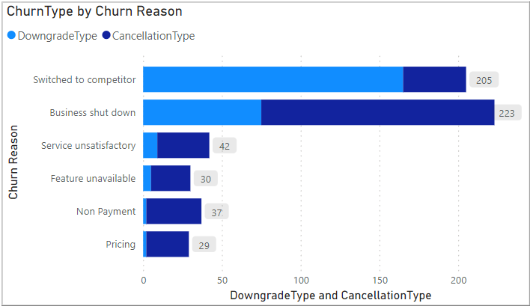
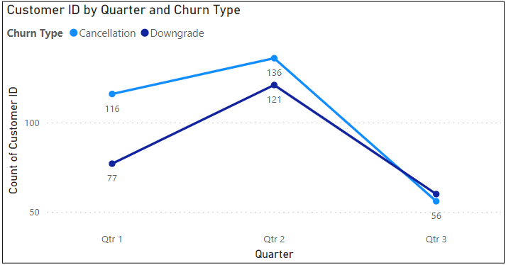
Key Findings
A significant portion of our customer base has made the transition to competitors' offerings, indicating a noteworthy shift in market dynamics.
Our customer base demonstrated a promising trajectory with gradual increments from Qtr1 to Qtr2, yet encountered a significant downturn in Qtr3, prompting a closer examination of underlying factors driving this decline.

Slide 5
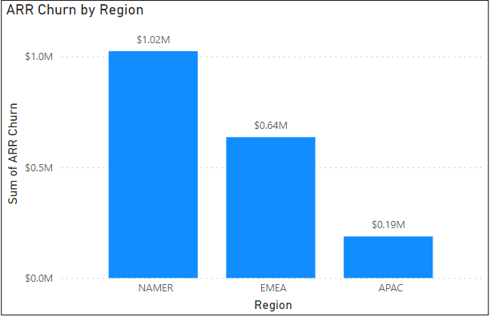
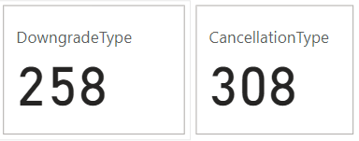
The NAMER region demonstrates the highest frequency of Annual Retention Rate (ARR) churn instances, highlighting the importance of targeted retention efforts within this key market segment.
Within our churn data, two primary churn types emerge: Downgrade and Cancellation.
The counts for these types are 258 and 308 respectively, reflecting distinct patterns of customer disengagement

Slide 6
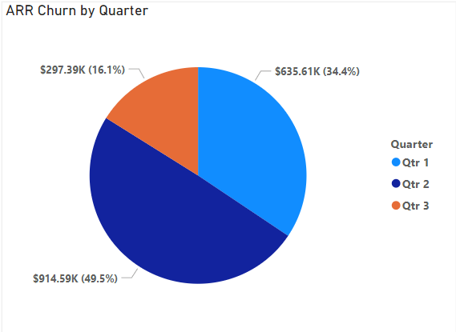
An intriguing observation surfaces as ARR churn exhibits a peak in Qtr2 compared to Qtr1 and Qtr3, suggesting potential seasonal or operational factors influencing customer retention rates during this period.

Slide 7
Recommendations
Focus on enhancing product features, customer service, and overall customer experience to differentiate ourselves in the market. Identify gaps in our offerings and areas for improvement to regain customer loyalty.
Investigate Qtr3 customer count dip: Analyze feedback, market trends, and operations to find causes. Develop strategies for consistent growth: Adjust pricing, enhance products, and engage customers better.
Focus on NAMER region: Launch targeted retention campaigns and personalized outreach. Collaborate with sales and CS teams to understand and address unique customer needs.
Offer incentives or discounts to prevent downgrades and provide seamless cancellation processes to mitigate churn impact.. Analyze patterns and reasons behind each churn type to proactively address underlying issues and improve customer satisfaction and retention rates.
Further investigate the factors contributing to the peak in ARR churn during Qtr2. Determine if there are seasonal trends, product releases, or external factors influencing customer behavior. Offer targeted promotions or incentives during periods of increased churn to encourage customer retention.

