Slide 1
ARE CARS WASTING SO MUCH FUEL?

Slide 2
TABLE OF CONTENTS
1.-About the Project
2.-Data Source
3.-Data Visualization
4.-Linear Regression
5.-Conclusion

Slide 3
1.-ABOUT THE PROJECT
In this power point presentation, I will explain my research project on finding how different engine characteristics affect fuel consumption.
Obtaining the values for each variable for which the fuel consumption is minimum, on a specific data frame.

Slide 4
2.- DATA SOURCE
Data frame has been obtained from Kaggle.
Kaggle is a web platform, where you can search or published dataset by free.
For this project, have been downloaded a data frame, with 5077 rows and 18 columns, of different car characteristics.

Slide 5
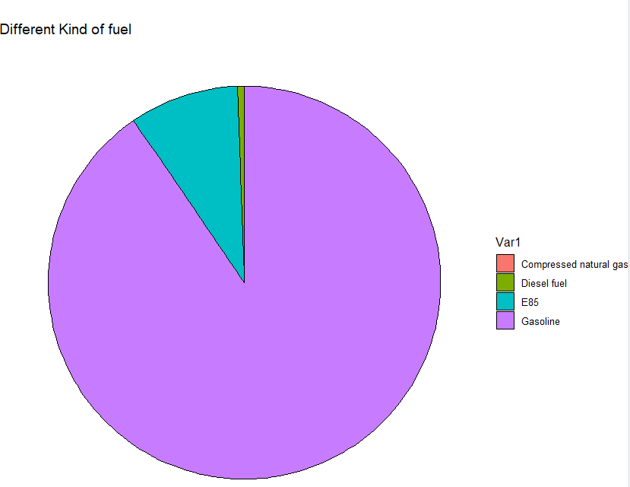

3.-DATA VISUALIZATION

Slide 6
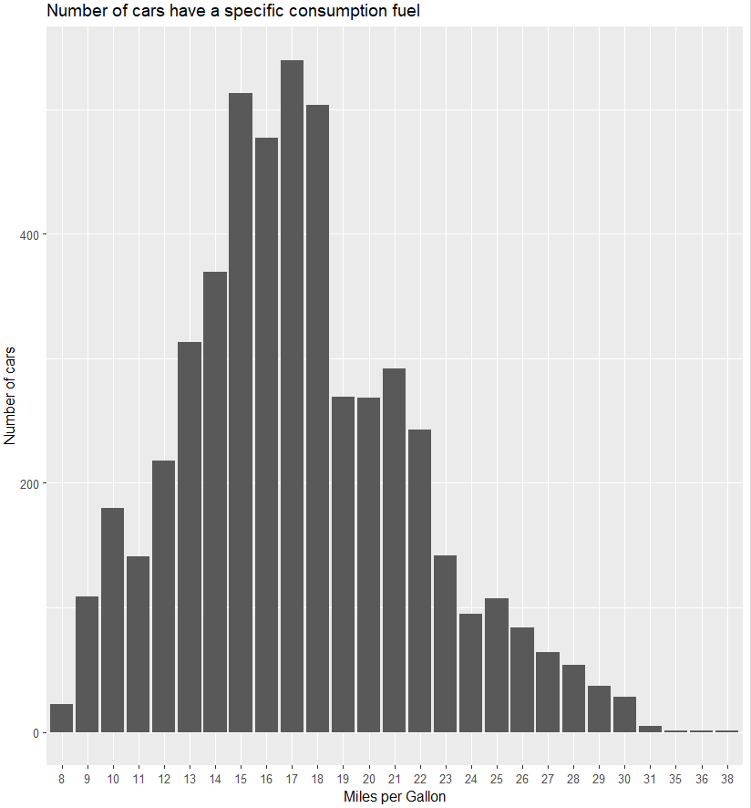
How much fuel spend most of the cars?

Slide 7
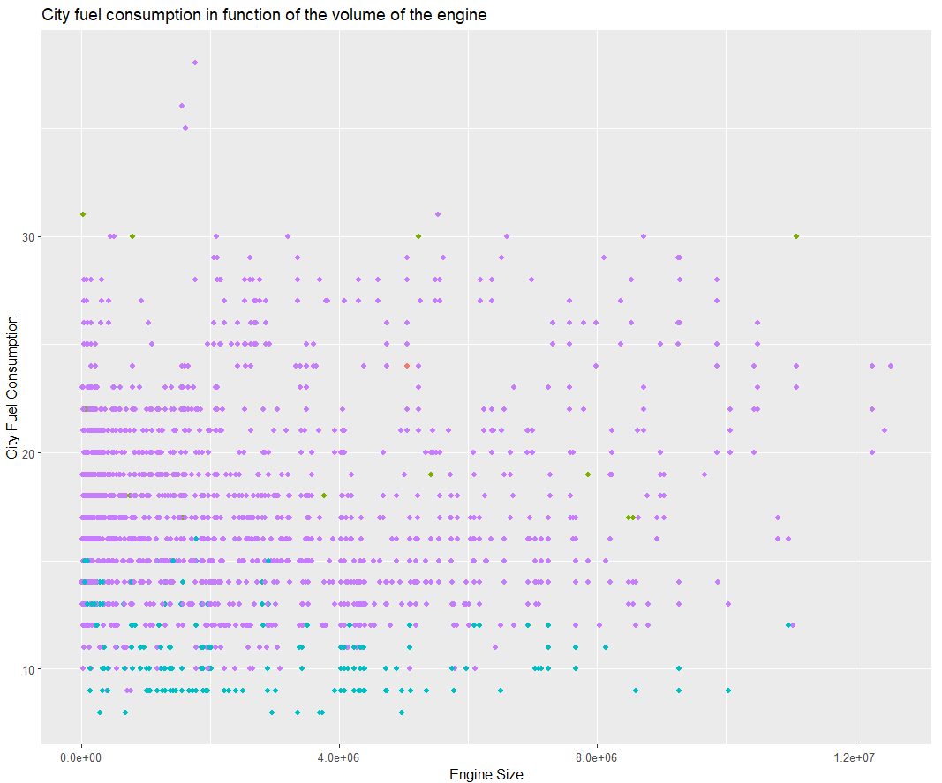
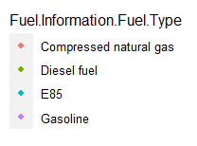
Is the size of the engine a determinant variable?

Slide 8
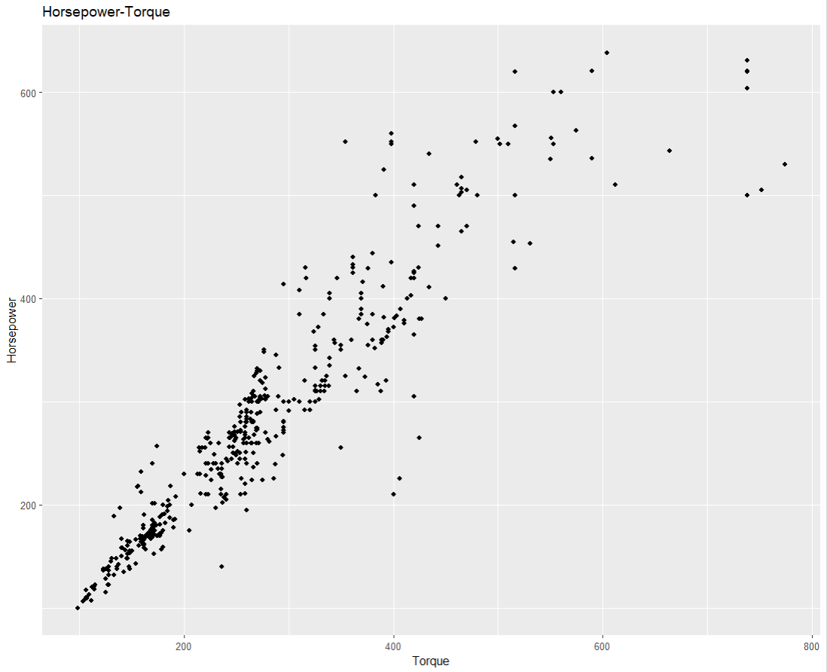
4.-LINEAR REGRESSION
Multiple or simple?
Horsepower and torque of an engine
Correlation = 0.94

Slide 9
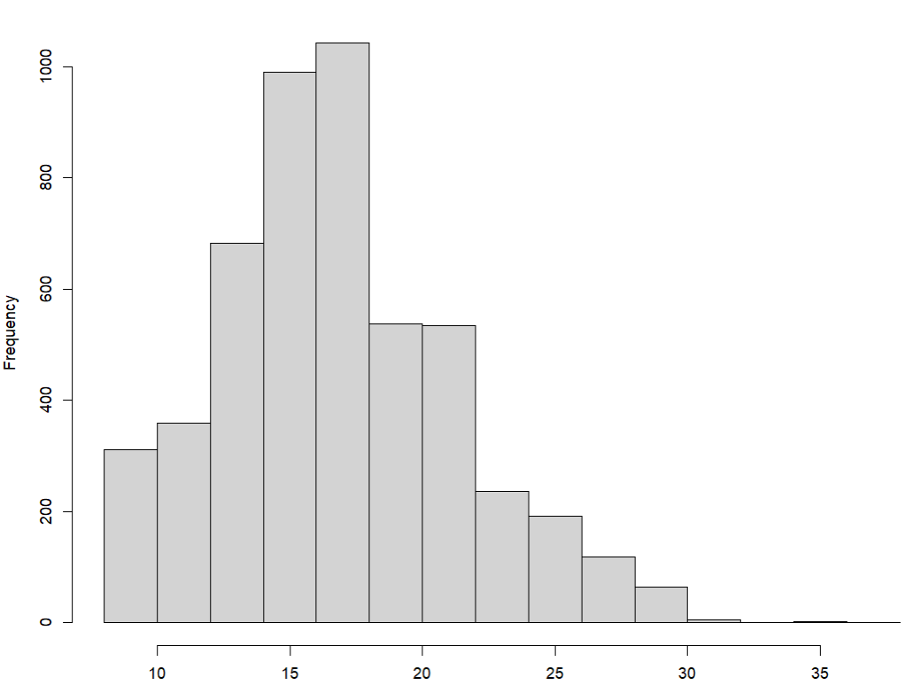
4.1-Normal Distribution
Has the variable “Fuel City Consumption” a normal distribution?
Fuel city consumption

Slide 10
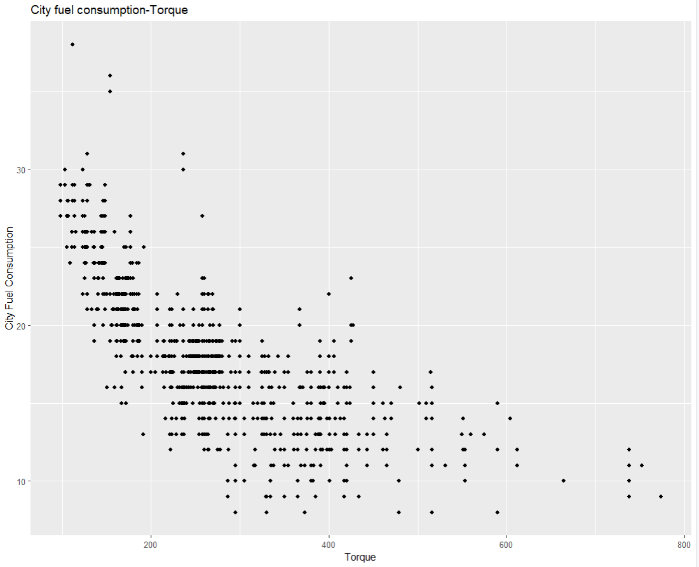
4.2-Linearity
Is there a linear relationship between “Fuel City Consumption” and “Torque” variables ?

Slide 11
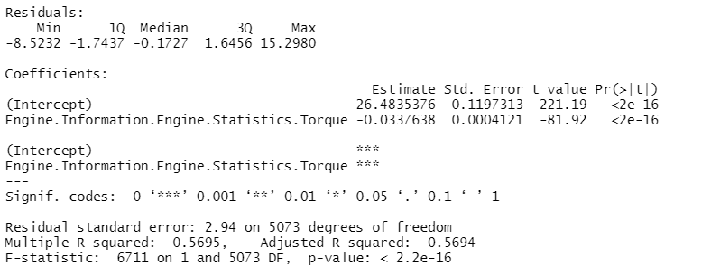
4.3-Regression Analysis
Null hypothesis could be rejected
There exist a negative linear relationship between torque and miles per gallon.

Slide 12
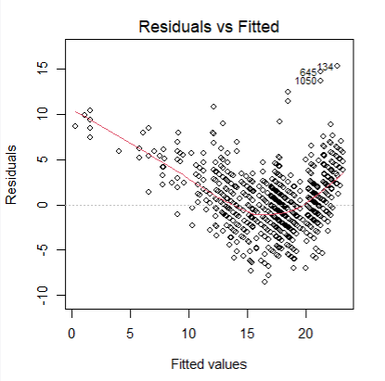
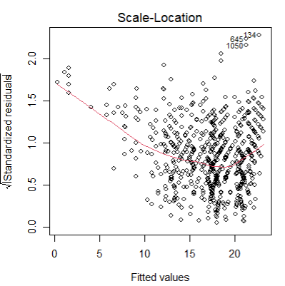
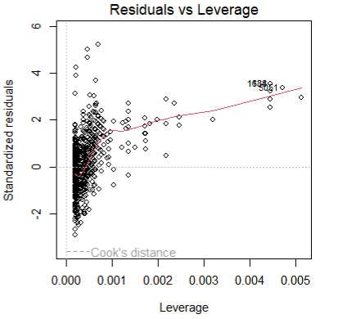
4.4-Check the homoscedasticity
The red lines representing the mean of the residuals should be horizontal and centered around zero

Slide 13
MUCHAS GRACIAS

