Slide 1
Indoor positioning system
Author: Velcherean Raul
Supervisor: asis.eng. Harja Gabriel

Slide 2
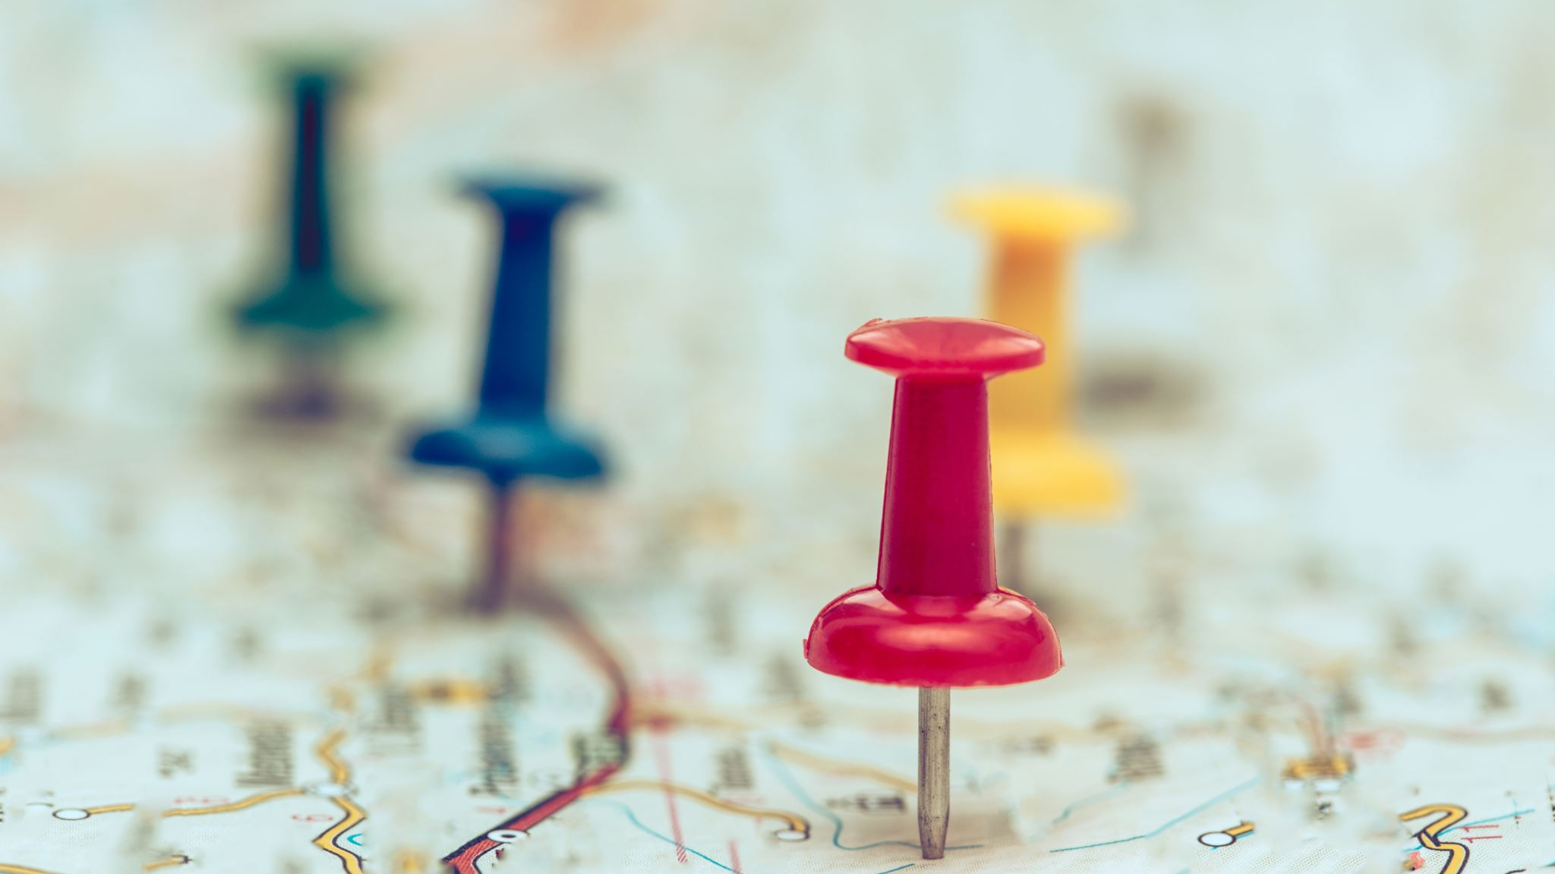
What is a positioning system?

Slide 3

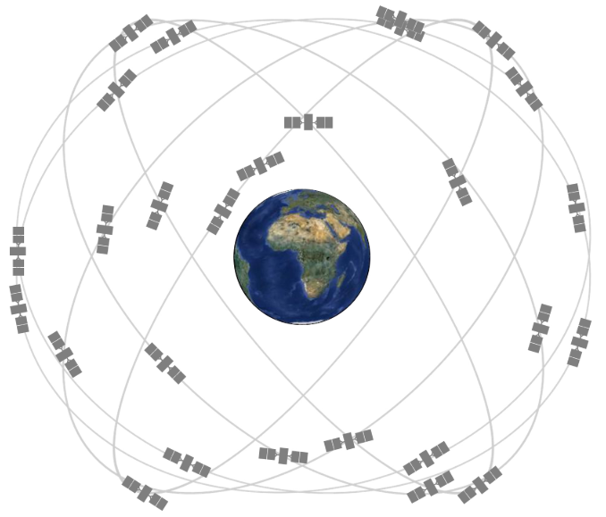
Global Positioning System

Slide 4
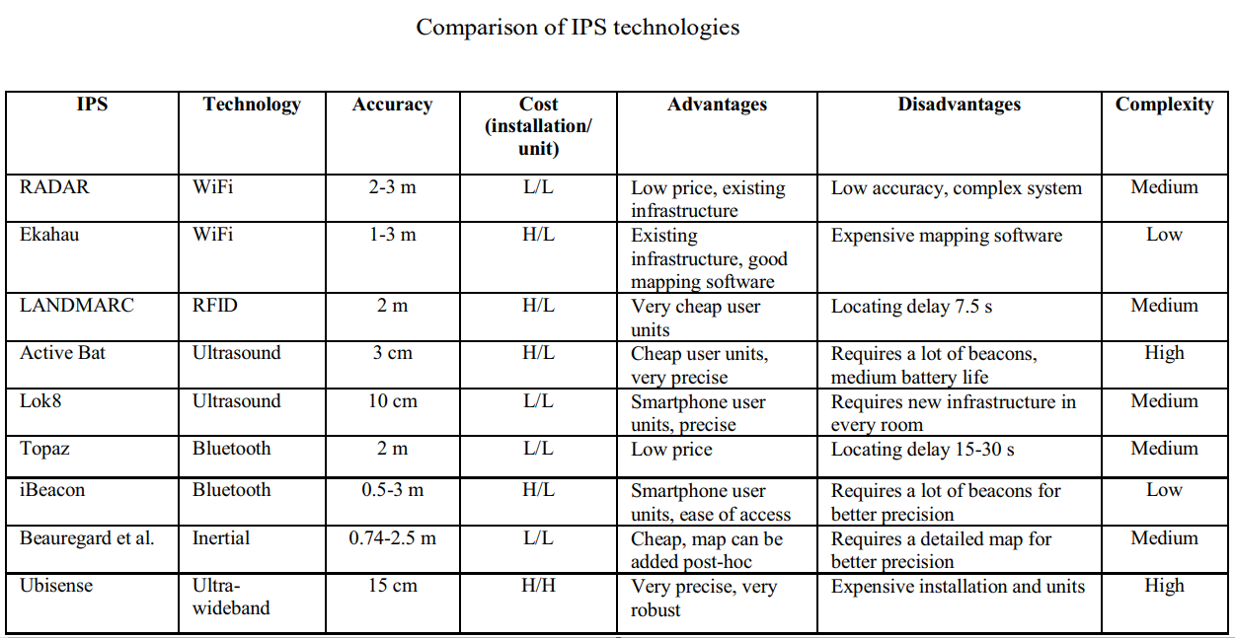

Slide 5
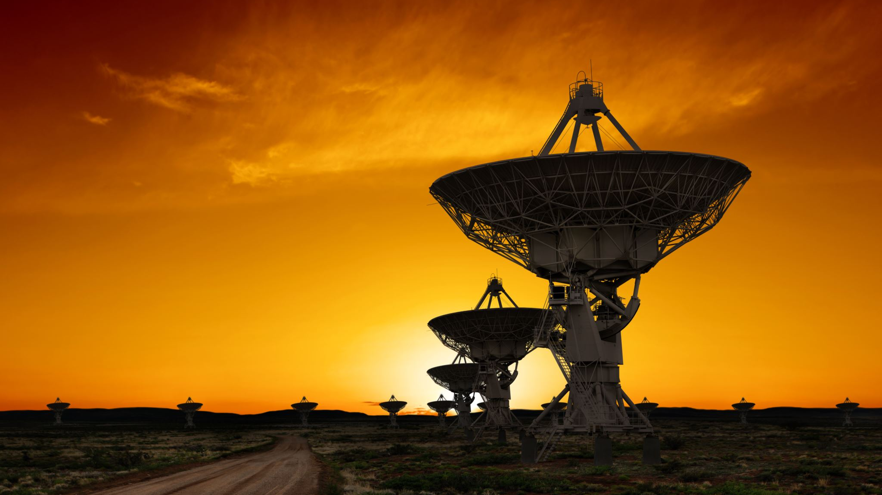
UWB – Ultra Wide Band

Slide 6
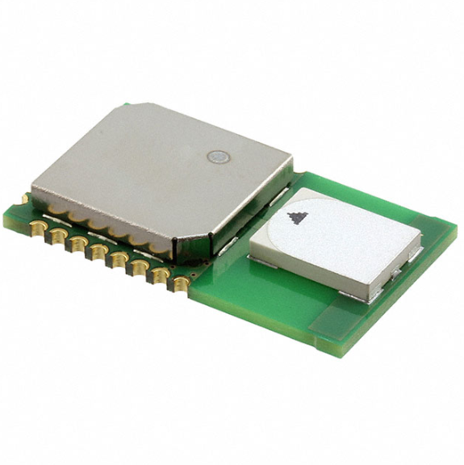
DWM1000
Transceiver IC with antenna, all RF circuitry, power management and clock circuitry all in one
4 RF bands (3.5GHz to 6.5 GHz)
Low power consumption
Data rates: 110 kbps, 850 kbps, 6.8 Mbps
63.8976 GHz sampling clock used for ranging (15.65 ps period)
23 mm x 13 mm x 2.9 mm

Slide 7
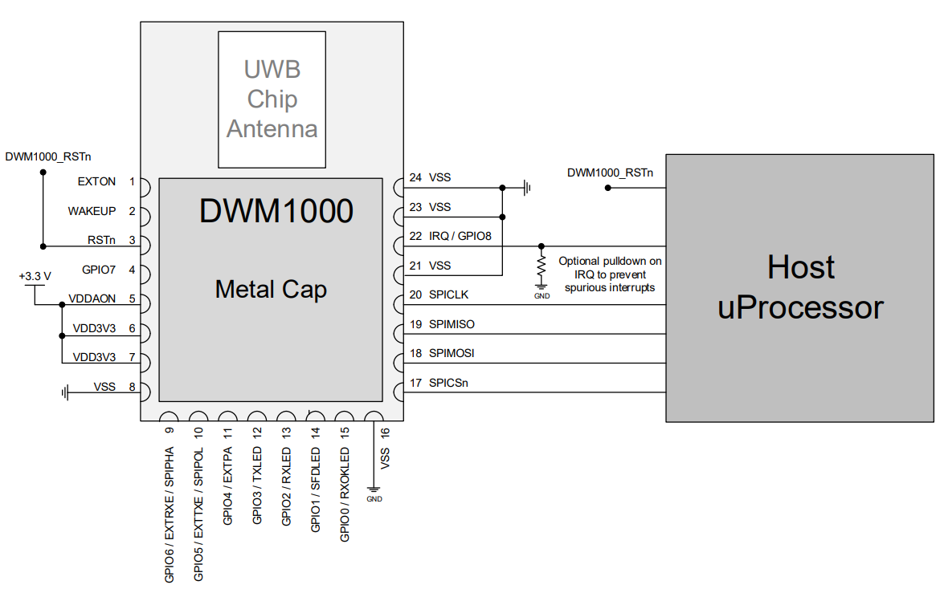
Microcontroller – DWM1000 connection

Slide 8
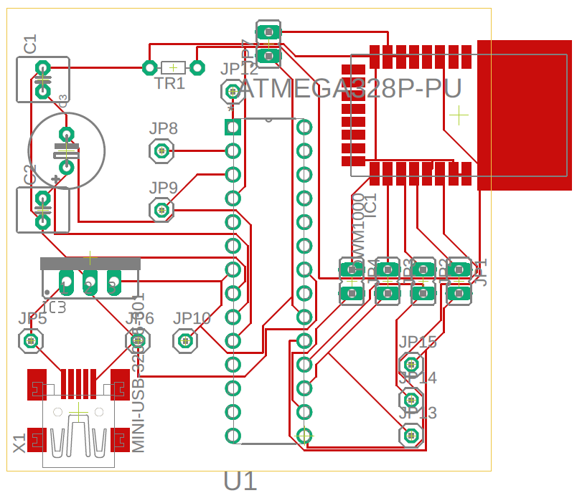
Design of the PCB
DWM1000
ATmega328P
3.3V voltage regulator
Mother mini-USB connector
Capacitors, Oscillator, Pins

Slide 9
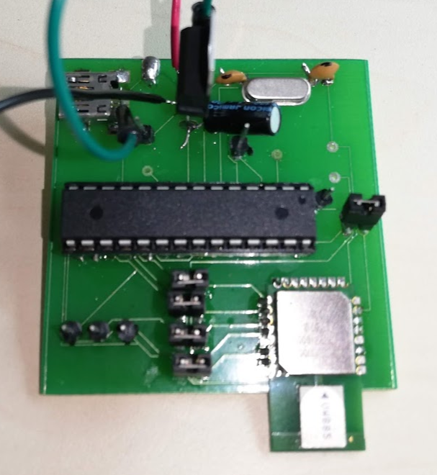
Final form

Slide 10

Trilateration

Slide 11
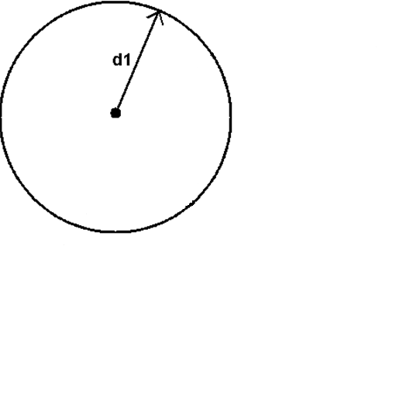

Slide 12
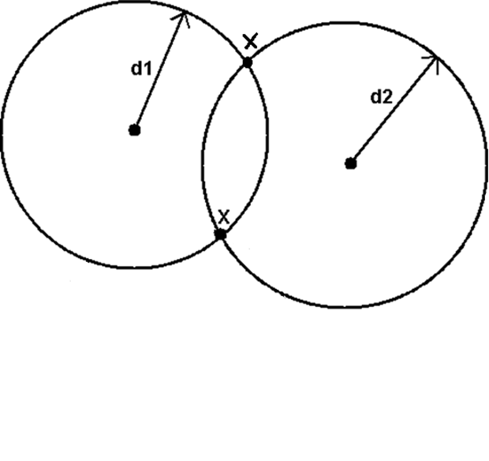

Slide 13
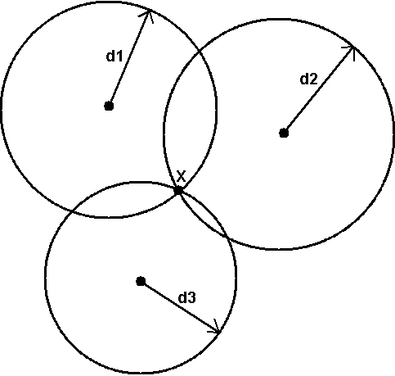

Slide 14
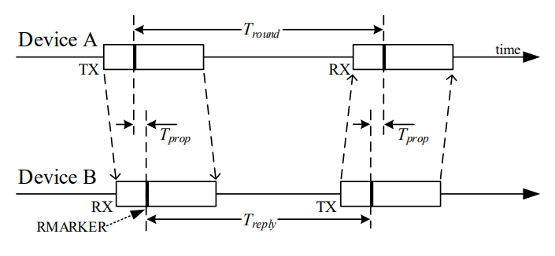
Single-sided two-way ranging

Slide 15

Single-sided two-way ranging

Slide 16
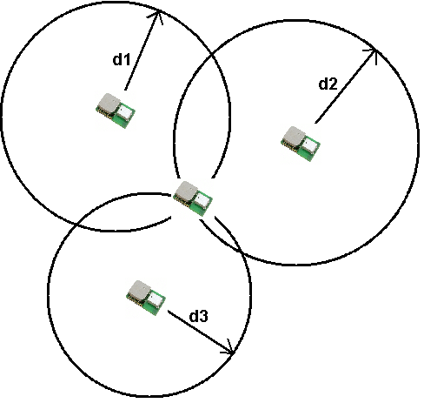

Slide 17
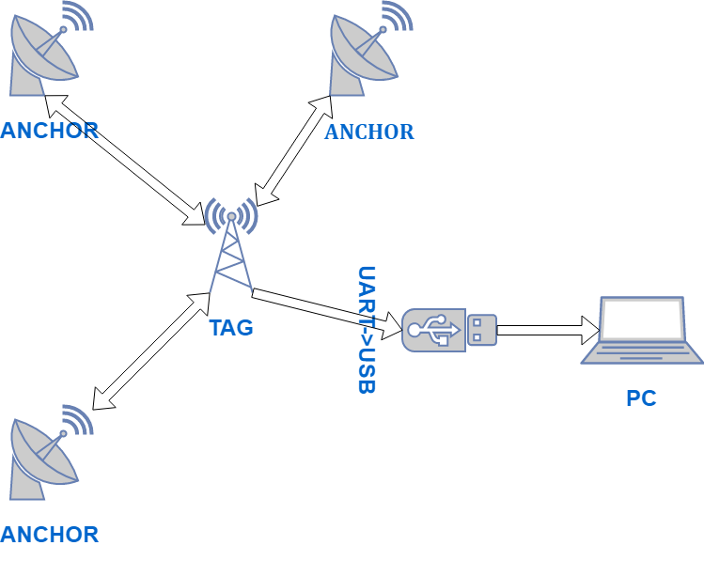

Slide 18
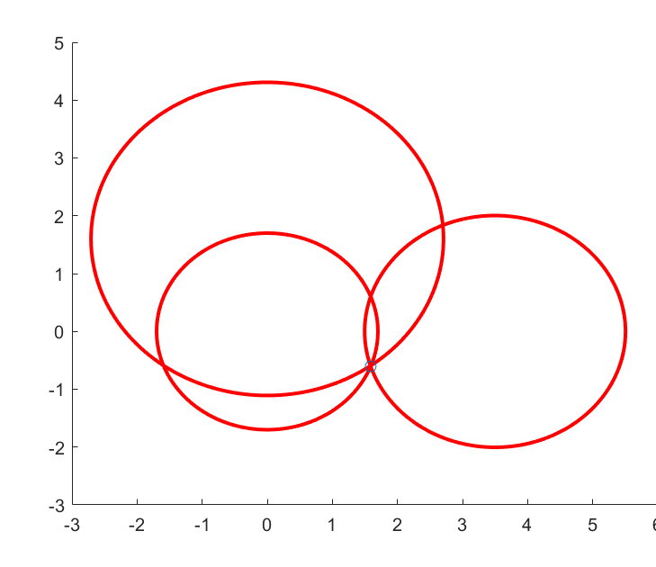
Modified trilateration
Calculate the intersection of 2 circles
Calculate which point from the previous step is close to the third circle

Slide 19
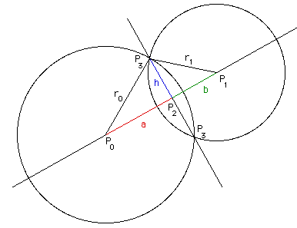
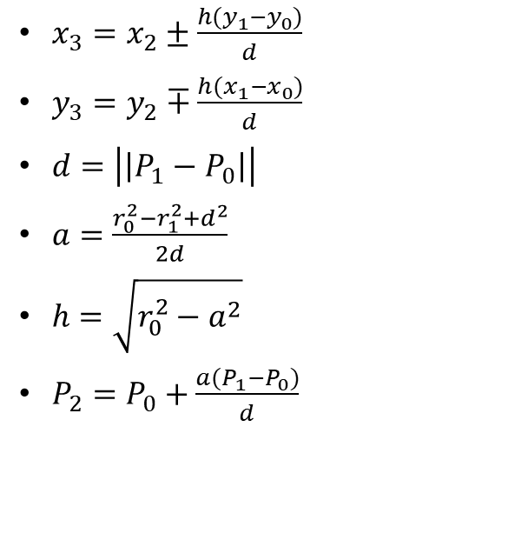
Intersection of 2 circles
$x_{3}=x_{2}±\frac{h(y_{1}−y_{0})}{d}$
$y_{3}=y_{2}∓\frac{h(x_{1}−x_{0})}{d}$
$d=\left|\left|P_{1}−P_{0}\right|\right|$
$a=\frac{r_{0}^{2}−r_{1}^{2}+d^{2}}{2d}$
$h=\sqrt{r_{0}^{2}−a^{2}}$
$P_{2}=P_{0}+\frac{a(P_{1}−P_{0})}{d}$

Slide 20
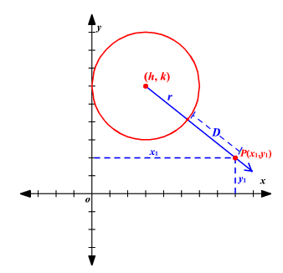

Shortest distance from point to circle
$d=|\sqrt{{\left(x_{1}−h\right)}^{2}+{\left(y_{1}−k\right)}^{2}}−r|$

Slide 21
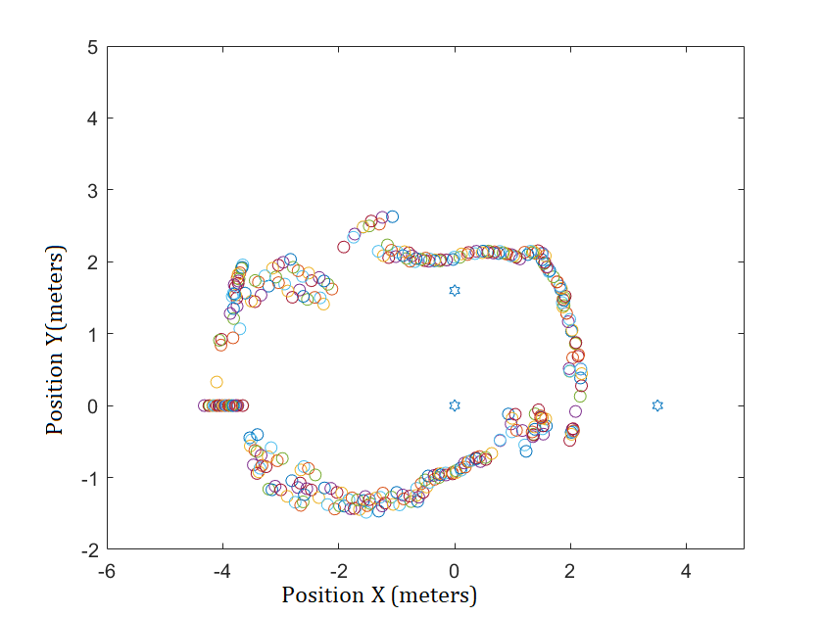

Slide 22

Thank you for your attention

