Slide 1
Indoor positioning system
Author: Velcherean Raul
Supervisor: asis.eng. Harja Gabriel

Slide 2

What is a positioning system?

Slide 3

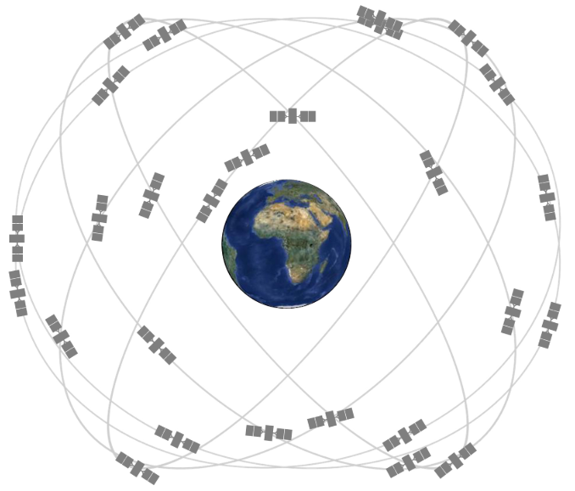
Global Positioning System

Slide 4
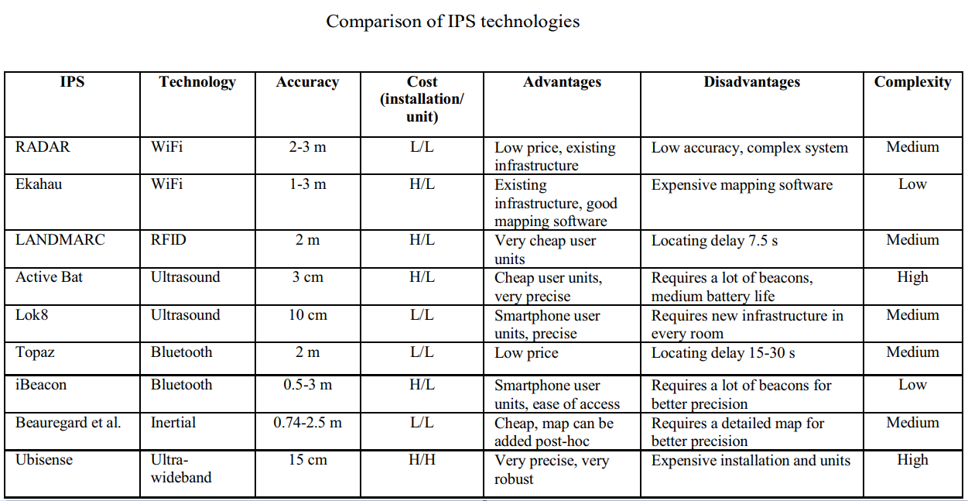

Slide 5
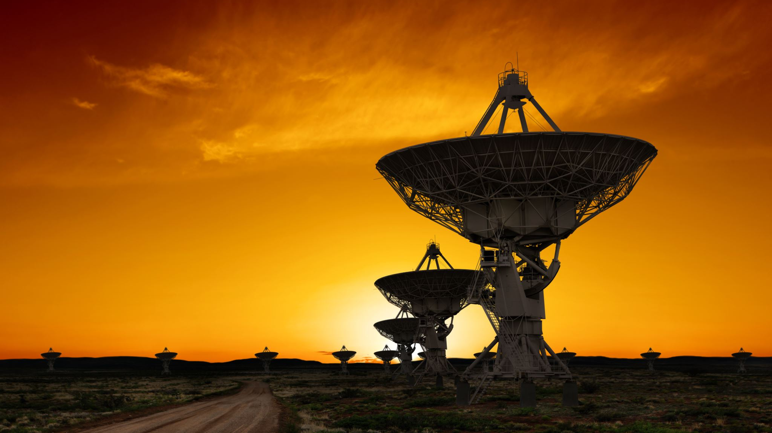
UWB – Ultra Wide Band

Slide 6
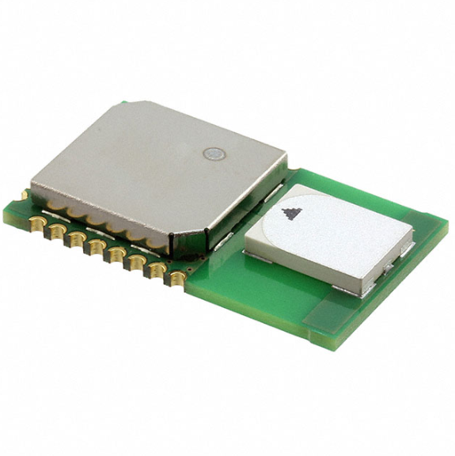
DWM1000
Transceiver IC with antenna, all RF circuitry, power management and clock circuitry all in one
4 RF bands (3.5GHz to 6.5 GHz)
Low power consumption
Data rates: 110 kbps, 850 kbps, 6.8 Mbps
63.8976 GHz sampling clock used for ranging (15.65 ps period)
23 mm x 13 mm x 2.9 mm

Slide 7
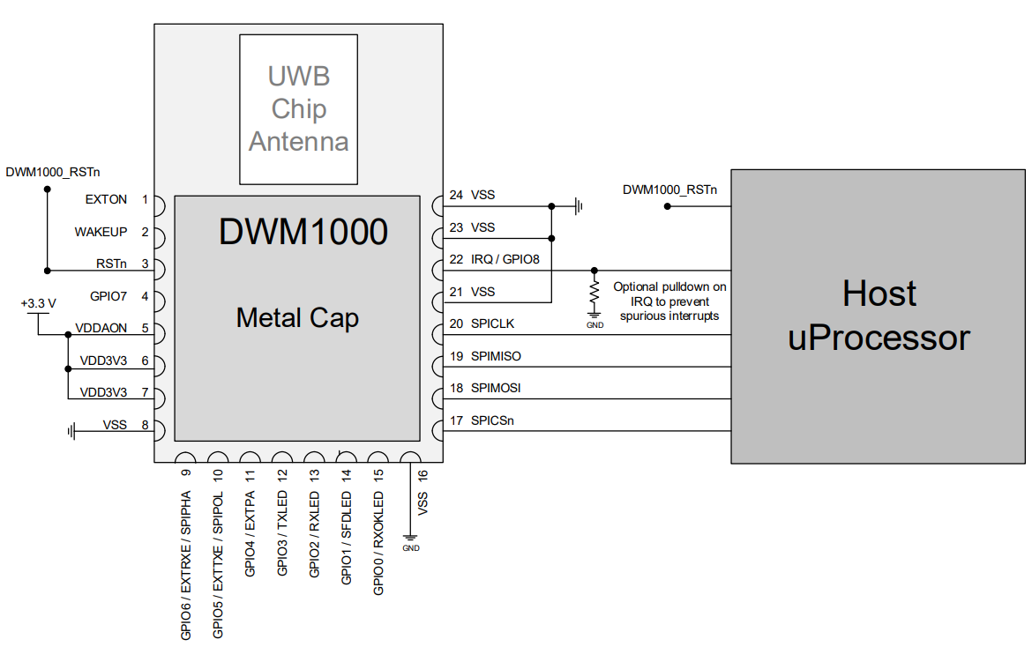
Microcontroller – DWM1000 connection

Slide 8
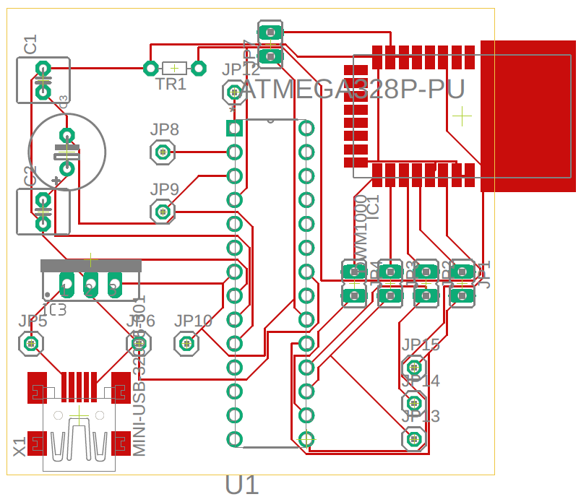
Design of the PCB
DWM1000
ATmega328P
3.3V voltage regulator
Mother mini-USB connector
Capacitors, Oscillator, Pins

Slide 9
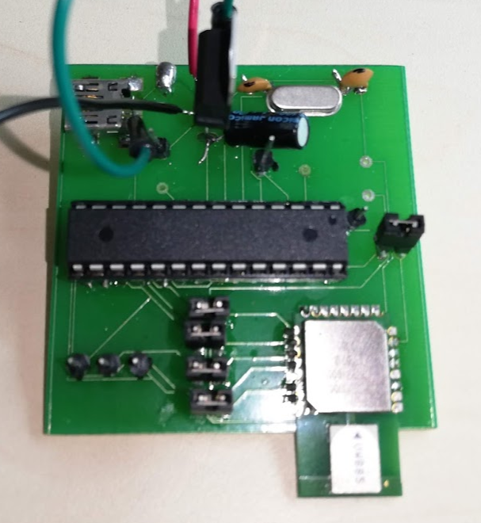
Final form

Slide 10

Trilateration

Slide 11
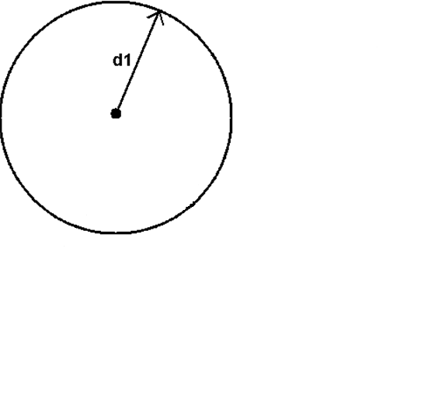

Slide 12
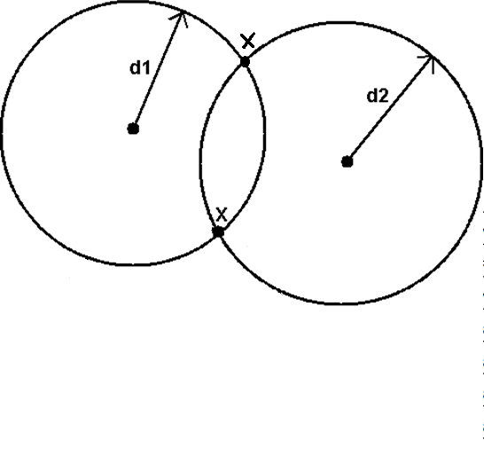

Slide 13
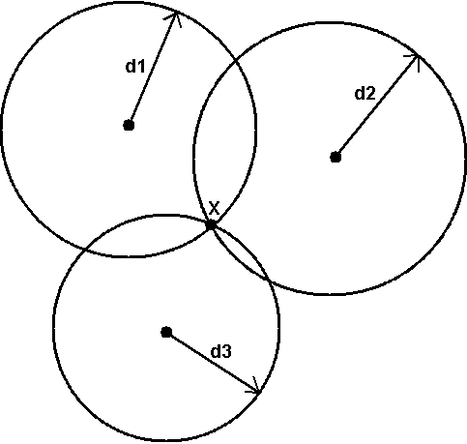

Slide 14
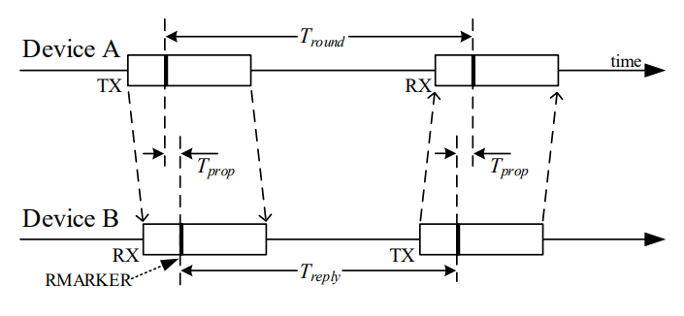
Single-sided two-way ranging

Slide 15

Single-sided two-way ranging

Slide 16
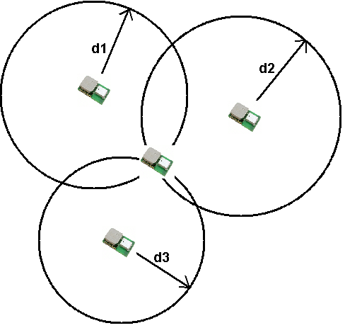

Slide 17
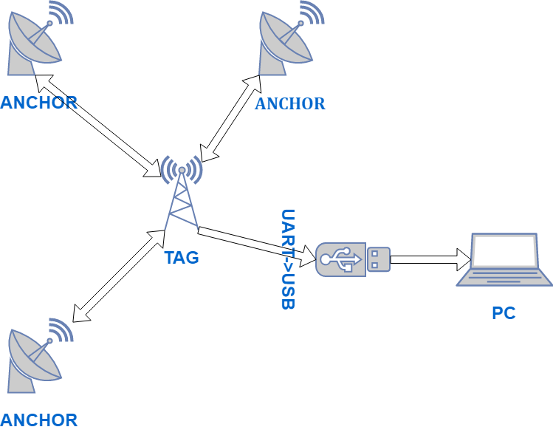

Slide 18
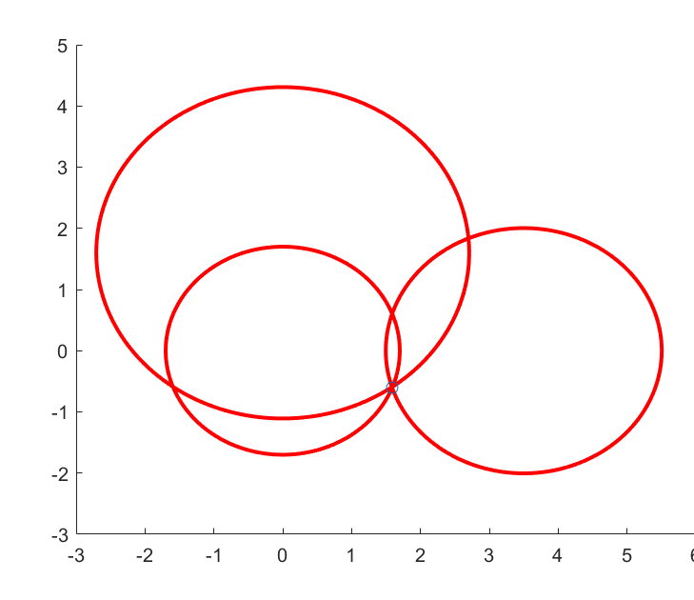
Modified trilateration
Calculate the intersection of 2 circles
Calculate which point from the previous step is close to the third circle

Slide 19
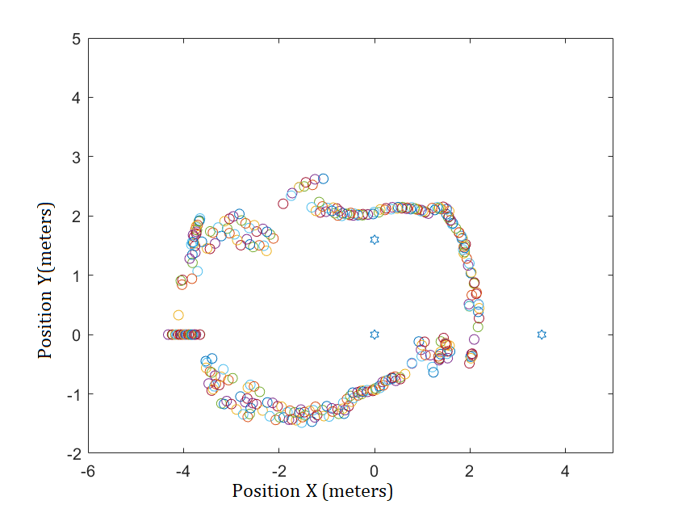

Slide 20

Thank you for your attention

