Slide 1
Indoor monitoring system
Velcherean Raul

Slide 2

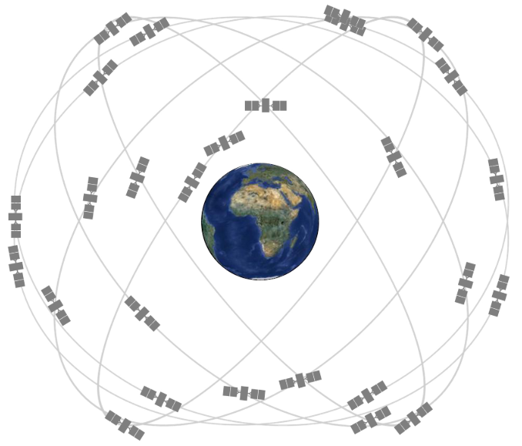
Global Positioning System

Slide 3
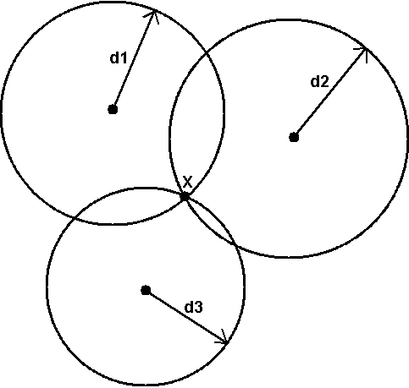
Trilateration

Slide 4
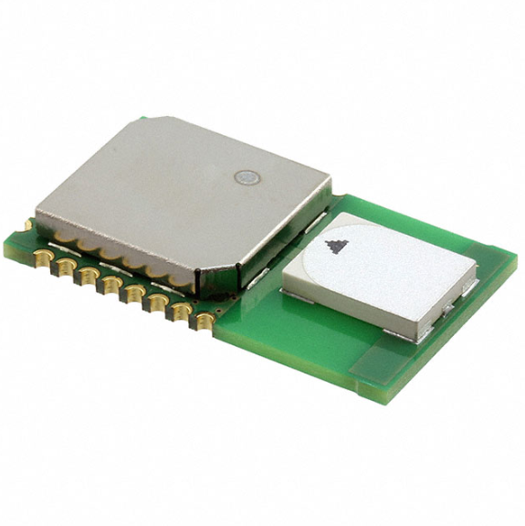
DWM1000

Slide 5
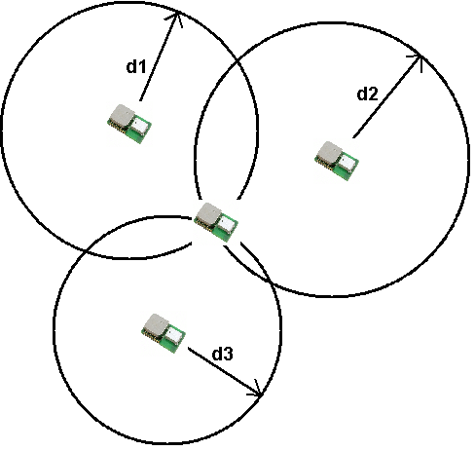

Slide 6

Thank you for your attention

