Slide 1
Indoor positioning system
Author: Velcherean Raul
Supervisor: asis.eng. Harja Gabriel

Slide 2

What is a positioning system?

Slide 3

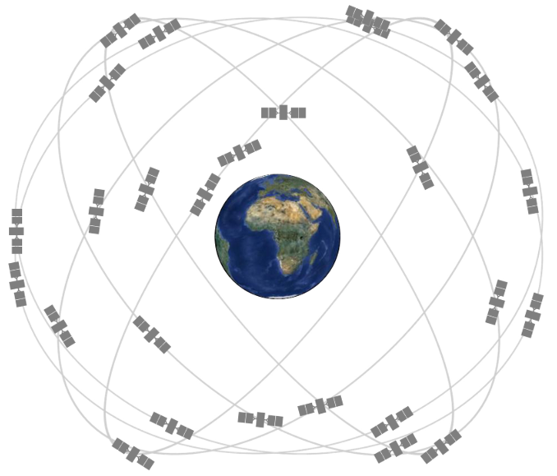
Global Positioning System

Slide 4
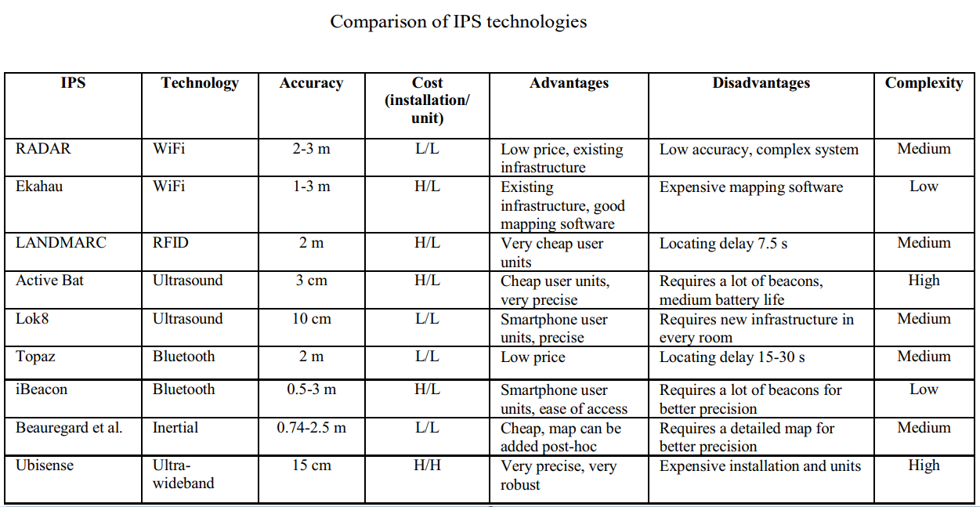

Slide 5
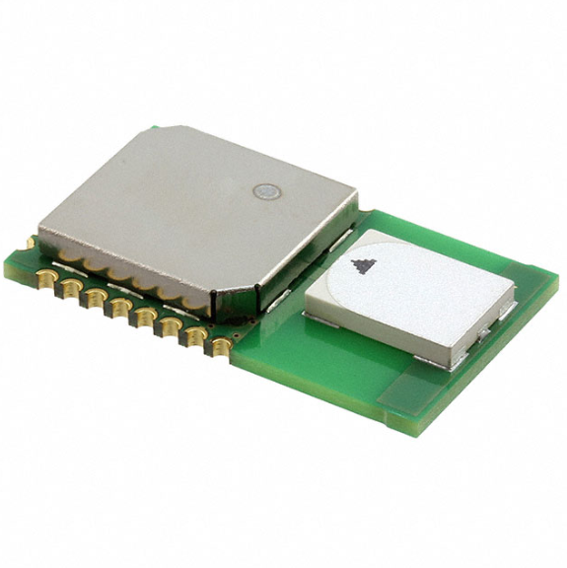
DWM1000

Slide 6
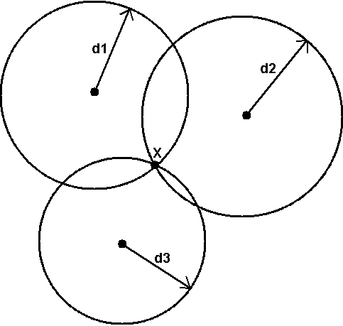
Trilateration

Slide 7
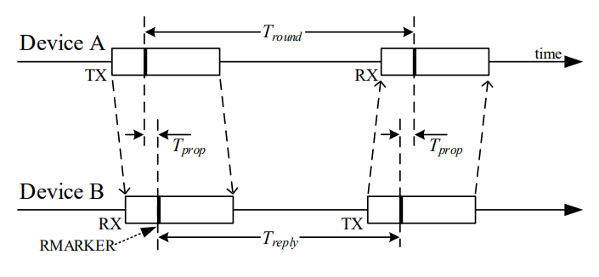
Single-sided two-way ranging

Slide 8

Single-sided two-way ranging

Slide 9
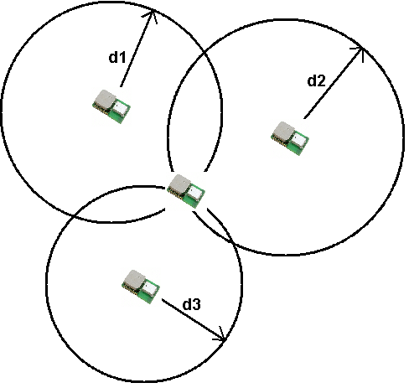

Slide 10

Thank you for your attention

