Slide 1
Activity classification using noisy video streams
João Rôla
Raul Viana
Rodrigo Azevedo
Internship supervisors
Leonardo Capozzi
Afonso Sousa
30 de julho de 2021
Notes:
Sub-Capa
‹#›

Slide 2
Introduction/motivation
Autonomous vehicles are expected to become pervasive in the years to come.
Share vehicles are expected to play a key role in urban mobility
The automatic recognition of activity will provide valuable information, but it faces difficulties due to the noise that affects visual information.
Accurate classification is therefore extremely valuable.
‹#›
Notes:
O reconhecimento da actividade tem como objectivo reconhecer actividades dos ocupantes dos veículos autónomos partilhados.

Slide 3
Objectives
Definition and preparation of the best available dataset
Integration of motion information in a proper classification model based on deep neural networks
Fine-tune the classification model hyper-parameters
Report the work and the results
‹#›

Slide 4
Work Description
Brief research about the PyTorch framework and libraries concerning deep-learning and neural networks.
Determine what freely available dataset and model would best suit our needs (HMDB-51).
Adaptation of the dataset by way of frame extraction, and development of a dataloader for action recognition.
Splitting of the dataset into validation and training groups.
‹#›
Notes:
Referir: scripts para adaptação do dataset, labels, 80/20

Slide 5
Work Description
Upload of the modified dataset to Google cloud.
Testing our notebook script with a reduced version of the dataset (fewer classes).
Running our notebook through the whole 51 classes.
Fine-tuning of the parameters and statistics gathering.
‹#›
Notes:
Frames -> imagens PIL -> tensores -> stack de tensores

Slide 6
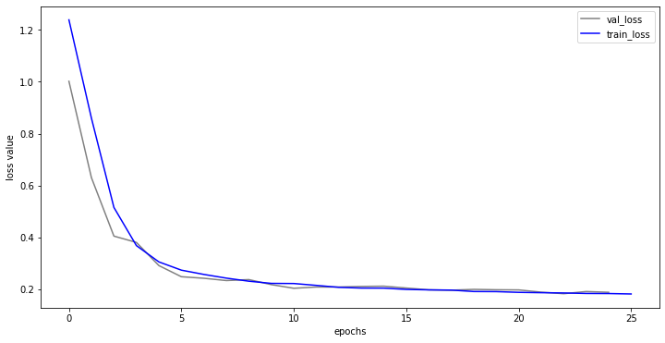
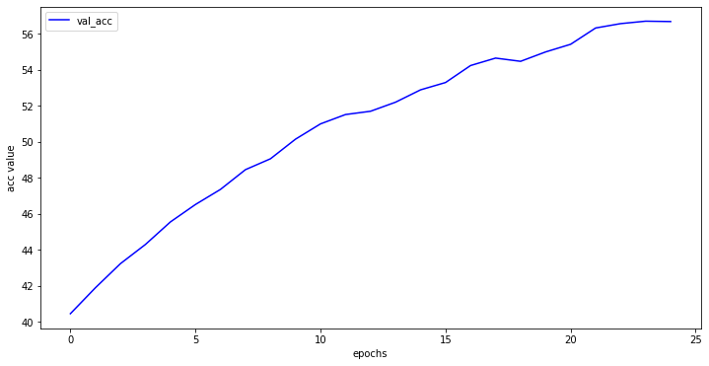
Obtained Results
Resnet (2D+1) 18
all layers frozen, except the last one
batch_size: 16
learning rate: 2e-4
‹#›

Slide 7
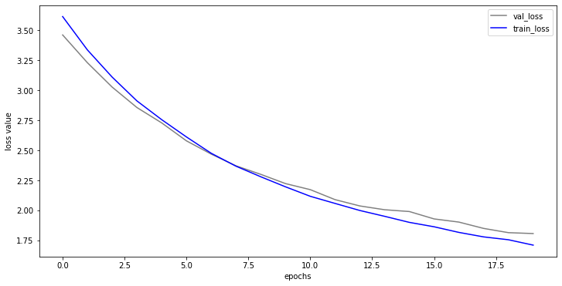
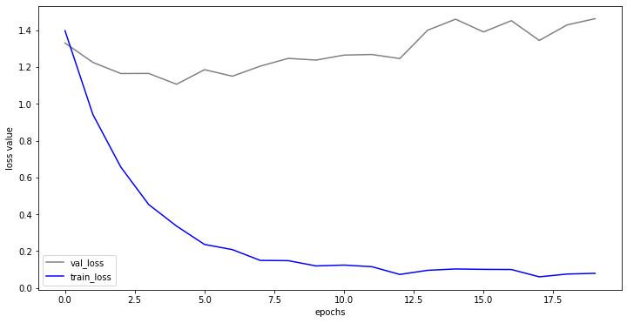
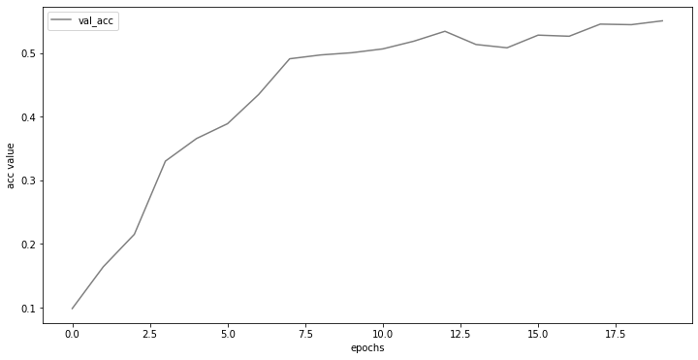
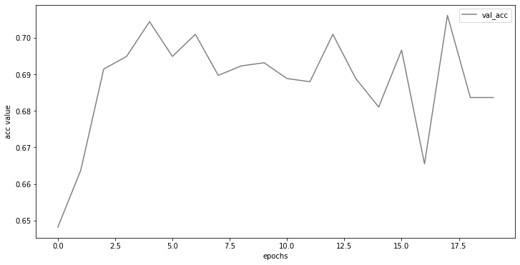
Obtained Results
ResNet 3D 18:
all layers frozen, except the last one
batch-size: 10
learning-rate: 1e-4
ResNet 3D 18:
all layers unfrozen
batch-size: 10
learning-rate: 1e-4
‹#›
Notes:
Perto da 10ª época a linha de loss do validation set parece sofrer uma inflexão o que pode querer dizer que o modelo começa a sofrer de overfitting, apesar de serem poucas épocas para isso. De qualquer forma a curva da accuracy começa a convergir a partir da 10ª época.
No modelo da esquerda seria de esperar que o treino fosse mais demorado em termos computacionais. O que se registou foi uma curva de validation loss que sugere um dataset de treino não representativo, ou seja que não fornece informação suficiente para o modelo aprender, por exemplo demasiado pequeno. No entanto, apesar da curva de validation accuracy ser algo instável, atinge valores maiores do que os outros modelos.

Slide 8
Obtained Results
As expected, the ResNet3D18 achieved the best accuracy when trained with all layers unfrozen.
There were no significant differences between ResNet3D18 and Resnet(2D+1)18 trained with all layers frozen except the last one.
 | Max Accuracy
Resnet (2D+1) 18 frozen) | 57%
ResNet 3D 18 (frozen) | 56%
ResNet 3D 18 (unfrozen) | 73%
‹#›

Slide 9
Conclusions
All the proposed objectives were accomplished
Video classification model training implies heavy computation
Model with unfrozen layers has better performance, although at the cost of extremely long training time
The hyper-parameter values have quite impact in model performance
‹#›

