Slide 1
News Reliability Model
Raum

Slide 2
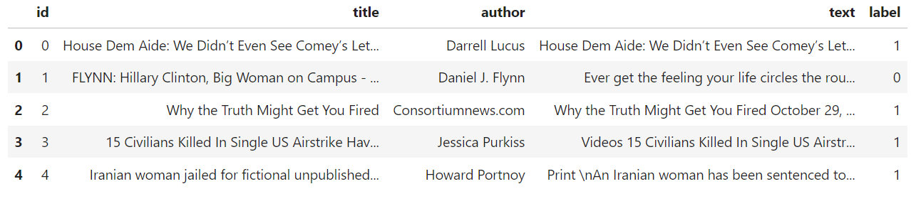
Visualising the dataset
‘id’
‘title’
‘author’
‘text’
‘label’: 1 and 0 represent unreliable and reliable articles respectively

Slide 3
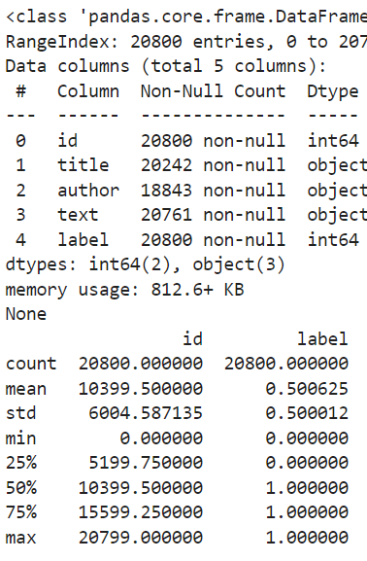

Slide 4
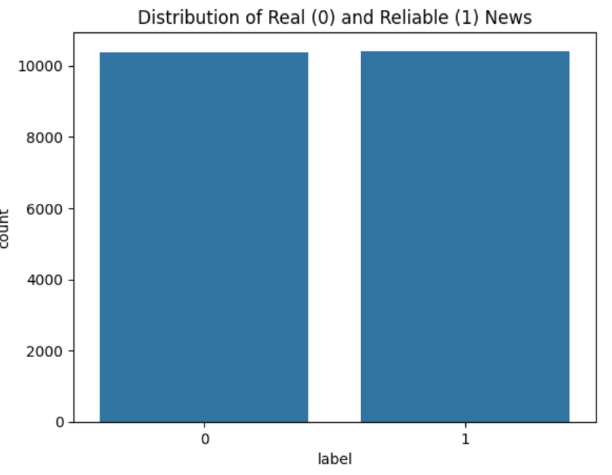

Slide 5
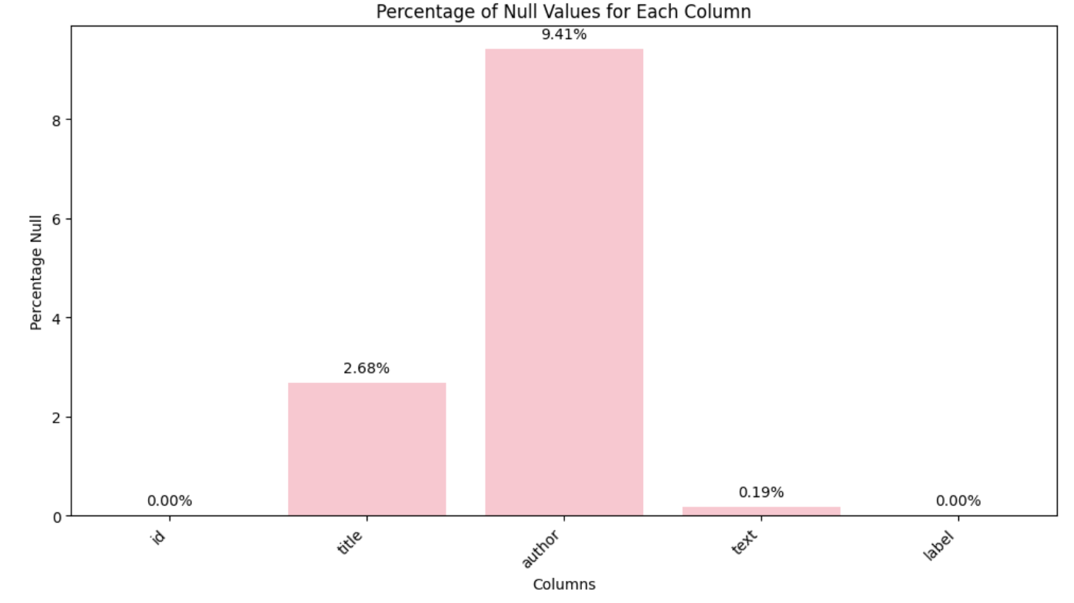
Pre-Processing
The dataset contained some null values.
39 of 20800 (0.19%) entries of the text column were non-null; I deleted these samples.

Slide 6
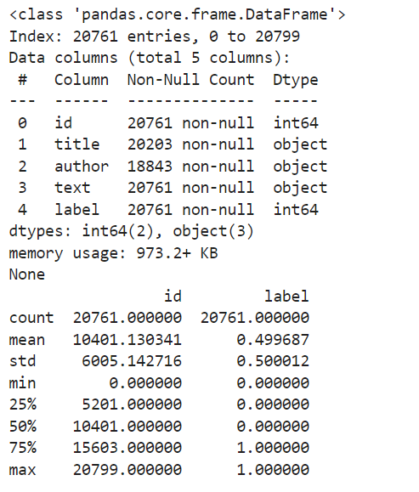
The new data description demonstrates this reduction in samples from 20800 to 20761 (the number of non-null text value samples)

Slide 7
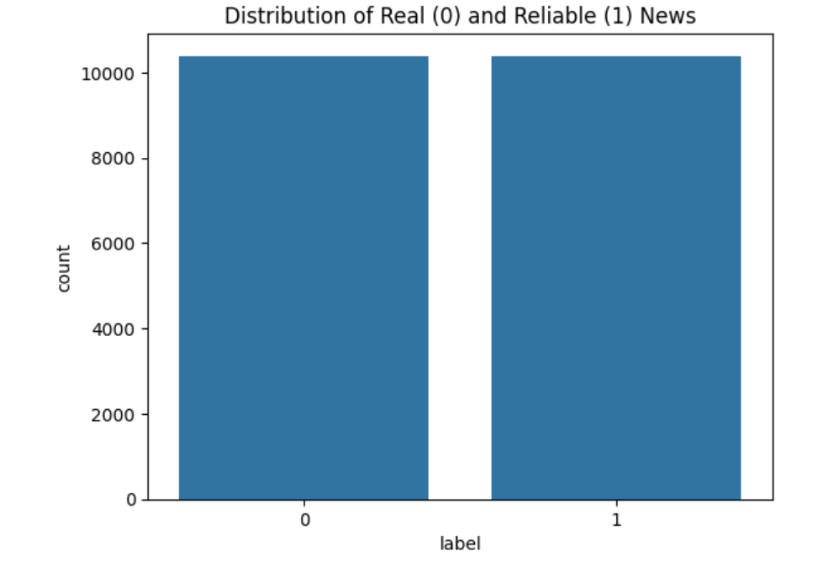

Slide 8
Visualising Reliability
Word Clouds (Word Frequency)
Plotting Word Frequency
N-gram analysis (bigrams)
Sentiment Analysis

Slide 9
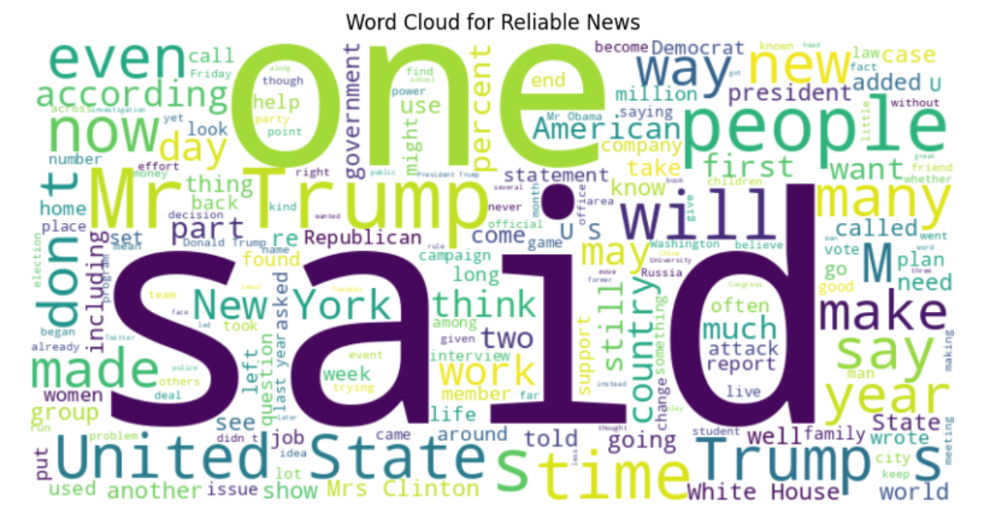
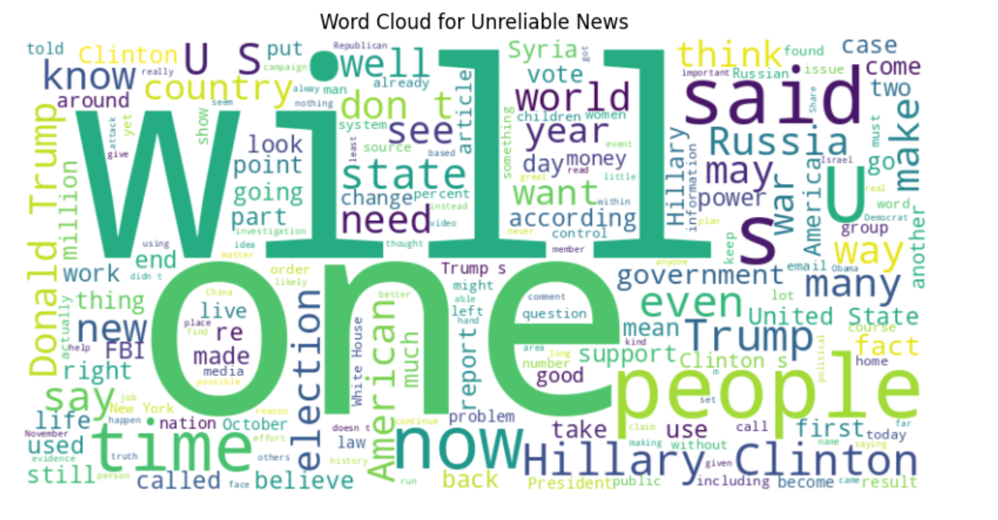
1. Word Clouds

Slide 10
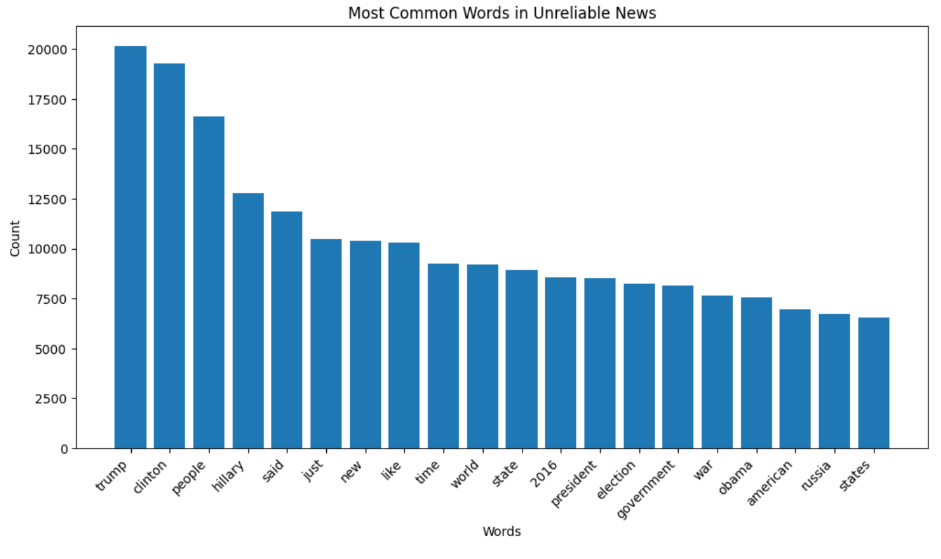
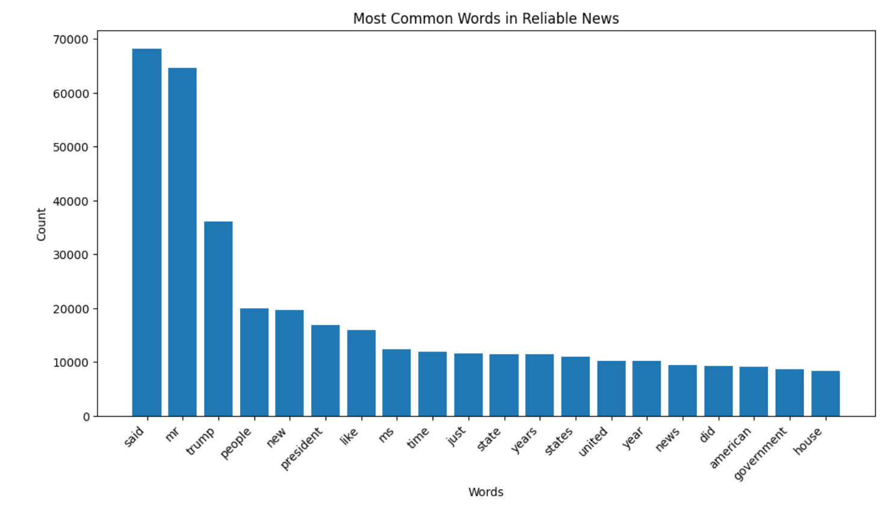
2. Plotting Word Frequency

Slide 11
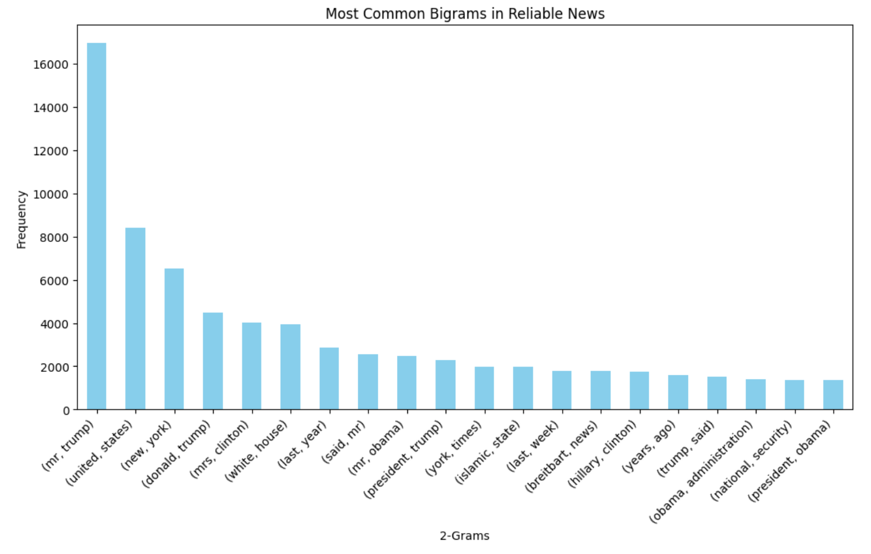
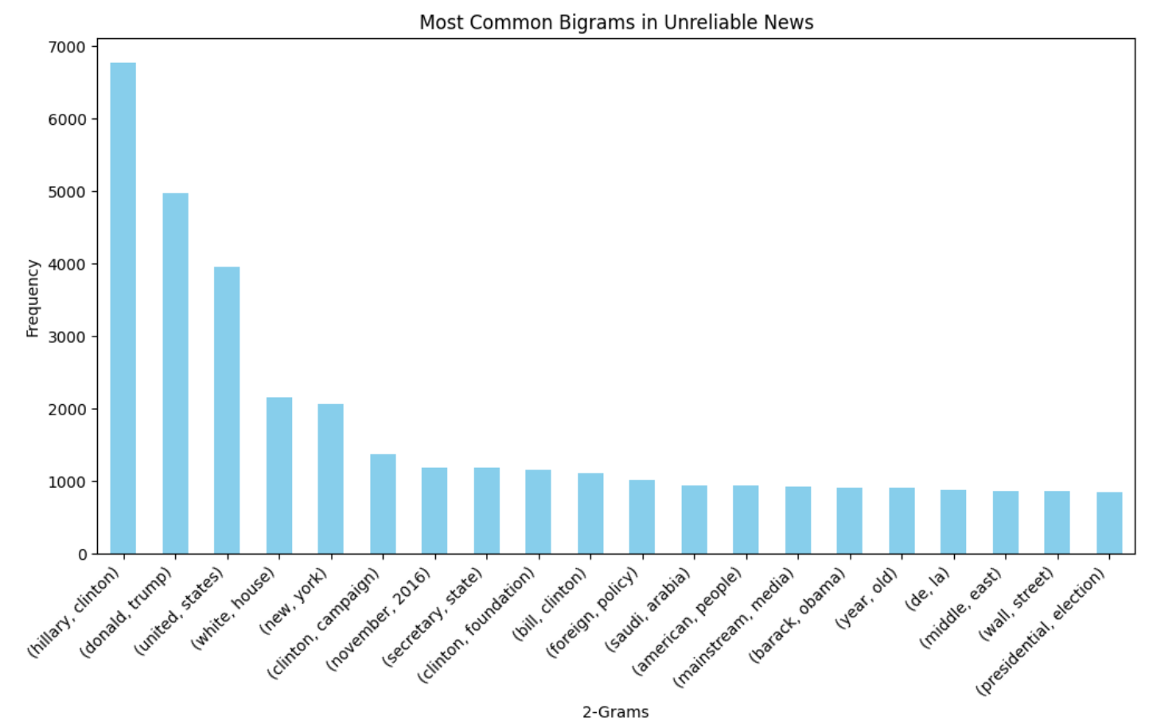
3. N-gram analysis (bigrams)

Slide 12
4. Sentiment Analysis
I used sentiment polarity (a part of sentiment analysis) to determine the degree of positivity or negativity expressed in each text, a numerical measure.
This is equivalent to a human analysing the tone or mood within a text through language choice among other things.
The TextBlob library analyses the sentiment of a given text and outputs the numerical value for sentiment polarity.

Slide 13
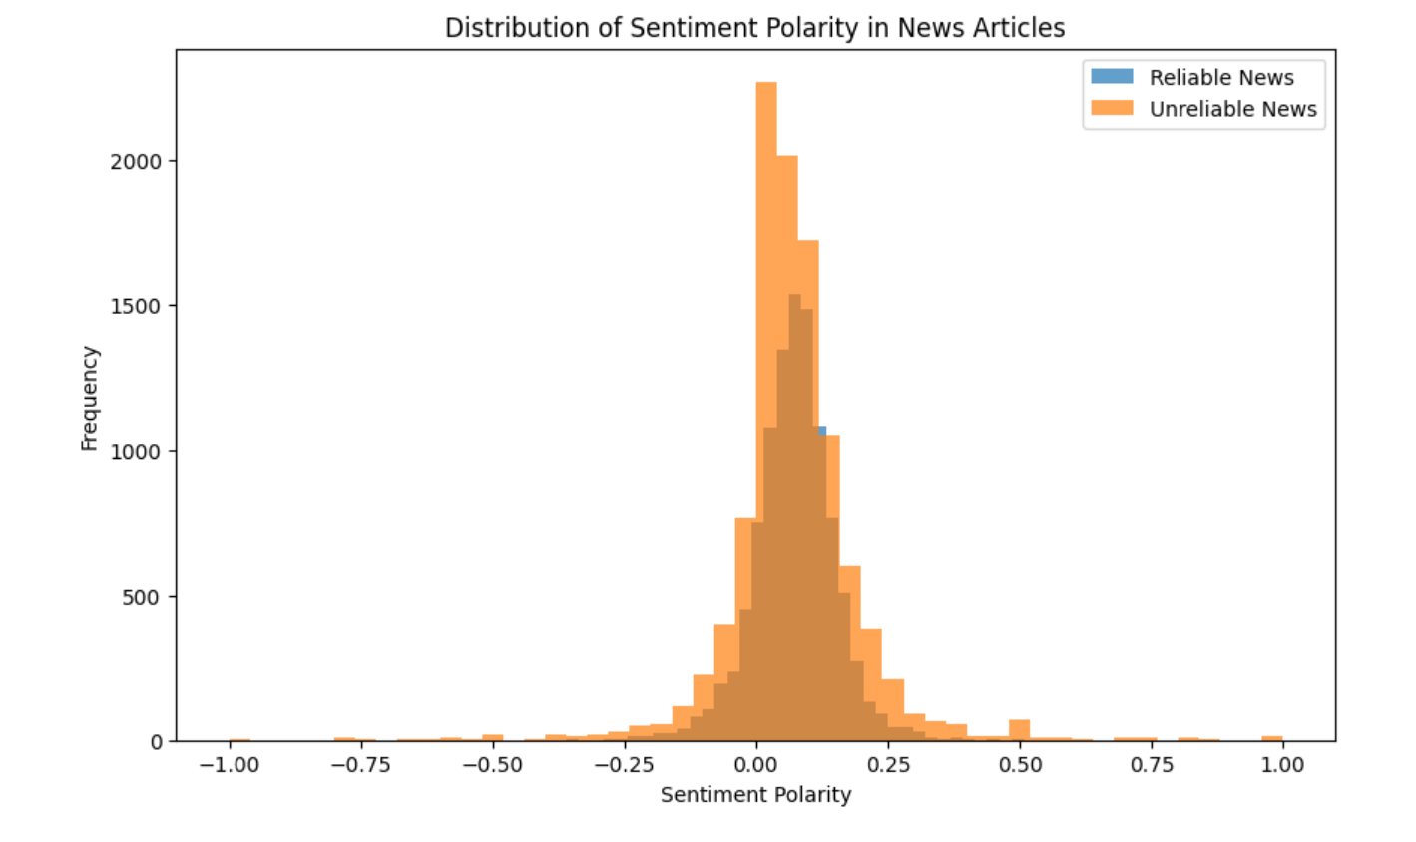

Slide 14
Logistic Regression (with ‘text’ column)
Create Vocabulary: Identify all unique words in the entire set of documents.
Tokenisation: Break down each document into individual words.
Word Frequency: Count the frequency of each word in each document.
Vector Representation: Represent each document as a vector, where each element in the vector corresponds to the frequency of a word in the vocabulary
To address some of the limitations of bag-of-words I used TF-IDF (Term Frequency-Inverse Document Frequency).
Instead of representing a document as a raw word frequency vector, TF-IDF considers both the frequency of a word in a document (Term Frequency) and the rarity of the word across all documents in the dataset (Inverse Document Frequency).
I first started by tokenising and creating a bag-of words representation of the text within each article
This approach represents a document as an unordered set of words, disregarding grammar and word order but keeping track of word frequency. The basic idea is to create a vocabulary of unique words present in the entire set of documents and then represent each document as a vector in this high-dimensional space, with each dimension corresponding to a word in the vocabulary.

Slide 15

Since there was an equal distribution of 'reliable' and 'unreliable' news, this score is respectable - where a random guess strategy would yield, on average, a score of 50%.
Let us compare this to the model's performance on the training set, because it is interesting.

Slide 16

The model does not seem to be overfitting as using the test set only reduced accuracy by 2%

Slide 17
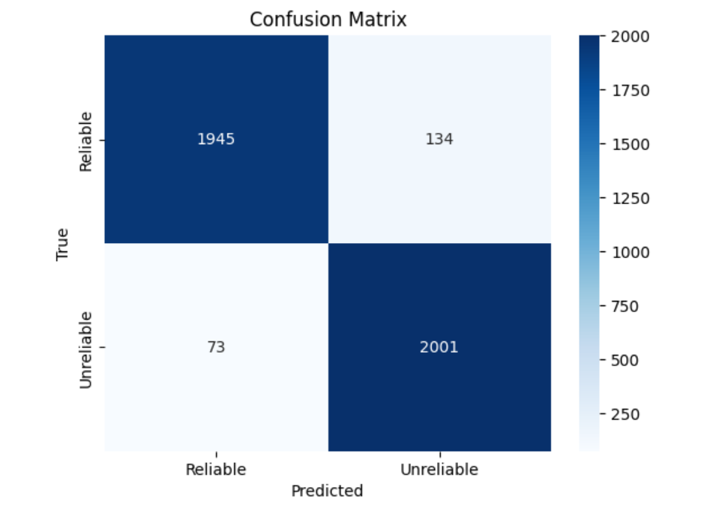

Slide 18
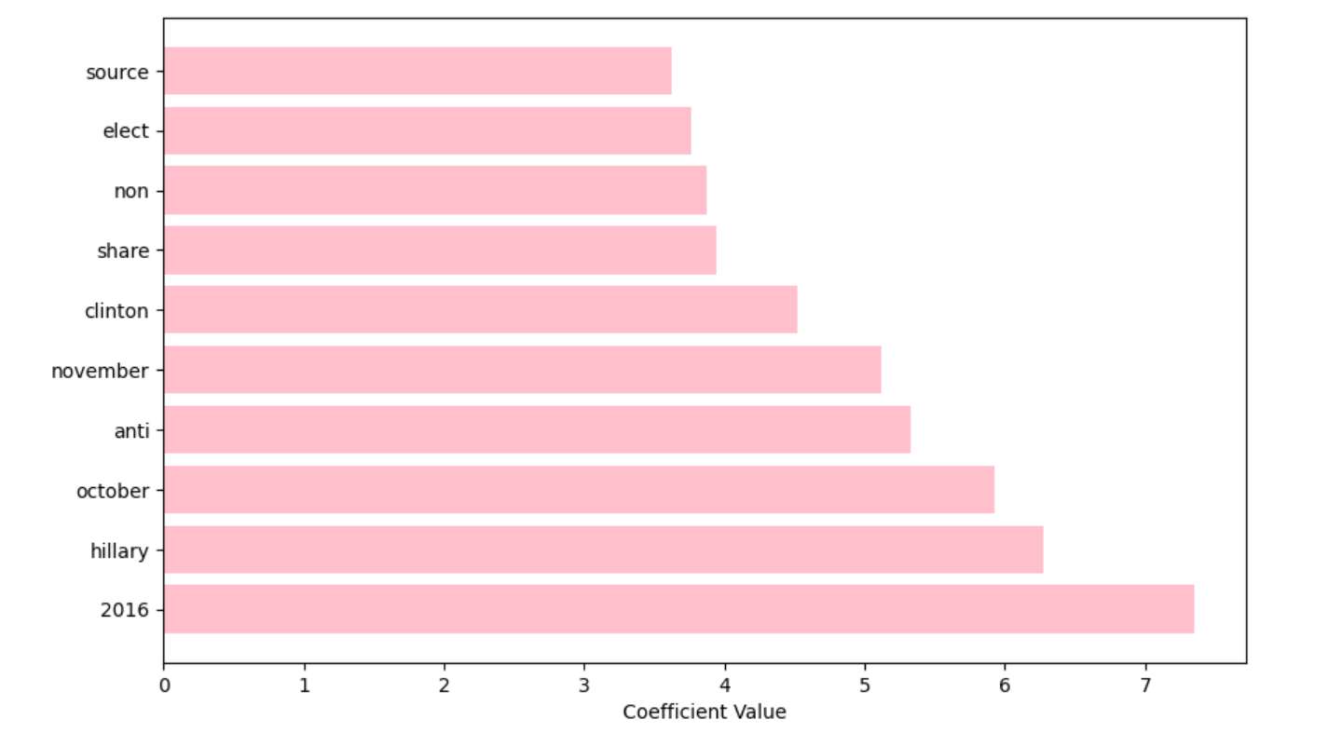
An interesting thing to observe when combining logistic regression with TF-IDF is the coefficient the model gives to each word.
Below is a visualisation of the coefficient (weight) of words in determining reliability of a given article.

Slide 19
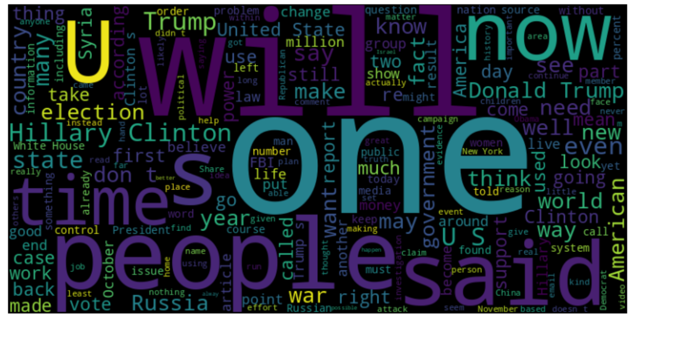
This word cloud shows the most common words within articles deemed 'reliable'.

Slide 20
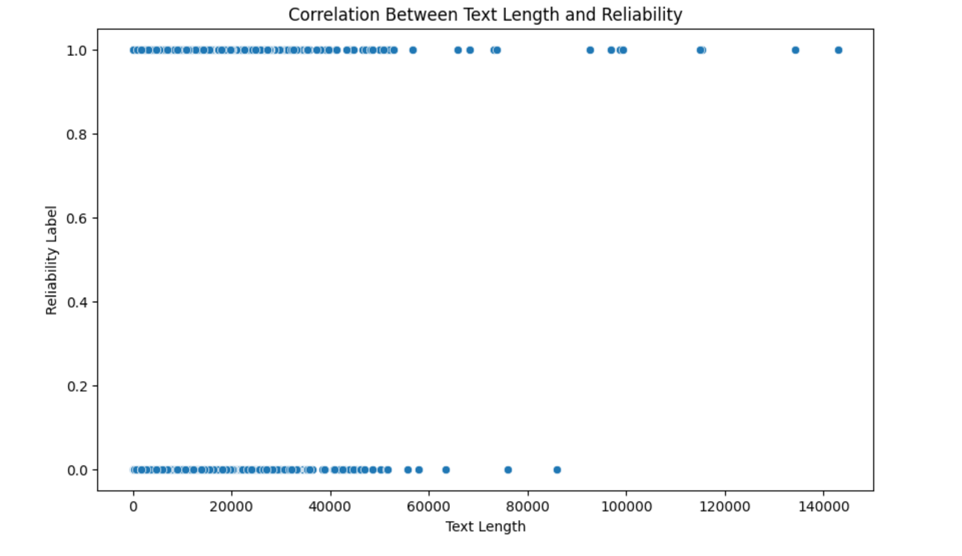

Slide 21






Logistic Regression (Article Title)

Slide 22
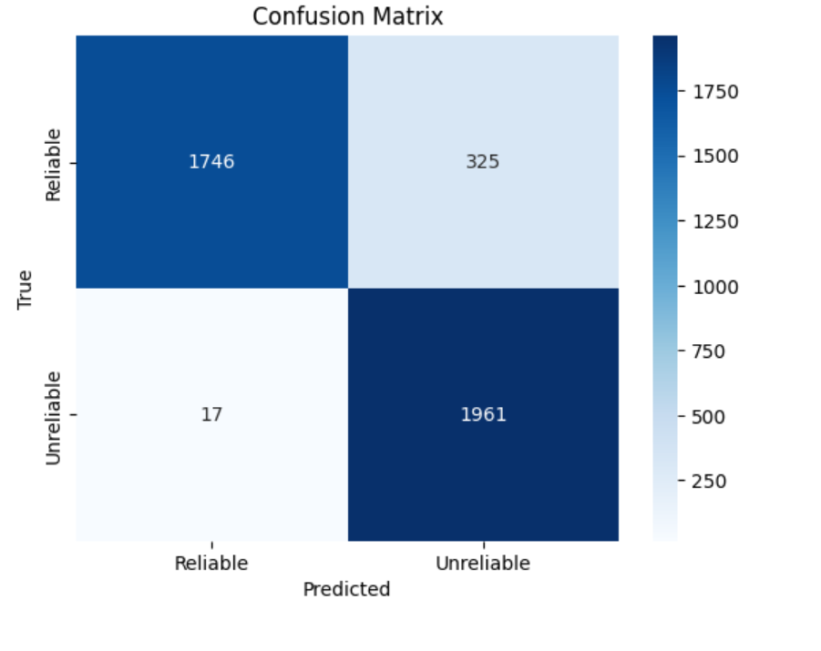

Slide 23
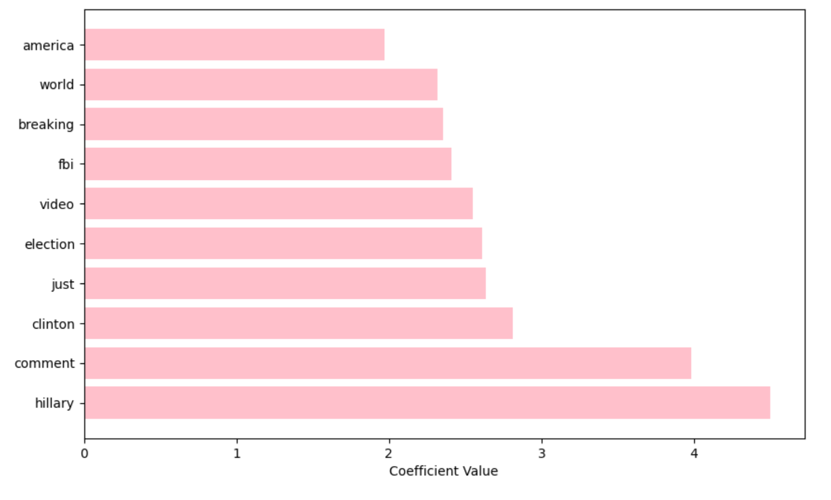

Slide 24
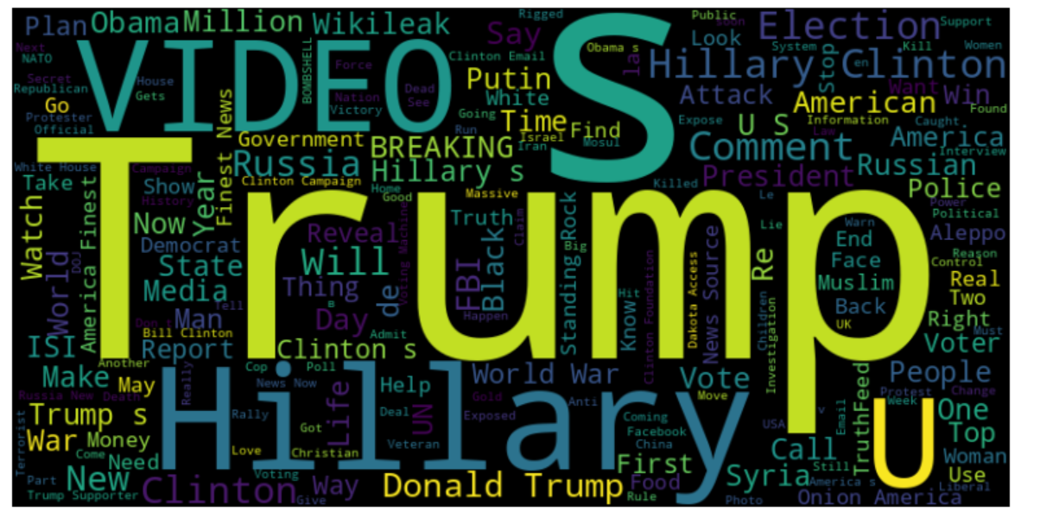

Slide 25
