Slide 1

Mini Project MTD350
Stochastic Programming Models
Supervisor: Prof. Vikas Vikram Singh
Course Coordinator: Prof. Viswanathan Puthan Veedu
Submitted by:
Raunak Lohiya Vishavjeet Singh
2014MT60362 2014MT60570

Slide 2
Introduction
The aim of the project is to learn to formulate, analyse and solve optimization problems involving stochastic models.
SP modelling involves concepts from optimization theory, probability and statistics and functional analysis.
Basic concepts including recourse actions, chance constraints and the nonanticipativity principle to development of two-stage and multi-stage stochastic programming problems would be covered.
SP finds its application in all areas of science and engineering, from telecommunication and medicine, to finance.

Slide 3
Implementations
Analysis of monthly data from 31-01-2011 to 31-12-2016 obtained via Quandl API.
MEAN RETURNS: VARIANCE-COVARIANCE MATRIX:
MARUTI > TCS > MSFT > GS > RELIANCE
Variance Order: MARUTI > GS > RELIANCE > MSFT > TCS
RELIANCE | GS | MARUTI | MSFT | TCS
1.00283 | 1.009 | 1.02104 | 1.01172 | 1.01591
 | RELIANCE | GS | MARUTI | MSFT | TCS
RELIANCE | 0.004889 | 0.001772 | 0.0037489 | 0.0012848 | 0.000244
GS | 0.001772 | 0.006672 | 0.0021833 | 0.0024767 | 0.001125
MARUTI | 0.0037489 | 0.0021833 | 0.0097254 | 0.001926 | -0.00067
MSFT | 0.0012848 | 0.0024767 | 0.001926 | 0.0043629 | 0.000503
TCS | 0.000244 | 0.001125 | -0.00067 | 0.000503 | 0.003615

Slide 4
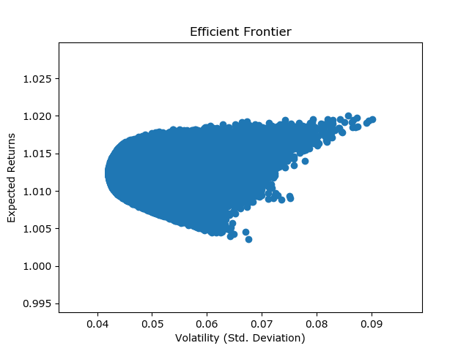
Markowitz Curve
Obtained by Monte Carlo Simulation.

Slide 5
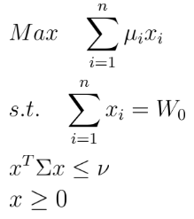
Static Models
Model 1 - Expectation Maximization
:
𝝼 | 0.001 | 0.002 | 0.003 | 0.004 | 0.005 | 0.01
RELIANCE | NaN | 3.50E-07 | 3.31E-08 | 3.12E-08 | 4.48E-08 | 9.13E-09
GS | NaN | 6.03E-07 | 6.36E-08 | 5.80E-08 | 8.26E-08 | 1.38E-08
MARUTI | NaN | 0.24794 | 0.499594 | 0.62546 | 0.71545 | 0.99999
MSFT | NaN | 0.19120 | 1.20E-07 | 9.52E-08 | 1.30E-07 | 1.77E-08
TCS | NaN | 0.56085 | 0.50040 | 0.37453 | 0.28454 | 3.43E-08
Optimal Value | NaN | 1.01638 | 1.01848 | 1.01912 | 1.01959 | 1.02105

Slide 6
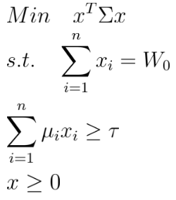
Model 2 - Variance Minimization
𝛕 | 1.01 | 1.015 | 1.02 | 1.021 | 1.022
RELIANCE | 0.20643 | 6.21E-02 | 8.59E-10 | 4.10E-09 | NaN
GS | 0.01576 | 8.35E-06 | 1.61E-09 | 7.73E-09 | NaN
MARUTI | 0.08016 | 0.17788 | 0.79622 | 0.99091 | NaN
MSFT | 0.24773 | 0.24156 | 2.50E-09 | 1.19E-08 | NaN
TCS | 0.44990 | 0.51843 | 0.20377 | 0.00908 | NaN
Optimal Value | 0.00176 | 0.00185 | 0.0061 | 0.0095 | Inf

Slide 7
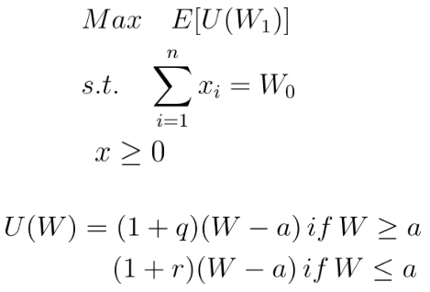
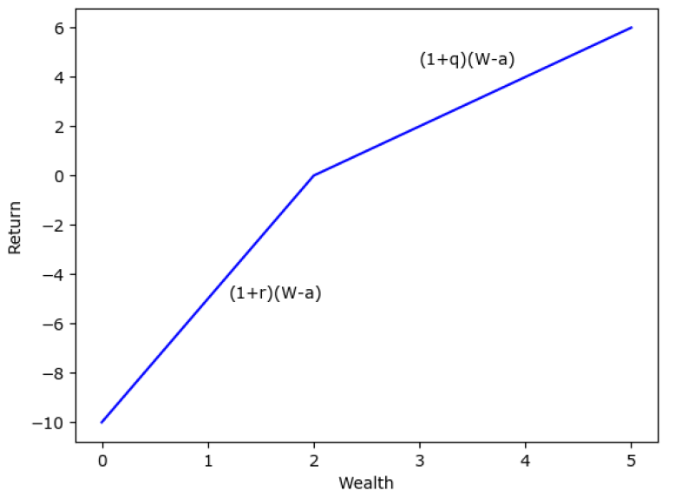
Model 3 - Utility Function

Slide 8
Model 3 - Utility Function
Multivariate normality assumption!! Sample Approximation Approach
Skewness and Kurtosis Test: p -value (0.1363, 0.0002)
RELIANCE | 6.83E-10 | 3.84E-09 | 3.84E-09 | 1.03E-09 | 3.39E-10
GS | 3.10E-09 | 5.09E-09 | 5.09E-09 | 1.06E-09 | 0.5722542276
MARUTI | 1 | 1 | 1 | 1 | 0.4377457712
MSFT | 4.27E-10 | 3.14E-09 | 3.14E-09 | 9.97E-10 | 3.05E-10
TCS | 5.41E-10 | 3.61E-09 | 3.61E-09 | 1.02E-09 | 5.51E-10
Optimal Value | 1.056 | 0.2091 | 0.4184 | 1.1546 | 0.188878
Variance | 0.00972 | 0.15 | 1 | 10 | 0.00972

Slide 9




Chance Constraint, VaR and CVaR
Constraints involving random variables are very restrictive
Get probabilistic constraints:
Value at risk (VaR): or
But, VaR pays no attention to the magnitude of losses!!
Conditional VaR (CVaR):

Slide 10
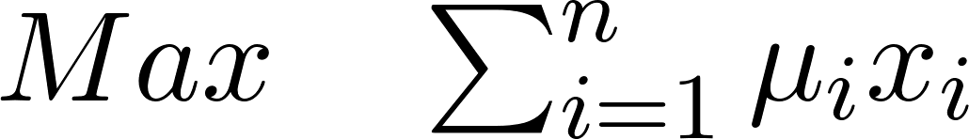
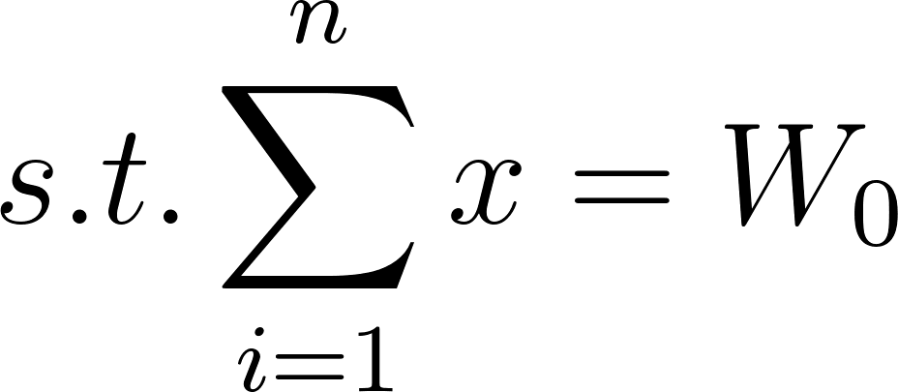
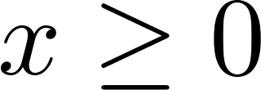



Model 4 - Chance Constraint
: multivariate normal distribution with mean vector and covariance matrix
Notes:
W1 normal mean Sum(ux) cov xTsigmaX

Slide 11
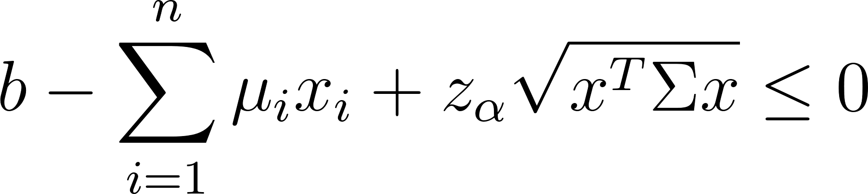
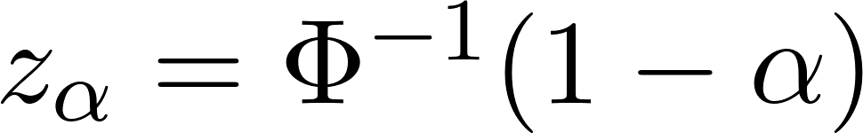
Chance constraint :
where
(α, b) | 0.01, 1.0 | 0.3, 1.0 | 0.35, 1.0 | 0.4, 1.0
RELIANCE | NaN | NaN | 5.14E-09 | 2.87E-08
GS | NaN | NaN | 1.35E-08 | 6.02E-08
MARUTI | NaN | NaN | 0.53282 | 0.99582
MSFT | NaN | NaN | 3.69E-08 | 1.01E-07
TCS | NaN | NaN | 0.46717 | 0.0041
Optimal Value | NaN | NaN | 1.01865 | 0.0095
Notes:
alpha b/w and ½
Cvx modelling system
Can’t ConcaveNONdecreasing(convex) arg should be concave

Slide 12
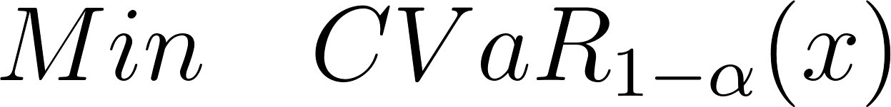
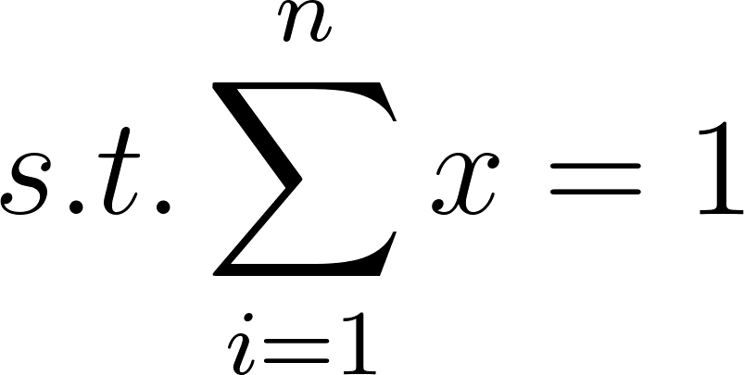
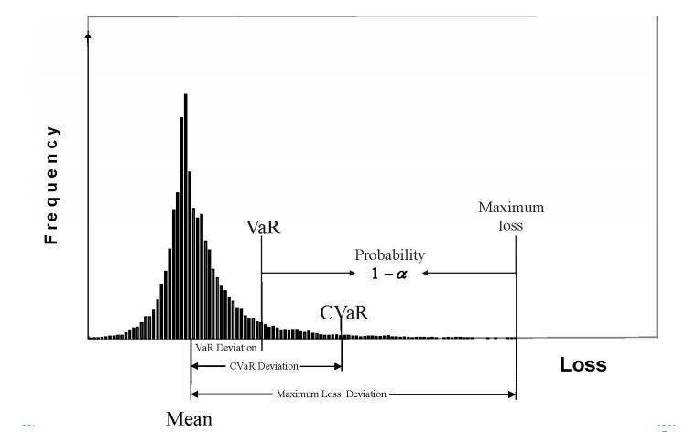
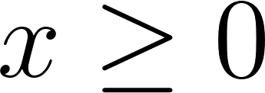
Model 5 - CVaR minimization

Slide 13

 | 0.75 | 0.80 | 0.85 | 0.90 | 0.95
NSE/RELIANCE | 0.080952 | 0.093474 | 0.10393 | 0.11178 | 0.14296
EOD/GS | 0.0053597 | 0.001782 | 3.6044e-21 | 0.012519 | 1.4772e-17
NSE/MARUTI | 0.16541 | 0.15398 | 0.14603 | 0.1508 | 0.12676
EOD/MSFT | 0.23675 | 0.25105 | 0.25157 | 0.23643 | 0.2476
NSE/TCS | 0.51153 | 0.49972 | 0.49846 | 0.48847 | 0.48268
Expected Return | 1.0143 | 1.0146 | 1.0144 | 1.0141 | 1.0137

Slide 14
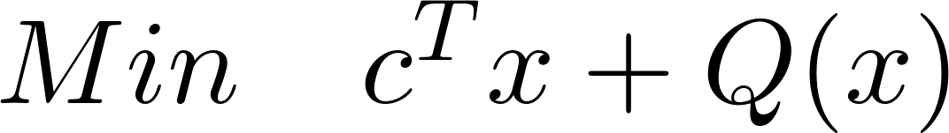
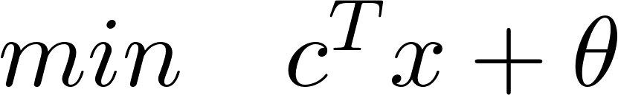

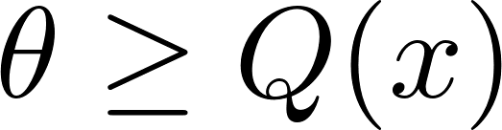
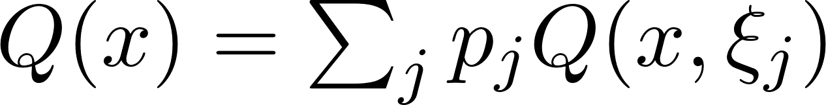
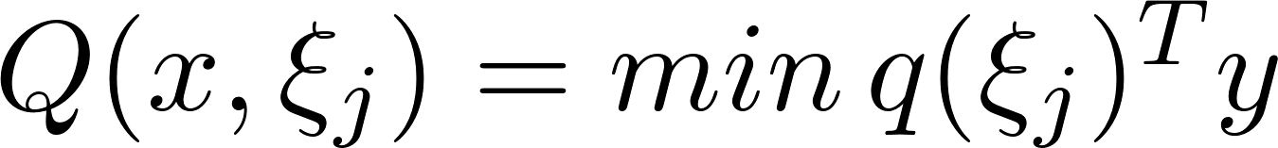
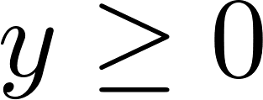
Two Stage Models
Benders decomposition :
2 stage problem : equivalent problem :
where

Slide 15
Benders decomposition can be divided into two stages -
Adding Feasibility cuts
Adding Optimality cuts

Slide 16


Feasibility cut
Initially take
Let be the optimal solution

Slide 17


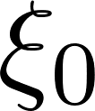
If for any realization of the second stage problem becomes infeasible generate a feasibility cut to remove from the feasible region.
Generating feasibility cut
If for some realization above problem has positive optimal value, generate feasibility cut :
Notes:
Finite steps
Hyperplane formed using finite number of constraints

Slide 18
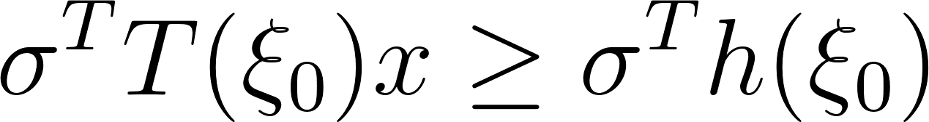
Modified problem :
Keeping on finding feasibility cuts until it is not possible to find any more.

Slide 19
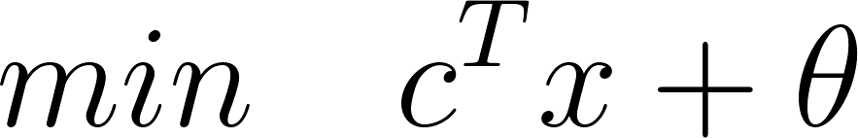
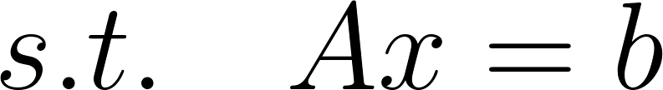
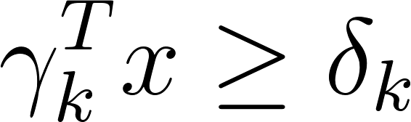
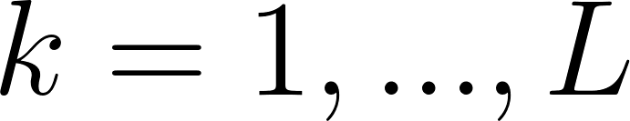
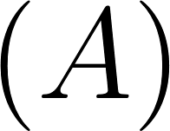
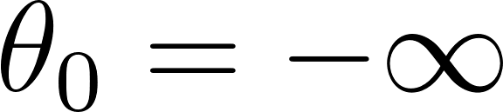

Optimality cut
After finding all the feasibility cuts:
Initial value
Let optimal solution be

Slide 20
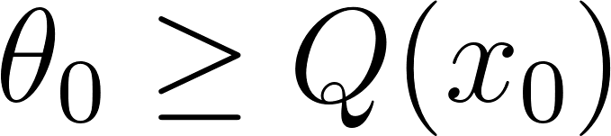

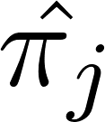
Check whether
If true then is the optimal solution.
else generate optimality cut as
where is the optimal solution of the dual of the 2nd stage problem for the jth scenario

Slide 21
Add to
Solve it, repeat the steps till we get an optimal solution.
Notes:
Converge in finite no. of steps

Slide 22
Model 6 - A Multiproduct assembly problem
Cost of input factors
and input requirements
Demand scenarios
and sell prices
Resource | Costs | Input Requirements
 | $ | Desk | Table | Chairs
Lumber (bd ft) | 2 | 8 | 6 | 1
Finishing (hrs) | 4 | 4 | 2 | 1.5
Carpentry (hrs) | 5.2 | 2 | 1.5 | 0.5
Demand scenarios |  |  |  | Sell price
 | Low | Most likely | High | $
Desks | 50 | 150 | 250 | 60
Tables | 20 | 110 | 250 | 40
Chairs | 200 | 225 | 500 | 10
Probability | 0.3 | 0.4 | 0.3
Notes:
1 bd ft = 1 ft * 1 ft * 1 inch

Slide 23
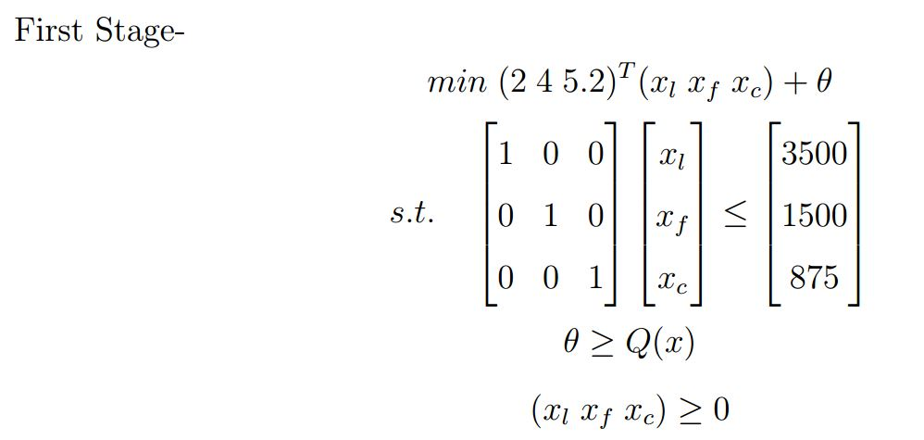
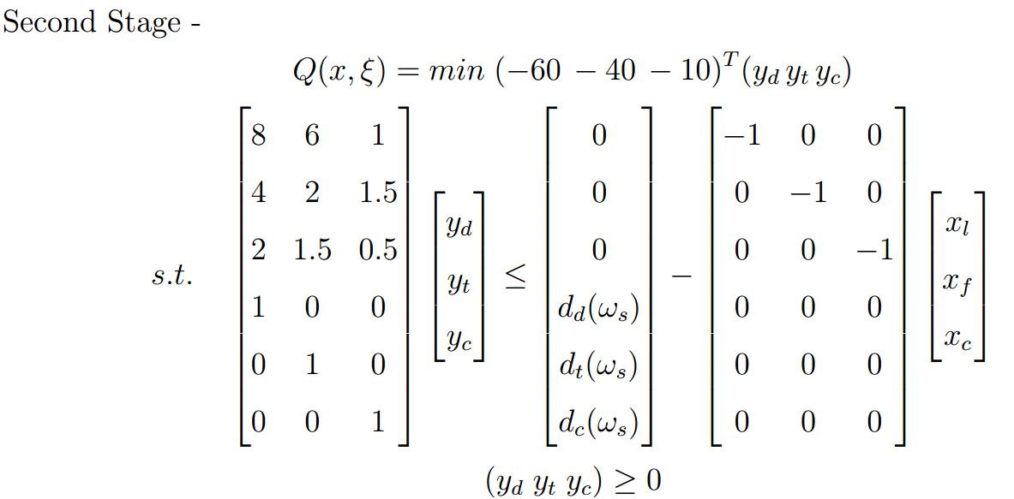
1300 bd ft of lumber, 540 hours of finishing & 325 hours of carpentry.
The profit will be approximately $ 1730 on an average.

Slide 24
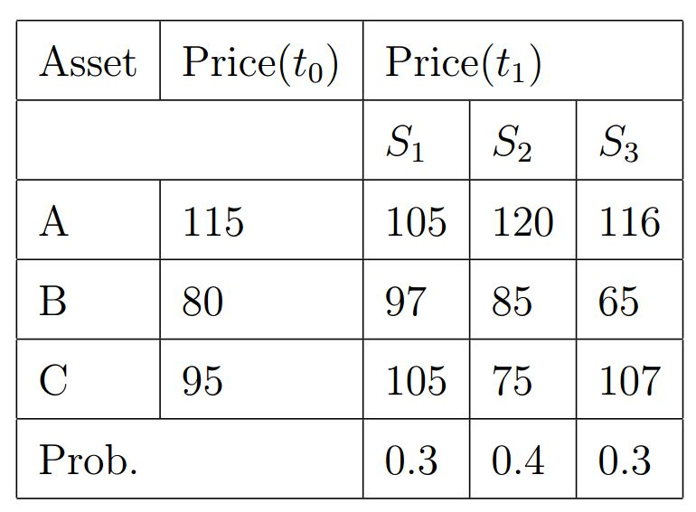
Model 6 - An Asset Liability Management Problem
Total capital Rs 15000, won’t invest more than Rs 7000 in any asset
Notes:
100 face value

Slide 25
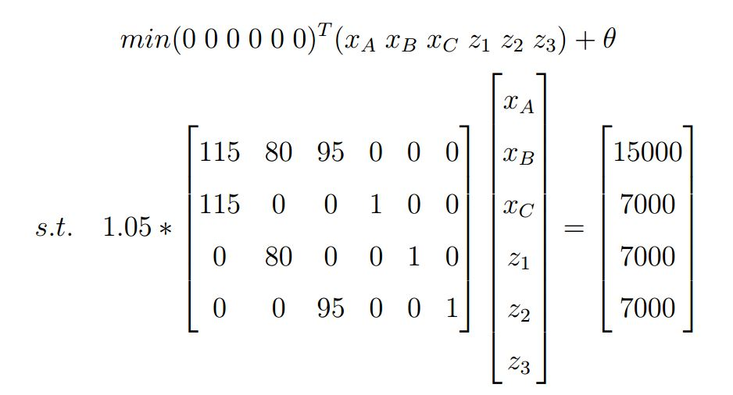
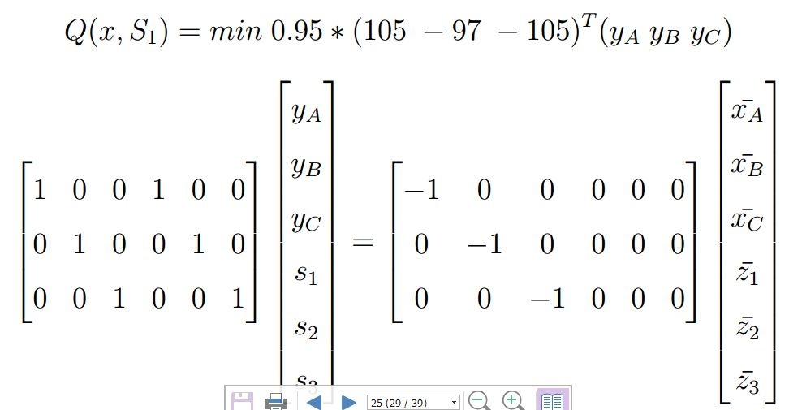
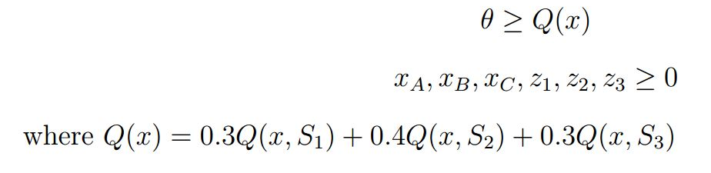
A : Rs 7003.5, B : Rs 6972, C : Rs 997.5, Maxm avg sale proceeds : Rs 10161

Slide 26


Multi-Stage Models
Model 8 - Minimum Return Soft Optimization
represents VaR (non smooth and non convex)
Soft Optimization solution softens the goal:
Obtain a good enough solution (top k% solution) rather than global optimum.
The obtained solution should be highly probable to be a good enough solution.

Slide 27


Soft Optimization
Stage 1: Sample the feasible set X to generate a finite subset S.
Let G denote set of good enough solutions in S.
Stage 2: Select the best solution from S.

Slide 28

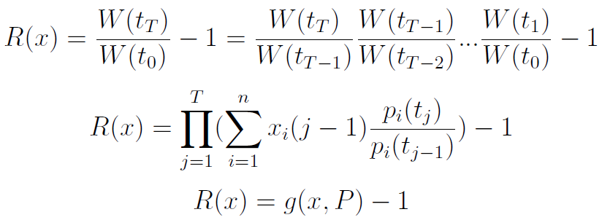
Stage 1
Create a set of 1000 sample strategies which satisfies the problem constraints:

Slide 29
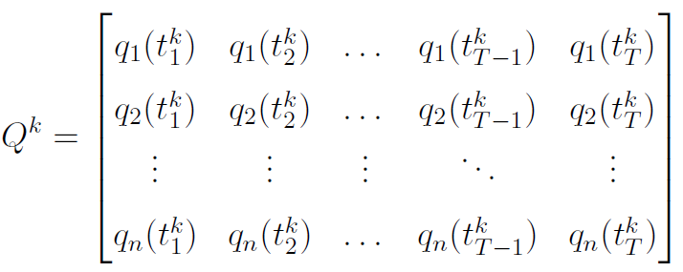
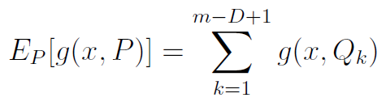

Slide 30

Stage 2
Determine the sample strategy with the least VaR.
For each x in S, generate time-series data of its loss rate (- return) using historical prices of the securities.
Sort losses obtained for a given strategy x and choose the strategy with smallest

Slide 31
Minimum Return Soft Optimization
With hyperparameters, 𝛂 = 0.95 and 𝞵 = 0.05, expected return = 0.0506
Time Period | 0 | 1 | 2 | 3
RELIANCE | 0.169405 | 0.271794 | 0.316299 | 0.022173
GS | 0.004387 | 0.036054 | 0.136329 | 0.144516
MARUTI | 0.163146 | 0.312296 | 0.040541 | 0.284698
MSFT | 0.369359 | 0.213963 | 0.25217 | 0.221357
TCS | 0.293702 | 0.165892 | 0.25466 | 0.327255

Slide 32


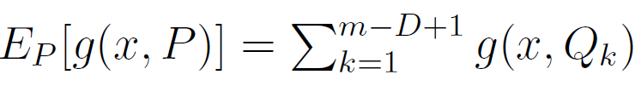
Model 9 - Multi Stage Controlled VaR Soft Optimization
Maximise return subject to VaR
Stage 1: Generate 1,000 sample strategies by estimating VaR using historical simulation method
Stage 2: Determine the sample strategy with the largest return where returns are estimated using

Slide 33
The expected return for 𝛂 = 0.95 and 𝜷 = 0.1, expected return = 0.0615
Time Period | 0 | 1 | 2 | 3
RELIANCE | 0.042409505 | 0.125266863 | 0.000533702 | 0.104495231
GS | 0.001447582 | 0.122846935 | 0.146846067 | 0.037387058
MARUTI | 0.225348595 | 0.24337832 | 0.509333427 | 0.29973329
MSFT | 0.275083533 | 0.289575621 | 0.213048959 | 0.264337767
TCS | 0.455710786 | 0.218932261 | 0.130237844 | 0.294046654

Slide 34
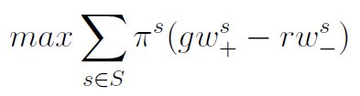
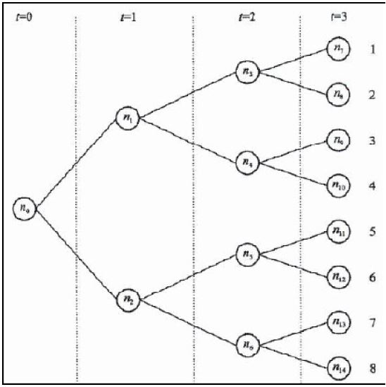
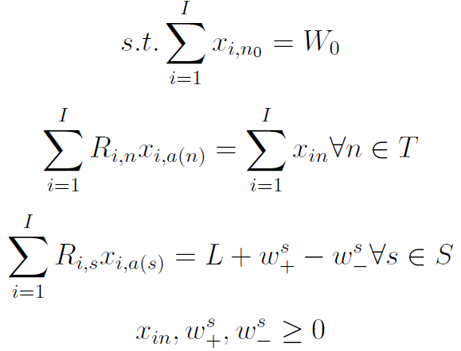
Model 10 - Multi-Period Optimization using Scenario Tree

Slide 35
Multi-Period Portfolio Optimization Using Scenario Tree
With initial wealth = 60 and final wealth = 80, we obtain
 | r; g = 5, 2 |  | r; g = 15, 2
Nodes | Stocks | Bonds | Stocks | Bonds
n0 | 60.00000003 | -2.71E-08 | 42.63006751 | 17.36993249
n1 | 74.99999994 | 6.63E-08 | 73.08930743 | 3.34E-10
n2 | 26.97907396 | 36.62092605 | 16.17813391 | 48.46406204
n3 | 93.74999996 | 3.57E-08 | 91.36163428 | 7.66E-10
n4 | 79.49999991 | 3.57E-08 | 77.47466587 | 7.07E-10
n5 | 75.4716981 | 3.85E-08 | 75.47169811 | 5.00E-09
n6 | 5.826260607 | 63.78699496 | 2.48E-10 | 71.42857143
Optimal Value | 2.2147 |  | 2.1445

Slide 36
Results
We test our models on monthly data from 31-12-2017 to 30-04-2018
Month | Reliance | GS | Maruti | MSFT | TCS
0 | 1 | 1 | 1 | 1 | 1
3 | 1.334864 | 0.9759288 | 1.1069856 | 1.0589327 | 1.0194412
6 | 1.5453501 | 0.9826007 | 1.3148492 | 1.1245166 | 1.1174993
9 | 0.9001626 | 1.0573870 | 1.3930949 | 1.2866202 | 1.17678715
12 | 0.9197282 | 1.1681929 | 1.6133859 | 1.4696055 | 1.39579782
15 | 0.9532146 | 1.04696494 | 1.49015566 | 1.45800464 | 1.54809848

Slide 37
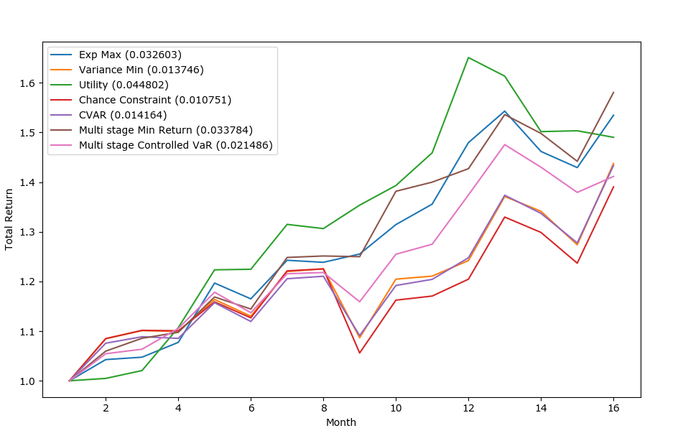
Results

Slide 38
References
Alexander Shapiro, Darinka Dentcheva, and Andrzej Ruszczynski. Lectures on stochastic programming: modeling and theory. SIAM, 2009.
Aparna Mehra R. Khemchandani Suresh Chandra, S. Dharmaraja. Financial Mathematics: An Introduction. Narosa Publishing House, 2012.
Chunhui Xu, Jie Wang, and Naoki Shiba. Multistage portfolio optimization with var as risk measure. International Journal of Innovative Computing, Information and Control, 3(3):709{724, 2007.
B.Nandi. Bender's decomposition. 2011.
Mehmet Can and Narela Bajram. A stochastic programming approach for multi- period portfolio optimization with transaction costs. Southeast Europe Journal of Soft Computing, 1(2), 2012.

Slide 39
Thank you!!

