Slide 1

Mini Project MTD350
Stochastic Programming Models
Supervisor: Prof. Vikas Vikram Singh
Course Coordinator: Prof. Viswanathan Puthan Veedu
Submitted by:
Raunak Lohiya Vishavjeet Singh
2014MT60362 2014MT60570

Slide 2
Introduction
The aim of the project is to learn to formulate, analyse and solve optimization problems involving stochastic models.
SP modelling involves concepts from optimization theory, probability and statistics and functional analysis.
Basic concepts including recourse actions, chance constraints and the nonanticipativity principle to development of two-stage and multi-stage stochastic programming problems would be covered.
SP finds its application in all areas of science and engineering, from telecommunication and medicine, to finance.

Slide 3

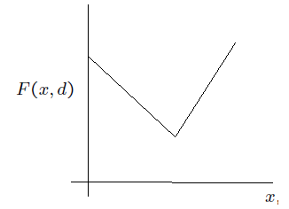

The News Vendor Problem
Aim: Minimize cost of ordering quantity x to satisfy demand d.
where c is the per unit cost of ordering, b > c is the per unit cost of additional order, h is the holding cost.
The minimum occurs at x = d

Slide 4

But, Demand D is random!!
Assuming probability distribution of D is known. Choose cost function as
Justification for optimizing the total cost on average due to Law of Large Numbers.
Example of recourse action or 2 stage problem.
At the first stage, before a realization of the demand D is known, one has to make a decision about ordering quantity x.
At the second stage after demand D becomes known, it may happen that d > x. In that case the company takes the recourse action of ordering the required quantity d - x at the higher cost of b > c.

Slide 5

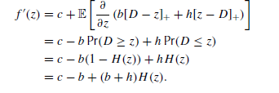
Closed Form Solution
Assume f(x) is well defined and continuous
At x = 0,
Notes:
f is continuous on closed interval [a, b] and F is the indefinite integral of f on [a, b]
A closed interval is an interval which includes all its limit points.
A point x in X is a limit point of S if every neighbourhood of x contains at least one point of S different from x itself.

Slide 6

Optimal solution
f(x) is convex function since f’’(x) is non negative. Thus, local optima is same as global optima.

Slide 7

Multi stage Models
Objective: minimize the expected value of the total cost over the planning horizon.
D(t): Demand of random process at time t
y(t): current inventory level at time t
x(t): replenished inventory level at time t [x(t) >= y(t)]
d(t): Realization of Demand after ordering at time t
ct; bt; ht: ordering, holding and backorder penalty cost per unit, at time t.
Notes:
Dynamic programming : 1) Overlapping Subproblems
2) Optimal Substructure
problem can be broken down into optimal sub-problems.
Recursively define the value of the solution by expressing it in terms of optimal solutions for smaller sub-problems.
Compute the value of the optimal solution in bottom-up fashion.

Slide 8

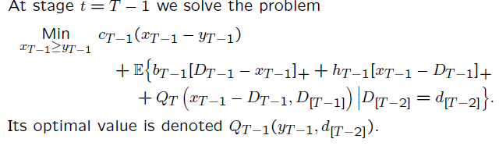

Dynamic Programming
At the last stage t = T, for observed inventory level yT, minimizing cost implies
:History of the demand process up to time t
: Realization of demand upto time t
Notes:
dynamic programming is a method for solving a complex problem by breaking it down into a collection of simpler subproblems, solving each of those subproblems just once, and storing their solutions.

Slide 9

Continued...
At any time t,
At time t = 1,
Problem: The value of function cannot be calculated in a closed form and it is difficult to approximate numerically.
Simplification: Stagewise independence (expectations are unconditional)

Slide 10


Nonanticipativity constraint
Under stagewise independence,
, implies
A sequence of decisions based on information available at current stage is called a policy. A policy satisfies nonanticipativity constraint.
Nonanticipativity constraint: Our decision about the inventory level xt should depends only on information available at the time of the decision.
A policy is said to be feasible if it satisfies other constraints with probability 1.

Slide 11
Optimal solution
Let x*(t) be an (unconstrained) minimizer of convex function f(x) =
Therefore, is an optimal solution. Such policy is called the basestock policy.

Slide 12



Chance Constraints
Constraints involving random variables are very restrictive
This leads to probabilistic constraints

Slide 13
Multiproduct Assembly
➢n types of products
➢m types of parts
➢A unit of product i requires a_{ij} units of part j
➢Demand D = (D₁,...,D_{n})
➢Cost c_{j} per unit of part j
➢Cost l_{i} to satisfy a unit of demand for product i
➢q_{i} unit selling price
➢Resale value of unused unit of part j is s_{j}<c_{j}

Slide 14
Aim: Decide x the number of parts to be ordered before the demand is realized such that the expected production cost is minimized.
After D is realized let number of units produced be z and number of parts left be y

Slide 15
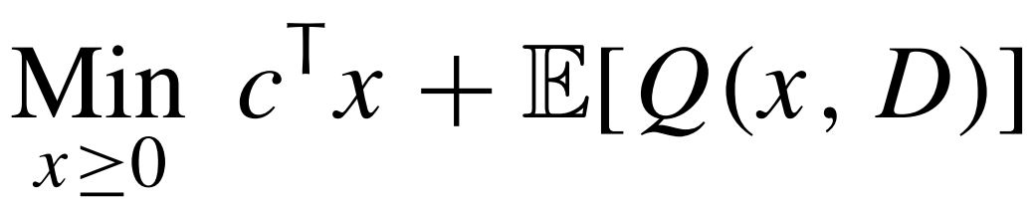
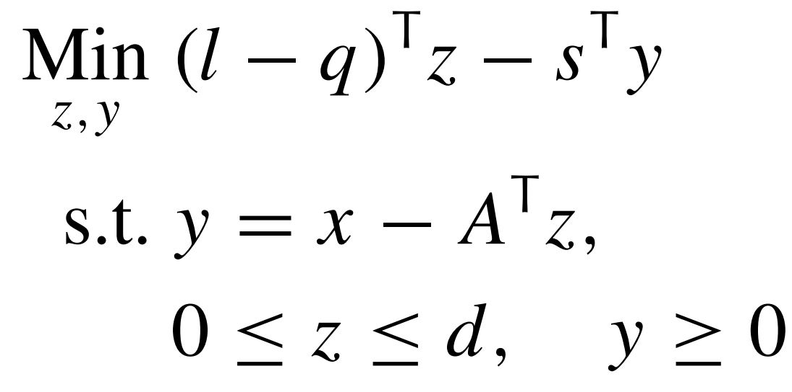
2 stage problem
First stage -
Where Q(x,D) is the optimal value of
Second stage -
Notes:
z,y depend on d and x
Q(x,D) is a r.v.

Slide 16
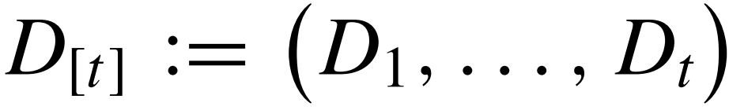
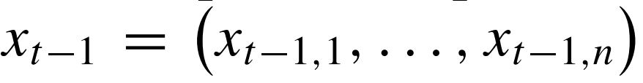
Multistage Model
Demand modelled as a stochastic process D_{t} t=1,...T where D_{t}=(D_{t1},...,D_{tn})
HIstory of demand in periods 1,...,t :
Quantities ordered at beginning of stage t:
z_{t},y_{t} units produced at the end of stage t
Holding one unit of part j in inventory costs h_{j}
Notes:
All costs and prices same in all periods
2 stage case x₀ - x and z₁,y₁ - z,y

Slide 17
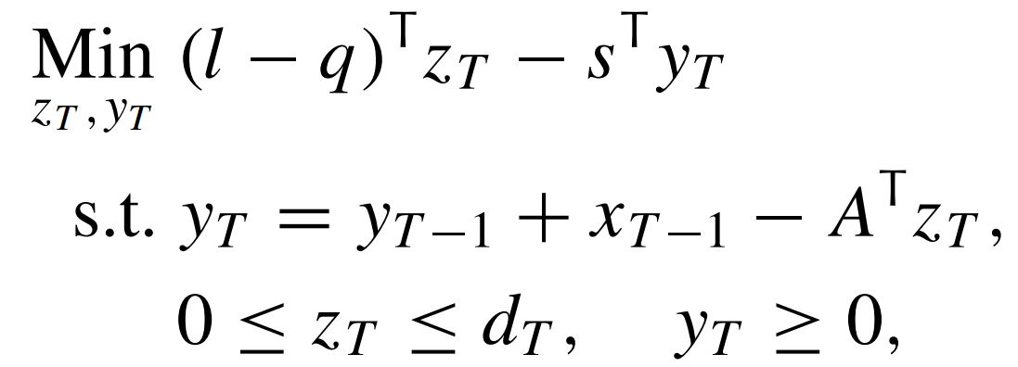
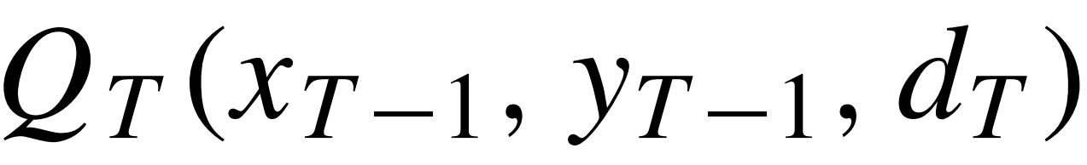
Problem at t=T,
(1)
Optimal value of (1) :

Slide 18
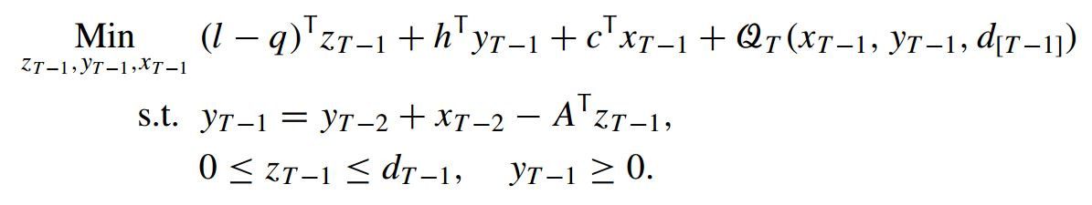
At t = T-1 the problem is
where

Slide 19
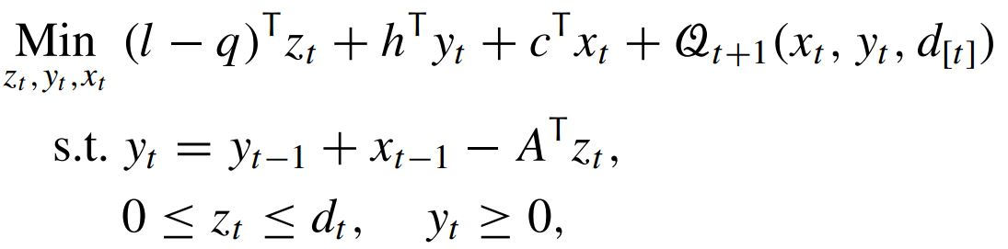
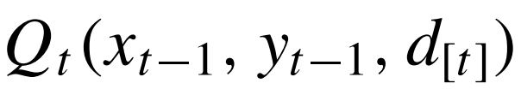
In general at stage t= T-1,...1 the problem is :
with
Optimal value :

Slide 20
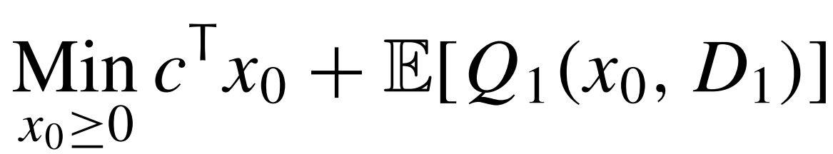
Backward recursion continues
At t=1, y₀ represents initial inventory levels
Q₁(x₀,d₁) depends only on x₀,d₁
Initial problem to determine x₀ :

Slide 21
Portfolio Selection
Wealth W₀
n assets
Invest x_{i} in asset i, ⅀x_{i}=W₀
Return rate R_{i} (a random variable) for asset i
𝛏_{i} = 1+R_{i}

Slide 22
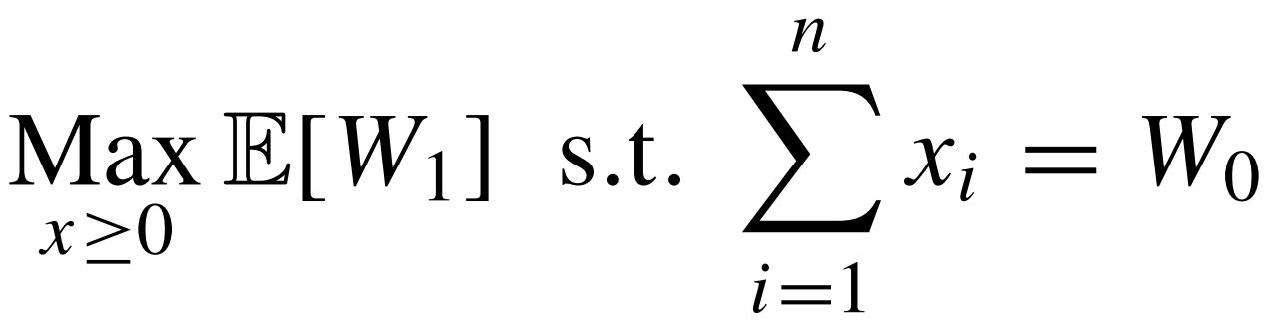
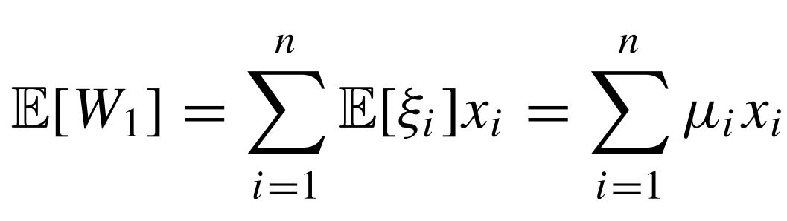
Aim: Maximize expected return

Slide 23
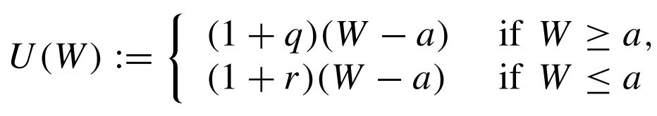
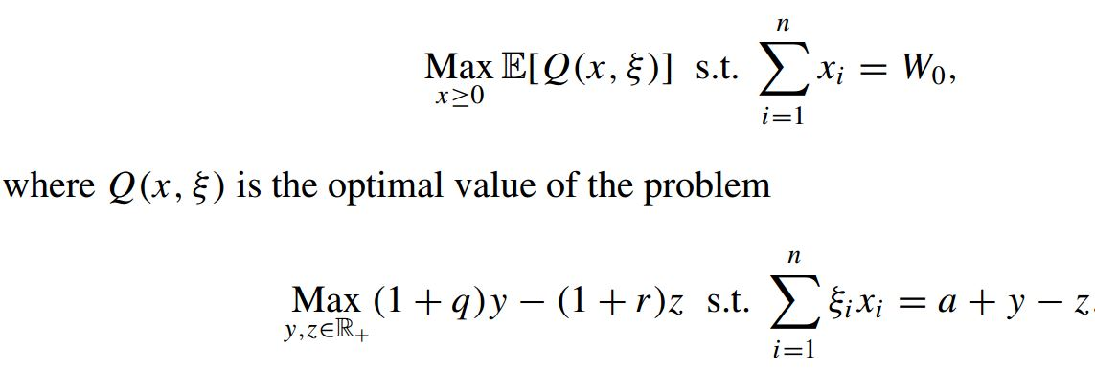
Aim: Maximize expected utility
where r>q>0 and a>0
2-stage stochastic linear program :
Notes:
U(w) is concave non-decreasing
a - amount we pay
y - amount we invest
z - amount we borrow

Slide 24
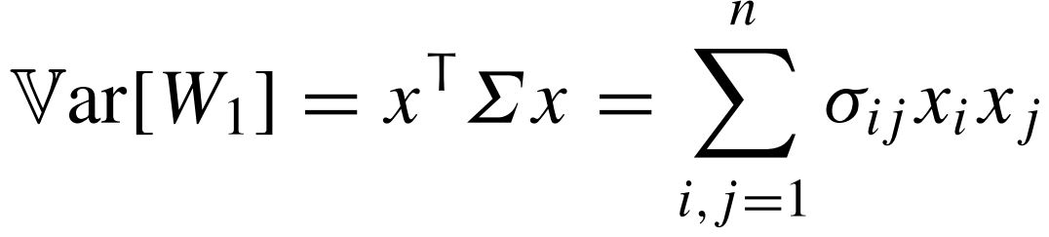
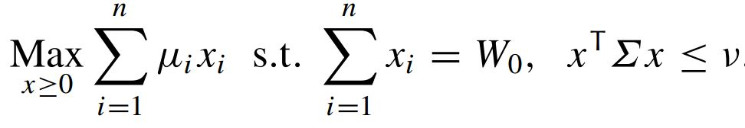
Aim: Maximize expected return while controlling risk
Risk :
where Σ is the covariance matrix of 𝛏.
Problem formulation :
(1)
where v > 0 is a specified constant
Notes:
Since W linear fn of 𝛏_{i} Var(W)=x⅀x^{T}
𝛏 and R have same covariance matrix
cov(X₁,X₂)=E((X₁-E(X₁))(X₂-E(X₂))) = E(X₁X₂)-E(X₁)E(X₂)
⅀ is +ve semidefinite a⅀a^{T}>=a for all a in R^{n}

Slide 25
x^{T}⅀x is convex quadratic
(1) is a convex problem
At least one feasible solution of investing everything in cash, Var[W₁]=0
Feasible set is closed and bounded.
∴ (1) has an optimal solution
Notes:
SPP convex coz concave objective and convex feasible
Feasible bounded - optimal can be proved using Weirstrass Theorem - Every bounded sequence has a convergent subsequence
Take arbitrary seq. {x_{k}} s.t. lim f(x_{k}) = inf f(x)

Slide 26
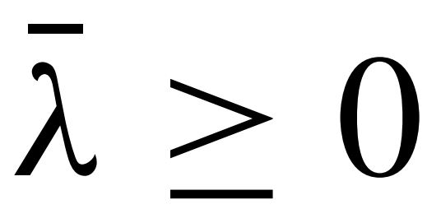
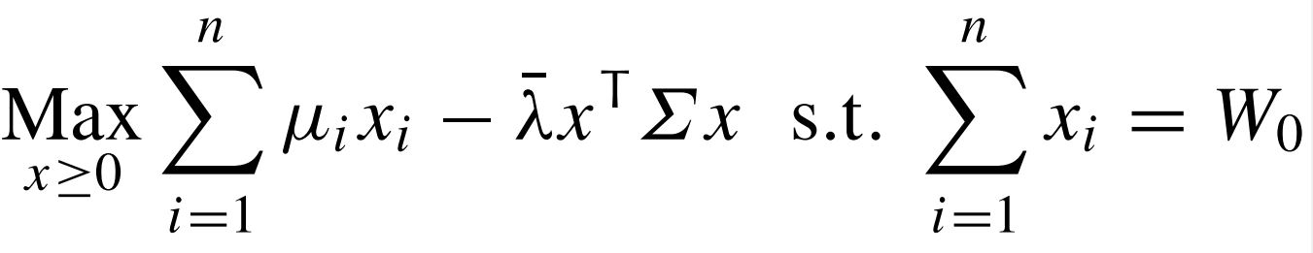

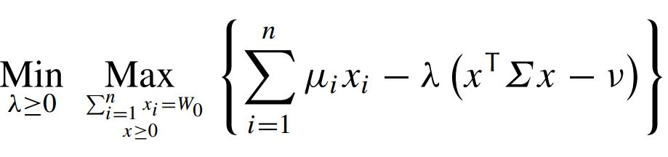
satisfies Slater’s condition
∴ no duality gap
∴ there exists Lagrange multiplier such that the (1) is equivalent to
where is given by an optimal solution of the dual problem
Notes:
Equivalence means SPP optimal value = lagrange SPP optimal + ƛv
Lagrange multipliers -
∇f(x)+Σλ_{i}∇g_{i}(x)=0
g_{i}(x)<=0
λ_{i}g_{i}(x)=0
λ_{i}>=0
L(x,λ) = f(x) + Σλ_{i}g_{i}(x)
Max f(x) s.t. g_{i}(x)<=0 equivalent to Max_{x}Min_{λ}L(x,λ)
Dual - Min_{λ}Max_{x}L(x,λ)
Necessity for KKT -
x local min at which basic constraint qualification holds Dbar x = delD xbar
D(x) - set of all feasible dirns there exists k>0 st 0<p<=k imply x+pd belong to feasible region
delD(x) linearizing cone = d s.t. d^{T}∇g_{i}(x)<=0 where i are s.t. g_{i}(x)=0

Slide 27
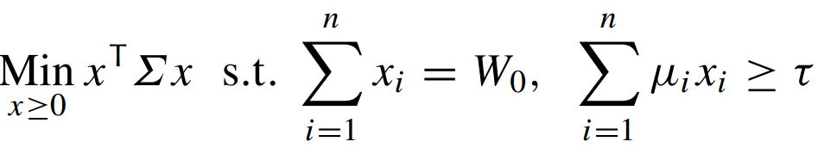
Aim: Minimize Var[W₁] keeping E[W₁] above 𝜏

Slide 28
References
Lectures on Stochastic Programming: Modeling and Theory
Book by Alexander Shapiro, Andrzej Piotr Ruszczyński, and Darinka Dentcheva
A Tutorial on Stochastic Programming
Alexander Shapiro∗ and Andy Philpott March 21, 2007
Stochastic Programming, Modeling and Theory. Lecture (15.10.2013)
https://www.youtube.com/watch?v=eJMuT65_VeY

