Slide 1
R-Tree: A Dynamic Index Structure for Spatial Searching
By:
Adarsh Goel (2020B3A70821P)
Arjoo Kumari (2020B3A70770P)
Chinmay Anand (2020B3A70800P)
Raunak Bhalla (2020B4A70859P)
Dimple Kakkar (2020B4A70632P)

Slide 2
Structure
R-tree [height, pointer to root node, MBR of tree]
Internal Nodes [array of child pointers, array of rectangular regions, parent pointer]
Leaf Nodes [array of pointers to objects, parents pointer, array of rectangular regions]
Each node must contain at least m(=2) entries and at most M(=4) entries.

Slide 3
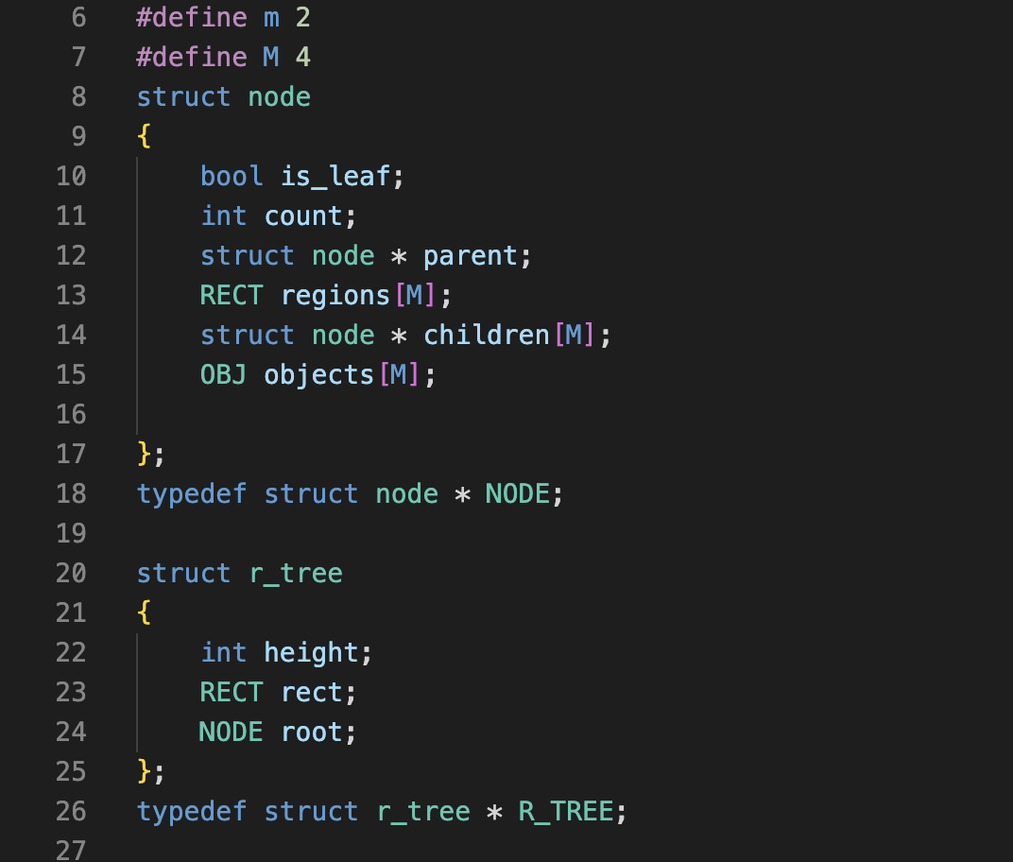
Structure

Slide 4
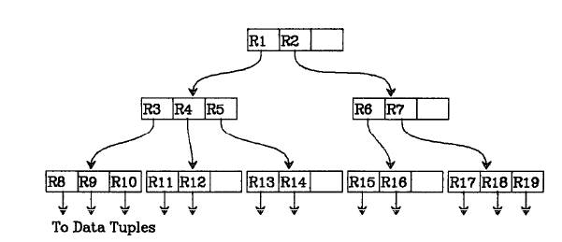
R-Tree: Illustrative Example
M = 3
m = 2

Slide 5
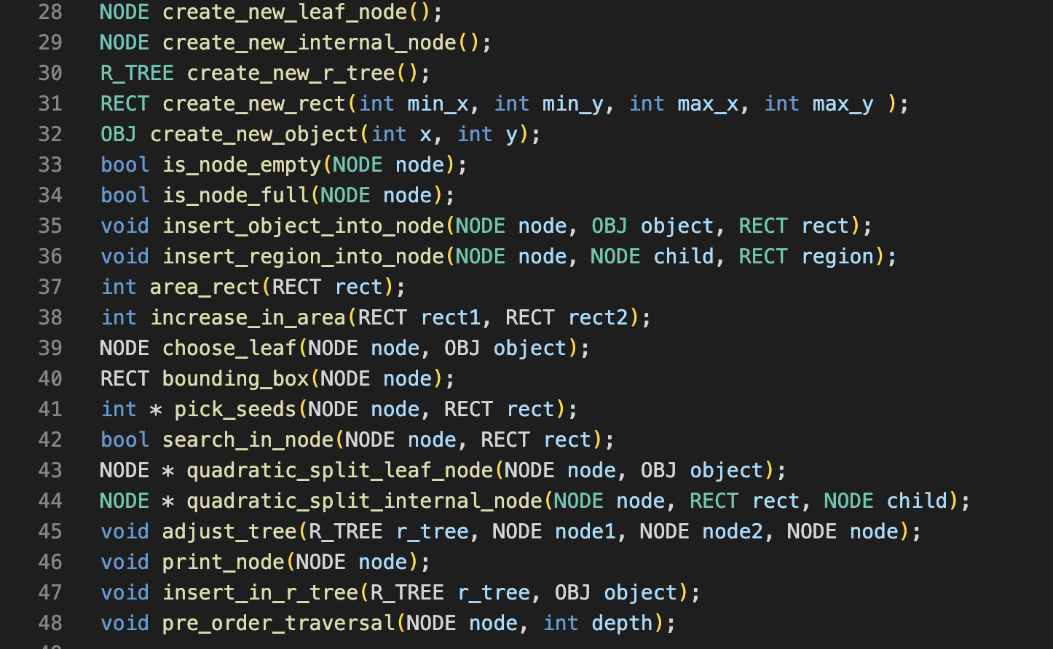
Methods Implemented
Insertion
Insert
Choose leaf
Adjust Tree
Quadratic Splitting
Pick seeds
Pick next
Pre- order traversal

Slide 6
Insertion
Pseudo Code
Inserts a new record into the R-tree.
Nodes that overflow are split and splits propagate up the tree.
Algorithm
Find position for new record using ChooseLeaf().
If the current leaf node has space for another entry, add record otherwise invoke QuadraticSplit().
Use AdjustTree() on L and propagate changes upward.
Insert(T, E)
{
L = ChooseLeaf(T, E);
INSTALL E;
IF (L is full)
{
L1, L2 = QuadraticSplit(L);
AdjustTree(L1,L2, L);
}
}

Slide 7
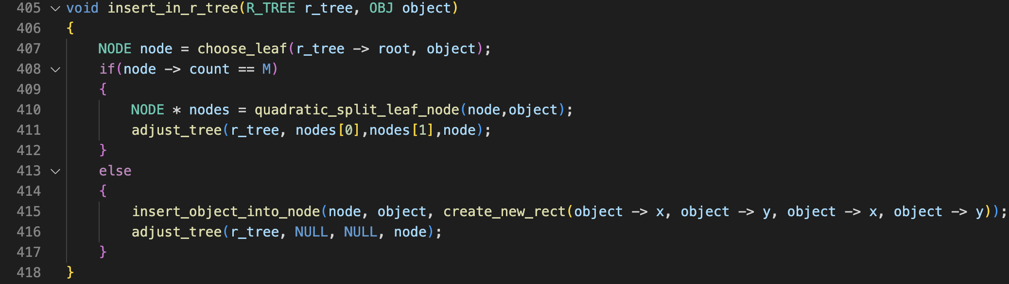
Insertion

Slide 8
ChooseLeaf
Pseudo Code
ChooseLeaf selects a leaf node to place a new entry E.
Algorithm
Initialize N as root node.
If N is leaf, return N.
Otherwise, find the entry F whose rectangle needs least enlargement to include the new rectangle. In case of ties, choose the entry having smallest rectangle.
Move downwards until a leaf is reached by setting N = child node and repeat from step 2.
N ChooseLeaf(T, E)
{
SET N = T;
IF (N is a non-leaf node)
{
Find the F such that F.FI needs least enlargement to include E.EI in N;
SET N = F.Fp;
ChooseLeaf(N, E);
}
ELSE
return N;
}

Slide 9
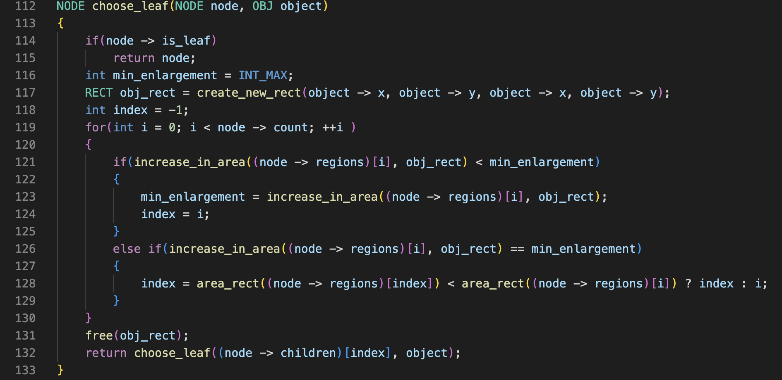
ChooseLeaf

Slide 10
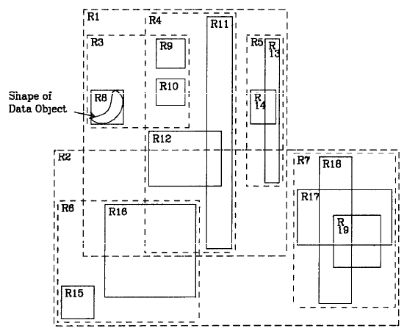
R-Tree: Insertion Example
Insert the new data point Nw into the R-tree shown
Nw

Slide 11
Insertion: Example
Nw
Nw goes here creating an overflow

Slide 12
AdjustTree
Move upwards from node L to root and adjust MBRs along the way.
Algorithm: Input L1, L2 and L
Initialize N = L. If L was split earlier, initialize N1 = L1 and N2 = L2.
If N = root, then check if it was splitted. If it was splitted create a new root node having N1 and N2 as children. Increase height of tree. Now stop the procedure.
Let P = N.parent. If N was not split , adjust MBR in P.
If N was split. Replace N with N1 in P as its child. Create a new entry Enn and assign appropriate rectangle to Enn covering N2. Add Enn to P if possible else, split P to create P1 and P2 with all entries of P and Enn.
Assign N = P and N1 = P1, set N2 = P2 if a split occurred in P.
Repeat from Step 2.2.

Slide 13
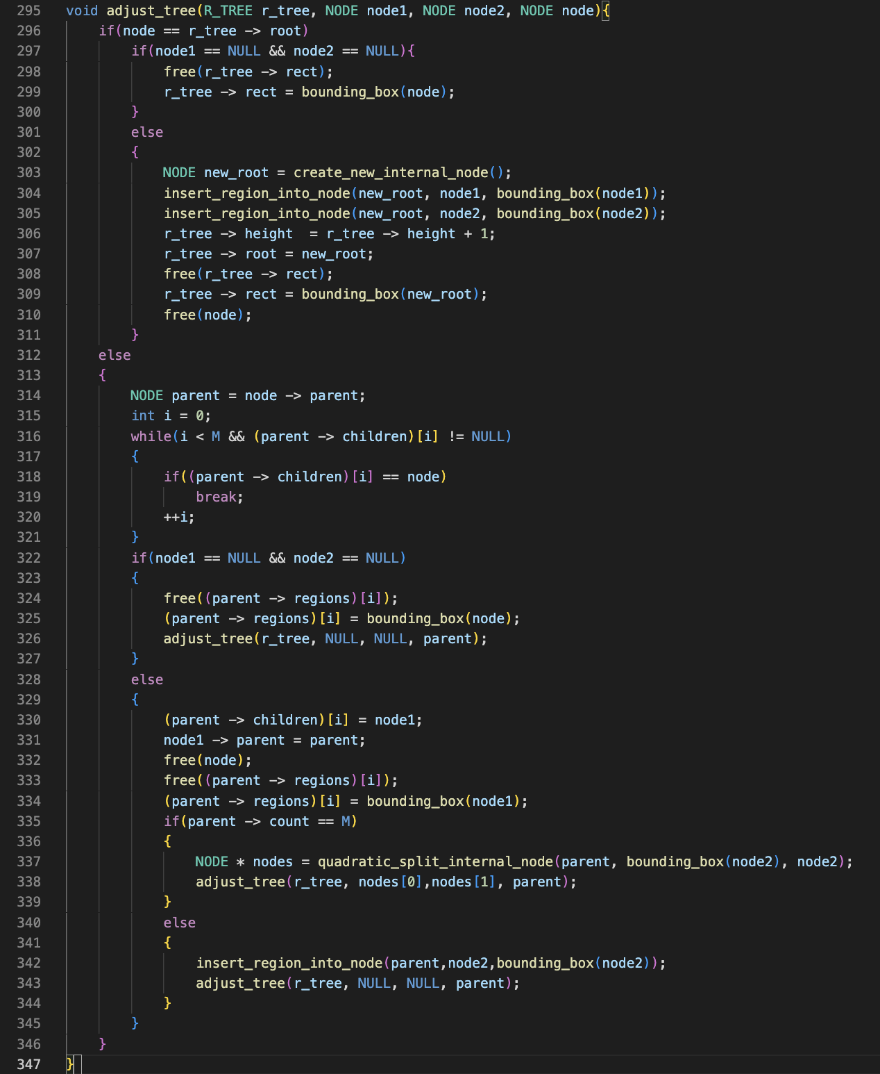
AdjustTree

Slide 14
AdjustTree: Example
Nw
Nw goes here creating an overflow

Slide 15
AdjustTree: Example
AdjustTree: Example
M = 3
m = 2
R3
R4
R5
R3’’
Nw
R8
R9
R10

Slide 16
AdjustTree: Example
M = 3
m = 2
R3
R4
R5
R3’’
R3’’ should go into this
Nw
R8
R9
R10

Slide 17
AdjustTree: Example
M = 3
m = 2
R1
R2
R3
R3’’
R4
R5
Overflow: This was split
Nw
R8
R9
R10

Slide 18
AdjustTree: Example
M = 3
m = 2
R1
R1’
R2
R3
R3’’
R4
R5
Nw
R8
R9
R10

Slide 19
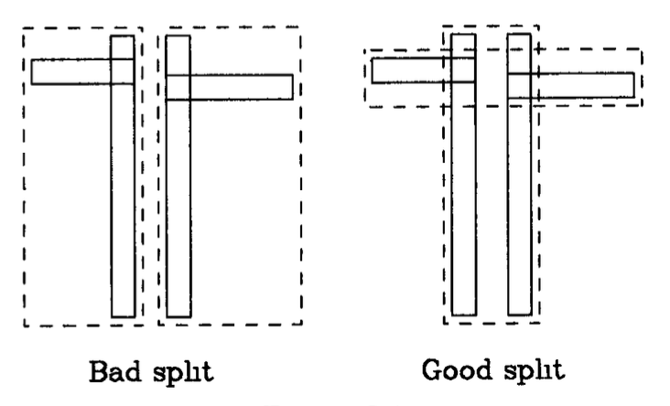
Node Splitting
To add a new entry to a full node of M entries, we split the M+1 entries into two nodes.
The idea behind division is to reduce the need to examine both new nodes upon subsequent searches.
Therefore, the total area of the two covering rectangles after a split need to be minimized.
The are three different kind of splitting algorithms out of which we have implemented quadratic-cost algorithm.

Slide 20
Quadratic Splitting
It attempts to find a small-area split, but is not guaranteed to find one with the smallest area possible.
The cost is quadratic in M and linear in the number of dimensions
Algorithm
Pick first entry for each group using PickSeed()
Check if done. If done, stop.
If one group has M-m+1 entries, put the entries into the remaining entries and stop.
Select the next entry to assign using PickNext()
Add the entry to the group which requires least enlargement to accommodate new entry and in case of ties, add the entry to the group with smaller area, then to the group having lesser entries.

Slide 21
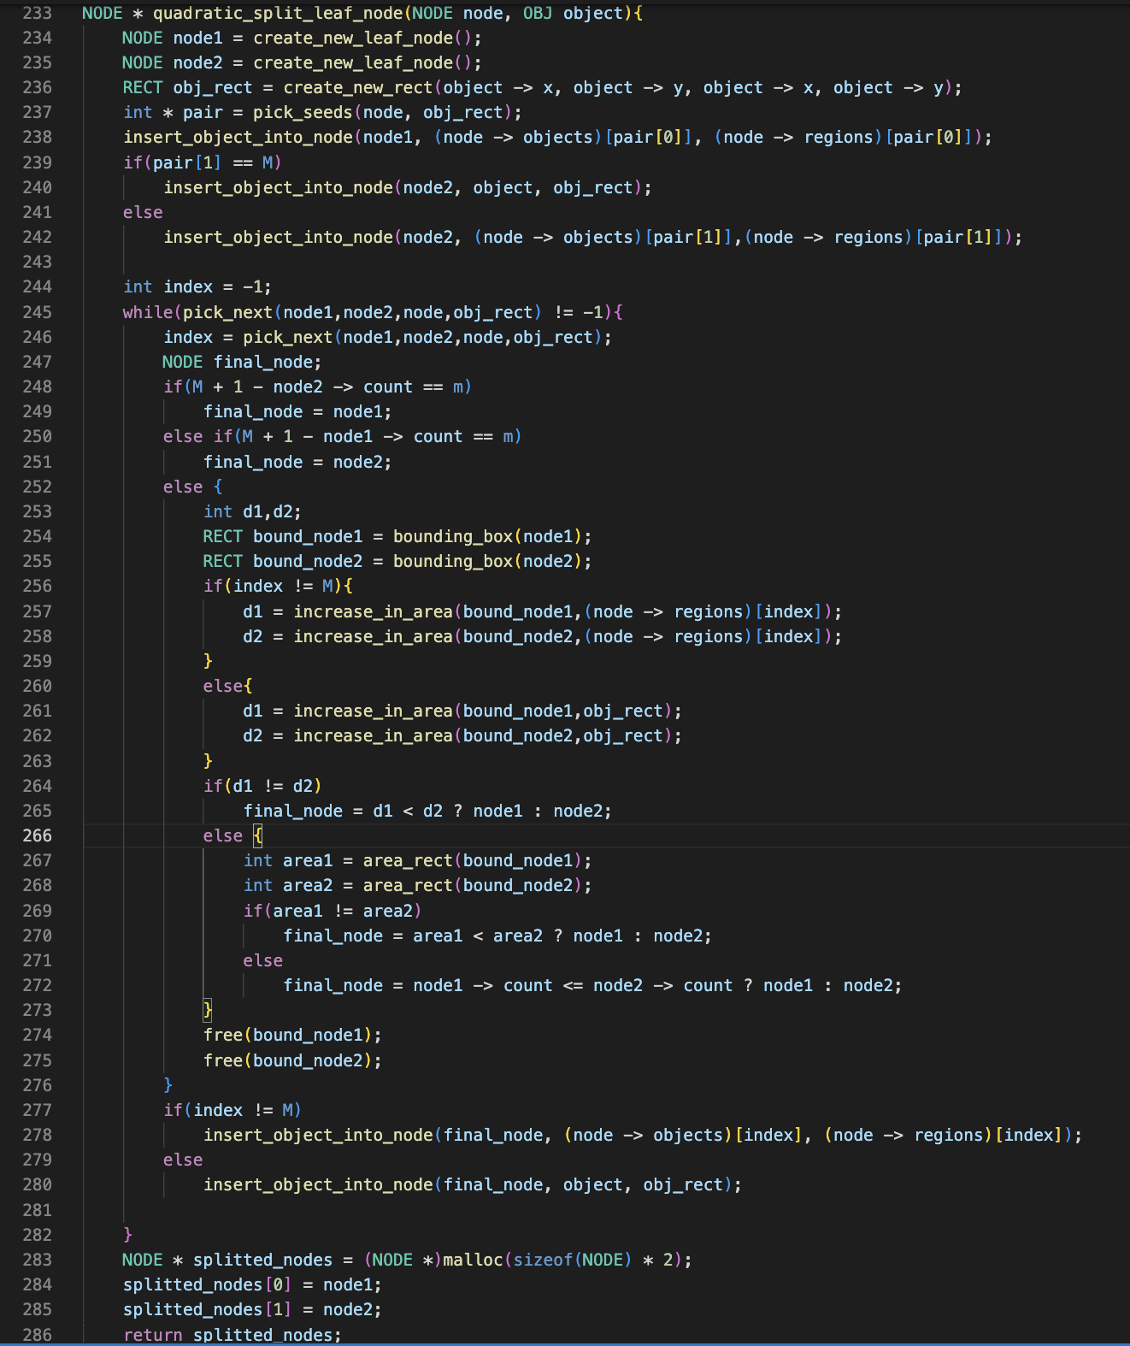
Quadratic Splitting

Slide 22
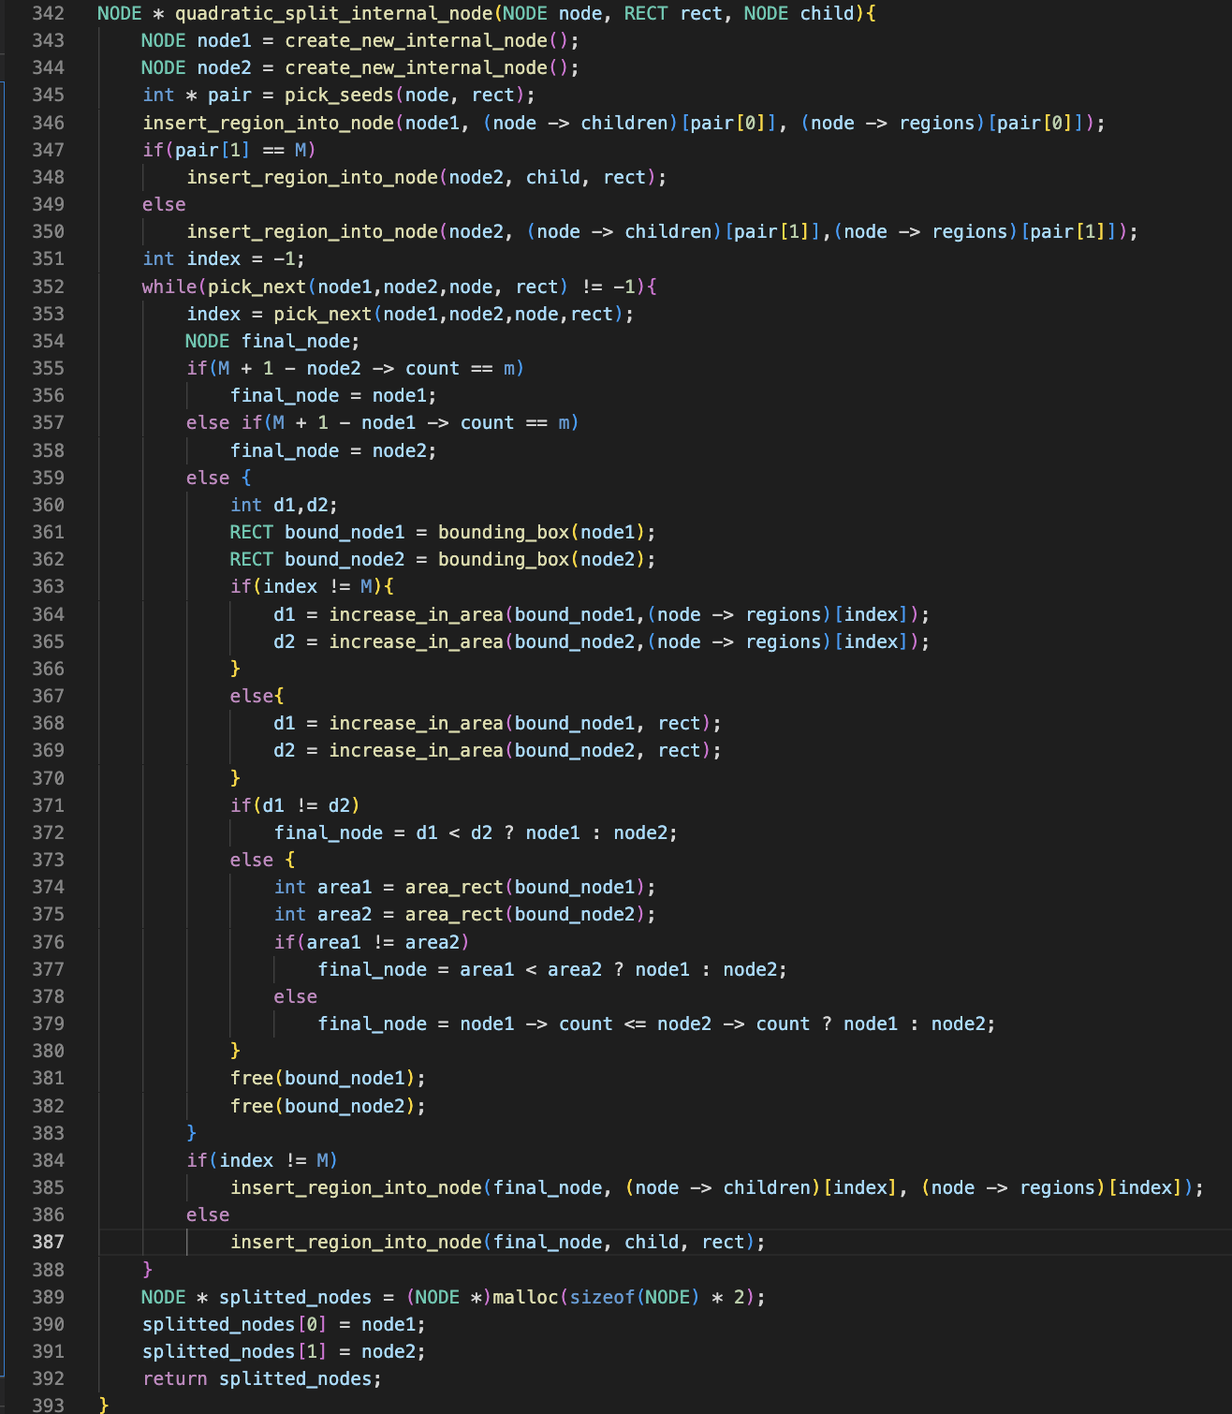
Quadratic Splitting

Slide 23
PickSeed
It chooses two entries to be the first elements of the group.
Algorithm
[Calculate inefficiency of grouping entries together] For all pairs of entries E1 and E2 a rectangle J is created which includes E1.I and E2.I. Calculate inefficiency d as d = area(J) − area(E1.I) − area(E2.I)
[Choose the most wasterful pair] Choose the pair with the largest d.

Slide 24
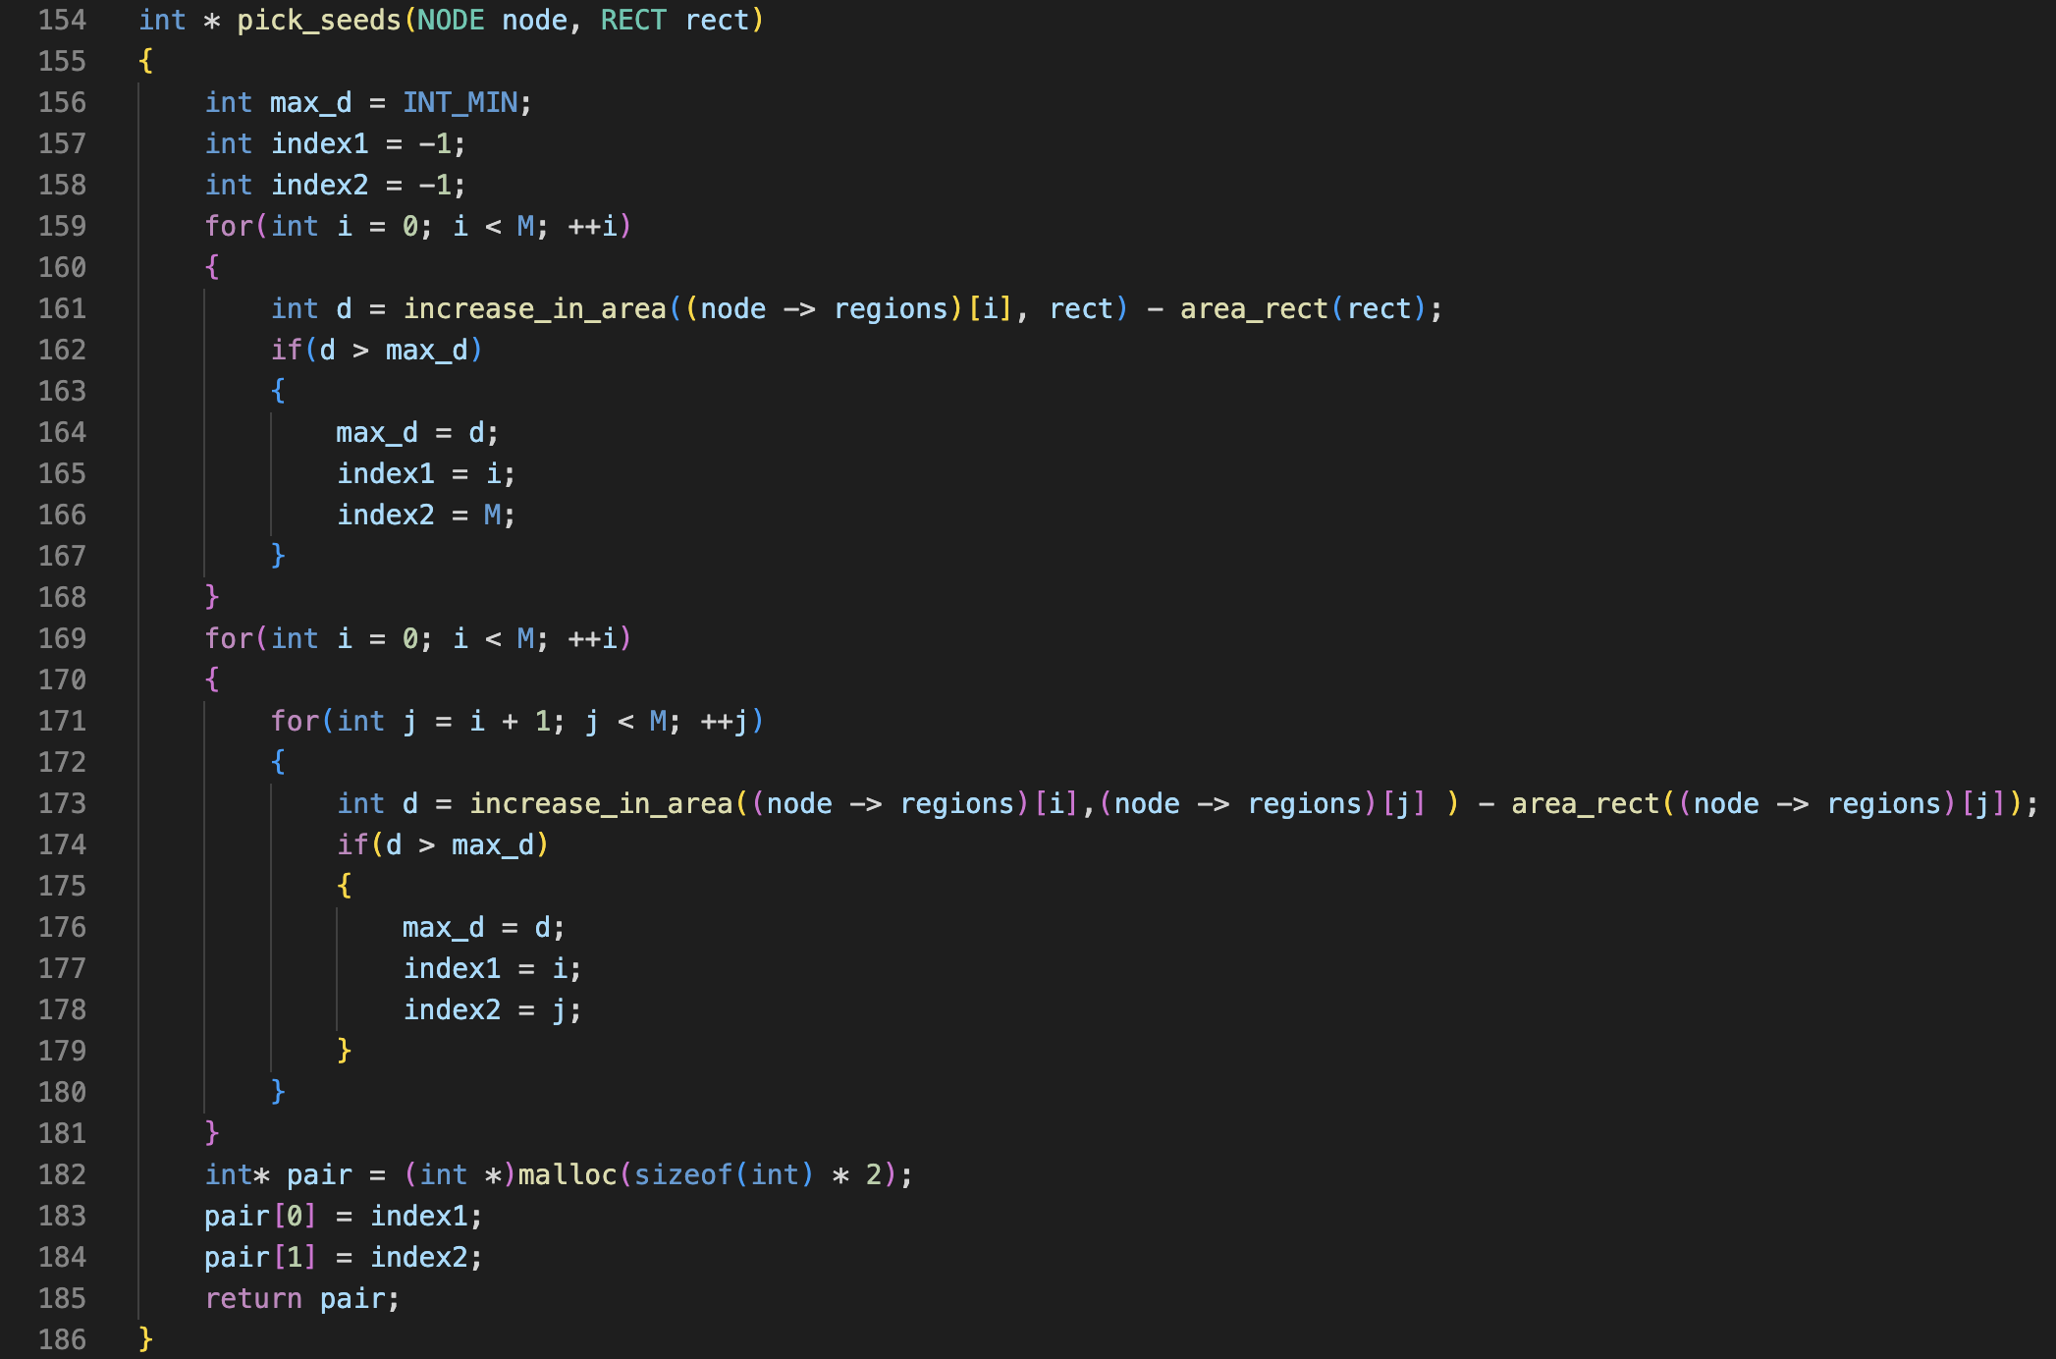
PickSeed

Slide 25
PickNext
It selects the entry to be the assigned from the remaining set of entries.
Algorithm
Determine the cost of putting each entry in each group:
d1 = Enlargement required in MBR of Grp1 to include the entry.
d2 = Enlargement required in MBR of Grp2 to include the entry.
cost = |d1-d2|
b. Find entry with greatest preference for a group. Choose any entry with the maximum cost.

Slide 26
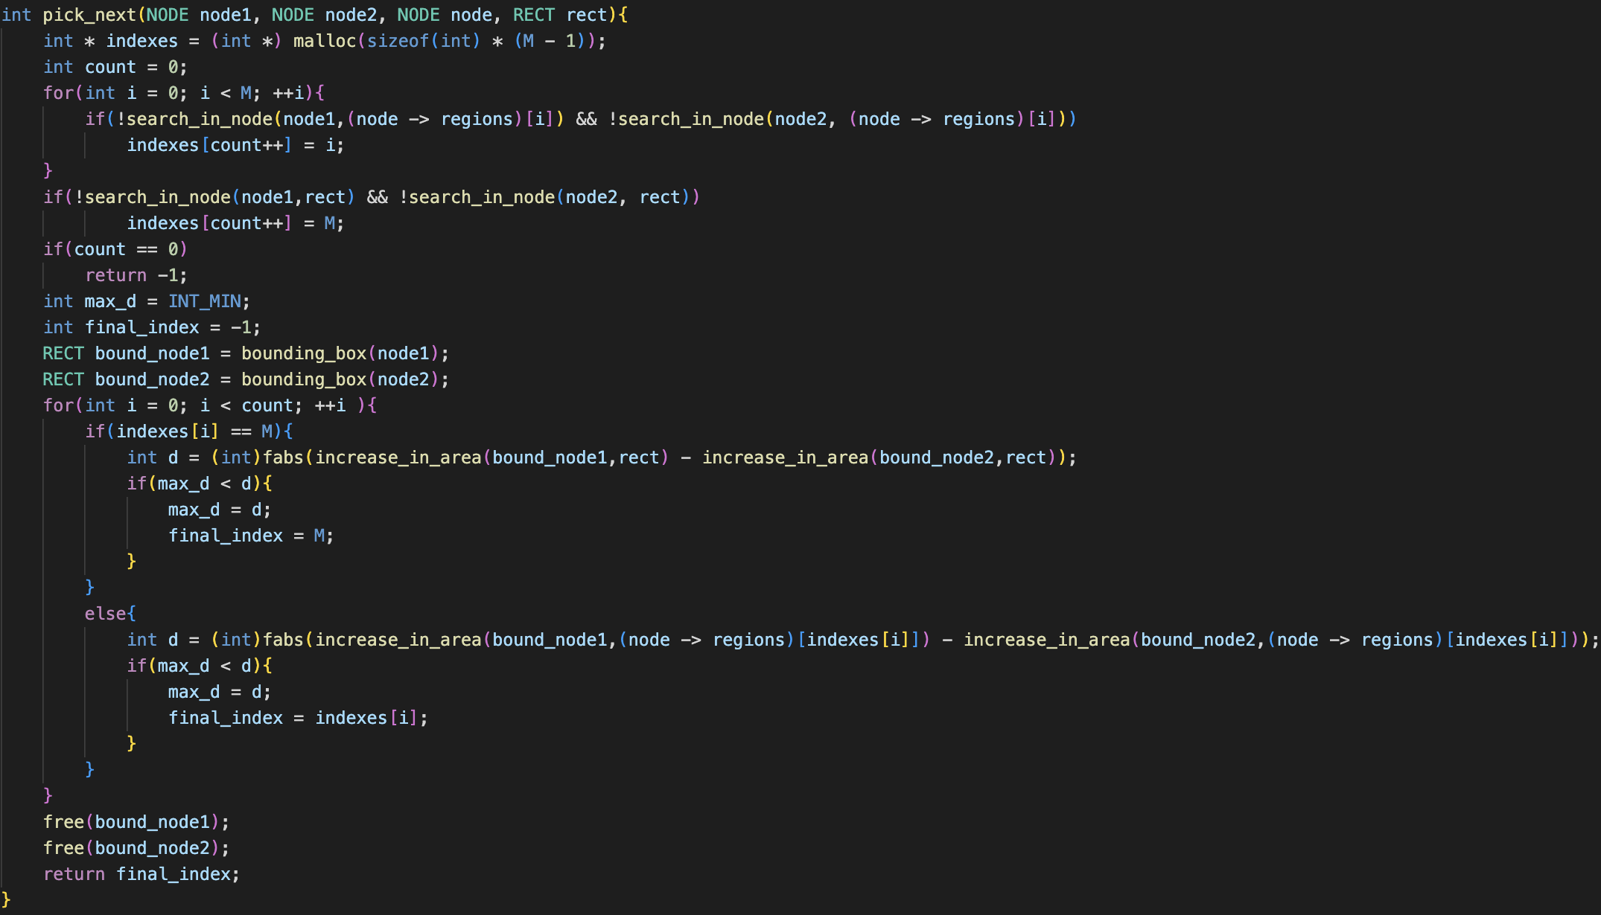
PickNext

Slide 27
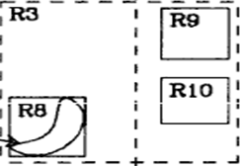
Splitting: Example of R3
Nw

Slide 28
Splitting: Example of R3
Nw

Slide 29
Splitting: Example of R3
Nw

Slide 30
Splitting: Example of R3
Nw

Slide 31
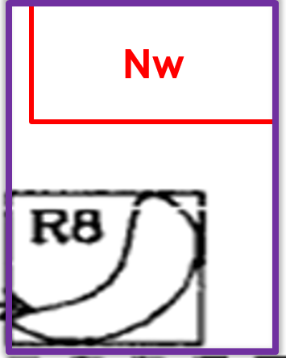
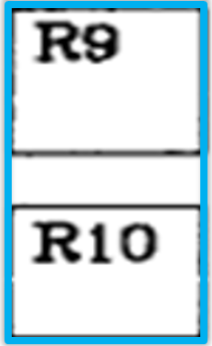
Splitting: Example of R3
R3
R3’’

Slide 32
Pre-Order Traversal
Prints the R-Tree in Pre-Order form i.e. first prints the node and then its children.
Algorithm: Input Node and depth
Initialise N = Node
If N is NULL then return.
If N is leaf node, then print all the objects within it and return.
If N is internal node then print MBR of N.
For each of the children of N, repeat steps from 2.1 with Node = child of N and depth = depth + 1.

Slide 33
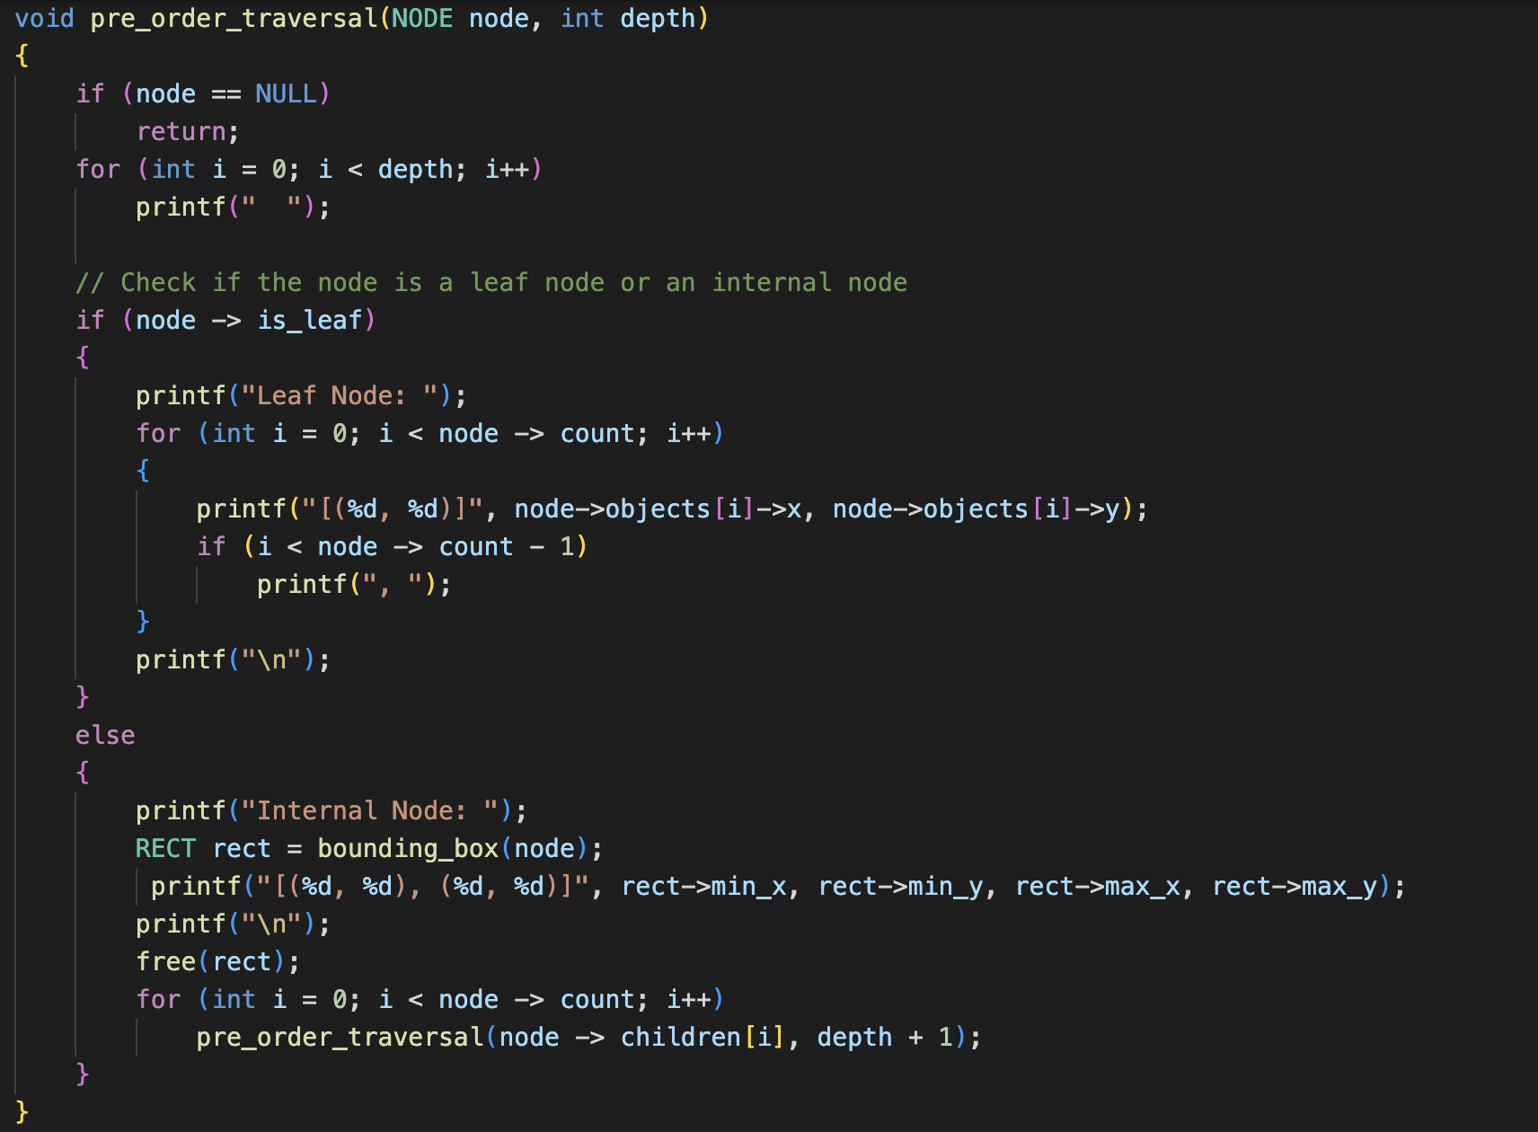
Pre-Order Traversal

Slide 34
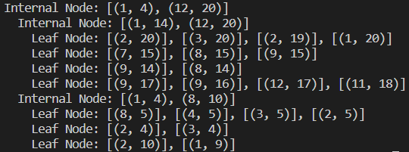
Pre-Order Traversal

Slide 35
Thank You

