Slide 1
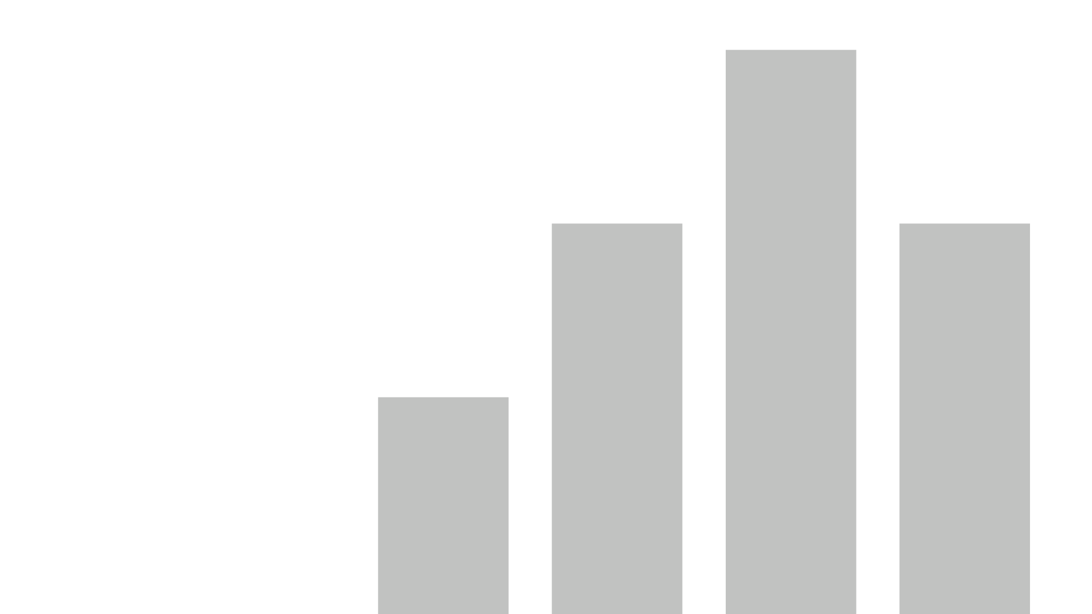


MoodScriber Analytics
View in Power BI
Click here to Access Project Files
By – Raunak Raj
202000482

Slide 2
Abstract
In the project, Microsoft's Power BI software was utilized for data analytics of the input file. Its diverse features facilitated data modelling, creation of custom measures, and the generation of attractive visuals.
For a more sophisticated display of data, the number of entries was increased to 999 and a few new columns were added in the Input file like Days, Months, Years, Gender, Age and Emotions. Reference columns for these were also made to facilitate Data Input.
The Analytics Focus on 3 Main Groups and 3 Accessory Groups which are:
Main: Mood, Emotions, Activities
Accessory: Gender, Age, Days/Day Types
Each values of these groups have been cross analysed with each other to give meaningful insights, along with other insight values.
The Presentation also contains embedded Power BI data at the end to facilitate checking of the Dashboard on the presentation itself.

Slide 3
About the Data Set
The Data Set has been set for a time period of 2020 to 2024 (5 years) and contains relevant data throughout all 999 rows.
The newly entered columns are Days, Months, Years, Gender, Age and Emotions. The data has been made to be as accurate as possible to a real life dataset. (Example: For the year 2024 the data only ranges between January to April)
The 1st 10 columns are used for Analytics. Rest of the columns are present for Data Modelling, Inputting and DAX (Data Analysis Expressions) based calculation purposes.
The data has been entered in the Input file through Python pandas manipulation, Excel Formulas and lastly hand inputting.

Slide 4
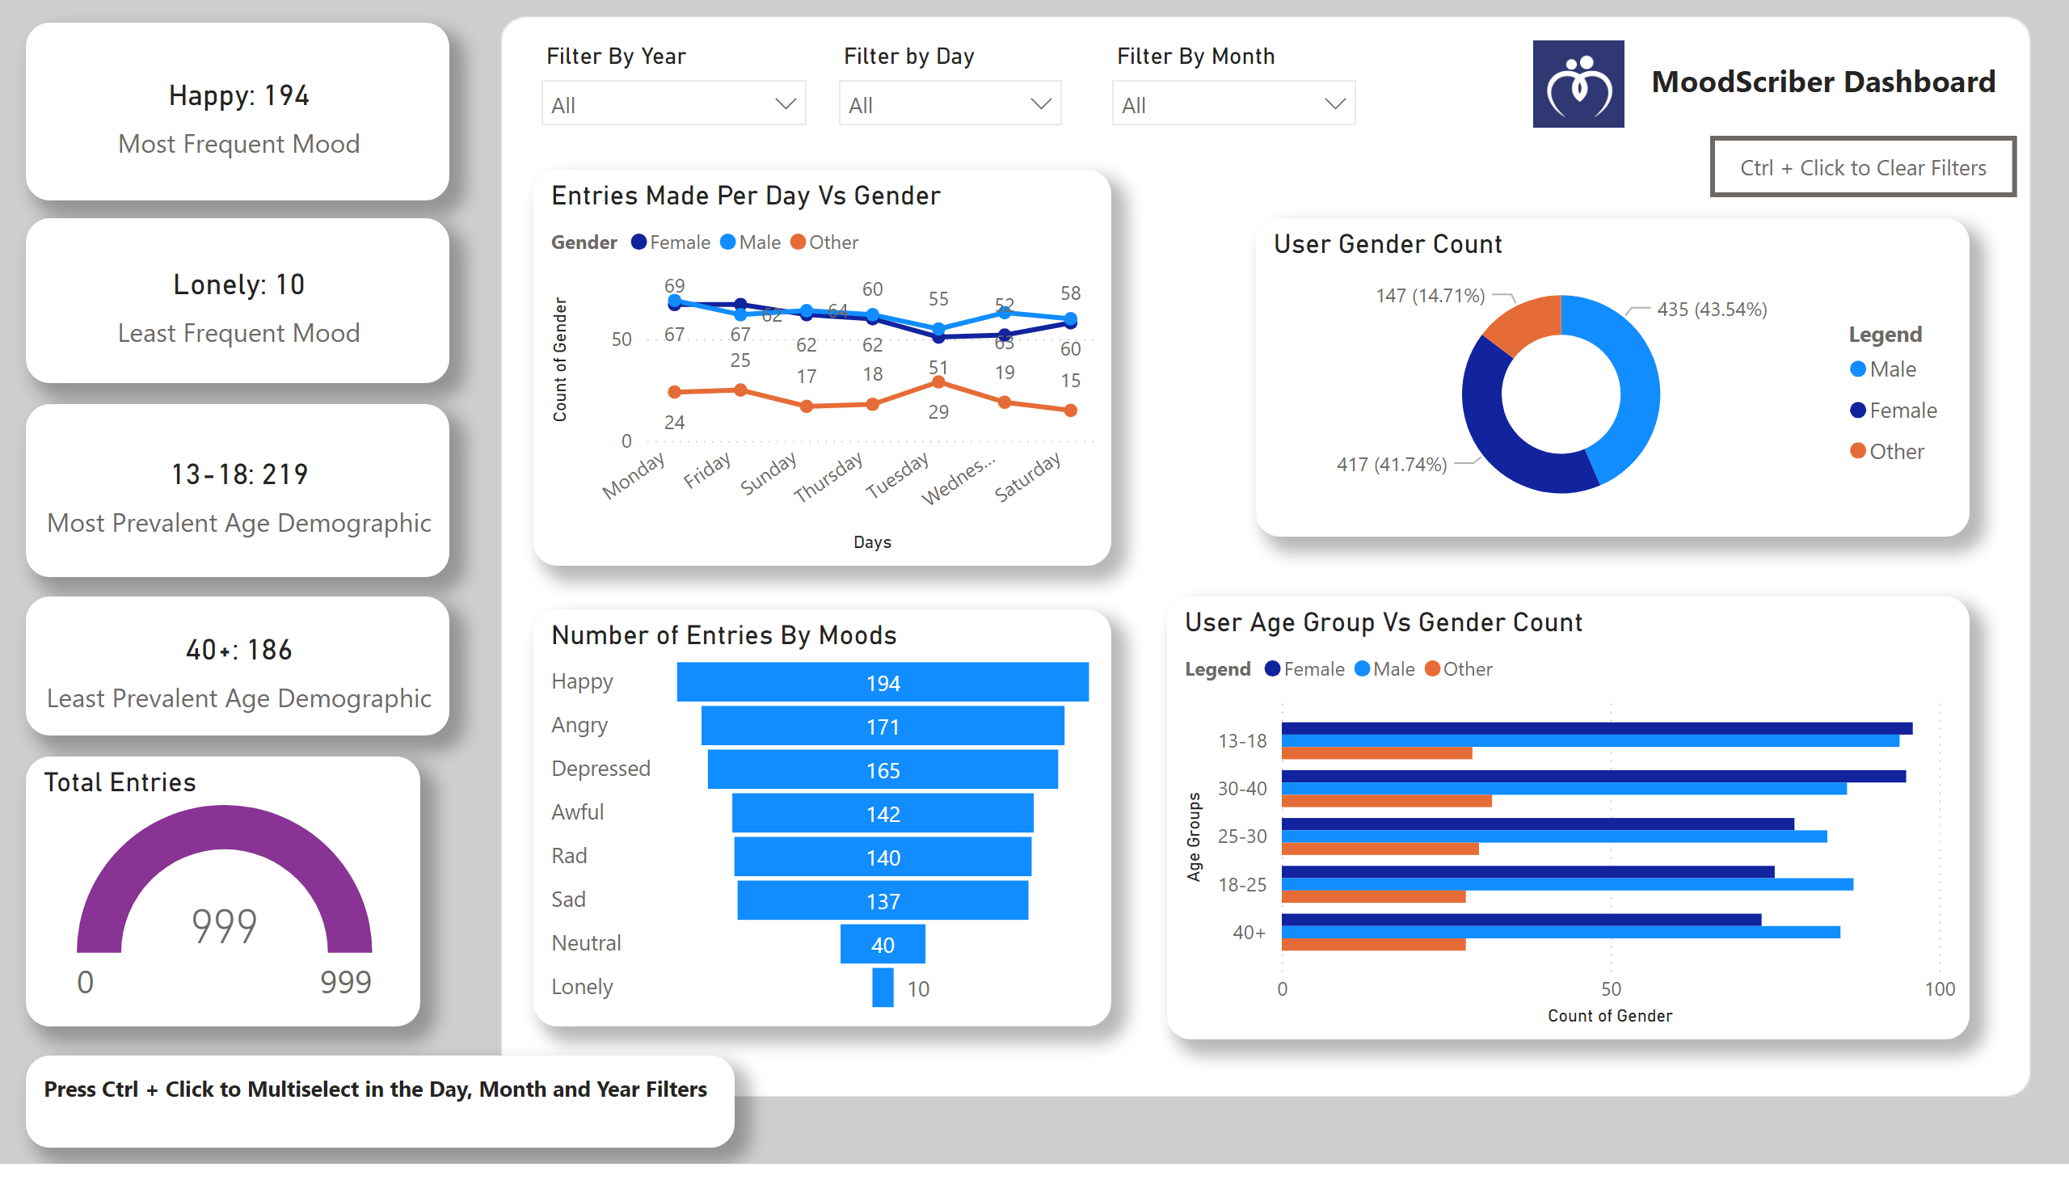
Home Page
Notes:
image
No alt text provided
textbox
No alt text provided
card
No alt text provided
card
No alt text provided
card
No alt text provided
card
No alt text provided
slicer
No alt text provided
slicer
No alt text provided
slicer
No alt text provided
Total Entries
No alt text provided
Entries Made Per Day Vs Gender
No alt text provided
Number of Entries By Moods
No alt text provided
User Gender Count
No alt text provided
User Age Group Vs Gender Count
No alt text provided
actionButton
Press Ctrl + Click to Clear all slicers.
textbox
No alt text provided

Slide 5



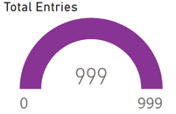
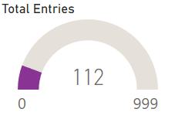
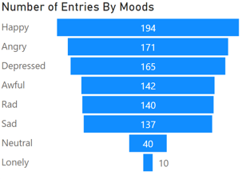
Mood
We can see that of the present data, the most frequently inputted value is “Happy” with a total of 194 entries and least inputted is Lonely with a total of 10 entries.
The changes in filters also portray the visual changes as follows:
The following shows that on applying the Month Filter of February, this visual now changes its values to the total entries made in February throughout 2020-2024.
We can also see the total number of entries by the different kinds of moods.
The data also shows that the User Base is nearly equally divided between Men and
Women.
These are some of the many visualizations regarding Moods. They can be better
explored by opening the Power BI website or the .pbix file on Power BI Desktop.

Slide 6
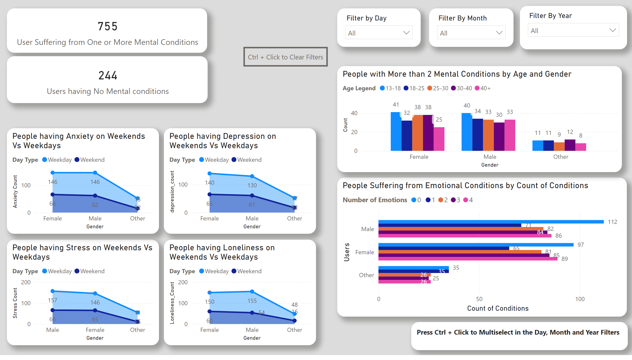
Emotional Conditions
Notes:
slicer
No alt text provided
slicer
No alt text provided
People Suffering from Emotional Conditions by Count of Conditions
No alt text provided
User Suffering from One or More Mental Conditions
No alt text provided
card
No alt text provided
People having Stress on Weekends Vs Weekdays
No alt text provided
People having Anxiety on Weekends Vs Weekdays
No alt text provided
People having Depression on Weekends Vs Weekdays
No alt text provided
People having Loneliness on Weekends Vs Weekdays
No alt text provided
People with More than 2 Mental Conditions by Age and Gender
No alt text provided
slicer
No alt text provided
actionButton
Press Ctrl + Click to Clear all slicers.
textbox
No alt text provided

Slide 7

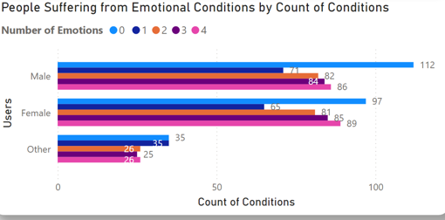
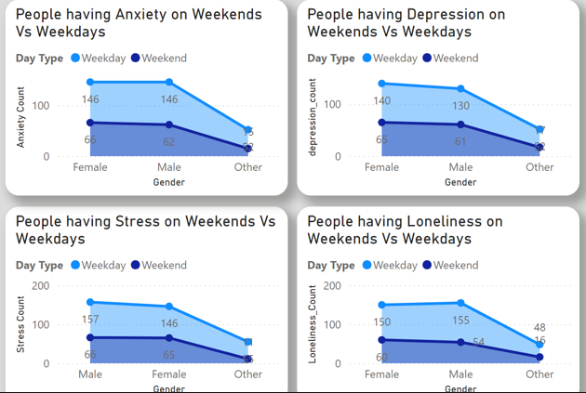
Emotions
The values of this Column have 0 – 4 possible values, but in the main excel file they’re written in the same column. In Power BI, this column was separated into 4 columns by delimiter separation.
This visual shows the number of people having some or the other Mental Condition.
We are also shown classification of people according to the number of conditions they have:
This visual shows the number of people having 0,1,2,3 or 4 conditions (from Anxiety, Stress,
Depression or Loneliness. This is further classified by Gender in the X axis (Male, Female and
Others). We see that Males on average have more Mental Conditions.
We also see Weekday Vs Weekend Comparison of the 4 above listed conditions:

Slide 8
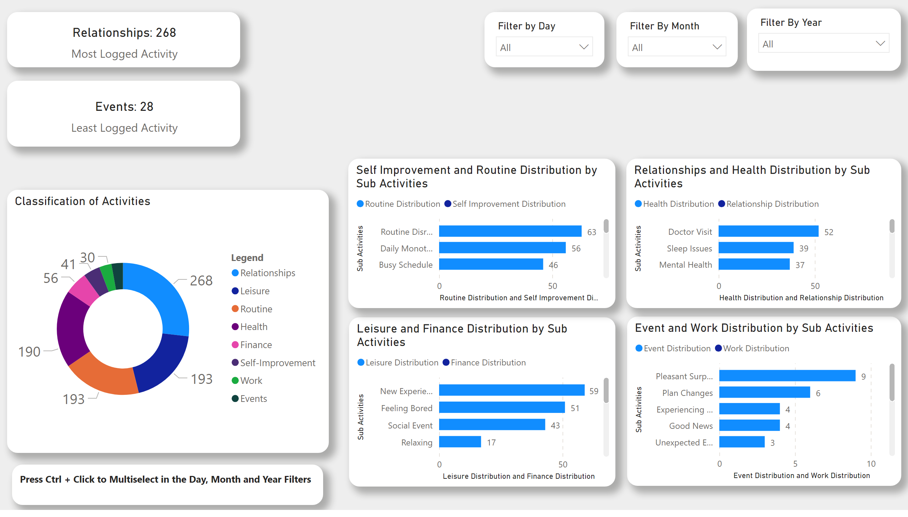
Activities and Sub-Activities
Notes:
Event and Work Distribution by Sub Activities
No alt text provided
Leisure and Finance Distribution by Sub Activities
No alt text provided
Self Improvement and Routine Distribution by Sub Activities
No alt text provided
Relationships and Health Distribution by Sub Activities
No alt text provided
card
No alt text provided
card
No alt text provided
Classification of Activities
No alt text provided
slicer
No alt text provided
slicer
No alt text provided
slicer
No alt text provided
textbox
No alt text provided

Slide 9


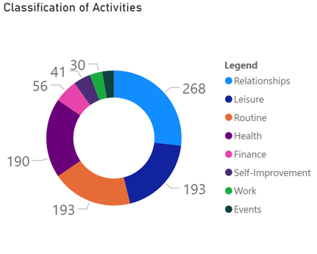
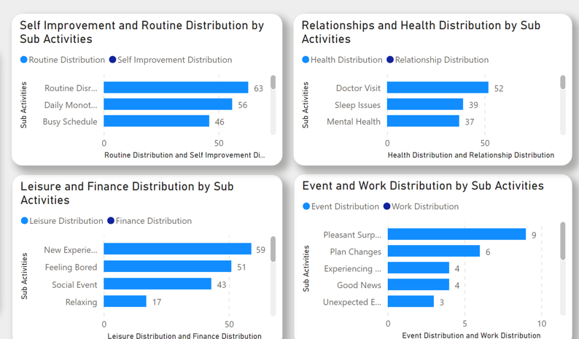
Activity
Each of the Activity in Column “Activity-1” has 6 sub-activities, which are given once per entry in column “Activity-2”.
The most frequently logged Activity is Relationship with 268 entries and least is Events with 28 entries.
There are a total of 8 activities classified in the following manner:
The Sub activities are also divided in accordance to the Activity Distribution in the following
manner:
Due to the excess of visualisations, the stack bar chart contains 2 Distributions per chart and has to be seen by scrolling.

Slide 10


Slide 13
Insights
This summarizes the analysis of the Dataset against the various metrics.
Key Insights are:
85% of the user base is evenly divided between Men and Women.
People mostly make entries about their relationships. (27% entries)
Around 75% of the people report experiencing some sort of Mental condition.
The most prevalent age bracket of users is ages 13-18 and people with ages between 13 to 30 make up 60% of the User Base.
Male Population is the majority among the people experiencing the Mental Conditions.

Slide 14
Thank you

