Slide 1
State diagrams stuff

Slide 2
IDLE
COLOR
Progress by default
Finished retaining current color scheme
Calculated color and LEDs to be updated
(frequency- and/or beats- based)
RETAIN
LEDs

Slide 3
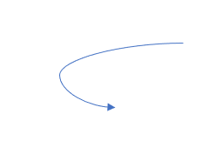
IDLE
PLAYING
IDLE
COLOR
indicator == START
state == PLAYING &&
song_done == false
Progress by default
song_done == TRUE
indicator == PLAY or START
indicator == PAUSE
Calculated color and LEDs to be updated
(frequency- and/or beats- based)
Finished retaining current color scheme
PAUSED
RETAIN
ESP32
LEDs

Slide 4
“User” DB
POST request
(info for “User”, “Room” DB’s)
update
dev server
web app
GET request
(current song in each room)
(pause/play status)
“Room” DB
update
Updated info from
“User”, “Room” DB’s
GET request
ESP32
Playing mode,
patterns info
LEDs

