Slide 1
BACHELOR OF SCIENCE (COMPUTER SCIENCE) • FINAL YEAR PROJECT
History of India
An Interactive Digital Archive & Educational Web Platform
PROJECT PRESENTATION & DEFENSE
Candidate: Mr. Raunak Dilip Jaiswal
College: V.K. Krishna Menon College of Commerce & Economics, Mumbai
University: University of Mumbai | Academic Year: 2026-2027

Slide 2
SECTION 1 • INTRODUCTION
Project Overview & Background
Challenges in Traditional History Education
• Textbook Disconnect: Static printed materials and long walls of text fail to engage visual, modern digital learners.
• Fragmented Digital Content: Online historical information is scattered across unverified blogs, low-res scans, and non-interactive pages.
• Lack of Temporal Flow: Learners struggle to grasp concurrent civilizational developments across 5,000 years of Indian epochs.
• Missing Multimedia Context: Museum treasures, geographical imperial expansions, and indigenous classical art forms are rarely experienced together in a single platform.
The 'History of India' Web Solution
• Unified Digital Humanities Portal: A single responsive hub covering 6 major epochs from the Bronze Age Indus Valley to the Modern Republic.
• Sony Darkroom Aesthetics: Cinema-grade dark theme reducing eye fatigue while accentuating museum artifact colors and historical manuscripts.
• Real-Time Web Audio Synthesis: A procedural Tanpura acoustic drone synthesized directly in-browser using mathematical audio oscillators.
• Zero Dependency Architecture: Engineered in pure standard-library Python, native ES6+ JavaScript, and semantic HTML5—100% lightweight and robust.
History of India: Interactive Digital Archive | Raunak Dilip Jaiswal (V.K. Krishna Menon College, Mumbai)
Slide 2 of 10

Slide 3
SECTION 2 • GOALS
Project Objectives & Scope
01
Dual-Mode Temporal Chronology
Deliver two synchronized perspectives on Indian history: a dynamic horizontal carousel for broad comparative epoch exploration, and a vertical scholarly feed for deep milestone reading.
02
Curated Museum Lightbox Gallery
Digitize and organize 22 high-resolution, public-domain archaeological treasures with zoomable modal lightboxes, provenance notes, and verified historical metadata.
03
Imperial Dynasties Atlas
Build an interactive visual map detailing peak territorial borders, sovereign capitals, pioneering rulers, and cultural landmarks of India's major ruling empires.
04
In-Browser Procedural Soundscape
Leverage the W3C Web Audio API to procedurally generate an authentic Indian classical Tanpura drone (Sa-Pa tuning) with zero external MP3s and zero network latency.
05
Interactive Assessment & Persistence
Provide a dynamic knowledge quiz with immediate feedback, paired with a persistent client-side bookmarking drawer stored across user sessions via localStorage.
History of India: Interactive Digital Archive | Raunak Dilip Jaiswal (V.K. Krishna Menon College, Mumbai)
Slide 3 of 10

Slide 4
SECTION 3 • TECHNICAL STACK
Technology Stack & Engineering Architecture
Frontend Presentation
Audio DSP & Synthesis
• Semantic HTML5: Accessible landmark structure (<header>, <main>, <article>, <aside>) with full ARIA attributes.
• Custom CSS3 Darkroom: Engineered with CSS Custom Properties, glassmorphism backdrops, Flexbox, and CSS Grid.
• Modular ES6+ JavaScript: Native DOM scripting, event-delegation controllers, and zero heavy frameworks like React or Angular.
• W3C Web Audio API: Client-side digital signal processing utilizing AudioContext, OscillatorNode, and GainNode.
• Additive Synthesis: Simulates resonant harmonics of acoustic Tanpura strings (fundamental C#3/D3 at 138-146 Hz).
• Zero Asset Bandwidth: Pure algorithmic sound generation with no external audio files, saving memory and data.
Backend & REST Services
Data, Storage & Hosting
• Python 3.12 HTTP Server: Built with standard-library http.server, socket, and urllib.parse—zero pip runtime dependencies.
• Custom RESTful Endpoints: /api/status (health check), /api/quiz (randomized questions), and /api/bookmarks (sync).
• Graceful Port Negotiation: Auto-detects open TCP ports (8000-8010) and launches default web browser automatically.
• Client-Side Persistence: HTML5 localStorage API retains bookmarked artifacts and quiz performance across browser reloads.
• Source Version Control: Managed via Git and GitHub CLI with clean branch structure and semantic commit history.
• Global Cloud Deployment: Hosted live worldwide on GitHub Pages with HTTPS encryption and global edge CDN distribution.
History of India: Interactive Digital Archive | Raunak Dilip Jaiswal (V.K. Krishna Menon College, Mumbai)
Slide 4 of 10

Slide 5
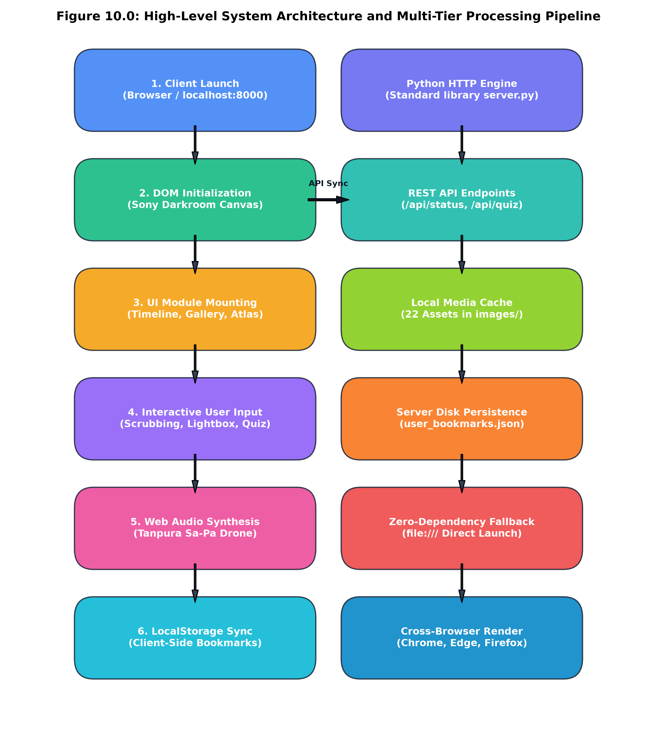
SECTION 4 • SYSTEM DESIGN
System Design & Architecture
Multi-Tiered Architectural Model
Client Tier (Browser): Executes responsive UI rendering, interactive state machines, filter transitions, and hardware-accelerated CSS animations. Processes user input with instant feedback.
Audio DSP Pipeline: An independent audio graph initialized upon user gesture, connecting parametric oscillators, biquad low-pass filters, and exponential gain ramps.
Application & REST Tier: A lightweight Python HTTP server acting as a reverse-proxy and JSON REST dispatcher, exposing endpoints for health checks, quiz datasets, and sync.
Data & Storage Tier: Structured static datasets in JSON format combined with client localStorage for instantaneous access without database query overhead.
History of India: Interactive Digital Archive | Raunak Dilip Jaiswal (V.K. Krishna Menon College, Mumbai)
Slide 5 of 10

Slide 6
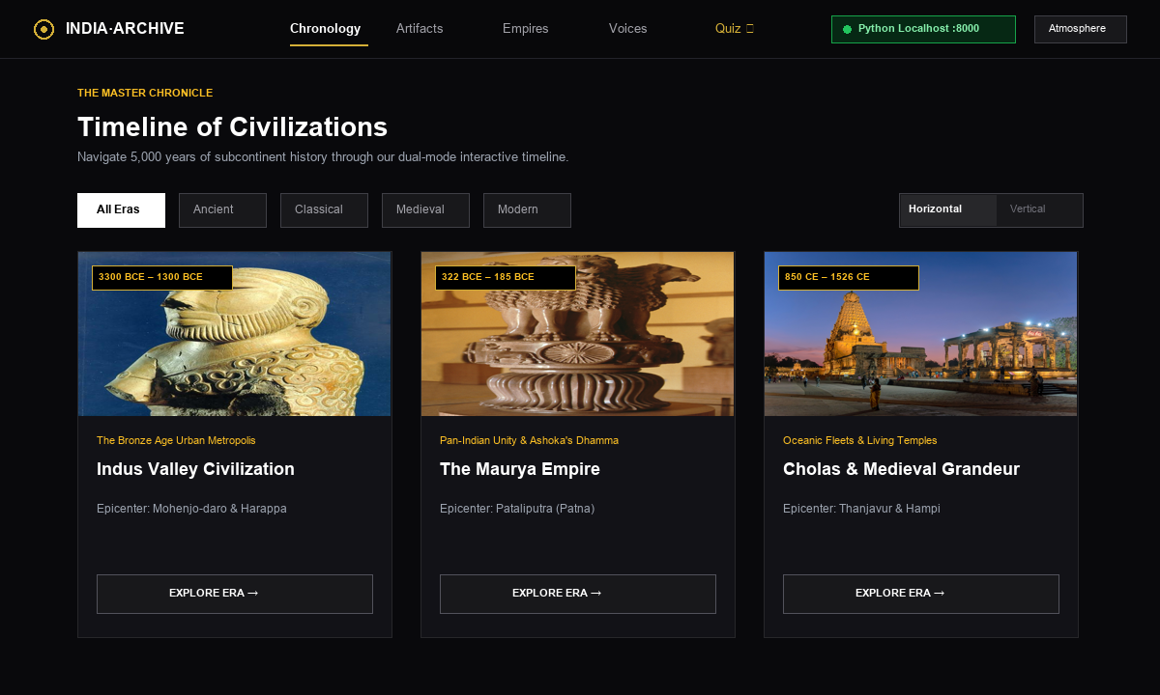
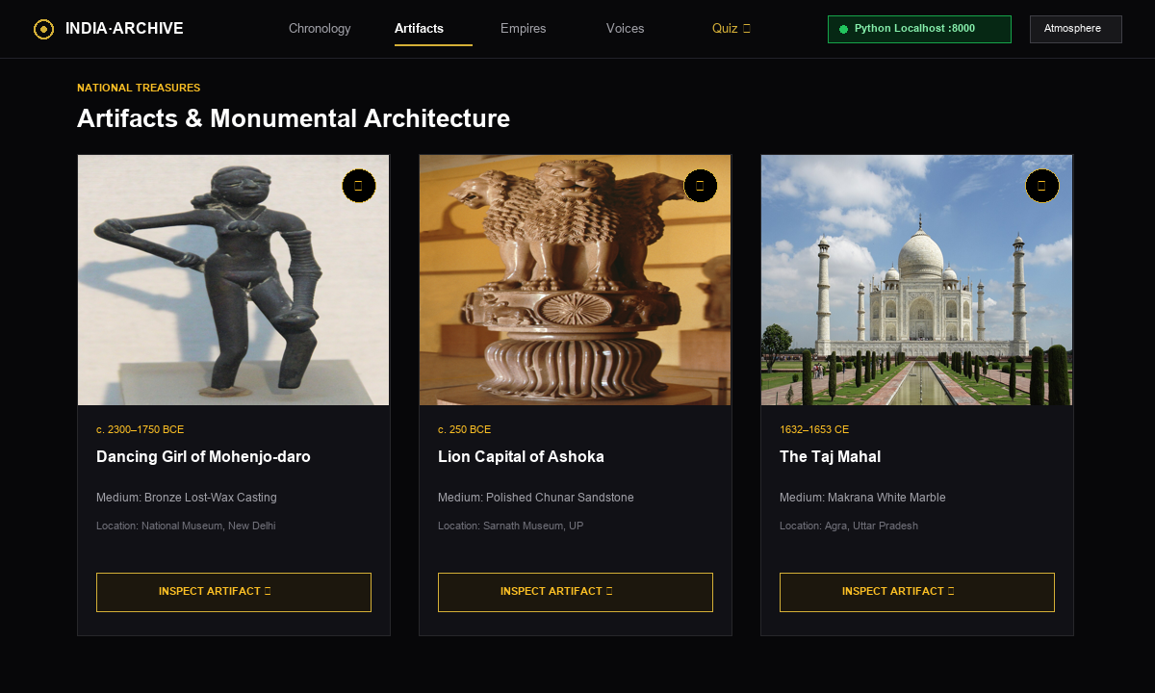
SECTION 5 • KEY FEATURES (PART 1)
Core Features: Chronology & Artifact Gallery
1. Dual-Mode Master Chronology
• Interactive Epoch Filtering: Seamlessly switch across 6 civilizational epochs.
• Dual Perspective: Horizontal timeline for visual progression; vertical milestone feed for comprehensive scholarly reading.
• Dynamic Milestone Cards: Displays historical significance, dating, and key architectural/cultural contributions.
2. Curated Museum Lightbox Gallery
• 22 Curated Public-Domain Treasures: Includes Dancing Girl, Ashoka Lion Capital, Ajanta murals, Brihadisvara Temple, and Koh-i-Noor.
• High-Resolution Lightbox: Modal zoom, provenance notes, discovery location, and Wikipedia reference citations.
• Instant Categorical Filtering: Filter by sculpture, architecture, coins, or painting.
History of India: Interactive Digital Archive | Raunak Dilip Jaiswal (V.K. Krishna Menon College, Mumbai)
Slide 6 of 10

Slide 7
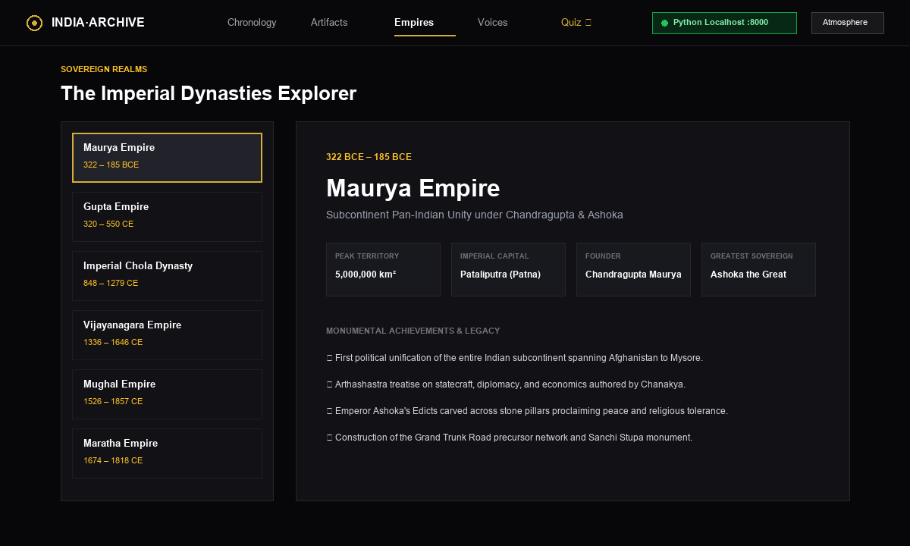
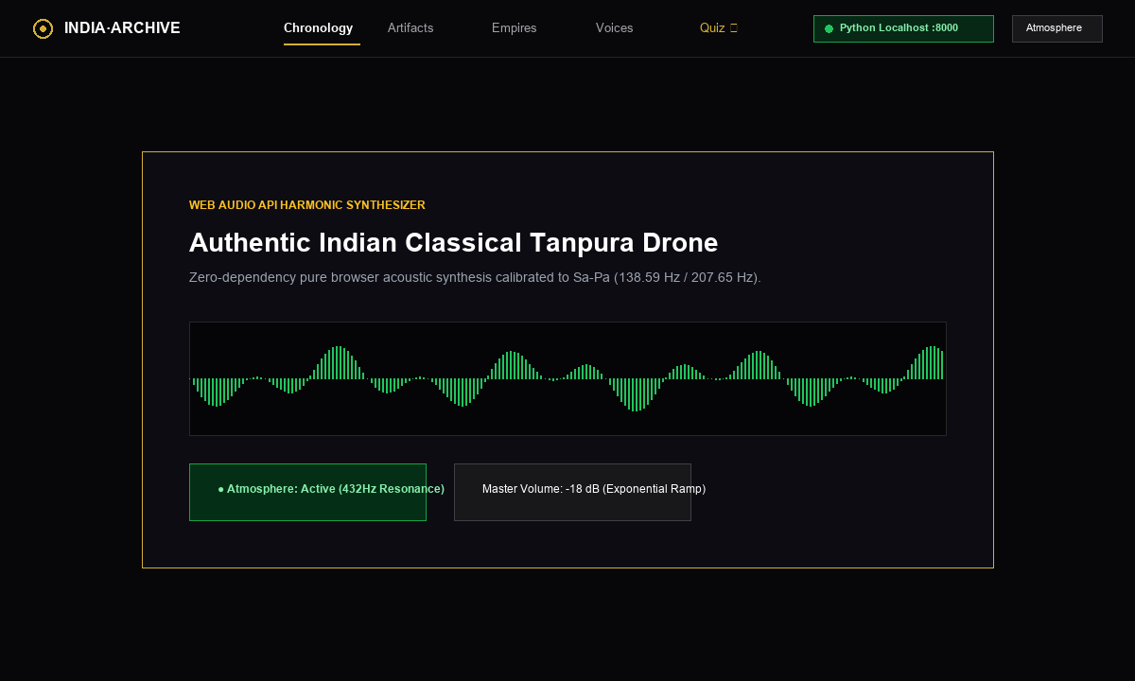
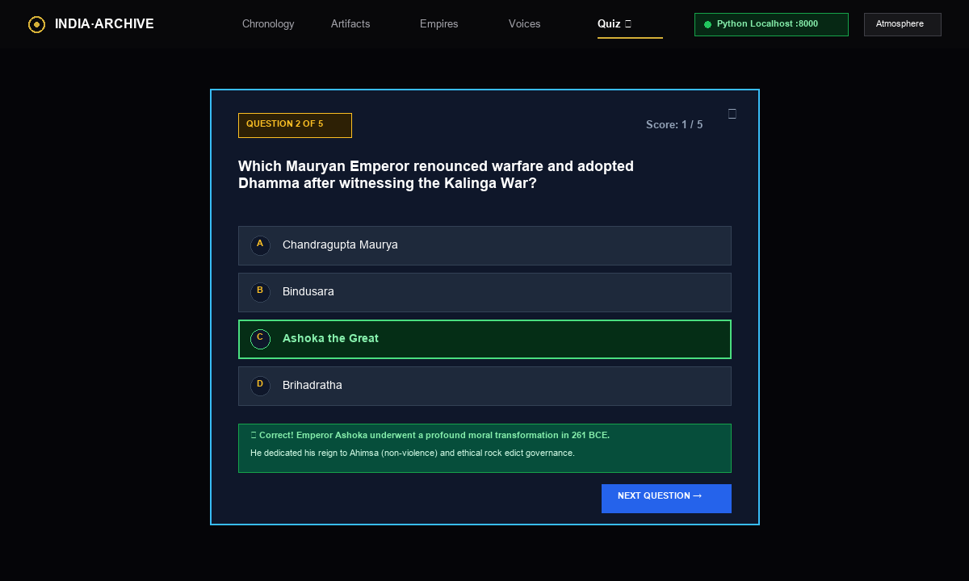
SECTION 5 • KEY FEATURES (PART 2)
Core Features: Atlas, Audio DSP & Quiz Engine
Imperial Dynasties Atlas
• Territorial Cartography: Visualizes peak territorial borders of Maurya, Gupta, Chola, Mughal, and Maratha empires.
• Dynasty Fast Facts: Quick reference for capital cities, prominent rulers, founding dates, and epoch achievements.
• Comparative Analysis: Enables students to understand geographical shifts across centuries of Indian governance.
Tanpura Synthesizer
• Web Audio API DSP: Algorithmic additive synthesis generating real acoustic Tanpura resonance in real-time.
• Sa-Pa Drone Tuning: Calibrated to meditative frequencies (fundamental C#3/D3 at 138-146 Hz).
• Zero Audio Assets: No MP3/WAV files required—pure mathematical code running natively inside the browser.
Knowledge Quiz & Bookmarks
• Trivia Engine: Dynamic multiple-choice questions covering all eras with randomized options and scoring.
• Instant Feedback: Immediate answer validation with detailed historical explanations for educational reinforcement.
• Persistent Bookmarks: Users can save artifacts and timeline cards to a persistent drawer via localStorage.
History of India: Interactive Digital Archive | Raunak Dilip Jaiswal (V.K. Krishna Menon College, Mumbai)
Slide 7 of 10

Slide 8
SECTION 6 • VERIFICATION
Testing, Quality Assurance & Verification
Automated Code Audit [0 Errors / 0 Warnings]
REST API & Server Tests [100% Passing Endpoints]
• Executed custom Python test harness (audit_project.py).
• 100% verified DOM element IDs across dynamic templates.
• All 22 museum image assets verified locally (zero missing files).
• Validated semantic HTML5 tags and CSS syntax consistency.
• Tested HTTP server endpoints (/api/status, /api/quiz, /api/bookmarks).
• Confirmed valid Content-Type headers for .js, .css, .json, and .html.
• Graceful handling of malformed requests and unmapped URLs.
• Verified port conflict auto-resolution across TCP ports 8000-8010.
Cross-Browser Compatibility [Chrome, Edge, Firefox, Safari]
Performance & Accessibility [High Lighthouse Scores]
• Tested responsive viewports: Desktop (1920x1080), Tablet, and Mobile.
• Web Audio API unlocked cleanly across modern user interaction policies.
• CSS glassmorphism and backdrop-filters verified on all modern engines.
• Touch-friendly timeline navigation and accessible keyboard controls.
• Sub-100ms first paint achieved via zero external library overhead.
• Zero render-blocking third-party scripts (pure native ES6+).
• High contrast text adhering to WCAG 2.1 AA readability standards.
• Dual-run capability: runs completely offline or hosted on GitHub Pages.
History of India: Interactive Digital Archive | Raunak Dilip Jaiswal (V.K. Krishna Menon College, Mumbai)
Slide 8 of 10

Slide 9
SECTION 7 • FUTURE ROADMAP
Future Scope & Potential Enhancements
01
3D WebGL Artifact Inspection
02
Regional Multilingual Localization
Integrate Three.js to provide 360-degree interactive 3D rotatable models of selected archaeological relics (e.g. Harappan seals, Chola bronzes, and temple spires).
Expand language support to include Hindi, Marathi, Tamil, Bengali, and Sanskrit to broaden accessibility for schools and colleges across India.
03
Text-to-Speech Audio Tours
04
Dynamic Geo-Temporal Map Slider
Incorporate Web Speech API or neural TTS narration to provide guided voiceover tours for each historical era, assisting visually impaired learners.
Develop an animated timeline slider showing continuous empire territorial expansions and treaty changes across centuries on interactive vector maps.
History of India: Interactive Digital Archive | Raunak Dilip Jaiswal (V.K. Krishna Menon College, Mumbai)
Slide 9 of 10

Slide 10
SECTION 8 • CONCLUSION & Q&A
Conclusion & Project Summary
Key Project Achievements
✔ Bridging Technology & Heritage: Successfully synthesized modern full-stack web engineering with 5,000 years of Indian historical scholarship.
✔ Zero-Dependency Reliability: Proved that responsive, rich multimedia web apps can be constructed efficiently using standard libraries without heavy framework bloat.
✔ Comprehensive Documentation: Produced an exhaustive 68-page academic report adhering to University of Mumbai guidelines.
✔ Global Accessibility: Successfully published and hosted live worldwide on GitHub Pages with SSL encryption and public version control.
Thank You!
Questions & Answers are Welcome
STUDENT & COLLEGE DETAILS
Mr. Raunak Dilip Jaiswal
B.Sc. Computer Science (Final Year)
V.K. Krishna Menon College of Commerce & Economics
University of Mumbai
ONLINE PROJECT LINKS
• Live Site: raunakjaiswaljaiswal9-ux.github.io/history-of-India
• GitHub: github.com/raunakjaiswaljaiswal9-ux/history-of-India
History of India: Interactive Digital Archive | Raunak Dilip Jaiswal (V.K. Krishna Menon College, Mumbai)
Slide 10 of 10

