Slide 1
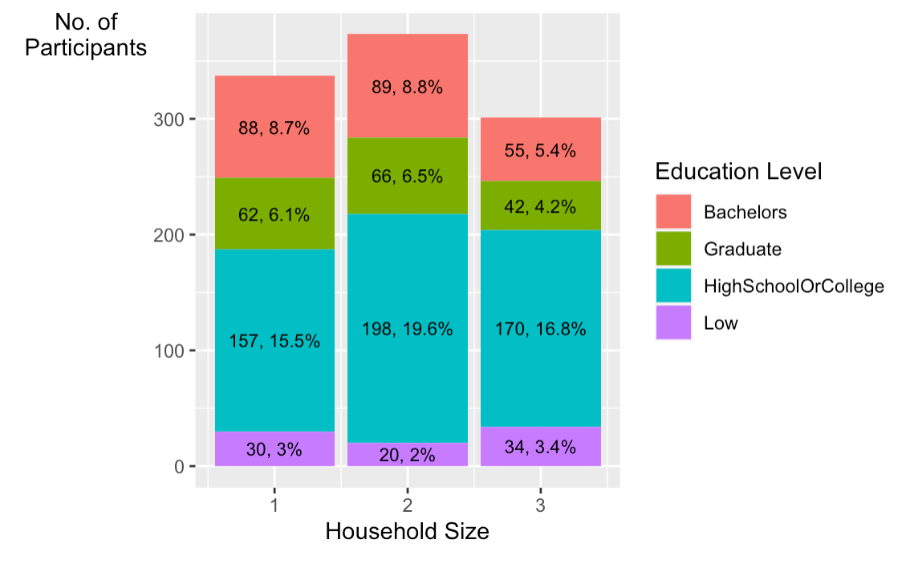
No title
Incorrect values on Y-Axis
Incorrect percentage
values

