Slide 1
Google for Startups AI Agents Challenge · Track 1: Build · 2026
MatRes
⚗️
Materials Resilience Agent
Supply risk analysis for EV battery engineering teams
AI · ADK · Gemini 2.5
From BOM upload to full risk report — under 90 seconds.
Cloud Run · MCP
🌐 Live demo:
https://matres-705351137331.us-central1.run.app

Slide 2
THE PROBLEM
One material disruption can cost $1.9 billion
🔴 GM Bolt Recall 2021
141,667 vehicles · $1.9B cost · Lithium battery thermal runaway
🔴 China Graphite Export Ban — Dec 2023
77% of global supply disrupted overnight · No advance warning
🔴 DRC Cobalt Concentration
73% of world supply · FEOC non-compliant under US IRA 2022
⏱ Engineers spend 3–6 weeks doing this analysis manually. Every time.

Slide 3
THE SOLUTION
Upload a BOM. Get a risk report in 90 seconds.
01
02
03
04
Supply Risk
Failure Modes
Substitutions
Qualification Roadmap
Which materials are geopolitically concentrated HHI score + FEOC flag per component
What failures those materials caused in real vehicles Real NHTSA recalls, severity 1–5
3 ranked alternatives with full property delta Energy density, cycle life, cost, CO₂
Standards, timeline in weeks, cost band in USD UN 38.3 · IEC 62660 · UL 2580 · ISO 26262
Every number in the output has a source citation. No uncited claims reach the UI.

Slide 4
TECH STACK
Built entirely on Google's AI stack
Gemini 2.5 Pro (Vertex AI)
Executive summary generation + reasoning over multi-source BOM data. All calls IAM-controlled — no direct API key in production.
Google Agent Development Kit (ADK)
Orchestrates 4 sub-agents with typed inputs, outputs, and FunctionTool calls. Root agent aggregates outputs into a single RiskReport.
Model Context Protocol (MCP)
USGS MCS 2025 and Materials Project data wrapped as standalone MCP servers. Agent queries them via tool calls — no hardcoded data access.
Cloud Run + Secret Manager + Cloud Build
Fully serverless, GCP us-central1. API keys in Secret Manager — zero hardcoded credentials in the container image or git history.
💡 Gemini 2.5 Pro routes through Vertex AI — auditable, billed to GCP project, IAM-controlled

Slide 5
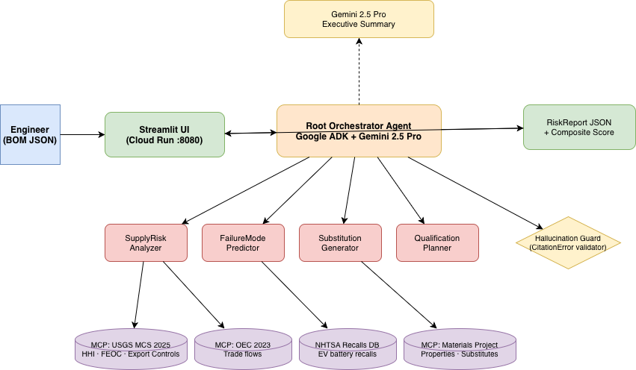
ARCHITECTURE
4 ADK sub-agents · MCP servers · Hallucination guard · Cloud Run

Slide 6
LIVE DEMO — SCENARIO A
NMC 811 Battery Pack — what MatRes finds in 14 seconds
SUPPLY RISK IDENTIFIED
TOP SUBSTITUTION RECOMMENDED
🔴 Cobalt
#1 LFP (LiFePO₄)
HHI 5,535 · DRC 73% · FEOC ⚠️
Composite score: 67 / 100
🔴 Graphite
HHI 6,058 · China 77% · Export ban active
Supply risk
10 / 100
(vs 70+ for cobalt)
🔴 Nickel
Energy delta
−42%
trade-off vs NMC 811
HHI 3,576 · Indonesia 55%
🔴 Lithium
Qualification
80 weeks
~19 months
HHI 3,142 · Australia 47%
Cost band
$925k–$1.85M
full certification
Source: USGS MCS 2025 · NREL Battery Report 2023 · IEC 62660

Slide 7
HALLUCINATION GUARD
Every number is cited. By design.
Engineers cannot act on uncited AI output — legal and regulatory exposure.
❌ Without MatRes
✅ With MatRes
"Cobalt is risky"
"Cobalt HHI: 5,535 · Source: USGS MCS 2025"
"LFP is safer"
"LFP supply risk: 10/100 · Source: NREL 2023"
"Qualification takes months"
"80 weeks · $925k–$1.85M · Source: UN 38.3, IEC 62660"
"China dominates graphite"
"China: 77% share · HHI 6,058 · Source: USGS MCS 2025"
CitationError middleware rejects any numeric output without a source field — before it reaches the UI

Slide 8
TRACK 1: BUILD
A genuinely new agent — not a wrapper
What it is NOT
What makes it novel
✗ Not a supply chain dashboard (Interos, Resilinc operate at KPI level)
✓ Connects geopolitical risk → failure data → substitution → qualification in one pipeline
✗ Not a data lookup tool (USGS, Materials Project have no agent layer)
✓ Hallucination guard enforces citations for regulatory-grade engineering output
✗ Not a general LLM query (ChatGPT/Gemini give uncited estimates)
✓ Deterministic sub-agents (FunctionTool) Fast, auditable, no hallucination on data
✓ Composite scorer with tunable weights Engineers adjust cost vs performance vs CO₂

Slide 9
BUSINESS CASE
Replacing 3 weeks of manual work with 90 seconds
TARGET CUSTOMERS
MARKET OPPORTUNITY
POST-HACKATHON PATH
Tier-1 EV battery suppliers Panasonic · LG Energy · Samsung SDI · CATL OEM procurement teams GM · Ford · Tata · Ola Electric Regulatory compliance teams US IRA 2022 FEOC deadline reviews
$4B supply chain risk software market No agentic competitor at the engineering-decision layer today Existing tools operate at dashboard level — not material-decision specific
Expand beyond EV batteries: · Semiconductor BOMs · Pharmaceutical supply chains · Aerospace materials Enterprise SaaS or API integration into ERP/PLM systems

Slide 10
TRY IT NOW
Live now — test it yourself in 2 minutes
🌐 https://matres-705351137331.us-central1.run.app
01
02
03
Download test BOM
Upload in the sidebar
See the full report
Get bom_fixtures/nmc811.json from github.com/raunakmantri9/MatRes
Open the demo URL → use the sidebar file uploader
Cobalt flagged HIGH → LFP ranked #1 → 19-month qualification roadmap
⌨️ github.com/raunakmantri9/MatRes
Built by Raunak Mantri · Google for Startups AI Agents Challenge 2026 · Gemini 2.5 Pro · Google ADK · MCP · Cloud Run

