Slide 1
CSE Workshop
PYTHON
Intro & Intermediate

Slide 2
Speakers:
Raunak Kumar Pandey
Syed Mohammed Faham
Shubham Kumar Agrawal
Jeet Kavaiya
Event Managers:
3

Slide 3
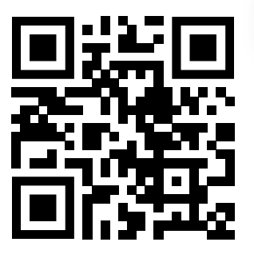
Resources
Github Link : https://shorturl.at/LzAp7
3

Slide 4
Rules and Flow
Be interactive: code along
Materials via Github
Hands-on
Simple project at end (15 min)
Ask questions anytime
3

Slide 5
Why Python?
Easy to learn, beginner-friendly
Used in:
AI/ML
Web Development
Data Analysis
Automation
4

Slide 6
Variables & data type
Basic Data Types :
Integers.
Example: 4, 18, 65
Floating-point numbers.
Example - 2.2, 3.5
Strings.
Example - “Welcome to CSE Workshop!”
Booleans -
Example - True, False
5

Slide 7
Operators and Operators Overloading
Arithmetic (+, - , / , *, %, **, //)
3 + 2 = 5, 8 - 6 = 2
Comparison (< , > , <= ,>= , !=, ==)
3 < 2 = False
Logical (or, and, not)
(3 < 2) or (2 < 3) = True
(3 < 2) and (2 < 3) = False
6

Slide 8
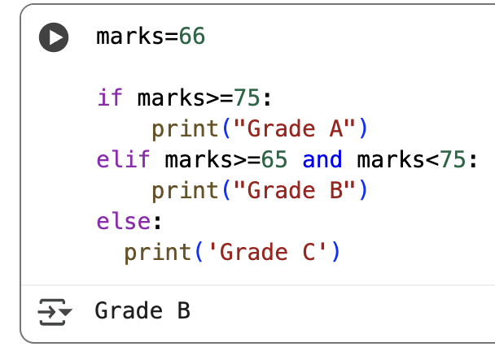
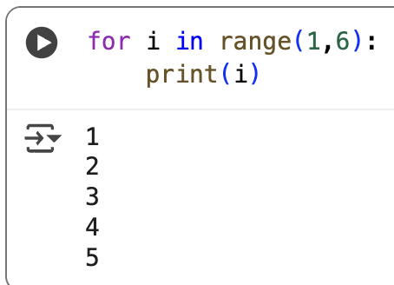
Control Flow
Conditionals (if, elif, else)
Loops (For, While)
6

Slide 9
Advance Data types
List
Example - [“Apples”, “Mango”]
Tuples
Example - (2,3)
Set
Example - {“dog”, “cat”}
Dictionary
Example - {‘apple’ : 2, ‘mango’ : 4}
6

Slide 10
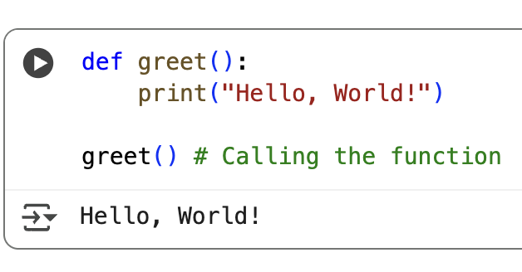
Functions
Function definition
Function call
6

Slide 11
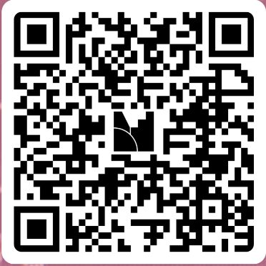
Quiz 1
Link : https://www.menti.com/alss11t86eef
6

Slide 12
File Handling & Exceptions
Open(), read/write files
try-except
6

Slide 13
OOPs Basic
Class and Object
Attributes and Methods
__init__ constructor
6

Slide 14
Important Libraries
numpy
pandas
Matplotlib
6

Slide 15

Quiz 2:
Link : https://www.menti.com/al11wwbazkfe
6

Slide 16
Mini Project
Problem Statement :
Analyze the Students_performance.csv dataset to evaluate how students’ performance varies by gender across different subjects (math, reading, and writing), and visually represent these differences using a bar graph for clear comparison.
6

Slide 17
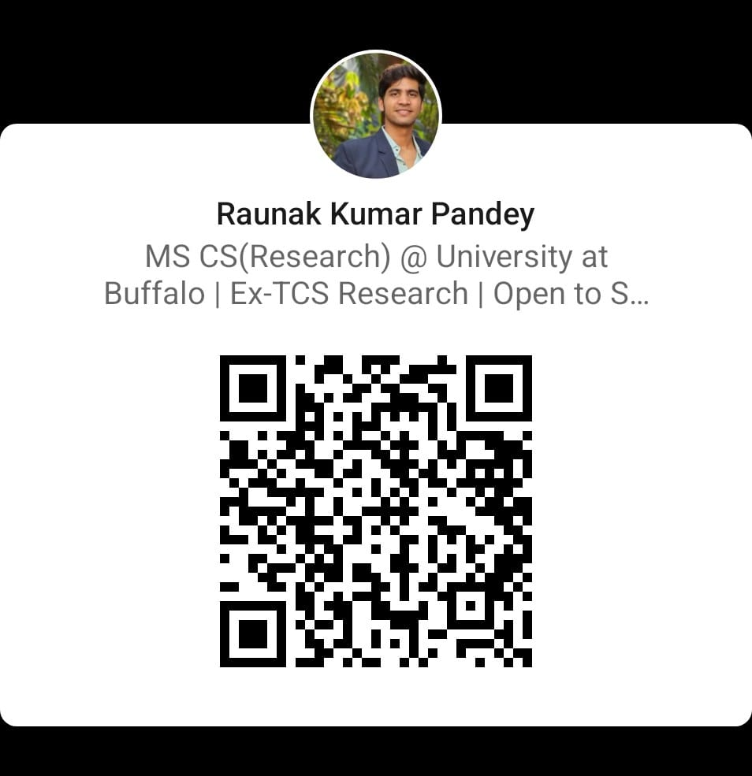

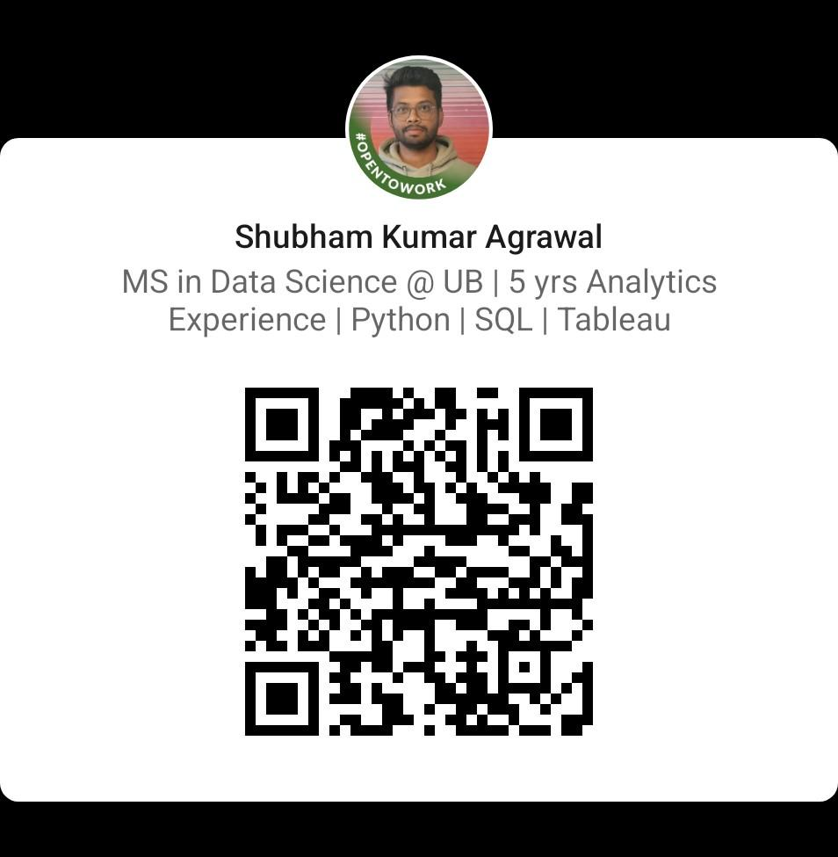
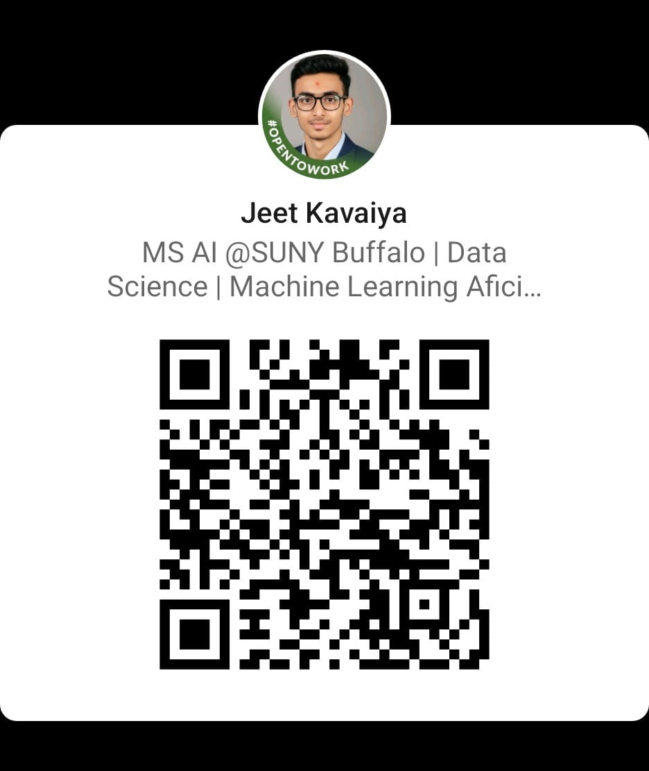
Thank You
6

