Slide 1
Sales Analysis Dashboard

Slide 2

Company Background
Amazon is a multinational e-commerce company established by Jeff Bezos on July 5, 1994, in Bellevue, Washington, US.
The company's headquarters are located in Seattle, Washington, and Arlington, Virginia, US.
The company provides the service worldwide, where the key people of the company are Jeff Bezos and Andy Jassy.
Notes:
The company has different types of services, such as Amazon.com, Amazon Alexa, Amazon Appstore, Amazon Luna, Amazon Music, and Amazon Pay. The owner of the company is Jeff Bezos, and the revenue of the company is USD 637.9 billion. It has 1556000 employees, operating income, and net income of USD 68.59 billion and USD 59.25 billion.

Slide 3
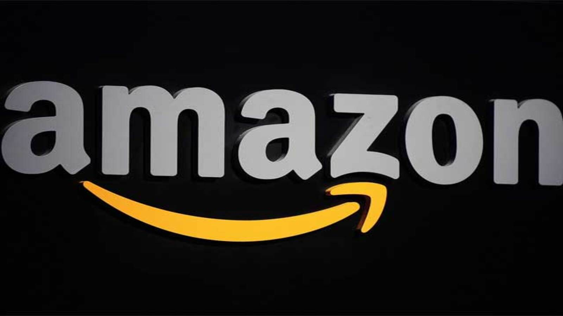
Problem Statement
Analyze total revenue trends over time.
Identify high-performing cities and states based on sales volume.
Measure average shipping times to detect delivery delays.
Detect high-demand product categories and styles.
Investigate the reasons behind the high return and cancellation rates.
Notes:
The goal is to convert the raw data into actionable insights that guide strategic decision-making and operational improvements.

Slide 4
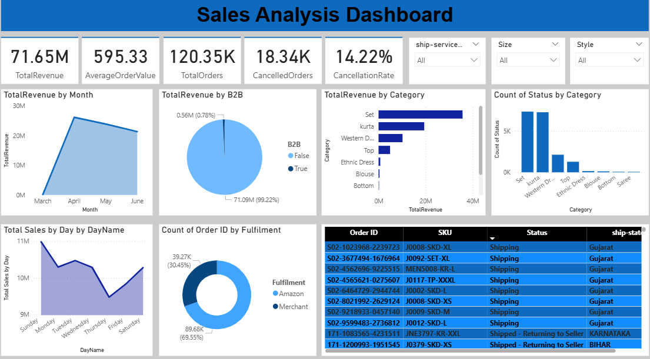
Dashboard Analysis

Slide 5

Conclusion
Monthly revenue analysis reveals clear peaks during certain months, likely due to festive seasons or promotions.
A few product categories contribute disproportionately to total revenue.
It indicates the need to improve merchant handling processes.
B2C orders experience more frequent cancellations compared to B2B.
Average order quantity patterns can inform restocking and bundling strategies.
Notes:
The company has strong revenue potential but needs to address fulfillment delays, customer dissatisfaction, and product-level inefficiencies to grow sustainably.

Slide 6

Recommendations
Launch targeted campaigns and bundle offers during these periods to maximize sales.
Where feasible, shift more fulfillment responsibility to Amazon’s logistics for reliability.
Investigate top-returned products and refine product descriptions or quality control.
Use B2B vs. B2C behavior patterns to design segment-specific campaigns and loyalty offers.
Use average quality orders and product demand to forecast inventory needs.
Notes:
By aligning strategies with customer behavior, seasonal trends, and fulfillment efficiency, the company can reduce costs, improve satisfaction, and boost revenue.

Slide 7


