Slide 1
Topic Name: Sales Analysis Dashboard
Presented By:
Raunak Sen

Slide 2

Company Background
Amazon, a multinational e-commerce leader, continuously navigates complex business challenges. Our strategic approach involves harnessing data-driven insights to optimize operations and ensure sustained growth. This presentation will detail how a new Sales Analysis Dashboard enhances our capabilities.

Slide 3
Problem Statement: Unpacking Key Challenges
Inconsistent Sales Performance
High Order Cancellations & Returns
Shipping Delays
Especially from merchant-fulfilled orders, impacting customer satisfaction negatively.
Variability across months and regions complicates accurate growth forecasting.
Significant rates indicate potential issues with product quality, customer expectations, or delivery.
Limited Customer Insight
Inventory Management Issues
Lack of detailed data on customer segments, regional performance, and retention behavior.
Stockouts or overstocking affect both customer satisfaction and operational costs.

Slide 4
Solution of The Key Challenges
Identify high-sales months from revenue trend analysis and plan promotions accordingly.
Use the data to identify products or SKUs with high return/cancellation rates.
Encourage migration to Amazon FBA or Easy Ship for better delivery success rates.
Use average quantity ordered and sales trends by category/size to plan inventory replenishment.
Segment customer orders using the B2B field in the dataset.
First, I have used Python based on an Excel sheet to perform EDA to clean the data and get accurate results, which I have performed in Google Colab.
Based on that, I have performed Power BI based on the same Excel sheet to get the dashboard of the project with the same values as per the Google Colab.

Slide 5
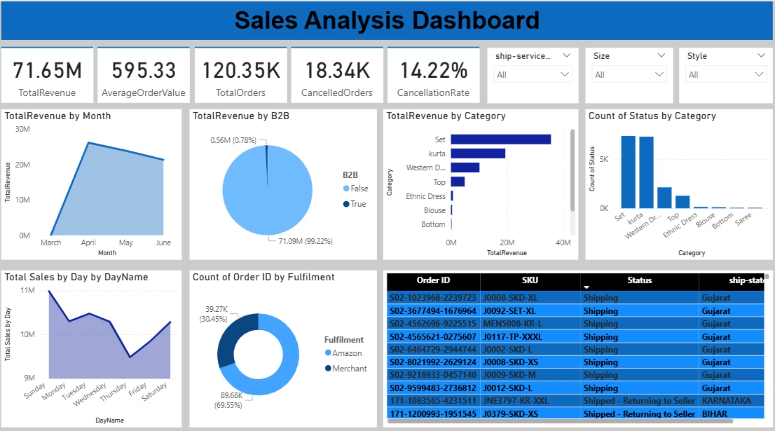
Dashboard Analysis: A Holistic View
This Sales Analysis Dashboard provides Amazon stakeholders with a comprehensive, real-time overview of key sales metrics. It integrates data from various sources to offer granular insights into customer behavior, product performance, and operational efficiency.
The dashboard is designed to address the identified problems by providing actionable visualizations and data points.

Slide 6
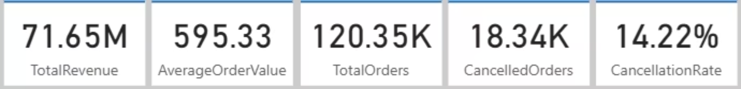
KPI Cards: Core Metrics for Performance Tracking
Total Revenue
Average Order Value
Total Orders
The aggregate sales amount generated across the entire analytical period.
Calculated as total revenue divided by the total number of distinct orders.
The overall count of distinct orders placed within the period.
Cancelled Orders
Cancellation Rate
Indicates 18,340 orders were cancelled, highlighting potential issues.
Reveals that 14% of all orders were cancelled, signifying an area for improvement.

Slide 7
DAX Formulas: Driving KPI Accuracy
The following Data Analysis Expressions (DAX) ensure precise calculation of each KPI, providing a robust foundation for our sales analysis.
Total Revenue
Average Order Value
Total Orders
SUM('sales_dataset[1]'[Cleaned_Amount])
DIVIDE(SUM('sales_dataset[1]'[Cleaned_Amount]), DISTINCTCOUNT('sales_dataset[1]'[Order ID]))
DISTINCTCOUNT('sales_dataset[1]'[Order ID])
Cancelled Orders
Cancellation Rate
CALCULATE(COUNTROWS('sales_dataset[1]'), 'sales_dataset[1]'[Status] = "Cancelled")
DIVIDE(CALCULATE(COUNTROWS('sales_dataset[1]'), 'sales_dataset[1]'[Status] = "Cancelled"), COUNTROWS('sales_dataset[1]'))

Slide 8
Key Insights: Unlocking Performance Drivers
Seasonal Revenue Peaks
Monthly revenue analysis clearly shows peaks during specific periods, likely driven by festive seasons or promotional campaigns.
Product Category Dominance
A few product categories disproportionately contribute to total revenue, indicating strong market demand or effective merchandising.
Merchant Fulfillment Challenges
Insights reveal a critical need to improve processes for merchant-handled orders to enhance reliability.
B2C vs. B2B Cancellation Disparity
B2C orders exhibit higher cancellation rates compared to B2B, suggesting different underlying factors.
Average Order Quantity Trends
Patterns in average order quantity provide valuable data for optimizing restocking and bundling strategies.

Slide 9
Recommendations: Actionable Strategies for Growth
Maximize Seasonal Sales
Launch targeted marketing campaigns and bundle offers during identified peak periods to capitalize on increased demand.
Enhance Fulfillment Reliability
Shift more fulfillment responsibility to Amazon's robust logistics network where feasible, especially for high-volume items.
Address Product Returns
Investigate top-returned products to refine product descriptions, improve quality control, or adjust customer expectations.
Segment-Specific Engagement
Design distinct campaigns and loyalty programs for B2B and B2C segments based on their unique behavior patterns.
Optimize Inventory Management
Utilize average order quantity and product demand forecasts to implement dynamic inventory stocking and pre-positioning strategies.

Slide 10
Thank You
GitHub ID: https://github.com/raunaksen26101997
LinkedIn ID: https://www.linkedin.com/in/raunak-sen-6a9848184/

