Slide 1
Sales Analysis Dashboard

Slide 2

Company Background
Amazon is an American multinational e-commerce company that faces different challenges while running its business.
To address the problems, the company leverages data-driven insights for operations optimization.
Notes:
The company offers various services, including Amazon.com, Amazon Alexa, Amazon Appstore, Amazon Luna, Amazon Music, and Amazon Pay. The owner of the company is Jeff Bezos, and the revenue of the company is USD 637.9 billion. It has 1556000 employees, operating income, and net income of USD 68.59 billion and USD 59.25 billion.

Slide 3

Problem Statement
Sales performance varies across months and regions, making it hard to predict whether growth will occur.
A significant portion of orders are cancelled or returned, indicating potential issues in product quality, customer expectations, or delivery experience.
Delays in shipping, especially from merchant-fulfilled orders, are leading to poor customer experience.
The company lacks detailed insight into customer segments, regional performance, and retention behavior.
Stockouts or overstocking of certain products affect both customer satisfaction and operational costs.
Notes:
The business needs to harness data analytics to understand these challenges, uncover patterns, and implement targeted improvements across finance, logistics, product management, and customer experience.

Slide 4
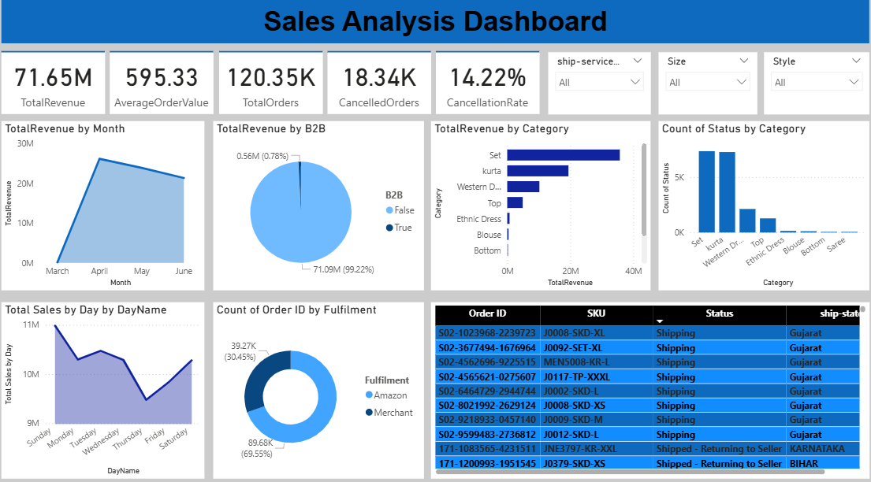
Dashboard Analysis

Slide 5





Dashboard Analysis (Continued)

Slide 6
Dashboard Analysis (Continued)
TotalRevenue = SUM('sales_dataset[1]'[Cleaned_Amount])
AverageOrderValue = DIVIDE(SUM('sales_dataset[1]'[Cleaned_Amount]), DISTINCTCOUNT('sales_dataset[1]'[Order ID]))
TotalOrders = DISTINCTCOUNT('sales_dataset[1]'[Order ID])
CancelledOrders = CALCULATE(COUNTROWS('sales_dataset[1]'), 'sales_dataset[1]'[Status] = "Cancelled")
CancellationRate = DIVIDE(CALCULATE(COUNTROWS('sales_dataset[1]'), 'sales_dataset[1]'[Status] = "Cancelled"), COUNTROWS('sales_dataset[1]'))
Notes:
Cleaned_Amount = IF(SEARCH("Cancelled", [Status], 1, 0) > 0, 0, [Amount])
MonthName = FORMAT('sales_dataset[1]'[Date], "MMMM")
MonthNum = MONTH('sales_dataset[1]'[Date])
DayName = FORMAT('sales_dataset[1]'[Date], "dddd")
DayNum = WEEKDAY('sales_dataset[1]'[Date], 1)
DayTable = DATATABLE("DayName", STRING, "DayNum", INTEGER, {{"Sunday", 1}, {"Monday", 2}, {"Tuesday", 3}, {"Wednesday", 4}, {"Thursday", 5}, {"Friday", 6}, {"Saturday", 7}})
Total Sales by Day = CALCULATE(SUM('sales_dataset[1]'[Cleaned_Amount]), TREATAS(VALUES(DayTable[DayName]), 'sales_dataset[1]'[DayName]))

Slide 7

Conclusion
Monthly revenue analysis reveals clear peaks during certain months, likely due to festive seasons or promotions.
A few product categories contribute disproportionately to total revenue.
It indicates the need to improve merchant handling processes.
B2C orders experience more frequent cancellations compared to B2B.
Average order quantity patterns can inform restocking and bundling strategies.
Notes:
The company has strong revenue potential but needs to address fulfillment delays, customer dissatisfaction, and product-level inefficiencies to grow sustainably.

Slide 8

Recommendations
Launch targeted campaigns and bundle offers during these periods to maximize sales.
Where feasible, shift more fulfillment responsibility to Amazon’s logistics for reliability.
Investigate top-returned products and refine product descriptions or quality control.
Use B2B vs. B2C behaviour patterns to design segment-specific campaigns and loyalty offers.
Use average quality orders and product demand to forecast inventory needs.
Notes:
By aligning strategies with customer behavior, seasonal trends, and fulfillment efficiency, the company can reduce costs, improve satisfaction, and boost revenue.

Slide 9


