Slide 1
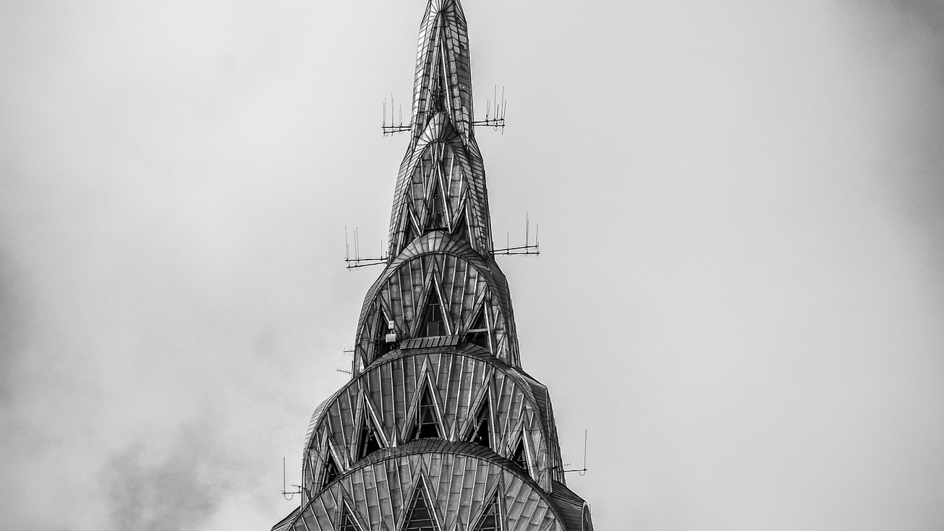
Coarse Architects

Slide 2

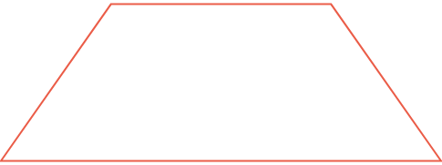
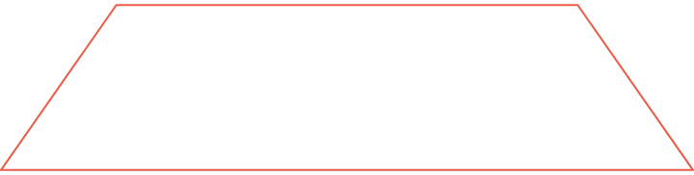
Design Excellence
Ambassadors
1
2
Leaders
3
Actors

Slide 3
















Gadget Use
Platform Usage
180 Daily Users
$50
$50
$79
$50
$88
$50
$50
$50
Facebook
Instagram
Linkedin
Internet
Apple
Desktop
Tablet
Mobile

