Slide 1
GT Collective

Slide 2
Facebook
Instagram
Twitter
Spokespersons
Technical Knowhow
Registrar of Companies
Distribution Capabilities
Regulators
Quick Guide
GT Offerings
Pinterest
Impact Analytics
Equity Raise
Coffee and Beverages
Health and Wellness
Fashion and Lifestyle

Slide 3
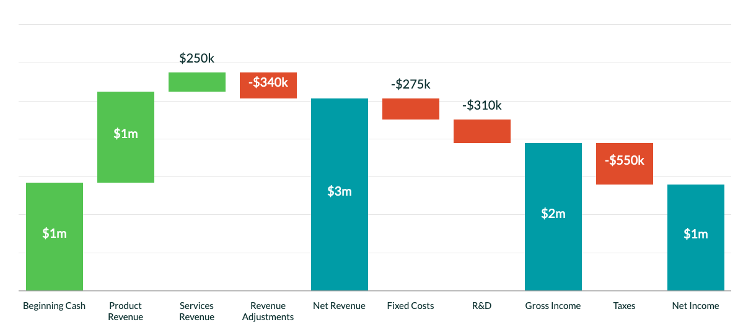
Simplifying Fintech Investments

Slide 4

Total Campaign Goals
Provide a quick snapshot of the campaign’s performance of the most important results.
Investors Main
83,535
Growth Drivers
31,418
Clicks per Avenue
53,898
Trade Strategy
50

Slide 5

Ethical Journey
Driving Targets
Penultimate Targets
Ambitious Targets

