Slide 1
Course Content Simplification Agent
IBM AICTE PROJECT
Presented By:
Student name : RAUNAK SINGH
College Name : MIT ACADEMY OF ENGINEERING
Department : SOFTWARE ENGINEERING

Slide 2
OUTLINE
Problem Statement
Technology used
Wow factor
End users
Result
Conclusion
Git-hub Link
Future scope
IBM Certifications

Slide 3
Problem Statement
Educational materials often vary in complexity and are not always accessible to learners with different levels of prior knowledge. Students may struggle to grasp key concepts due to jargon-heavy or overly advanced explanations in faculty notes and textbooks. The challenge is to develop an AI-powered agent that can intelligently analyze academic content and reframe explanations based on the learner's current proficiency—ranging from beginner to expert. This would support more inclusive learning and personalized education delivery at scale.
Proposed Solution: An AI Course Content Simplification Agent, built using IBM Granite models on watsonx.ai. This agent will leverage Natural Language Processing (NLP) and Retrieval-Augmented Generation (RAG) to intelligently analyze academic content from an indexed knowledge base.

Slide 4
Technology used
IBM cloud lite services
Natural Language Processing (NLP)
IBM Granite model

Slide 5
IBM cloud services used
IBM Cloud Watsonx AI Studio
IBM Cloud Watsonx AI runtime
IBM Cloud Agent Lab
IBM Granite foundation model

Slide 6
Wow factors
This agent boosts student comprehension and reduces study time by personalizing complex educational material for any learning level. It offers targeted support for students while helping educators manage diverse classroom needs.
Unique features:
Multi-Level Explanations: Instantly adapts any text for Beginner, Intermediate, or Expert understanding.
Factual & Grounded: Uses RAG to ensure answers are based only on the uploaded course documents, preventing errors.
Analogy & Jargon Engine: Creates simple analogies for abstract topics and defines technical terms on demand.
Auto-Quizzing: Generates questions from the content to reinforce and test knowledge.

Slide 7
End users
University & College Students
Professionals in Training
Curriculum Developers
Corporate Learning & Development (L&D) Departments

Slide 8
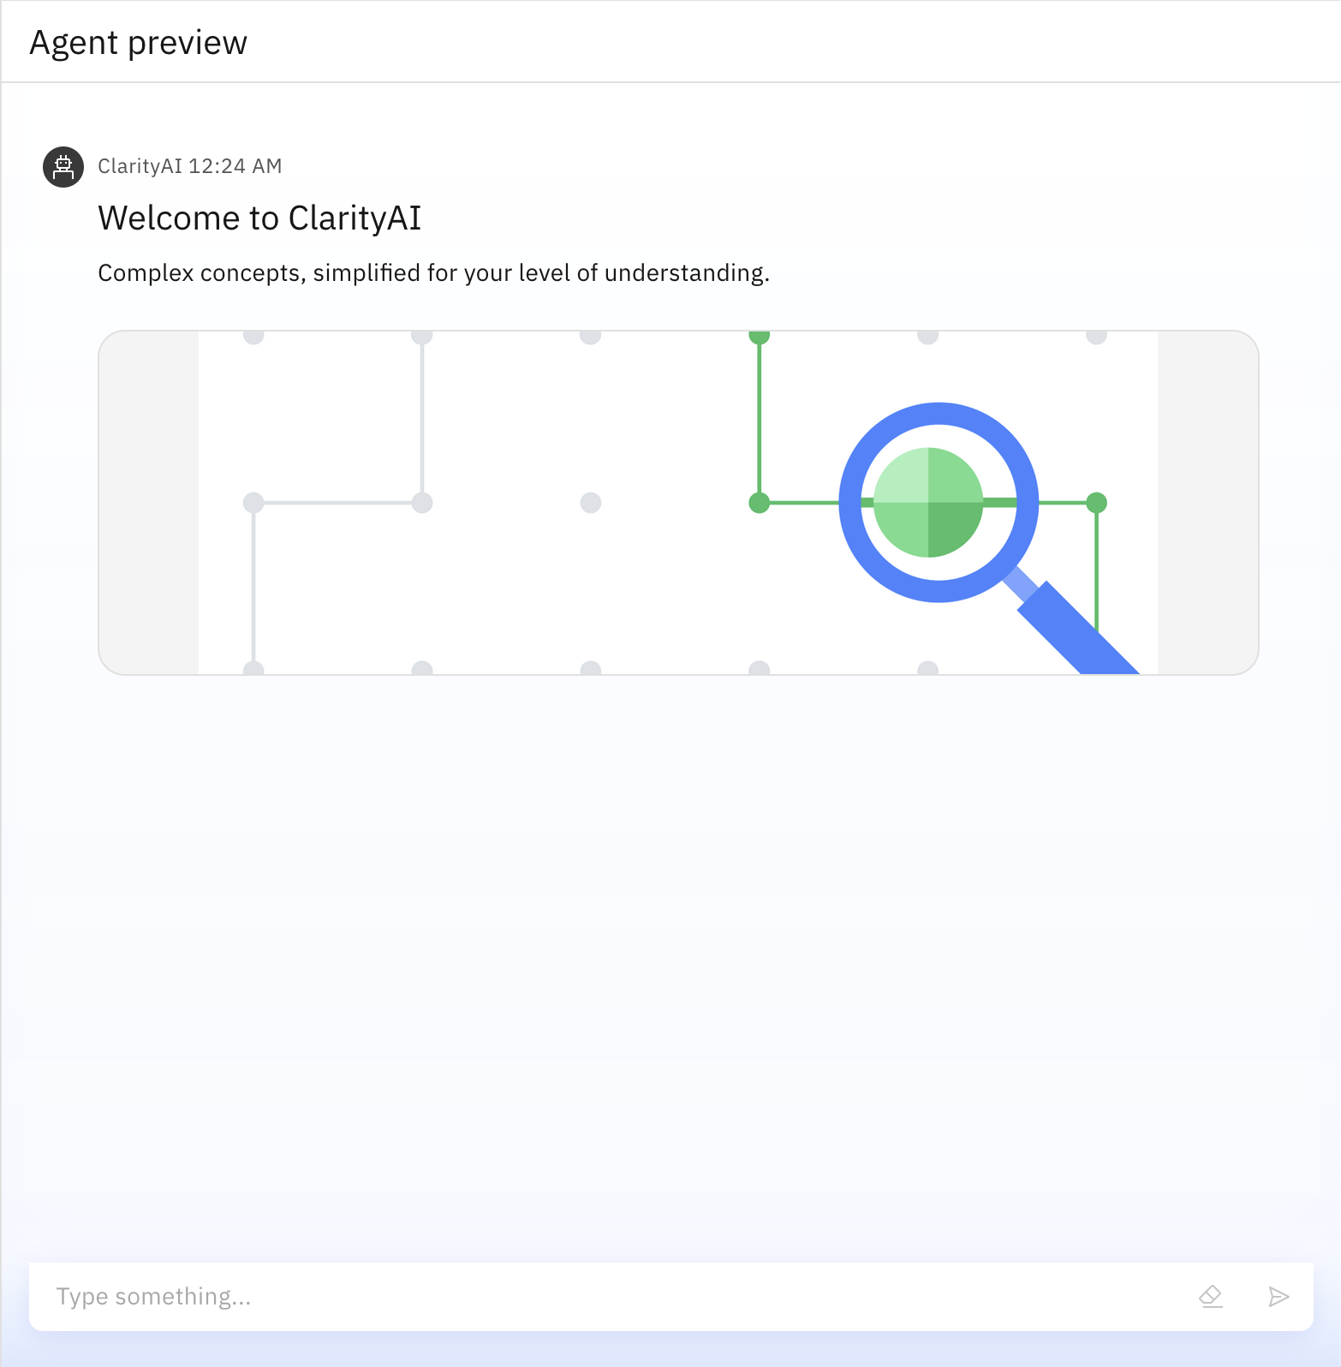
Results

Slide 9
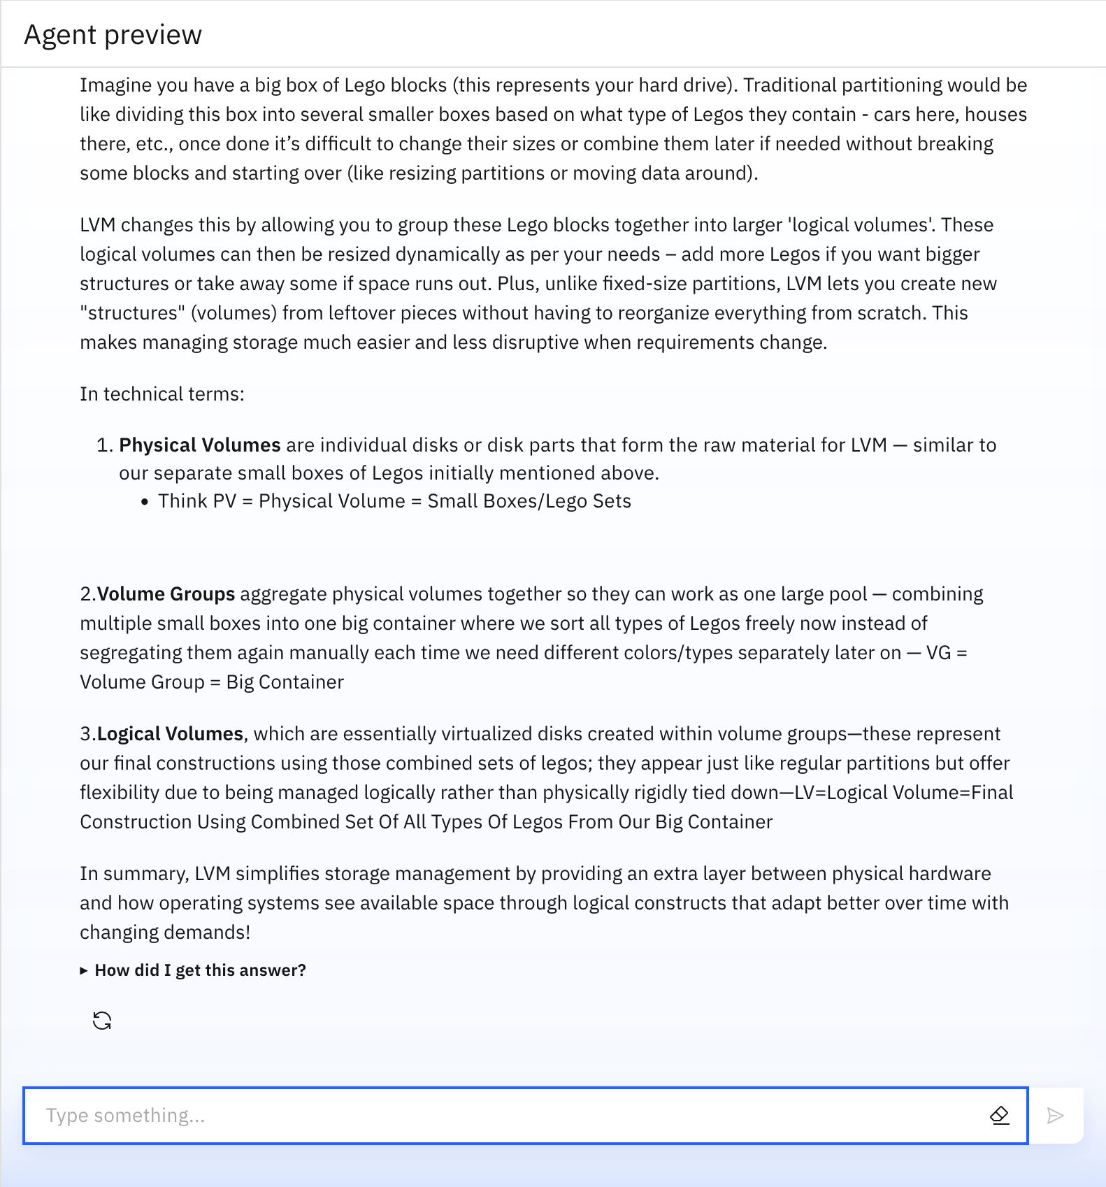
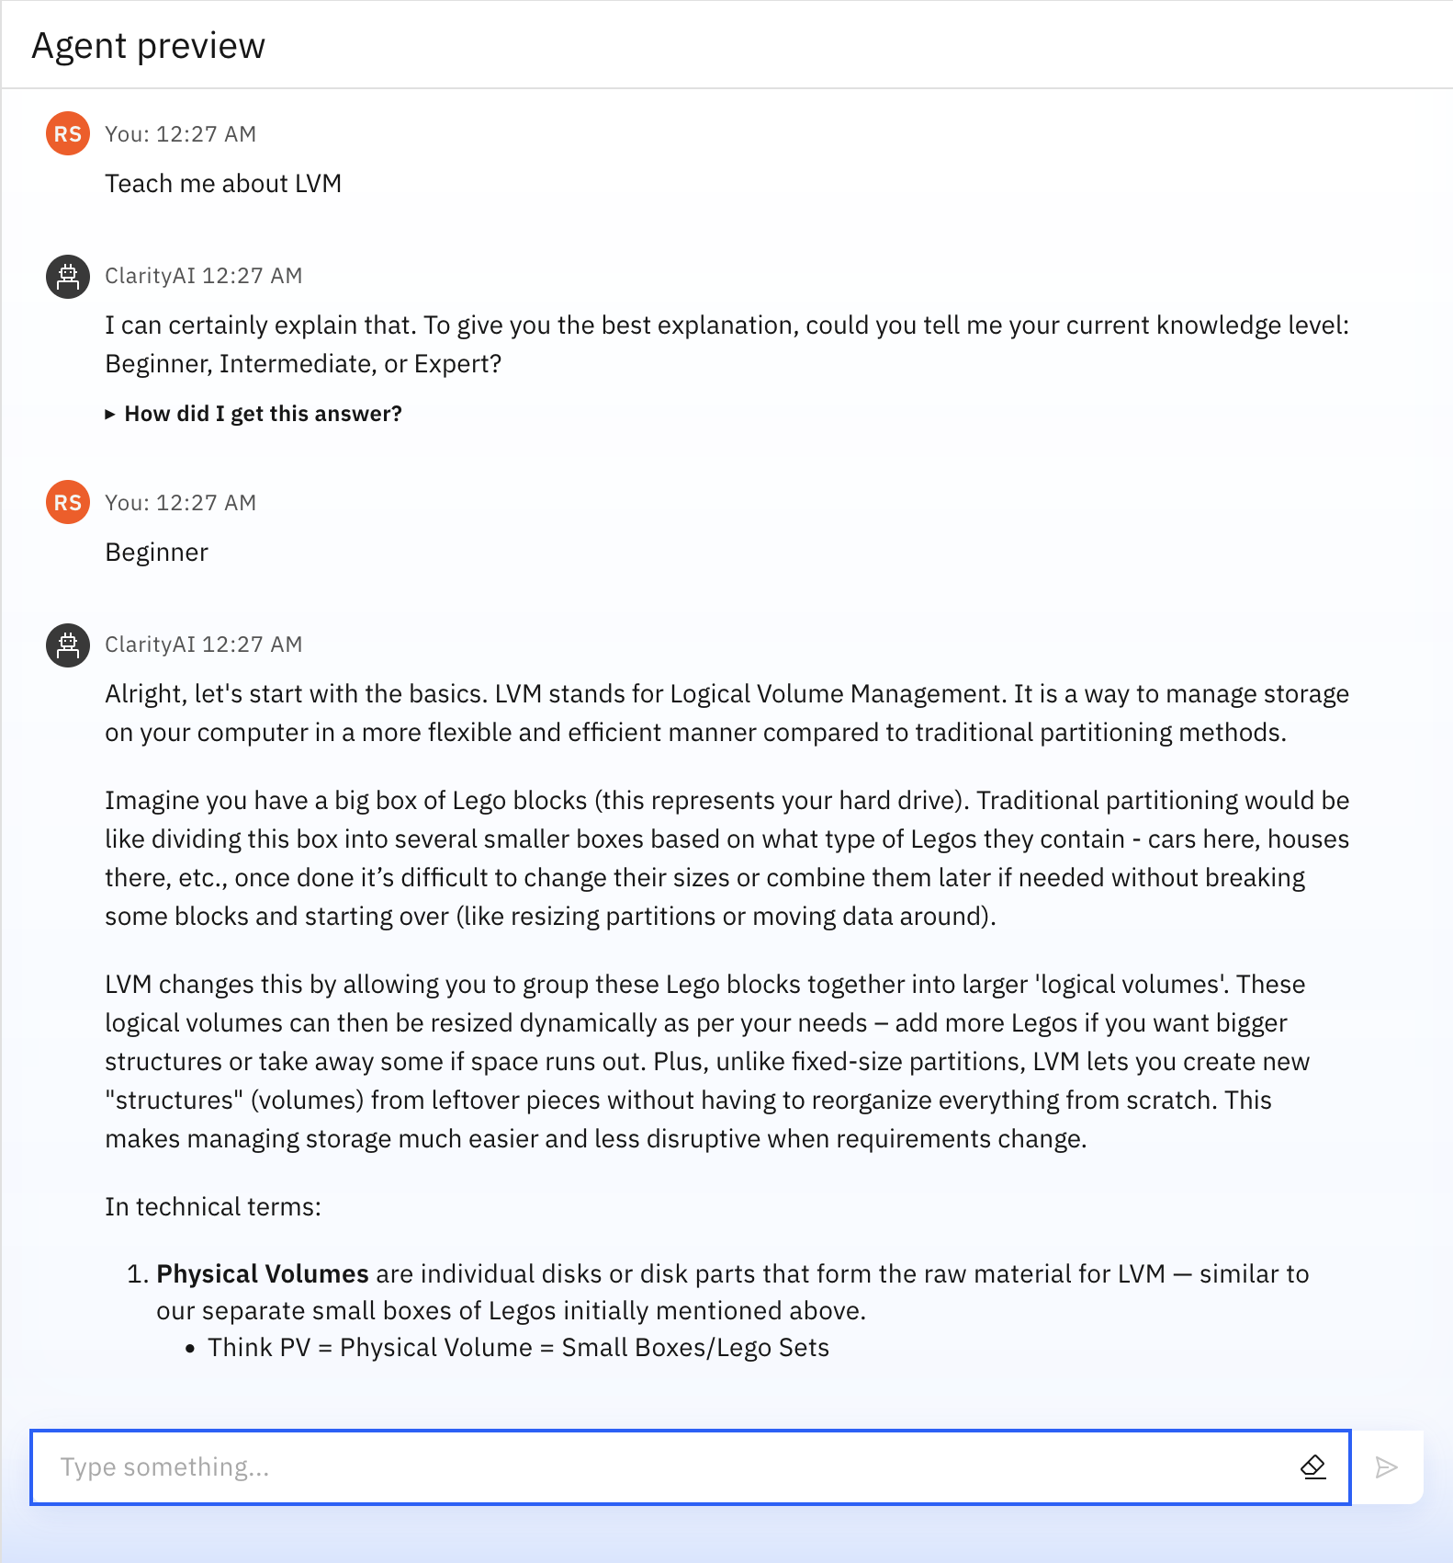
Results

Slide 10
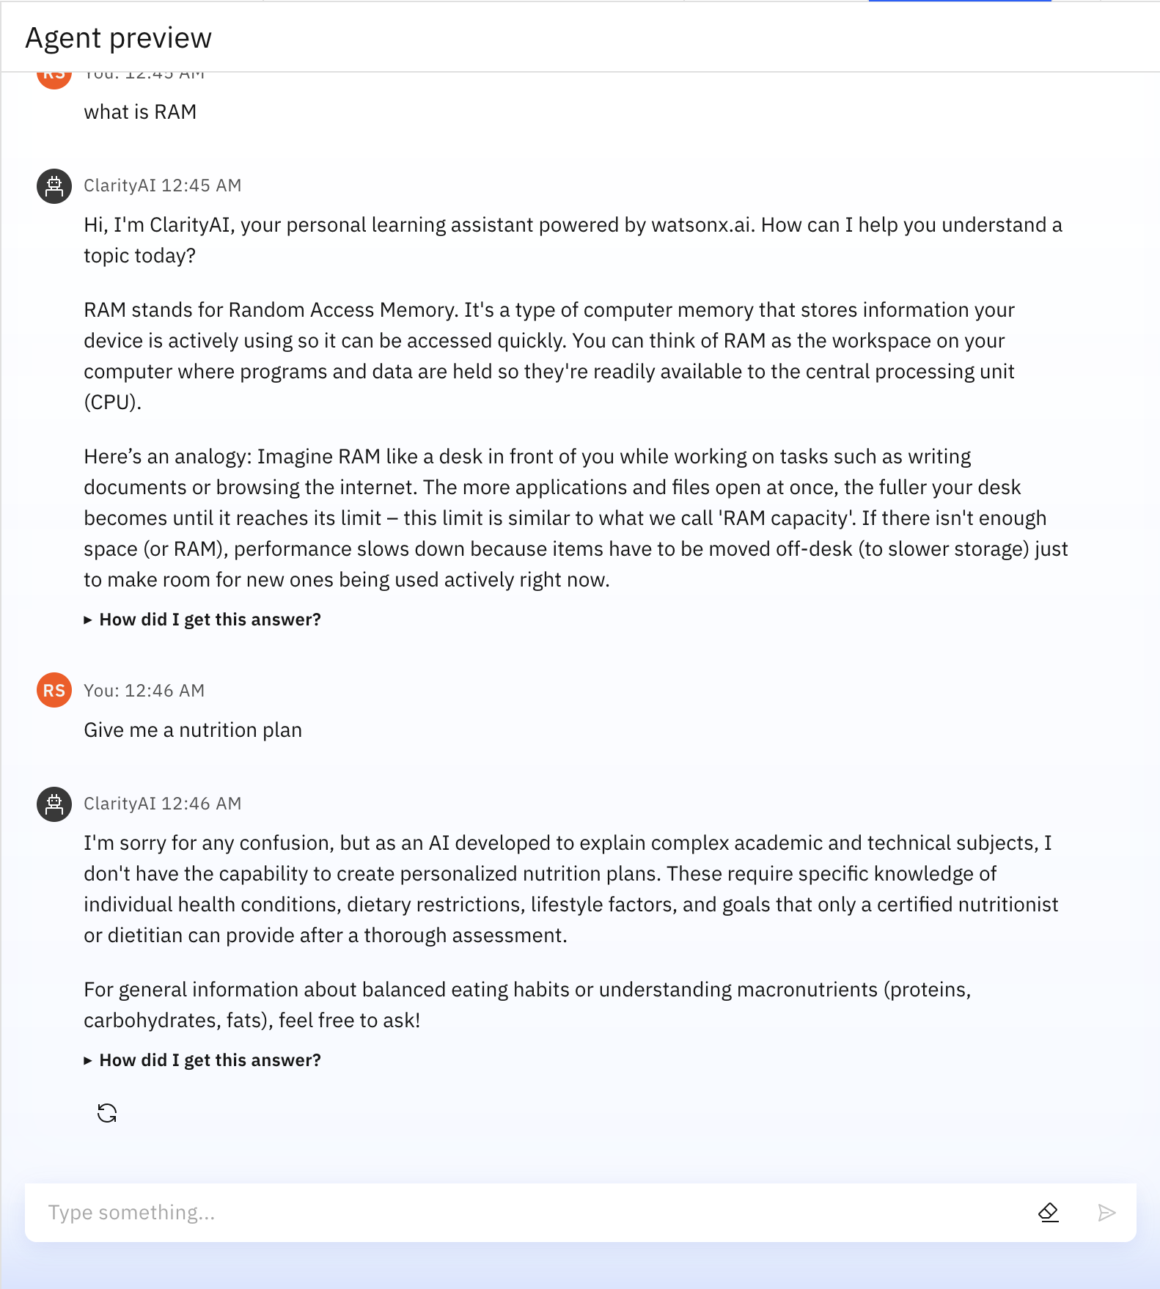
Results

Slide 11
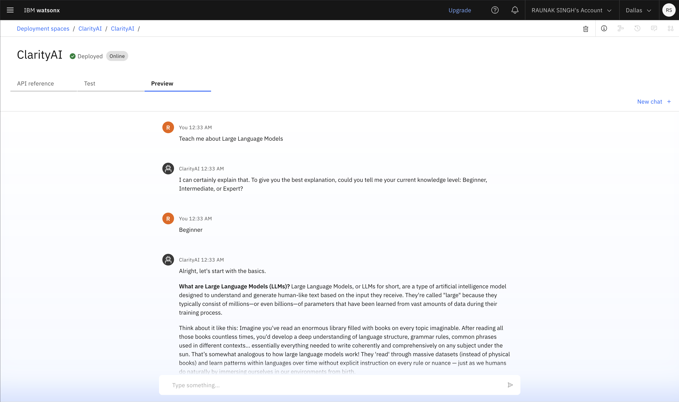
Results
Deployed AI Agent:

Slide 12
Conclusion
Personalizes Learning: Instantly adapts complex academic texts into Beginner, Intermediate, or Expert explanations, allowing students to learn at their own pace and comprehension level.
Makes Concepts Intuitive: Automatically generates simple analogies and defines technical jargon on demand, breaking down the biggest barriers to understanding difficult subjects.
Empowers Educators & Students: Provides a scalable tool that acts as a 24/7 personal tutor for students while enabling educators to easily create differentiated learning materials for a diverse classroom.

Slide 13
Future scope
Automated Curriculum Assistance
Multilingual Support
LMS Integration (Moodle, Canvas, etc.)
Automated Diagram & Visualization
Adaptive Learning Paths
Voice-Enabled Learning

Slide 14
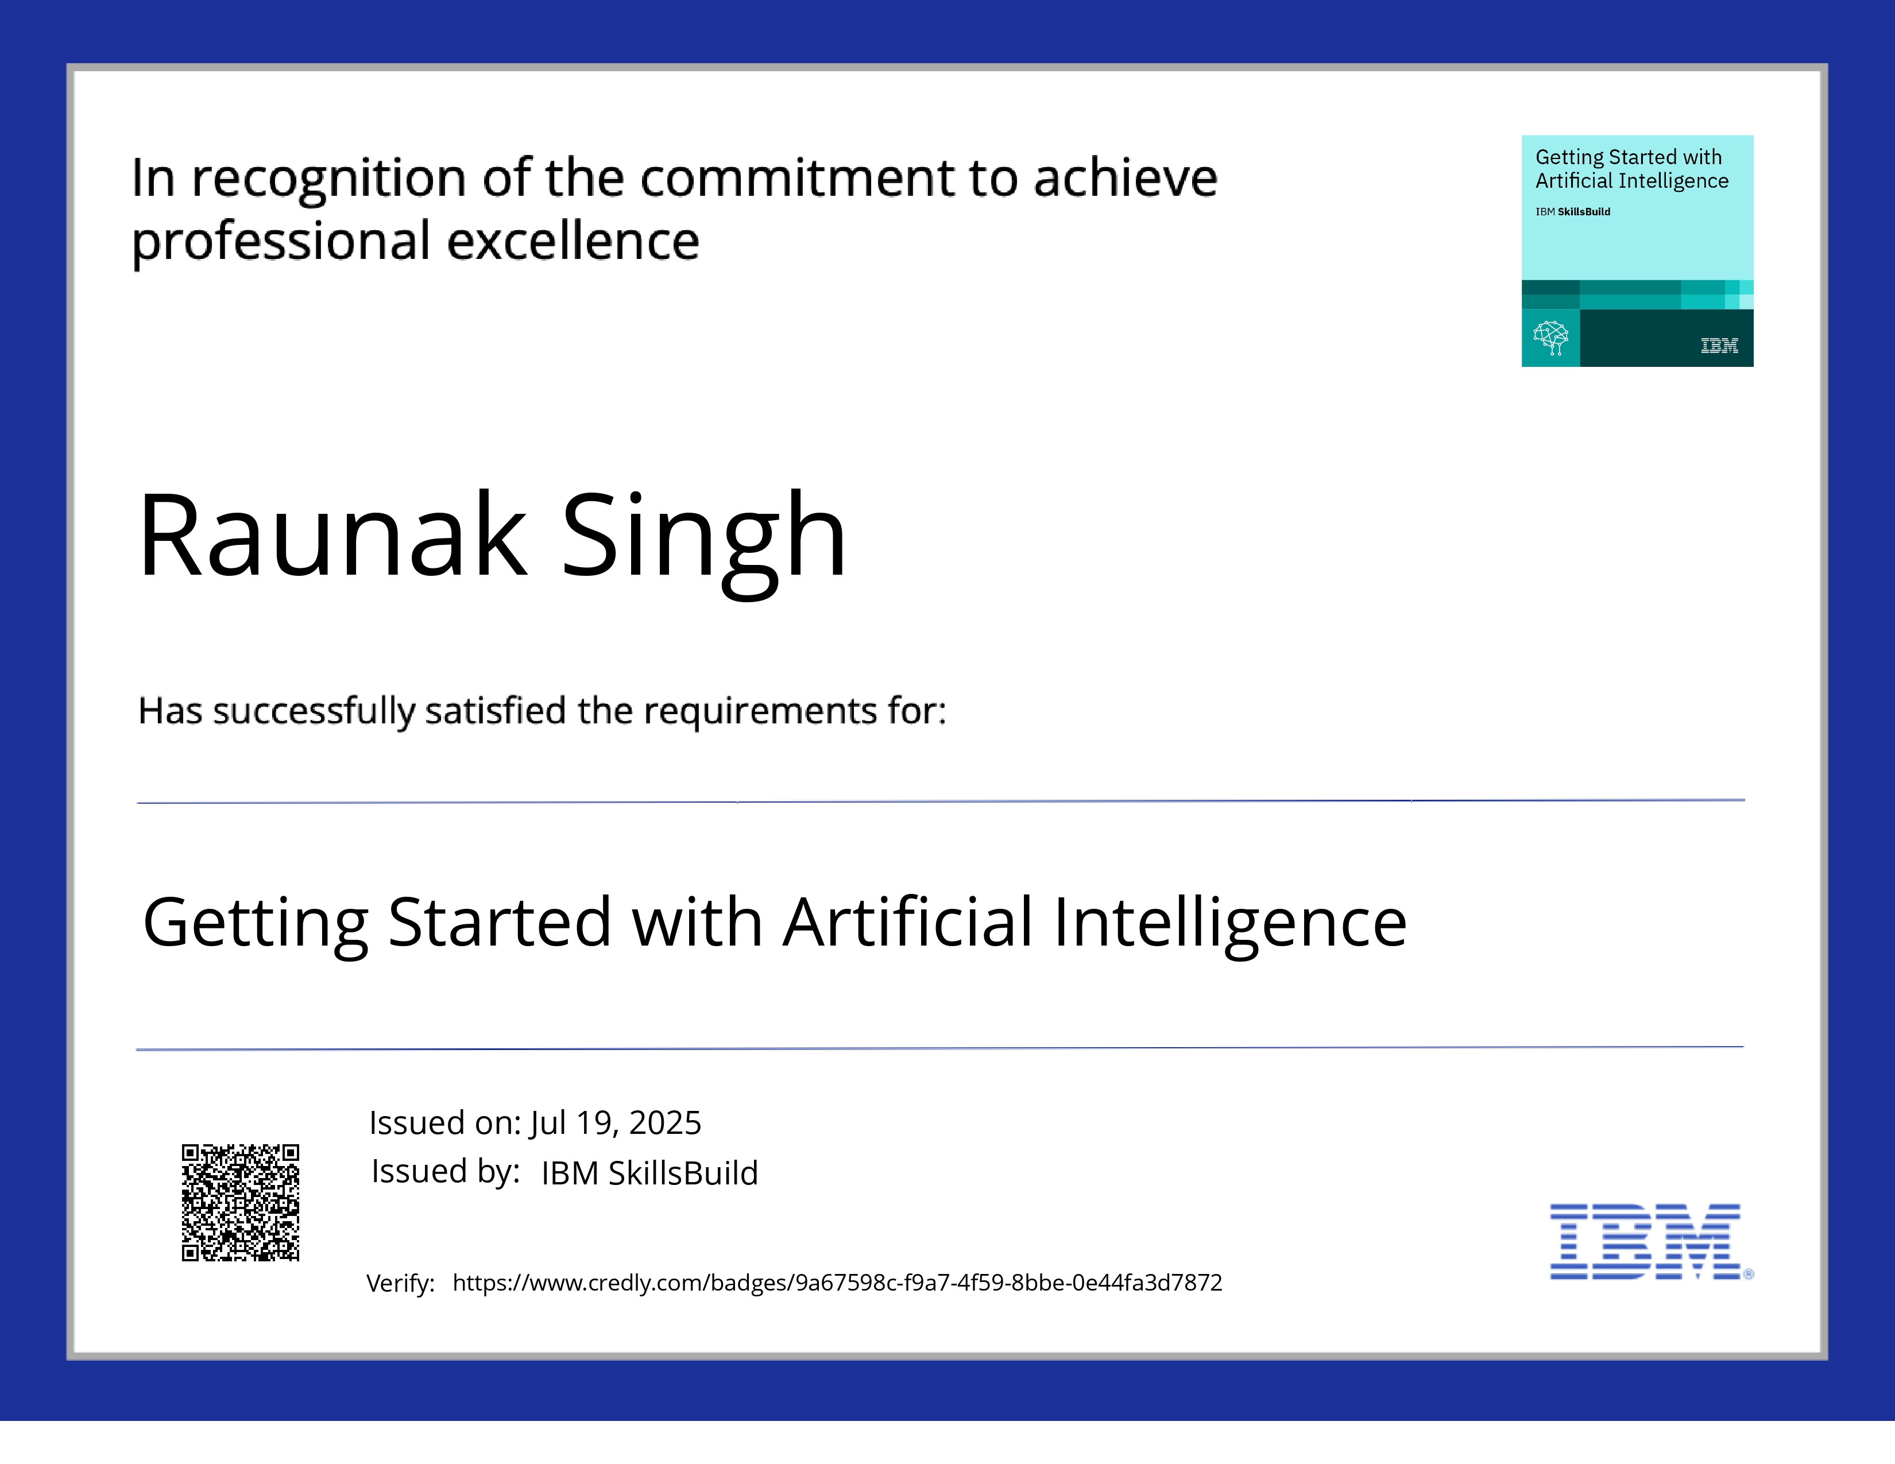
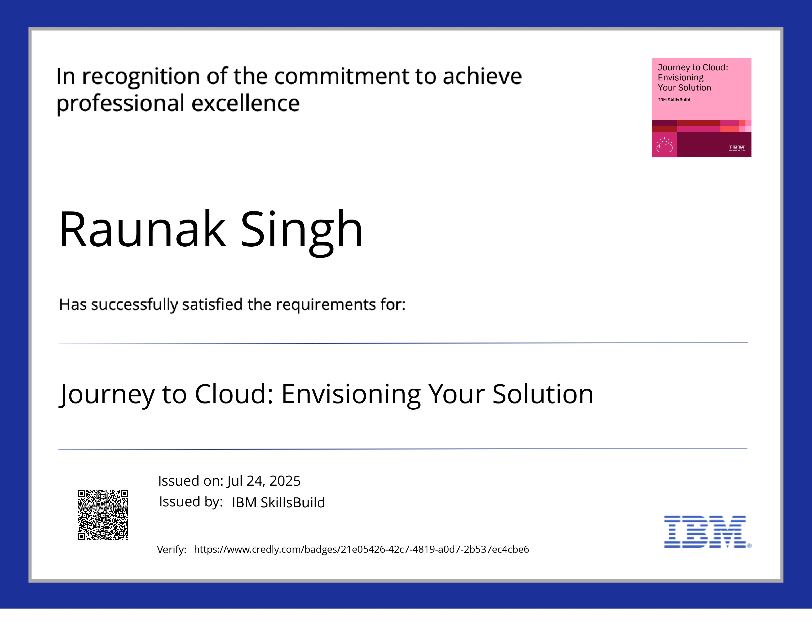
IBM Certifications

Slide 15
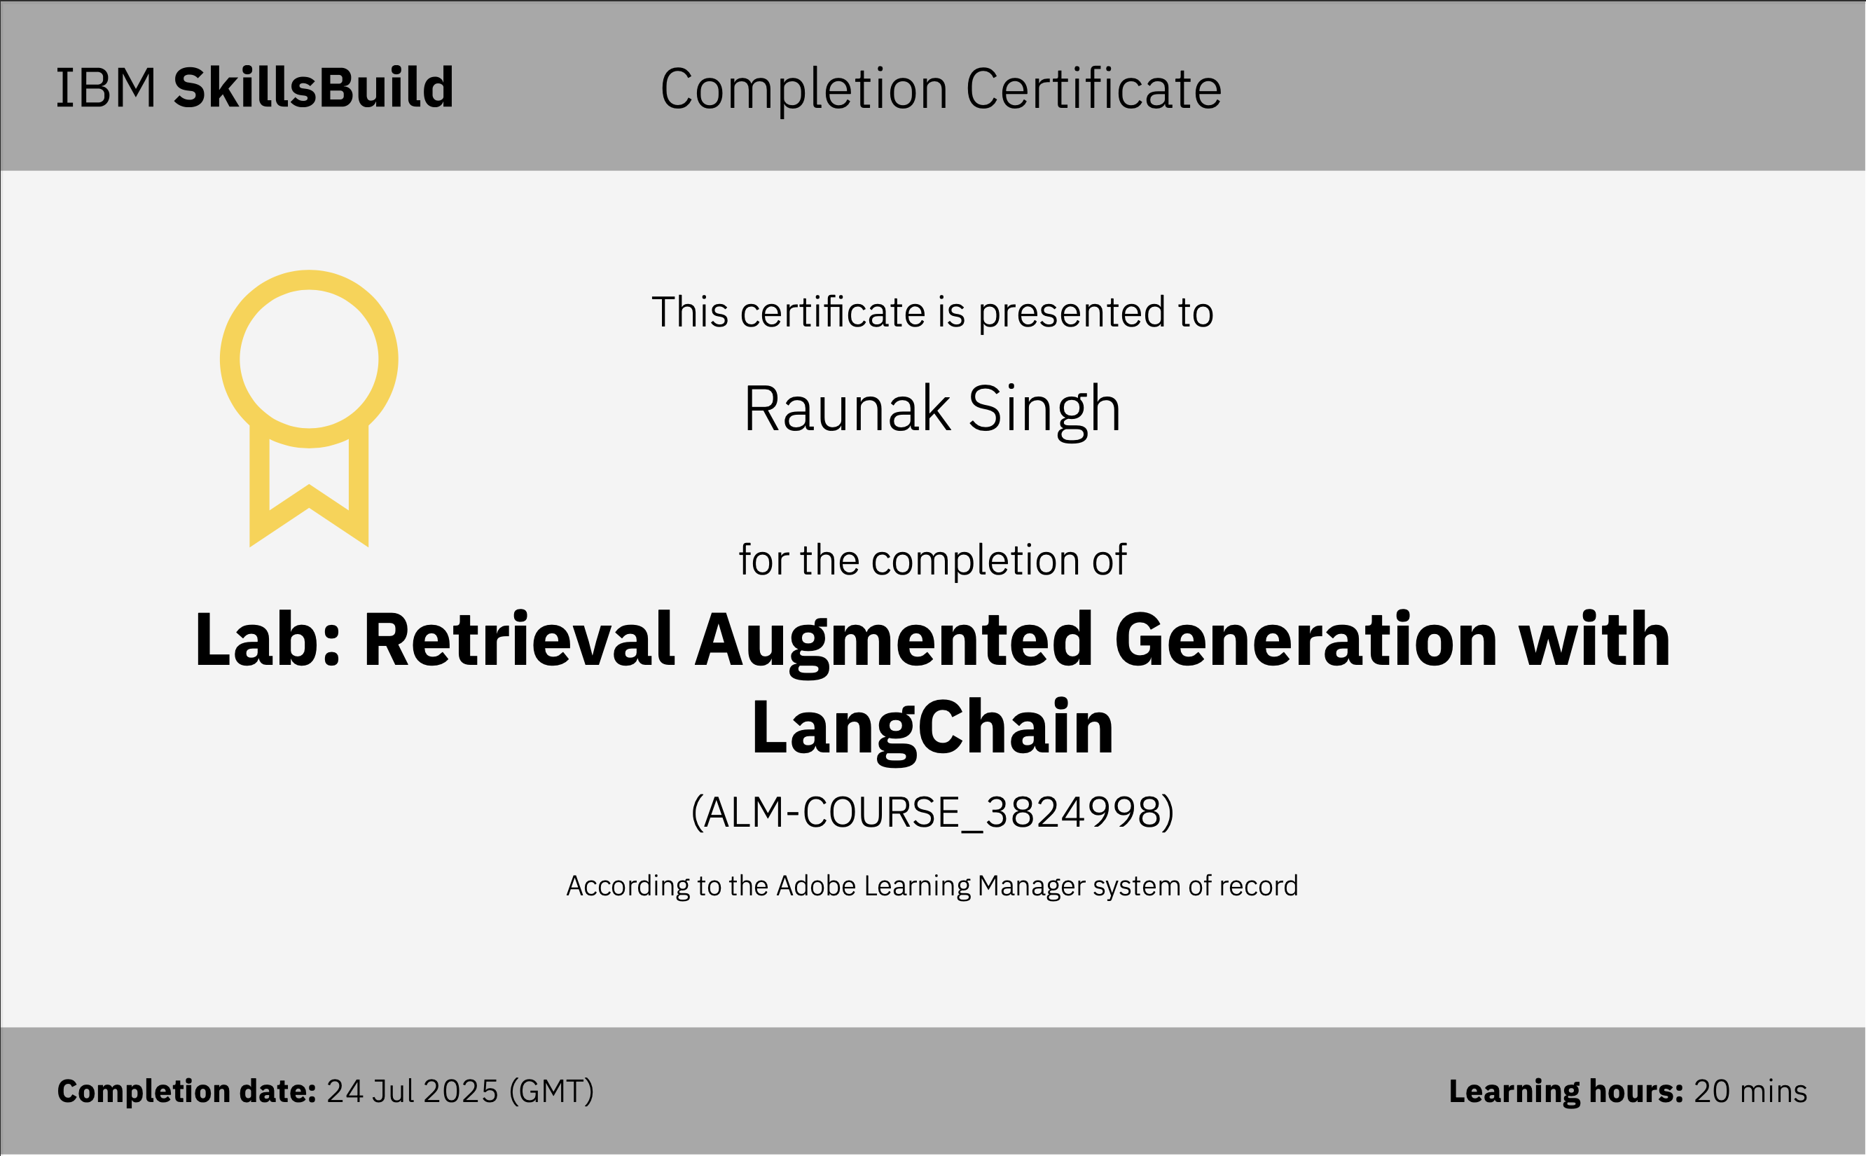

Slide 16
GITHUB LINK:
Click here for the GitHub repository
OR Go to:
https://github.com/raunaksingh-20/ClarityAI

Slide 17
THANK YOU

