Slide 1

Disentangling the components of the Milky Way with Gaussian Mixture Modelling
Raunaq Rai
rsr45@cam.ac.uk
Supervised by:
Dr. Anke Ardern-Arentsen
Institute of Astronomy, Cambridge
anke.arentsen@ast.ac.uk
Based on ‘On the existence of a very metal poor disk in the Milky Way’
-
Hanyuan Zhang, Anke Ardern-Arentsen, Vasily Belokurov

Slide 2
On the existence of a metal poor disk
The debate
Some studies argue that a metal poor disk exists at [Me/H] < -2
Others argue these belong to the prograde halo instead (exhibits net rotation is in the same direction as the disc but with a high velocity distribution)
Methodology (Brief)
Gaussian Mixture Models (GMM) are applied to separate distinct stellar populations in the velocity space.
The key focus is on testing for a rotation supported disk –like population at low metallicities and distinguishing it from a prograde halo component
Implications
The existence of a metal poor disk could indicate that a stable rotationally disk exists much earlier than current models suggest.
This could challenge the idea that the early milky way was dominated by chaotic mergers and a dispersion supported halo.

Slide 3
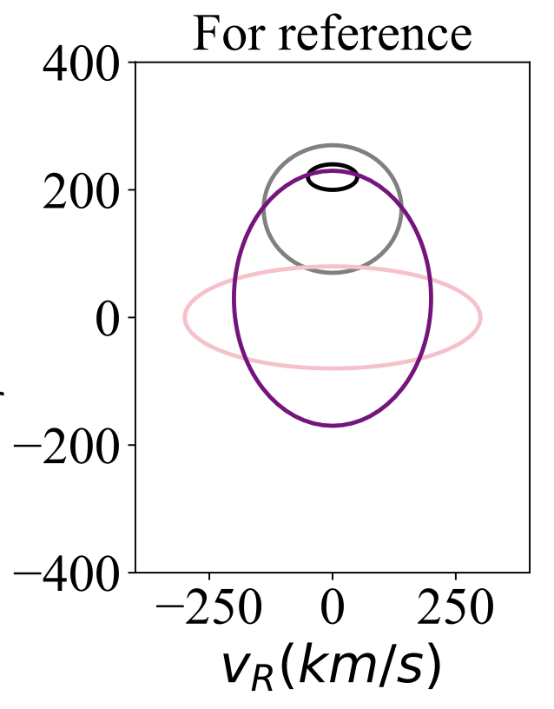

Components of the milky way
Thin Disk
The dominant components of the milky way containing most of the stars we see in the sky
Contain younger stars (greater metallicity)
Low velocity dispersion – move in circular orbits
Thick Disk
Kinematically hotter, older stellar population
Contain older stars (lower metallicity)
No significant gas content – little to no ongoing star formation
Gaia Sausage/Enceladus (GS/E)
Represents a dwarf galaxy that merged with the milky way in its early history
Highly radial orbit
Spherical Halo
Vast Diffuse component of the milky way
Contains some of the oldest most metal poor stars –
Stars move in random – highly elliptical orbits
V$φ$ (km/s)

Slide 4
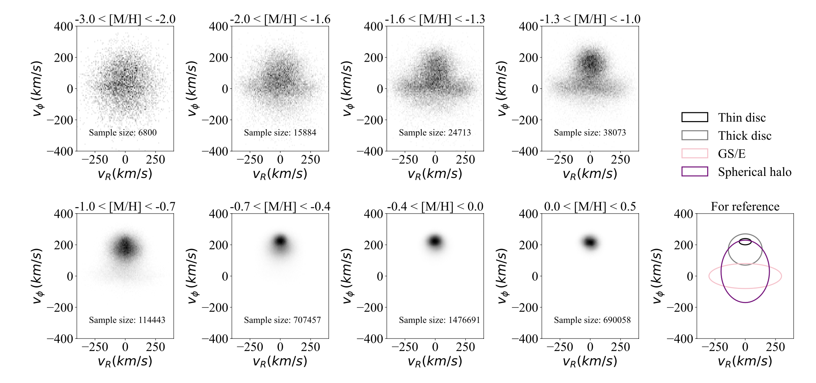

Slide 5
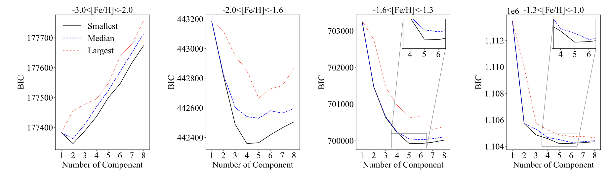
Extreme deconvolution Gaussian Mixture model
XDGMM was fit for a number of gaussian components, the minimum Bayesian Information Criteria score for the number of components was chosen
Initialize the number of gaussians by choosing the number returning the minimum Bayesian Information Criteria score.
Compute the likelihood and update the means, covariances and weights to maximize the log likelihood
Sounds like normal GMM right? But.....
Extreme Deconvolution can estimate the underlying true distribution: handles heteroscedastic noise, Multidimensional data, incomplete/missing data
A normal GMM would incorrectly attribute noise to real astrophysical structures
XG essentially corrects for this by ‘deblurring’ the velocity distribution ensuring that observables are real and are not just a product of observational errors.
Notes:
minimum BIC score indicates the best trade-off between model fit and complexity.
The BIC score decreases when the model fits better (higher likelihood), but increases when too many parameters are used.

Slide 6
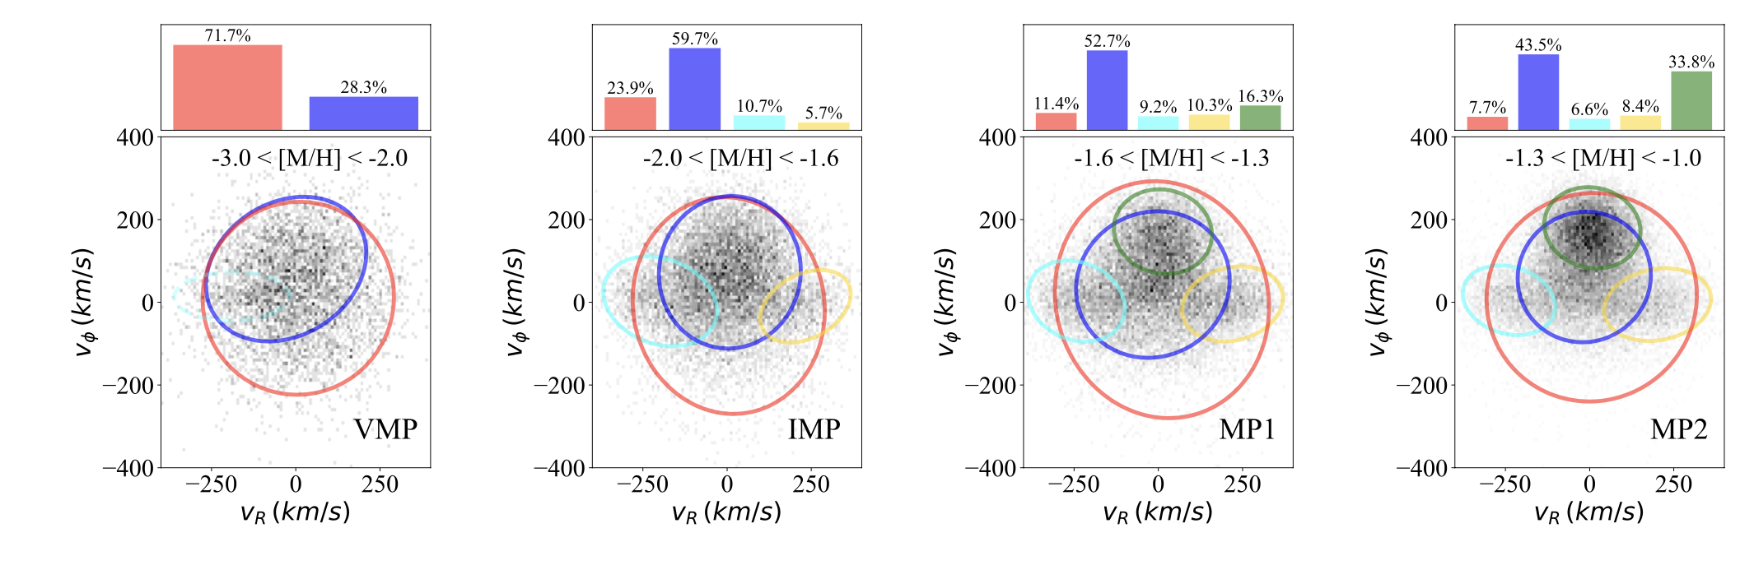
Results
Red : Stationary Halo
Blue : Prograde Halo
Aqua / Gold : GS/E
Green : Rotation Supported Disk
Gaussian Mixture model – extreme deconvolution
Aqua dashed : GMM component not identified in the 2 component GMM space, but in the 3-component space
Note: all analysis done in the 3D space, but visualized in 2D space

Slide 7
Conclusions and discussion
No significant evidence for a very metal poor disk
The prograde halo seems to explain the the excess of VMP stars
If a rotationally supported metal-poor disk clear we would see
A tight (low velocity dispersion), high azimuthal velocity component
Low velocity dispersion
Significantly separate from the halo component
Rotational supported disk evident from a metallicity of -1.6, but clearly evident by a metallicity of -1.3
Implications
Most VMP stars were not born in the disk but originate from pre-disk phase of the milky way or from galaxy mergers
This study shows that a prograde halo explains the velocity components of these very metal poor stars without the need for a disk

Slide 8
Limitations -> opportunities
GMM is an oversimplification of the actual distribution function of the velocity components
For example: The thin-disk velocity distribution is strongly non-gaussian because of asymptotic drift – accordingly we focus on metal-poor stars that are not included in the thin disk
A mixture model with dynamical distribution functions that describe the kinematics of the disk/halo more accurately
These dynamical models describe the motion of stars based on their gravitational potential
Jeans Equation which relates velocity dispersions, rotational velocity and the galactic mass distribution – used for the thick disk
Quasi Isothermal Distribution function for the thick disk
Schwarzschild orbit-based models for the halo

Slide 9
References
Zhang, H., Ardern-Arentsen, A. and Belokurov, V. (2023). On the existence of a very metal-poor disc in the Milky Way. Available at: https://arxiv.org/abs/2311.09294
Bovy, J., Hogg, D.W. and Roweis, S.T. (2011). Extreme deconvolution: Inferring complete distribution functions from noisy, heterogeneous and incomplete observations. The Annals of Applied Statistics, 5(2B). doi: https://doi.org/10.1214/10-aoas439
Deason, A.J. and Vasily Belokurov (2024). Galactic Archaeology with Gaia. New Astronomy Reviews, pp.101706–101706. doi: https://doi.org/10.1016/j.newar.2024.101706
‌
‌
‌

