Slide 1

Spectrum Sensing In Cognitive Radio Networks
Bollam Pravalika 2020BCS-021
Raunaq Singh Jabbal 2020BCS-063
Saahil Sabu Hameed 2020BCS-079

Slide 2
Contents
1
2
3
4
5
Introduction
Workflow
ANN
Building Model and testing
Vivado simulation and estimation

Slide 3
Introduction
There has been an increase in wirelessly communicating devices because of the development of wireless technologies and protocols. This development has led to an increase in demand for radio spectrum. Cognitive Radio is a concept that allows Secondary Users to use licensed spectrum belonging to Primary Users to overcome this demand increase. Spectrum Sensing is the part of Cognitive Radio where the Secondary Users listen to the spectrum and use the sensing data to determine if the Primary User is transmitting. Spectrum Sensing is of two types, non-cooperative and co-operative. Non-cooperative Spectrum Sensing is where an SU independently decides if the PU is active. Cooperative Spectrum Sensing is where multiple SUs use an algorithm to decide if the PU is active.

Slide 4
Introduction
For Machine Learning approach, we do not use Non-cooperative Spectrum Sensing approach of choosing a threshold, like we do in Classical Algorithms. Instead, we pass the energy values of all SUs to the algorithms as dataset, and the algorithm works on those values to conclude if the PU is transmitting. Spectrum Sensing is a Classification problem because we need to conclude if the PU is actively transmitting or not, so the algorithm will only give out values between 0 and 1, representing “PU is not transmitting” and “PU is transmitting” respectively.

Slide 5





Project Workflow
Data preprocessing
Involves sampling data
Creating ANN model
ANN model can be created by simply calling Sequential () API with three layers
Training model
Sampled data is propagated until the model stops improving
Saving and loading weights
So tuned weights are saved in a file and later used for testing
Testing the model
Created model is tested and

Slide 6
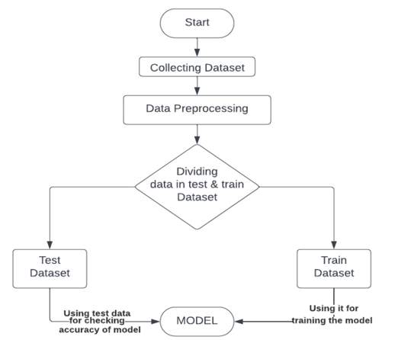
Workflow

Slide 7
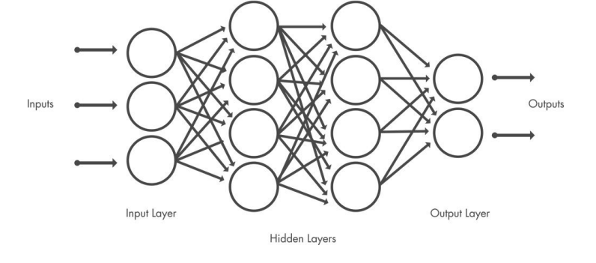
ANN
Artificial Neural Network (ANN) is a method in artificial intelligence that teaches computers to process data in a way that is inspired by the human brain.
It is a type of machine learning process, called deep learning, that uses interconnected nodes or neurons in a layered structure.

Slide 8
Multi layer Perceptron
Multilayer Perceptron is a feed-forward neural network because the data flows in the forward direction and consists of only three layers, input layer, hidden layer, and output layer.
The input layer receives the data, and the output layer gives the decision. The neurons in the layers learn and train with backpropagation.
Backpropagation aims to minimize the cost function and increase accuracy by adjusting the weights and biases which is dependent on the gradients of the cost function with respect to those parameters.

Slide 9

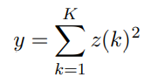
Data Generation
We consider the PU to be actively transmitting 50% of the time on average (P(H1) = 0.5)). We consider a Cognitive Radio Network with 1 PU and 7 SUs, distributed evenly at a distance of 500m to 1000m. Each SU senses for time period τ which we can vary and sensing bandwidth w = 5MHz. Each SU senses K = 2τw samples.
Training Dataset is set to 250 samples, testing dataset is set at 50000 samples. Signal Channel coefficient can be from Rayleigh Fading, Rician Fading, Nakagami Fading with the desired variance, or be absent, and is multiplied by path loss component.
where g is the fading component, d is the distance between SU and PU, a is the path loss component
After collecting K samples, the estimated normalised energy of an SU is:

Slide 10
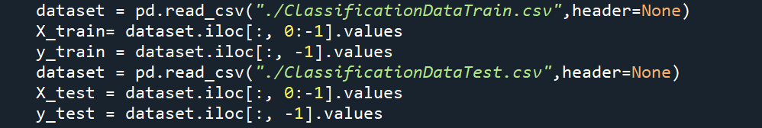
Data Sampling
Dataset Used :
Data is generated as per mentioned hypothesis.
Cloud-based opportunities
Iterative approaches to corporate strategy
Establish a management framework from the inside

Slide 11
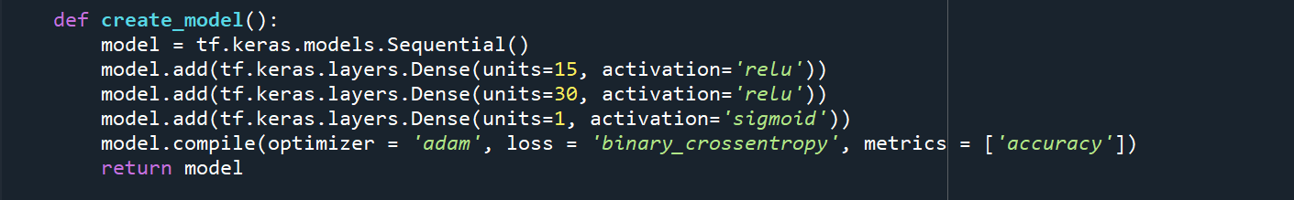
Creating Model
ab
Dense layer is a layer that is deeply connected with its preceding layer which means the neurons of the layer are connected to every neuron of its preceding layer.
Cloud-based opportunities
Iterative approaches to corporate strategy
Establish a management framework from the inside

Slide 12
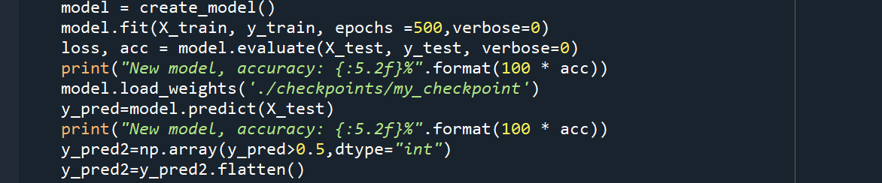
Training Model
ab
Weights are saved file in using model.save_weights (path). The tuned weights are used later to predict accuracy and output for test dataset.
Cloud-based opportunities
Iterative approaches to corporate strategy
Establish a management framework from the inside

Slide 13
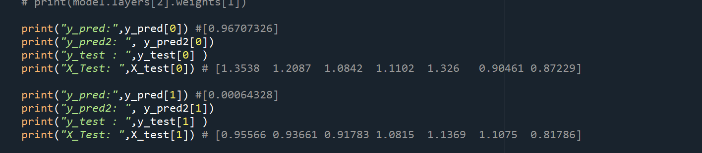
Testing Model
ab

Slide 14
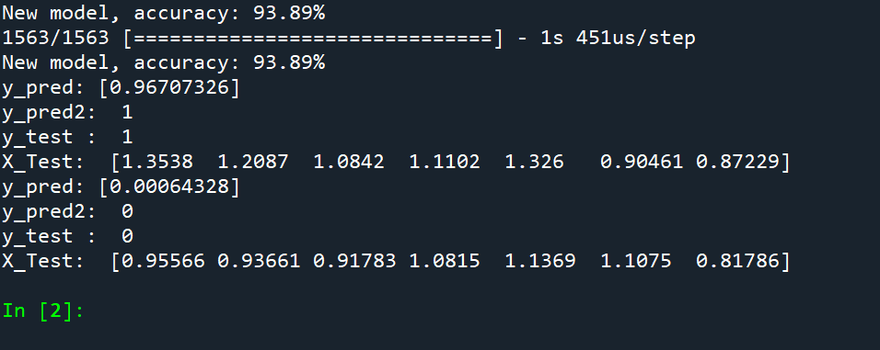
Results
CONCLUSION
​
Our model worked fair enough for a multilayer perceptron with 3 layers and 500 epochs giving 93.89 % accuracy

Slide 15
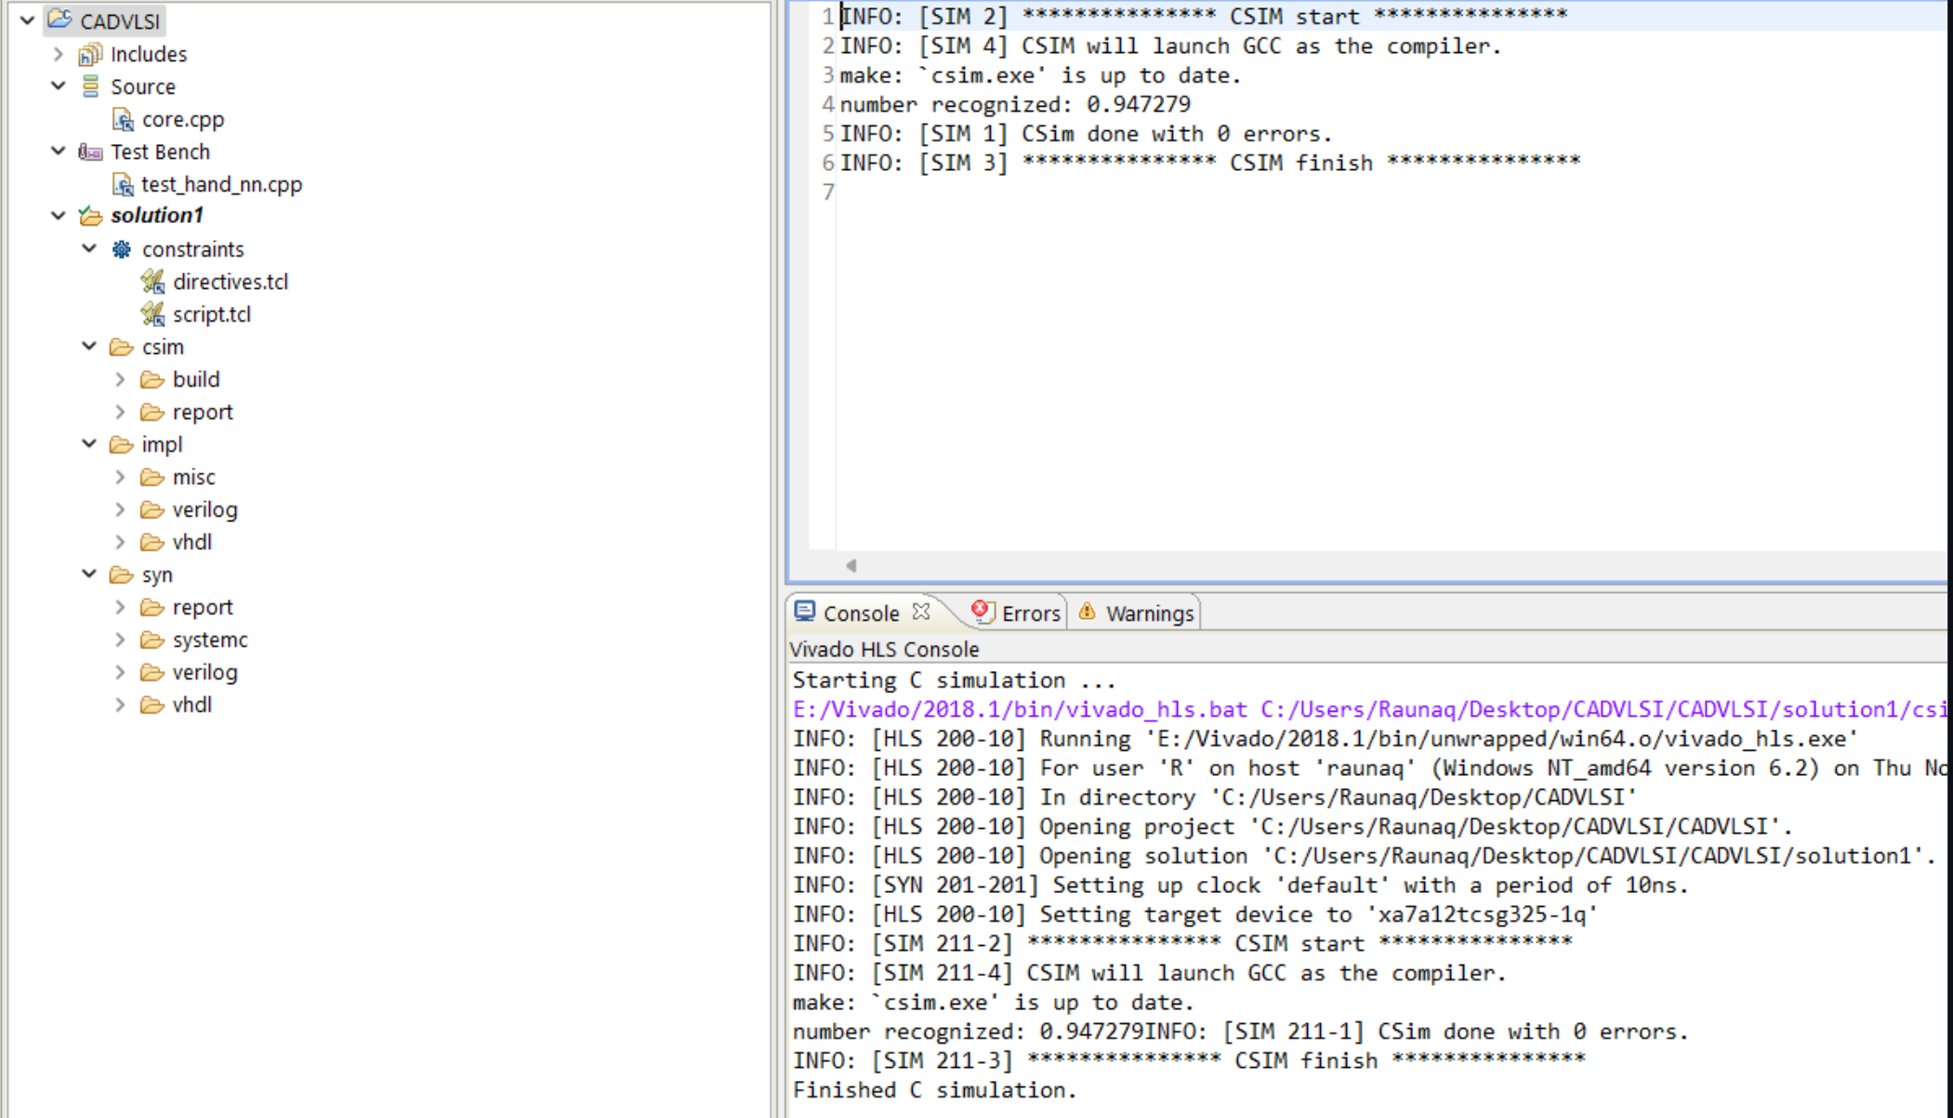
VIVADO
SIMULATION
​

Slide 16
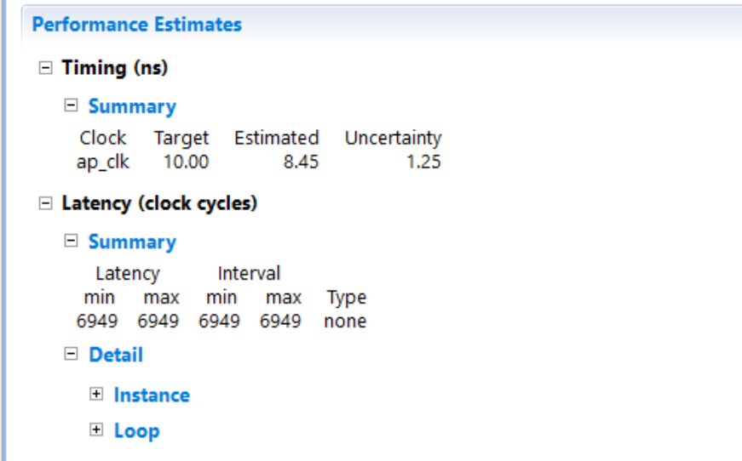
VIVADO Report
Performance
Estimation
​

Slide 17
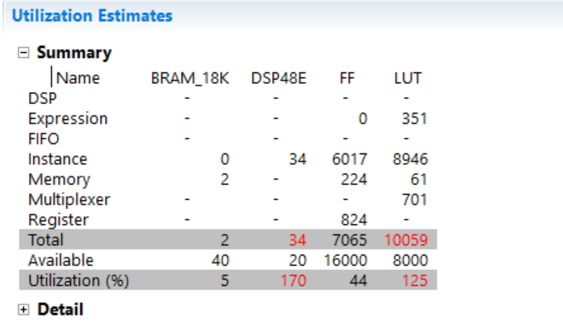
VIVADO Report
Utilization
Estimation
​

Slide 18


Thank you
2020BCS-021 Bollam Pravalika
2020BCS-063 Raunaq Singh Jabbal
2020BCS-079 Saahil Sabu Hameeed

