Slide 1

Generative Teaching Networks for Neural Architecture Search

Slide 2
Need for Neural Architecture Search
Neural Architecture Search is a subfield of automated machine learning (AutoML), is an overarching term that relates to the process of automating the different tasks involved in applying machine learning
The implementation of efficient neural networks generally requires a background in architectural engineering and lots of time to explore in an iterative process the full range of solutions to our knowledge.
The form and architecture of a neural network will vary in its use for a specific need. It is therefore necessary to design an architecture-specific to the given need.
The search for suitable architectures is a time-consuming and error-prone task and requires architecture design skills.

Slide 3
The challenge
NAS requires substantial computing resources. A naive NAS algorithm would evaluate each neural network by training it on a full data set until performance stops improving. Repeating that process for each of the thousands or more architectures considered during NAS is prohibitively expensive and slow.
NAS algorithms avoid this cost by only training for a small amount of time and taking the resulting performance as an estimate of true performance.
One possible way to speed the process up further would be to carefully select the most informative training examples from the full data set, a method that has been shown to speed up training.

Slide 4
How Generative Teaching Networks help
GTN’s create the training data itself. Hence GTN’s are not restricted to only creating realistic images, but instead it could create unrealistic data that is helpful for learning.
Thus, GTNs being free to create unrealistic data could enable faster learning than with real data. For example, GTNs could combine information about many different types of an object together, or focus training mostly on the hardest examples.

Slide 5
The method
A GTN is like the generator in a GAN, except without a pressure to make data look realistic. In GTN, the generator and the learner work in a cooperative manner, and not in an adversarial manner.
A GTN produces synthetic data that a never-seen-before learner neural network trains on for a small number of learning steps
Afterwards, the learner network is evaluated on real data which provides the meta-loss objective that is being optimized. We then differentiate through the entire learning process via meta-gradients to update the GTN parameters to improve performance on the target task.

Slide 6
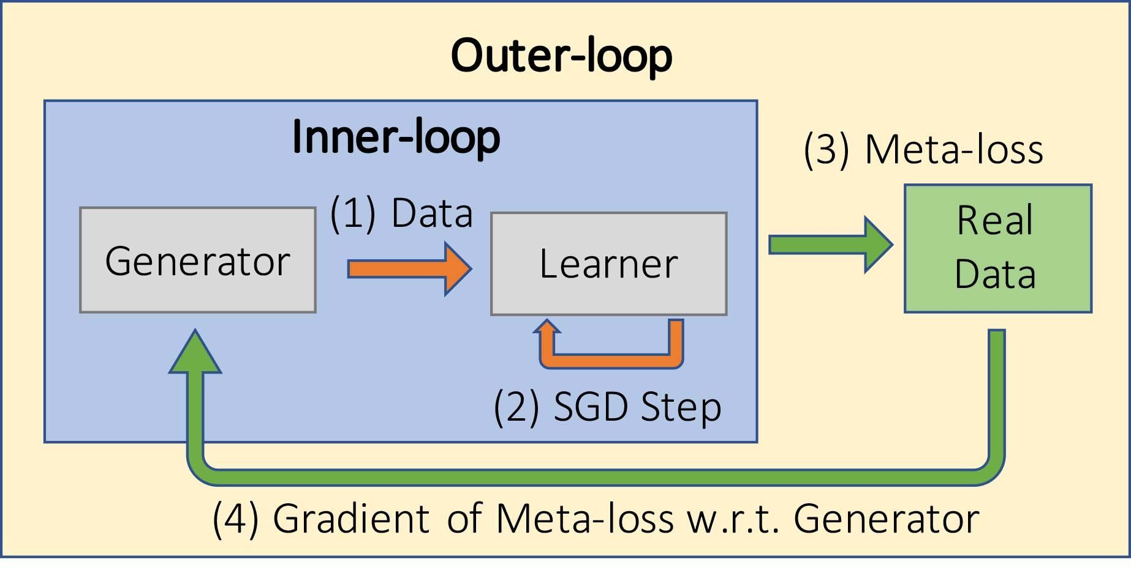
GTN Training Loop

Slide 7
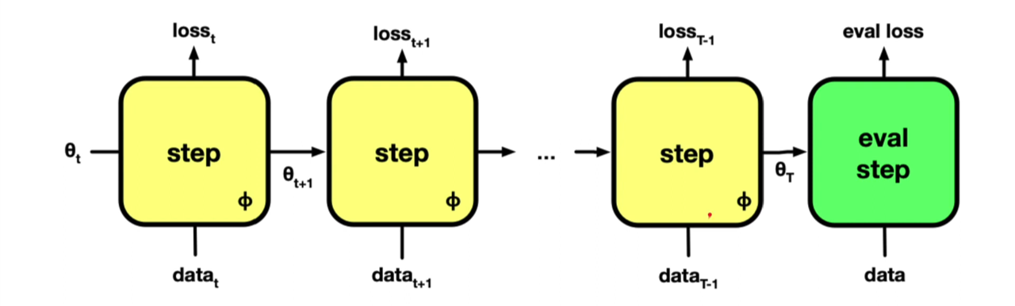
Computational Graph

Slide 8
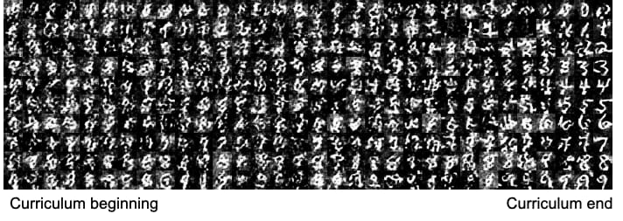
Generator Outputs

Slide 9
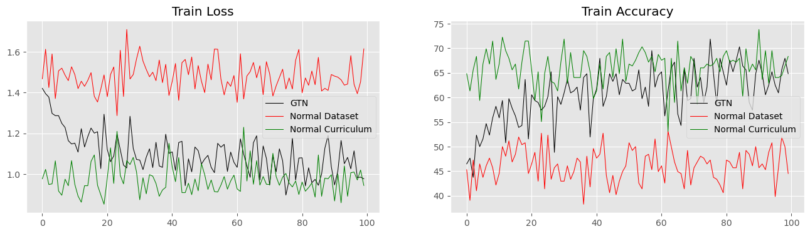
Results

Slide 10
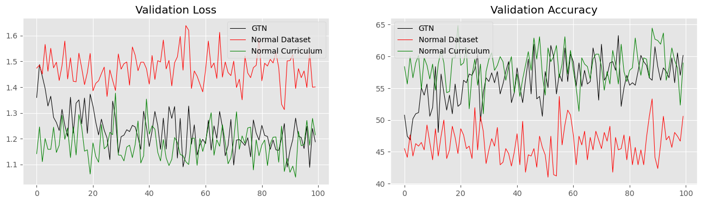

Slide 11
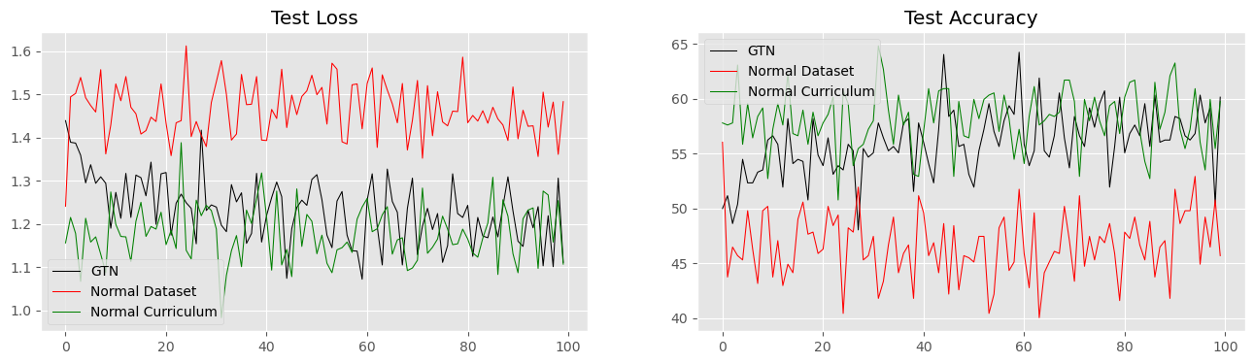

Slide 12
Virtusagtn Library
GPU Support
Uses gradient rerolling
Mypy and flake8 linted
TorchMetrics metrics support
Flexible training loop
Custom GTN’s

Slide 13
Advantages:
Can theoretically be used on any supervised learning technique.
Faster than research paper implementation that used gradient checkpointing.
More flexibility when it comes to choosing architectures compared to Keras Tuner.
Data generated by the generator can be used later for accelerated learning for similar architectures.
Works with very less training data.

Slide 14
Disadvantages:
Possible instability issues and bugs.
Performance will tend to increase regardless of the architecture as more learners are trained.
Might not give a substantial performance improvement when number of learners are very low.
Truly generative version of GTN takes a long time to provide good results.
Might not fit in larger models even with gradient rerolling.

Slide 15
Resources
https://github.com/raunaqjabbal/GTNCode
https://higher.readthedocs.io/en/latest/
https://arxiv.org/pdf/1912.07768.pdf

