Slide 1

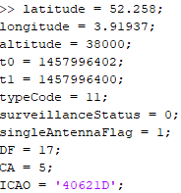
ADS-B Data to be Encoded MATLAB function to make an ADS-B Airborne Position message
Type Code = 9 to 18 (Barometric Altitude) or 20 to 22 (GNSS Altitude).
ME field structure:
Position information is encoded in Compact Position Reporting (CPR) Format.
Input Collection –
Latitude, Longitude, Barometric Altitude (in ft)
GNSS timestamps (t0, t1)
Type Code, Surveillance Status, Single Antenna Flag
Downlink Format (DF), Capability (CA), ICAO address
Generated Messages:
msg0: 8D40621D58C382D690C8AC2863A7
msg1: 8D40621D58C386435CC412692AD6
mostRecent: msg0 is the most recent message'
FIELD |  | MSG | ME | BITS
Type Code | TC | 33-37 | 1-5 | 5
Surveillance status | SS | 38–39 | 6–7 | 2
Single antenna flag | SAF | 40 | 8 | 1
Encoded altitude | ALT | 41-52 | 9-20 | 12
Time | T | 53 | 21 | 1
CPR Format | F | 54 | 22 | 1
Encoded latitude | LAT-CPR | 55-71 | 23-39 | 17
Encoded longitude | LON-CPR | 72-88 | 40-56 | 17

Slide 2
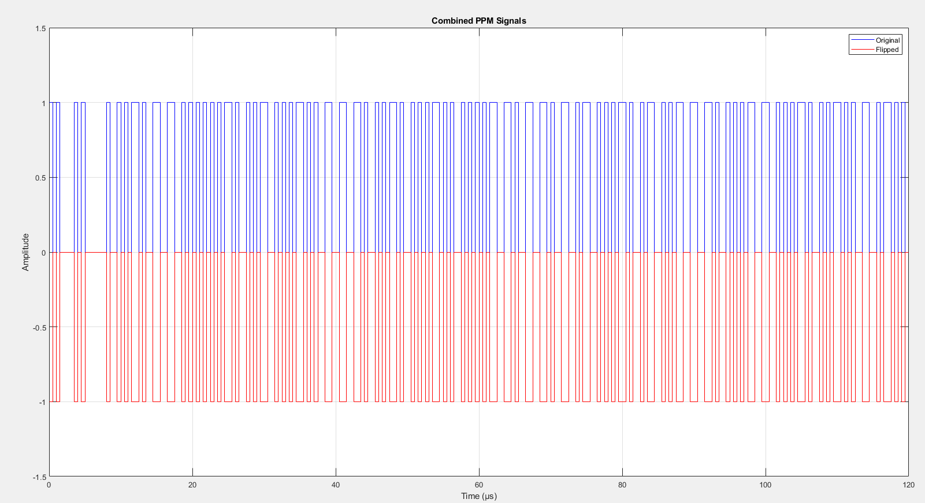
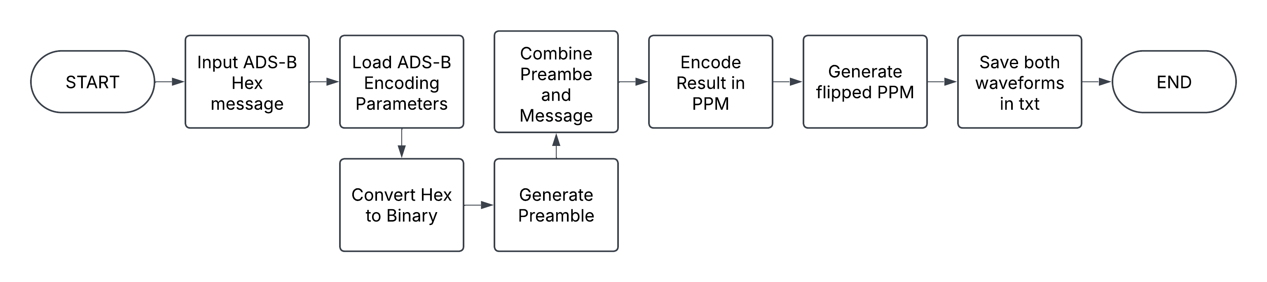
ADS-B PPM Encoding MATLAB function to encode Hex ADS-B message in PPM format
Key Features
Generates the PPM Encoded ADS-B signal and it’s flipped counterpart for the I+ and I- component
Appends 8μs of preamble to the generated ADS-B message
Saves time-amplitude pairs in a txt file to interface with function generator.

Slide 3
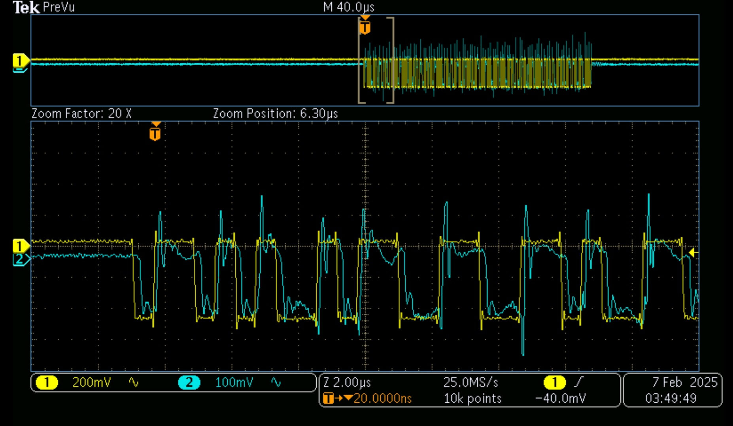
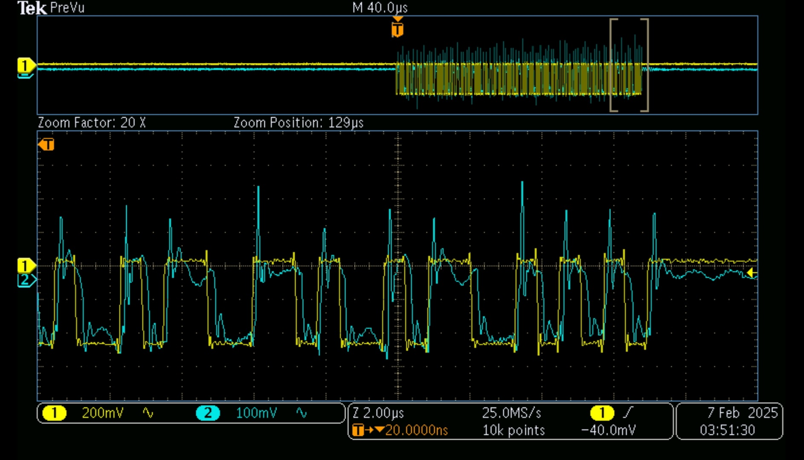
ADS-B PPM Transmit and Receive Results from Oscilloscope
Key Features
Waveform Generator: Loading txt file into waveform generator and supplying it to Tx.
Oscilloscope: Received Signal captured on Oscilloscope
Yellow Wave: Transmitted Wave (inverted because Oscilloscope is set to display the I- component)
Blue Wave: Received Wave (inverted because Oscilloscope is set to display the I- component)
Fig.: Transmission/Reception start
Fig.: Transmission/Reception ending

Slide 4
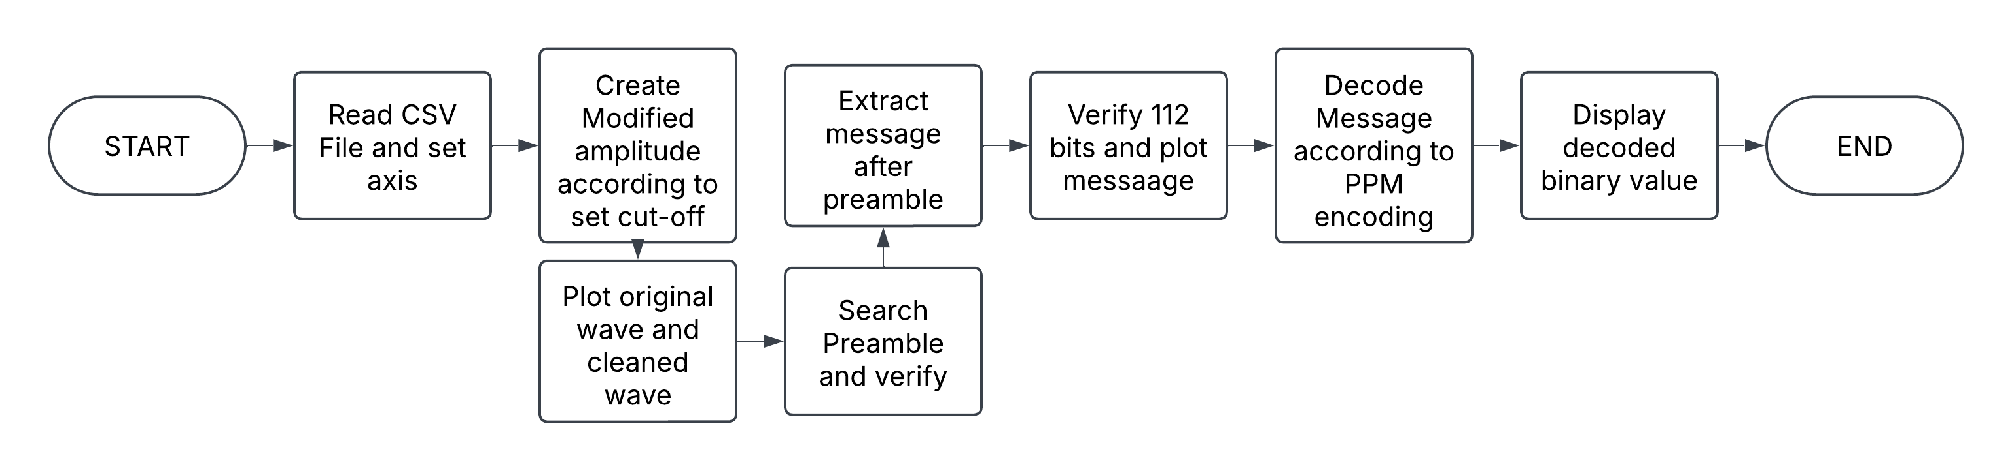
ADS-B Data to be Decoded MATLAB function to decode received ADS-B message
Key Features
Visualization: Verifies the received signal in 3 stages and shoes the waveform of the filtered signal,
Filter: Filters the received waveform to original PPM format with the preamble for verification.
Preamble validation: Validates the preamble and the Downlink Format to verify the decoded message is an ADS-B message.
Decoding: Follows ADS-B PPM encoding protocol to decode the PPM bits.
Output: Binary representation of received ADS-B PPM signal is displayed.
Post-processing: Binary message is loaded in pyModeS for verification and data extraction.
pyModeS: Free commercial ADS-B decoder used by common SDRs.

Slide 5
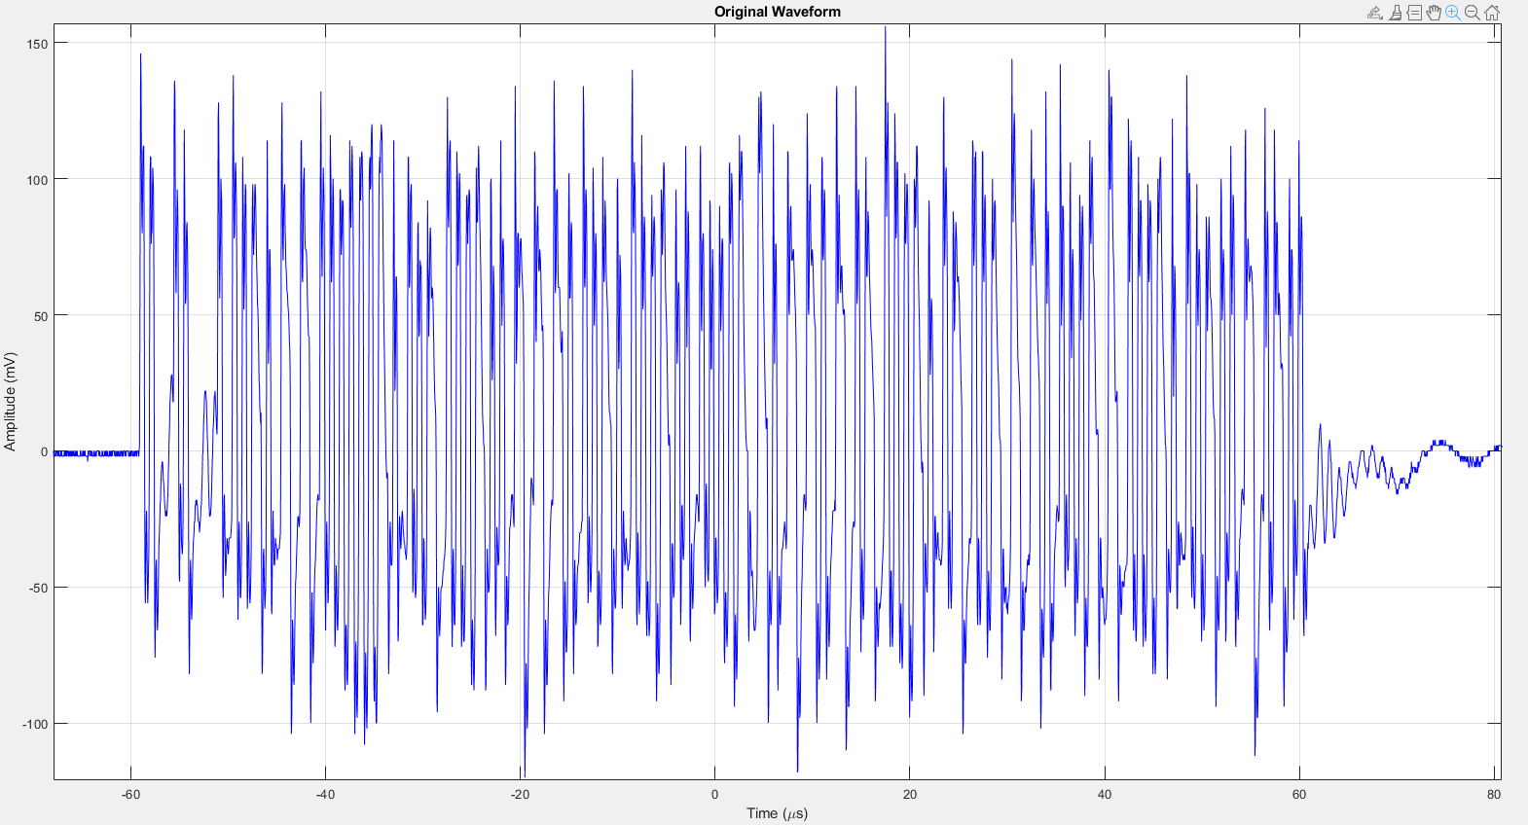
ADS-B PPM Decoding Original Signal from Oscilloscope
Key Features
Waveform Extraction: Exporting waveform from oscilloscope via a CSV file in time value pairs.
Plotting Extracted Signal: Original Received Signal

Slide 6
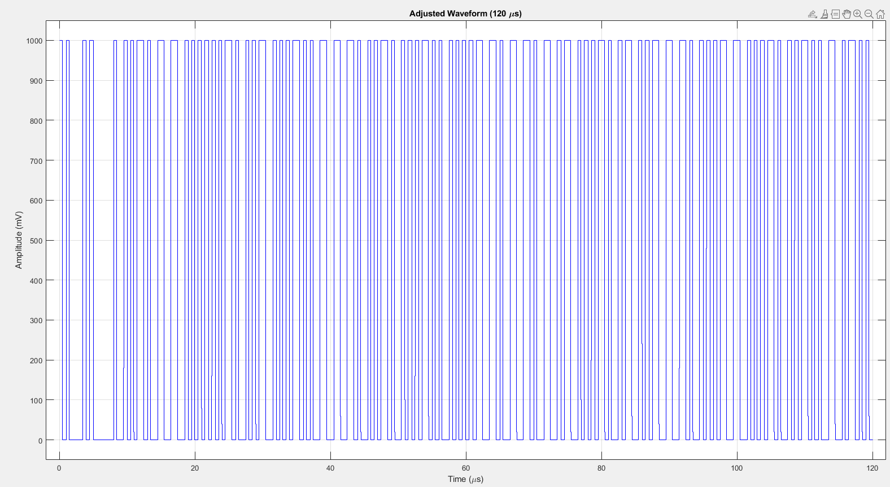
ADS-B PPM Decoding Filtered Signal with preamble
Key Features
Plotting Cleaned Signal: Filtered Received Signal including Preamble - 120μs

Slide 7
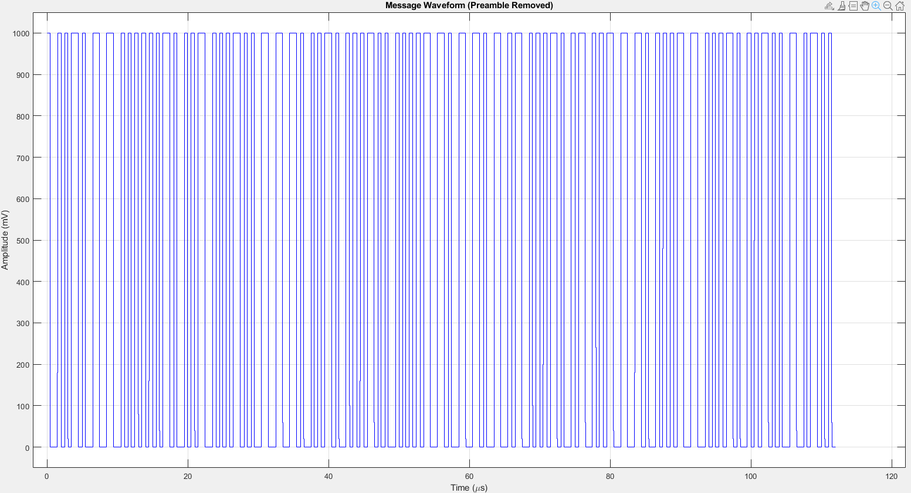
ADS-B PPM Decoding Message signal after preamble validation
Key Features
Plotting and extracting message signal: Message signal excluding preamble - 112μs

Slide 8

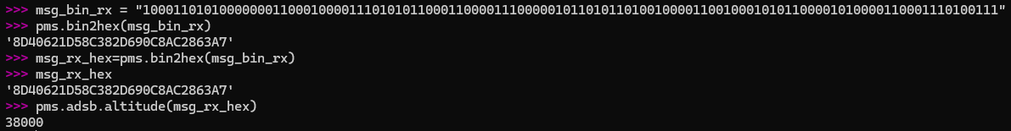
ADS-B PPM Decoding Message signal Decoding
Key Features
Binary Output: Gives the binary decoding of the PPM signal
Message loaded in pyModeS:
Hex Representation:
Altitude Decoding:

Slide 9

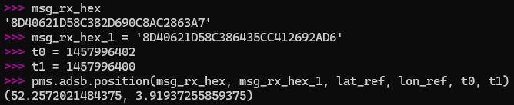

ADS-B PPM Decoding Message signal Decoding
Key Features
Position Decoding with reference: Gives the position approximation after reference position
Position decoding without reference:
Decoding Navigation Uncertainty Category - Position (ADS-B version 1)

Slide 10
ADS-B PPM Transmission & Reception Comparison Encoding and Decoding Comparison
Parameters | Transmitted ADS-B | Received ADS-B
Message in Hex | 8D40621D58C382D690C8AC2863A7 | 8D40621D58C382D690C8AC2863A7
Latitude | 52.258 | 52.2572021484375
Longitude | 3.91937 | 3.91937255859375
Altitude (ft) | 38000 | 38000
Downlink Format | 17 | 17
Capability | 5 | 5
ICAO | 40621D | 40621D
Type Code | 11 | 11

