Slide 1
BarangayConnect
IT114L Final Project Presentation
Institutional website for a barangay or local government office
Built with ASP.NET Core MVC on .NET 10
Uses an embedded SQLite database stored in the project source

Slide 2
Problem and Objective
Why the system was created
Manual service tracking can slow down resident transactions and office coordination.
The project centralizes announcements, resident records, appointments, and requests.
The goal is to demonstrate web development, UI design, and SQL-backed data management.

Slide 3
System Modules
Main features of the web application
Dashboard with service statistics and recent activity
Announcements page for public notices
Resident registry with data entry form
Service catalog with office schedules and requirements
Appointment scheduling form and listing
Service request submission and tracking

Slide 4
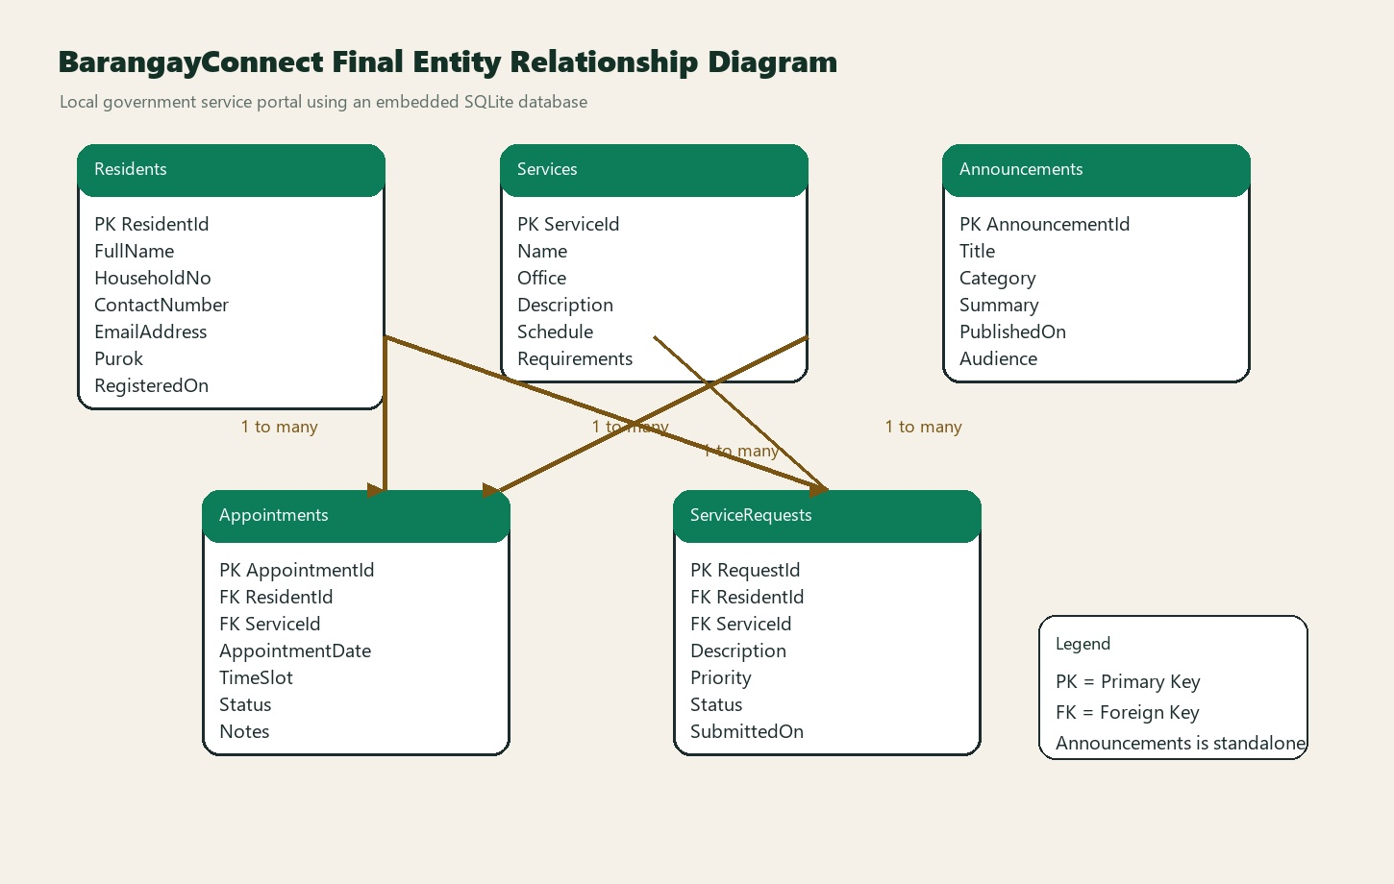
Database Design
Embedded SQLite for easy updates
Tables: Residents, Services, Announcements, Appointments, ServiceRequests
Appointments and ServiceRequests use foreign keys to connect Residents and Services
Database file is stored locally in App_Data/barangayconnect.db
Raw SQL statements are used for transparent retrieval and insert operations

Slide 5
Technology Stack
Frameworks and implementation choices
.NET 10 and ASP.NET Core MVC
Microsoft.Data.Sqlite for in-house SQL database handling
Bootstrap-based responsive user interface
Repository pattern for database initialization and data access

Slide 6
Conclusion
Project outcome
BarangayConnect satisfies the requirement for multiple pages, forms, navigation, and database integration.
The SQLite approach keeps the project easy to deploy, inspect, and modify.
The application demonstrates a practical institutional system that can be extended further with authentication and reporting.

